Slide 1
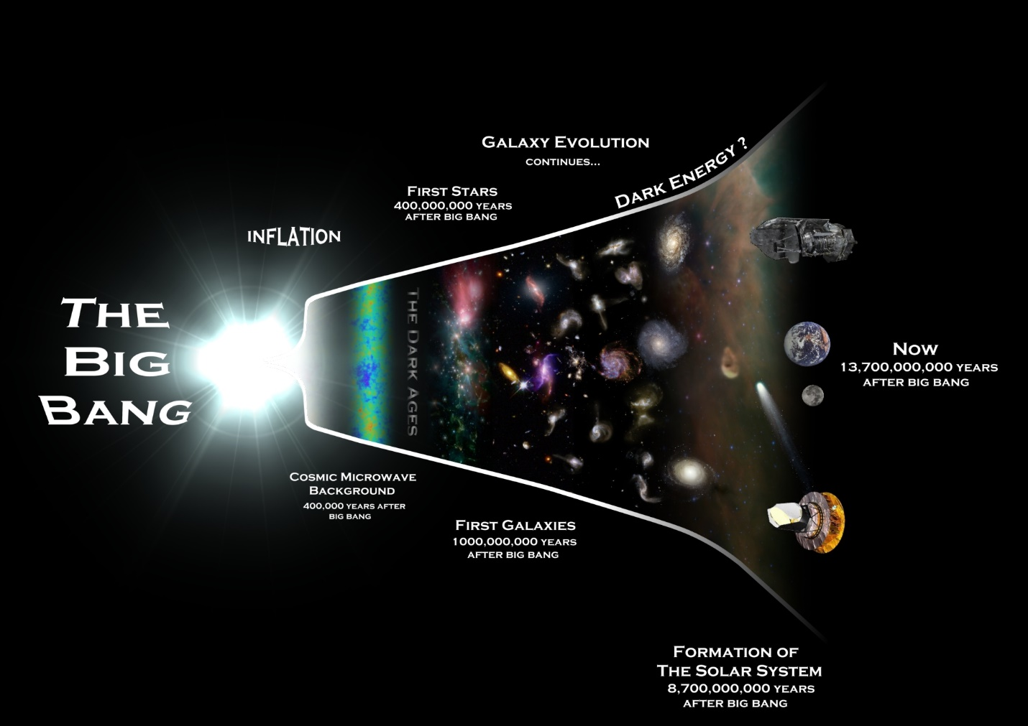
Welcome to Physics in and Through Cosmology
Please help yourself to Breakfast Munchies
box fill in a different person’s name. Fill your name in the same box on their paper.
Fill a different name in each box on your sheet.
Make sure to put your name in the same box on the other person’s sheet.

Slide 2
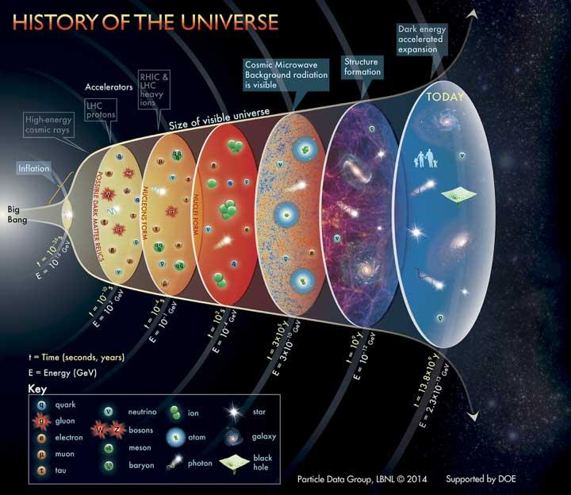
Use your sheet on which you filled in names to meet your partner for each term. Then discuss the answer for the question for that term.
1) CMB - What is it? Why is it significant in the study of the History of the Universe?
2) Photon – What is it? It is the force carrier for which force? How do cosmologists use them?
3) ATLAS – Where is this physically located? Why are thousands of Physicists using it?
4) Milky Way – What is it? What is at its center? What is its rotational curve evidence of?
5) Quantum Mechanics – What does this describe? How does it connect to dual nature?
6) Quark - What are they? Make up? What holds them together? How do they connect to color?

Slide 3
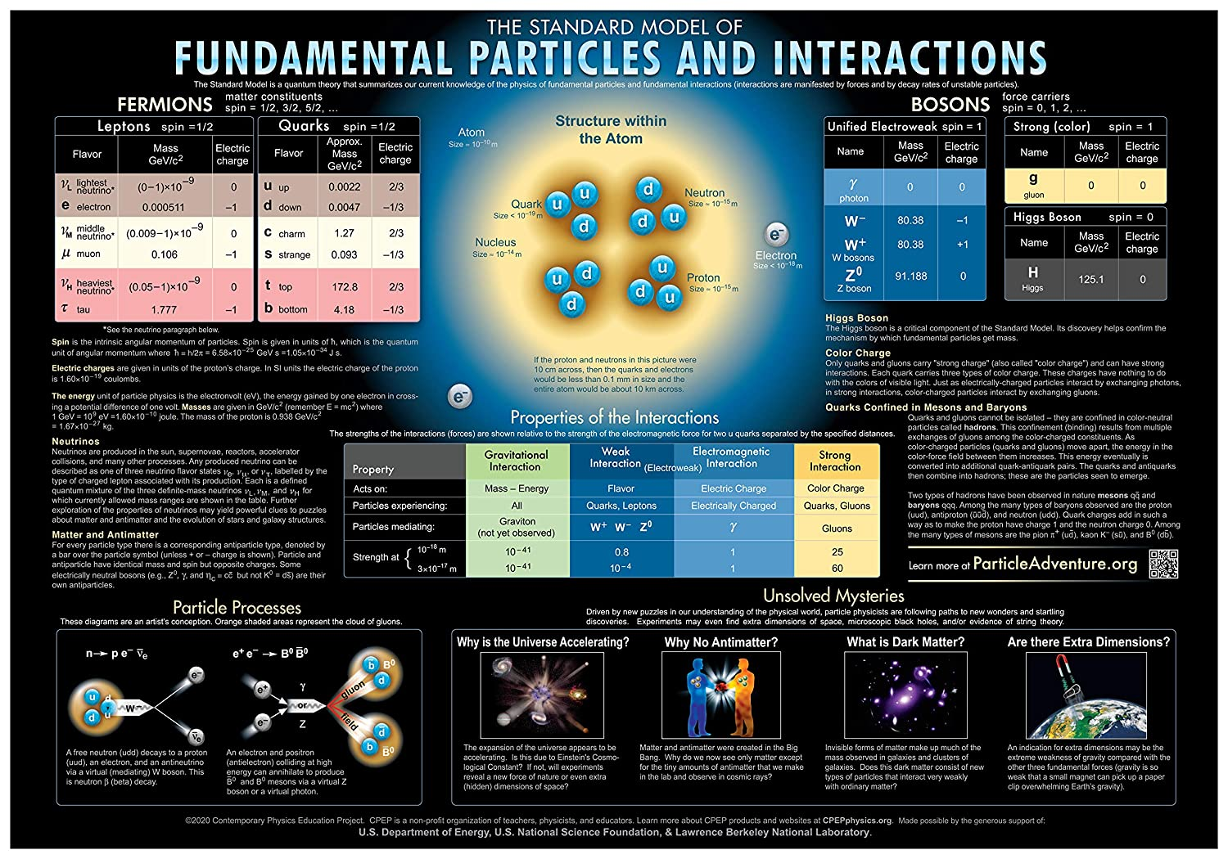
More - Use your sheet on which you filled in names to meet your partner for each term. Then discuss the answer for the question for that term.
7) Dark Matter – Even though we can’t ________it.
Give at least 3 bits of evidence it exists
8) Particle Decay – What is this? Give at least 2 examples.
9) Warping of space – What causes this? What does it explain?
10) Neutrino – What are they? why were neutrinos predicted by Pauli?
11) Electron – Why are they important?
What force doesn’t affect them?
12) Distance Ladders – Describe how each “rung” on the ladder works.

Slide 4
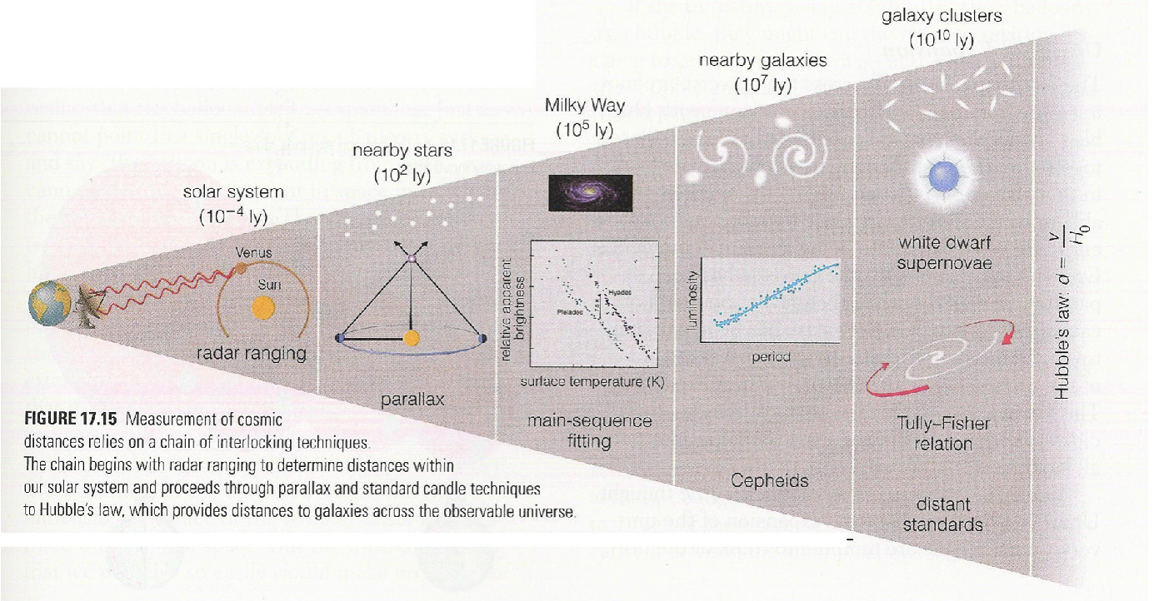
From the Lawrence Berkeley National Lab:
Tony Spadafora – Deputy Director of the Physics Division
Nathalie Palanque-Delabrouille – Division Director of the Physics Division
Eric Hall - Administrative Assistant III • Physics Division
Adam Foote- Administrative Assistant III • Physics Division
Laurie Kerrigan – Workshop Coordinator / teacher
Teachers:
Phil Becker
Sean Fottrell
Laura Guthrie
Bryan Marten
Mark Matsuzaki
Glen Melnik
Dorota Sawicka
Portia Sharma

Slide 5
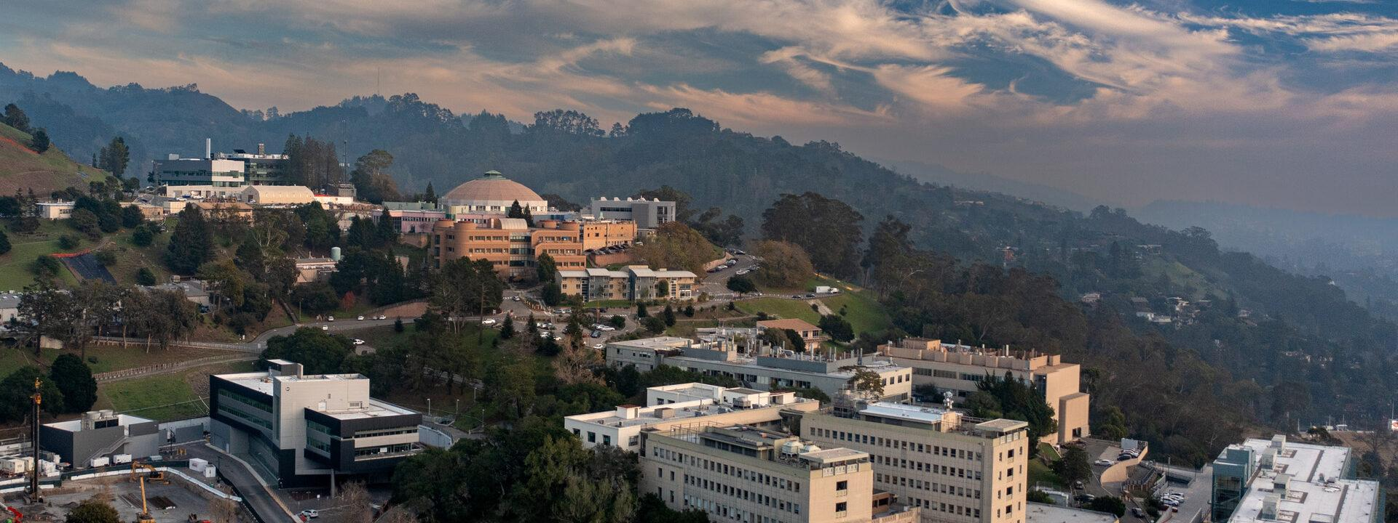
Ingrid Peterson Safety Coordinator Mon 9:00 am
instrumental in helping the Dark Energy Spectroscopic Instrument (DESI)
and Lux Zeplin (LZ) projects

Slide 6
LBNL Conference Room Safety
• Do not enter buildings where you do not have business. Limit access to those buildings
where you are attending meetings, conferences, conducting research or building 54
(cafeteria). Only enter other buildings if you have a LBNL host escorting you.
• Never go on building roofs.
• Our roadways are old and narrow. There are several locations that do not have
sidewalks. Exercise caution when driving, walking or running on LBNL roads.
• If driving, always yield to pedestrians and follow all California driving laws. You can be
issued a citation for violating California Law.
• If walking or running, to the extent available, use sidewalks and crosswalks.
• Exercise caution when passing by construction zones, and stay out of designated
construction areas.
• Adhere to posted signage. Follow posted speed limit signs. Do not access areas posted
as "Authorized Personnel Only."
• Do not consume alcoholic beverages on site.
• If smoking, only smoke at designated smoking areas.
• Call 911 for emergencies. You can call (510) 486-9666 at any time for non-life
threatening emergencies.

Slide 7
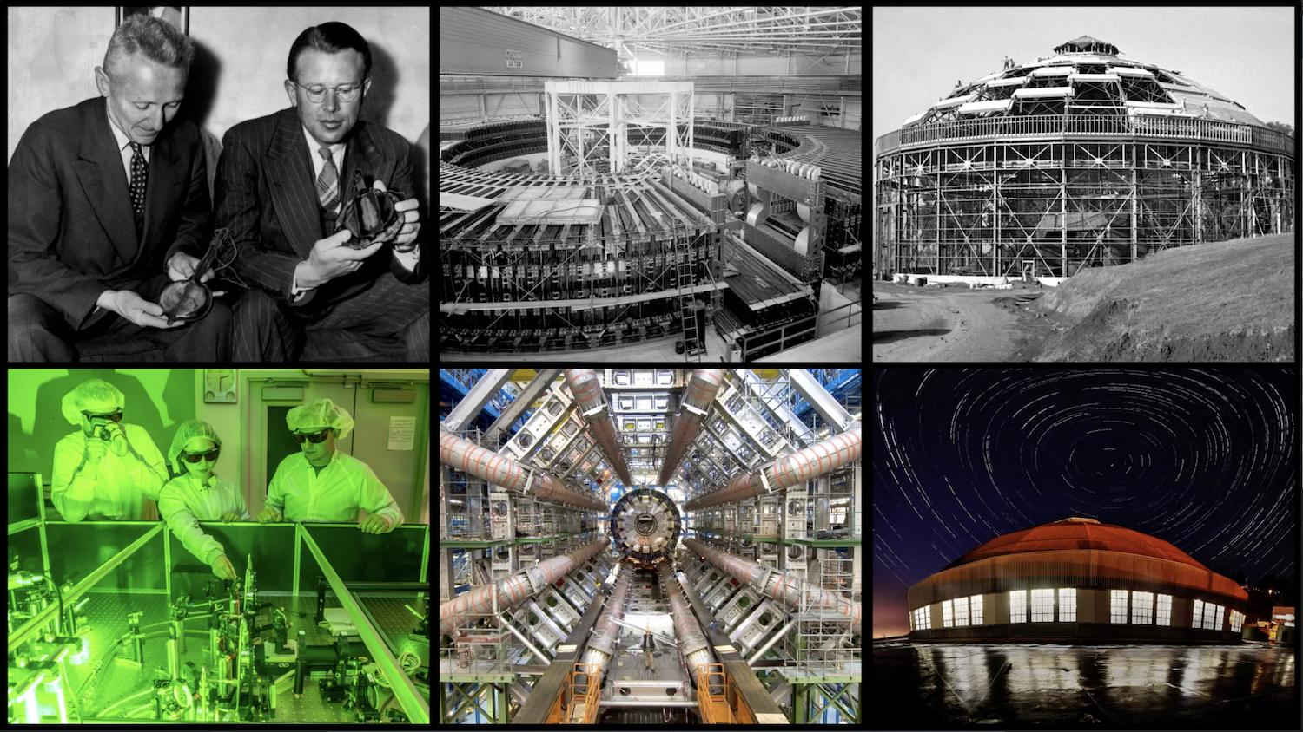

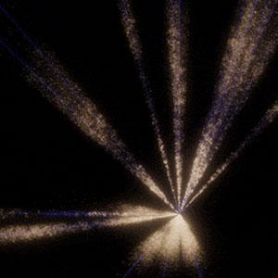
Tony Spadafora Deputy Director of the Physics Division

Slide 8
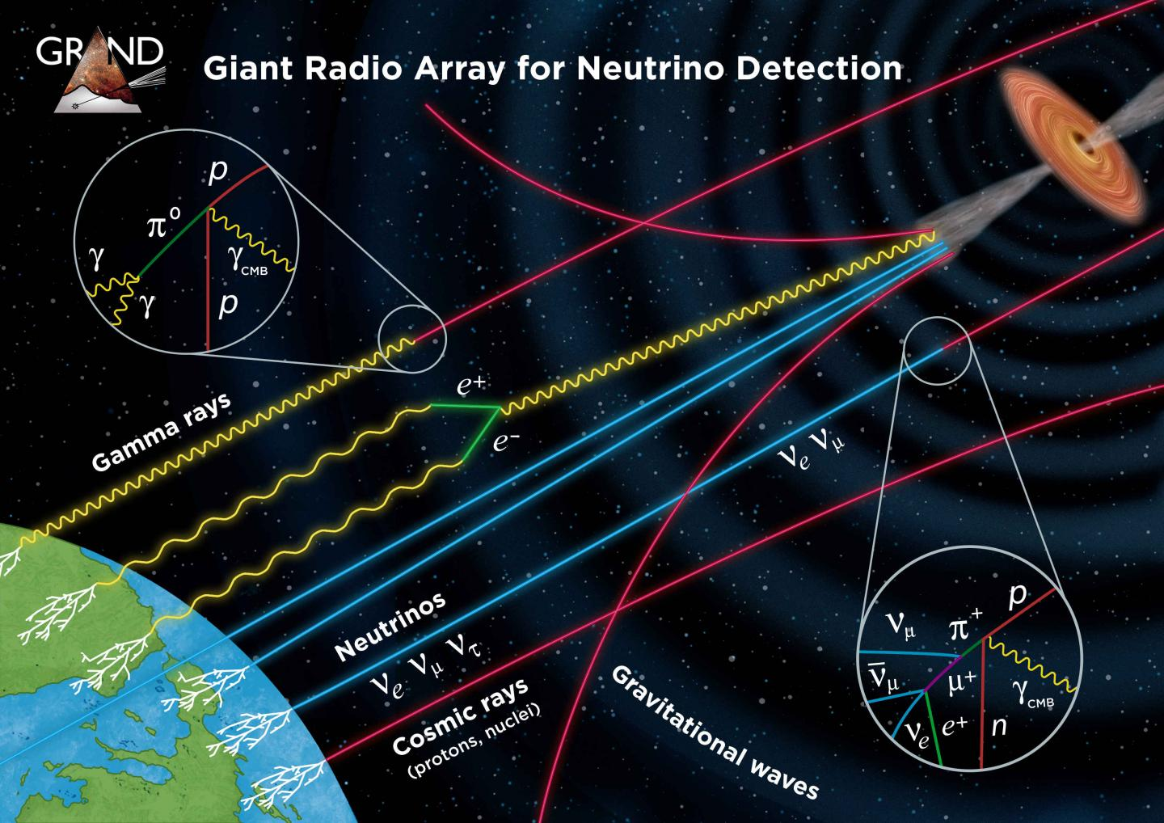
Mon 10-10:15
Glen
Melnik!
“Cosmic
Rays”
Physics
Teacher
and
Director
of the
Detectors

Slide 9
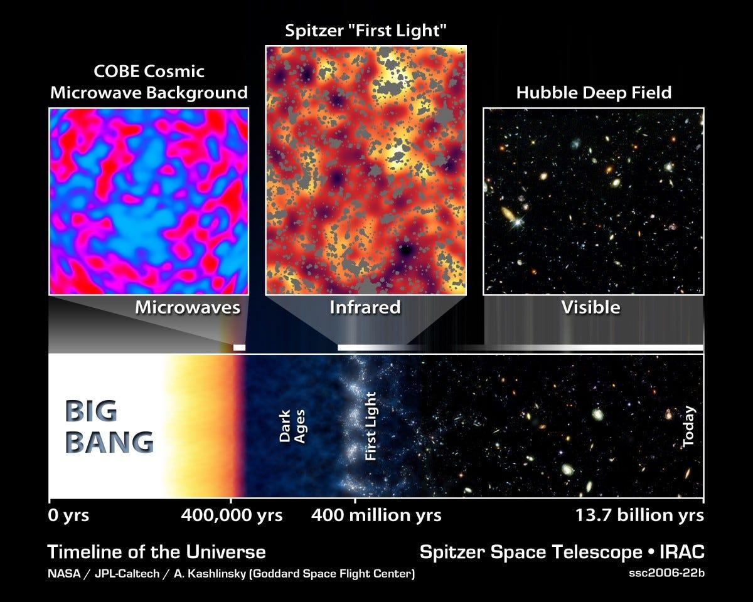
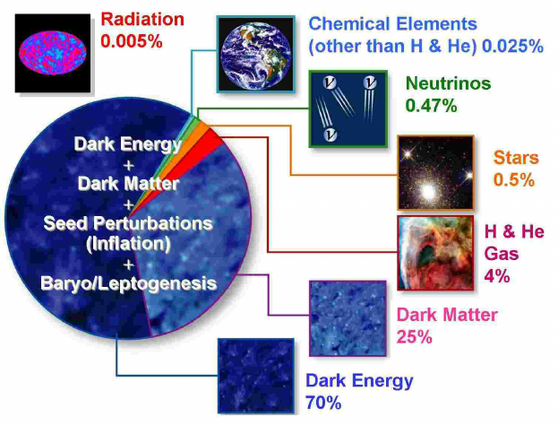
Kevin Langhoff Mon 10:30-12
“The Standard Model and Beyond”

Slide 10
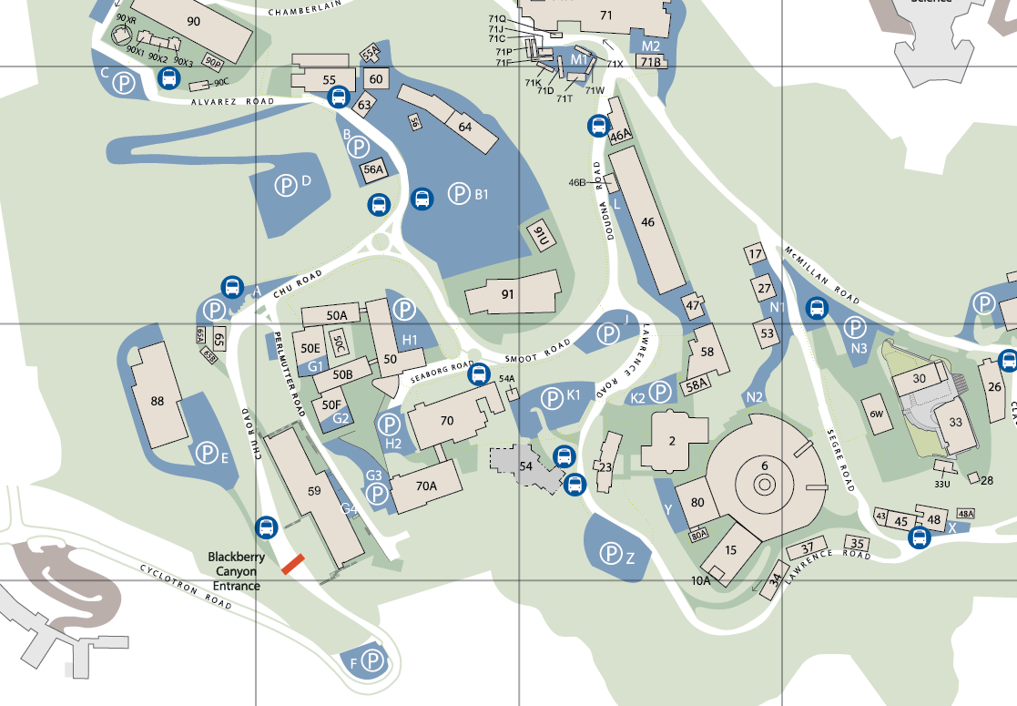
Lunch
Patio
50C-1
1:00 pm
Neutrinos
then
Cosmic ray detectors
or Interview a Scientist

Slide 11
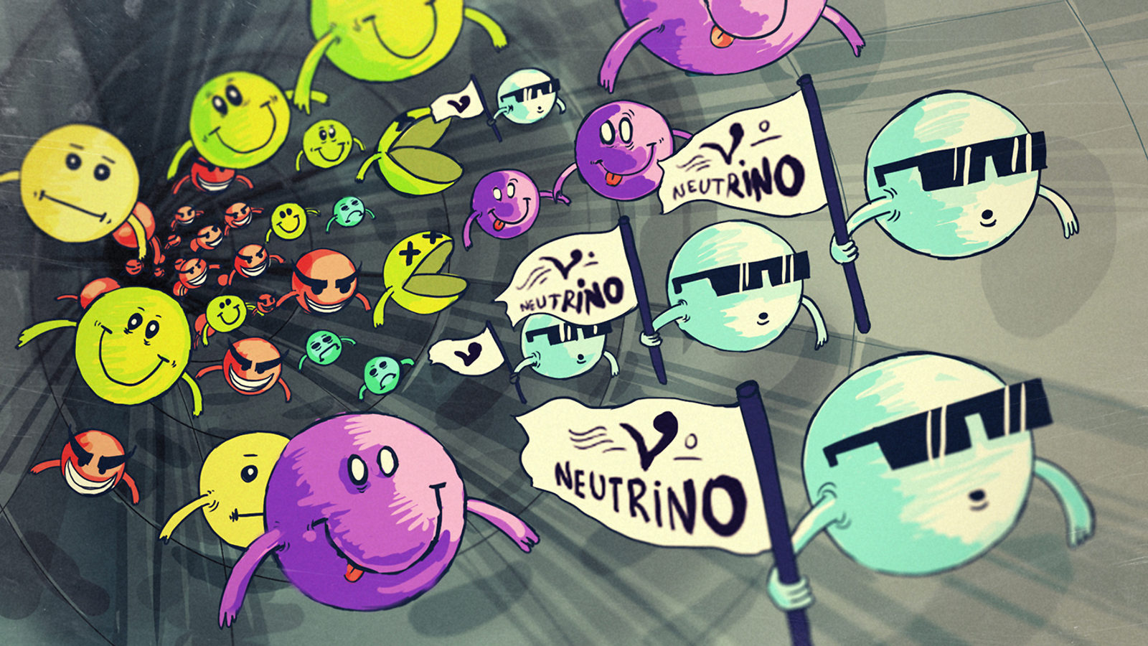
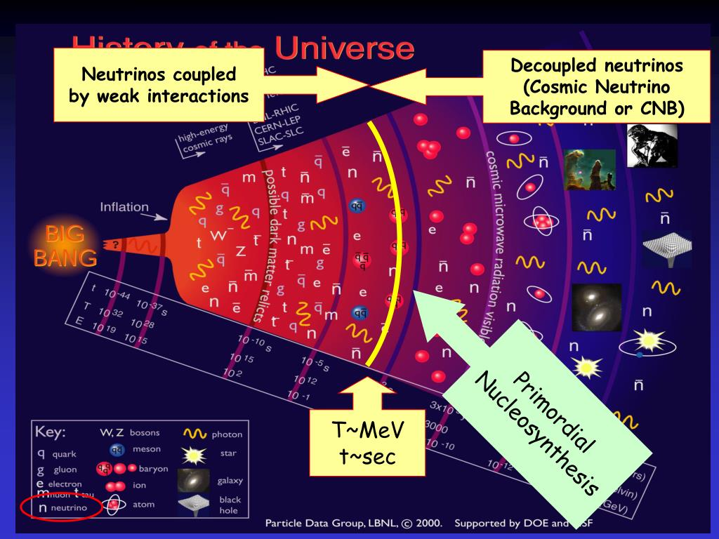
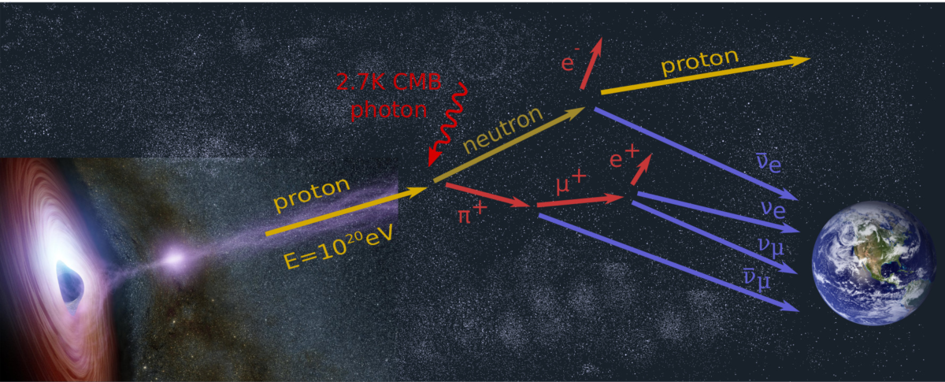
Jaafar Chakrani Mon 1-2:30
"Neutrinos: a peek into the
origin of the Universe?"

Slide 12

Small Group Scientist Interview
Goal: To have a close-up experience learning about a research project
and do a quick report back to the larger group.
Details of Report back: Students make a quick report
(video, power point etc.) that:
Explains the question the scientist’s work is investigating.
The basic laws of physics involved.
How this question is being investigated.
All the students are involved in the interview & put together the report.
If any follow-up emails to scientist need to include lakerrigan@lbl.gov
& your group’s teacher.
Don’t forget to thank your scientist for their time.

Slide 13
Group # | 1 | 2 | 5 | 6 | 7 | 4 | 3 | 8
Scientist name | Maria Mironova | Anne Fortman | Kevin Michael Langhoff | Angira Rastogi | Laura Nosler | Tsai-Chen Lee | Tanvi Wamorkar | Luke Grossman
Area | Particle Physics | New Physics | New Physics | Particle Physics | Particle Physics | Quantum Information | AI/ML | Particle Physics
Teacher / group | Laurie Kerrigan | Laura Guthrie | Sean Fottrell | Mark Matsuzaki | Bryan Marten | Dorota Sawicka | Portia Sharma | Phil Becker
Student 1 | Jessica Tam | Francisca Li | Ibrahim Nadeem | Jennifer Choi | Daphnée CHÉDRU | Brenton Hong | ZITONG TANG (Thomas) | Muskan Ladhar
Student 2 | Yu Tian Zhang | Ayush Adi | Anveet Patil | Maya Moss | Thelonious Kojan | Brooke Raymond | Aadi Patangi | Hadia Ahmadi
Student 3 | Jerry Peng | Christine Pineda | Sarang Athani | Aryamaan Dash | Jiayuan Fan |  | Kaushmit Bhowmik | Max Rombakh
Student 4 | Sergio Hernandez | Kimia Amiri | Alina Kustowkska | Isabella Castaneda | Jacob Landman | Teresa Yu | Rohin Vig | Benji Sirota
Student 5 | Lem Taichman-Bernstein | Rishab Ghosh | Sahana Sreekant | Kai Licata | Chloe Faison | Prahlad Vangeepuram Canchi
Student 6 | Bhavya Babbellapati | Chun-Yi Wu(Alfred) | Annika Hattan-Kutter | Remy Minnis

Slide 14
Scientist name | Maria Mironova | Anne Fortman | Kevin Michael Langhoff | Angira Rastogi | Laura Nosler | Tsai-Chen Lee | Tanvi Wamorkar | Luke Grossman
Area | Particle Physics | New Physics | New Physics | Particle Physics | Particle Physics | Quantum Information | AI/ML | Particle Physics
Group # | 1 | 2 | 5 | 6 | 7 | 4 | 3 | 8
Teacher / group | Laurie Kerrigan | Laura Guthrie | Sean Fottrell | Mark Matsuzaki | Bryan Marten | Dorota Sawicka | Portia Sharma | Phil Becker
time | Mon | Mon | Mon | Mon | Mon | Tues 10:45 | Tues 2:45 | Tuesd 10:45
ALS Tues 11-12 | 1,2,3,7
ALS Tues 3-4 | 4,5,6.8
Detector M 2:45-4 | 3,4,8
Detector T 10:45-12 | 5,6
Detector T 2:45-4 | 1,2,7

Slide 15
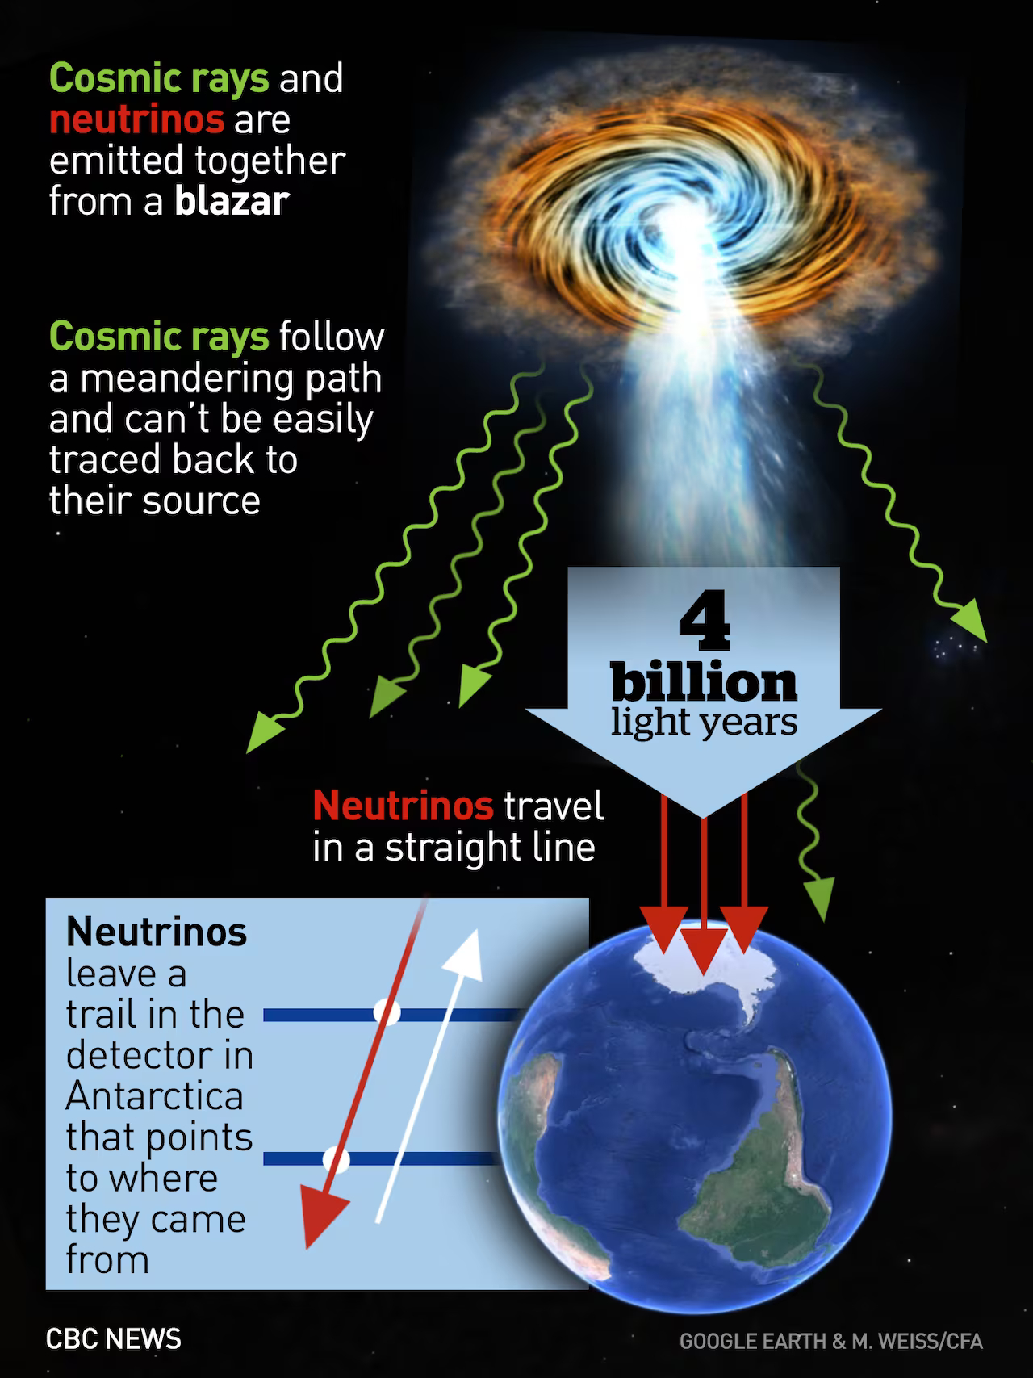
Tomorrow our speaker starts at 8:30
Now please meet in your scientist group
Groups 1,2,5,6,7,
your scientist should meet you here.
Groups 3,4,8
Will meet with Glen Melnik to do detector work
When you are finished for the day you may leave.

