Slide 1
Group # | 1 | 2 | 5 | 6 | 7 | 4 | 3 | 8
Scientist name | Maria Mironova | Anne Fortman | Kevin Michael Langhoff | Angira Rastogi | Laura Nosler | Tsai-Chen Lee | Tanvi Wamorkar | Luke Grossman
Area | Particle Physics | New Physics | New Physics | Particle Physics | Particle Physics | Quantum Information | AI/ML | Particle Physics
Teacher / group | Laurie Kerrigan | Laura Guthrie | Sean Fottrell | Mark Matsuzaki | Bryan Marten | Dorota Sawicka | Portia Sharma | Phil Becker
Student 1 | Jessica Tam | Francisca Li | Ibrahim Nadeem | Jennifer Choi | Daphnée CHÉDRU | Brenton Hong | ZITONG TANG (Thomas) | Muskan Ladhar
Student 2 | Yu Tian Zhang | Ayush Adi | Anveet Patil | Maya Moss | Thelonious Kojan | Brooke Raymond | Aadi Patangi | Hadia Ahmadi
Student 3 | Jerry Peng | Christine Pineda | Sarang Athani | Aryamaan Dash | Jiayuan Fan |  | Kaushmit Bhowmik | Max Rombakh
Student 4 | Sergio Hernandez | Kimia Amiri | Alina Kustowkska | Isabella Castaneda | Jacob Landman | Teresa Yu | Rohin Vig | Benji Sirota
Student 5 | Lem Taichman-Bernstein | Rishab Ghosh | Sahana Sreekant | Kai Licata | Chloe Faison | Prahlad Vangeepuram Canchi
Student 6 | Bhavya Babbellapati | Chun-Yi Wu(Alfred) | Annika Hattan-Kutter | Remy Minnis

Slide 2
Scientist name | Maria Mironova | Anne Fortman | Kevin Michael Langhoff | Angira Rastogi | Laura Nosler | Tsai-Chen Lee | Tanvi Wamorkar | Luke Grossman
Area | Particle Physics | New Physics | New Physics | Particle Physics | Particle Physics | Quantum Information | AI/ML | Particle Physics
Group # | 1 | 2 | 5 | 6 | 7 | 4 | 3 | 8
Teacher / group | Laurie Kerrigan | Laura Guthrie | Sean Fottrell | Mark Matsuzaki | Bryan Marten | Dorota Sawicka | Portia Sharma | Phil Becker
time | Mon | Mon | Mon | Mon | Mon | Tues 10:45 | Tues 2:45 | Tuesd 10:45
ALS Tues 11-12 | 1,2,3,7
ALS Tues 3-4 | 4,5,6.8
Detector M 2:45-4 | 3,4,8
Detector T 10:45-12 | 5,6
Detector T 2:45-4 | 1,2,7

Slide 3
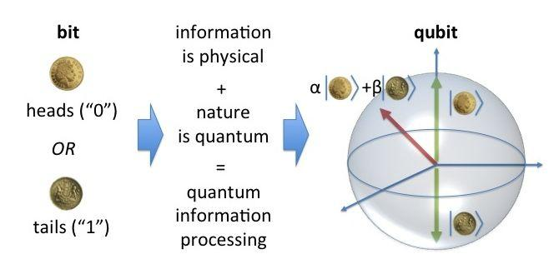
Giacomo Marocco Tues 8:30-10
"Quantum Measurements of the Invisible."

Slide 4
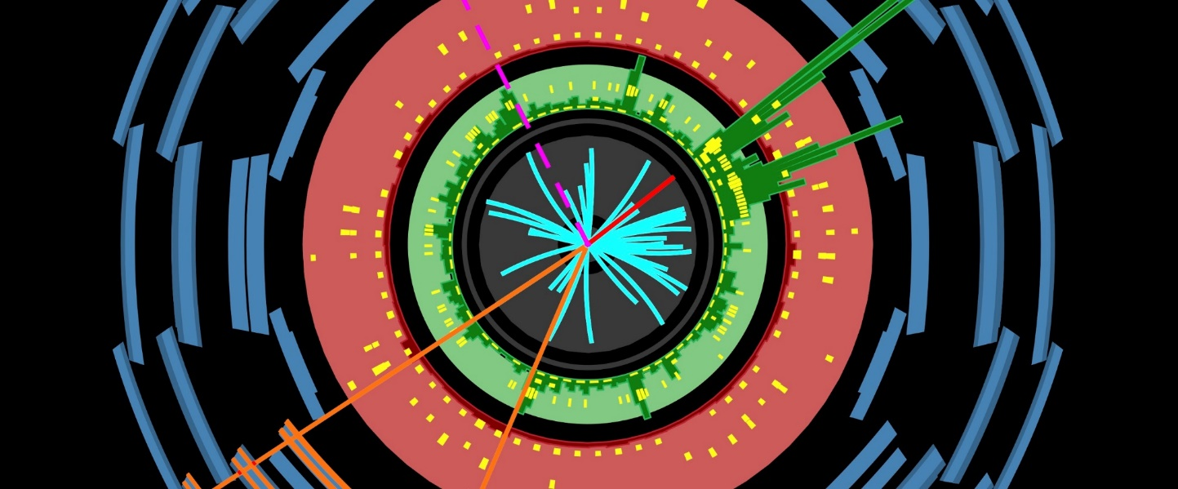
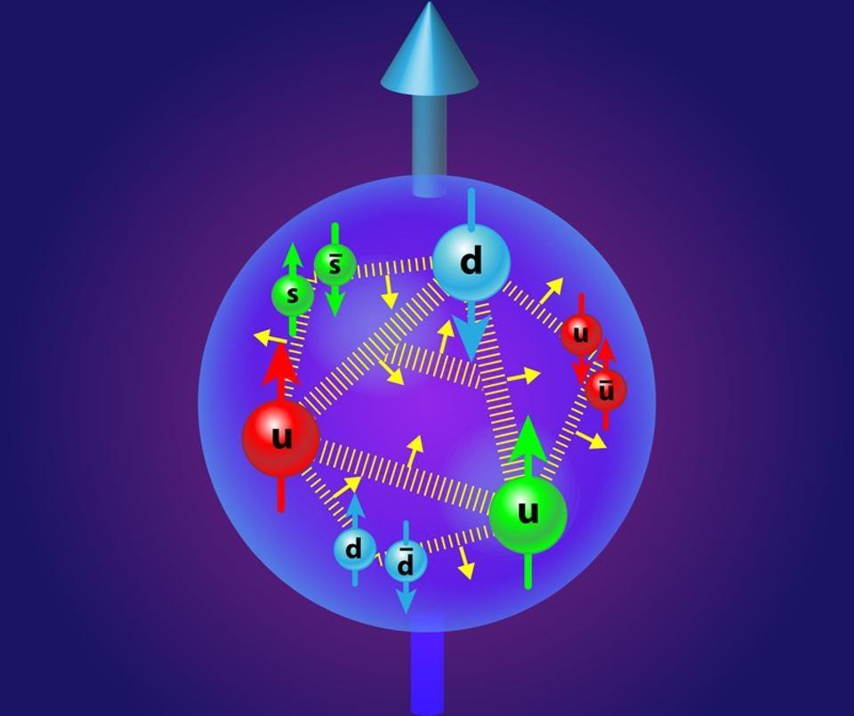
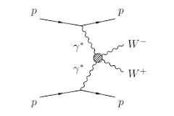
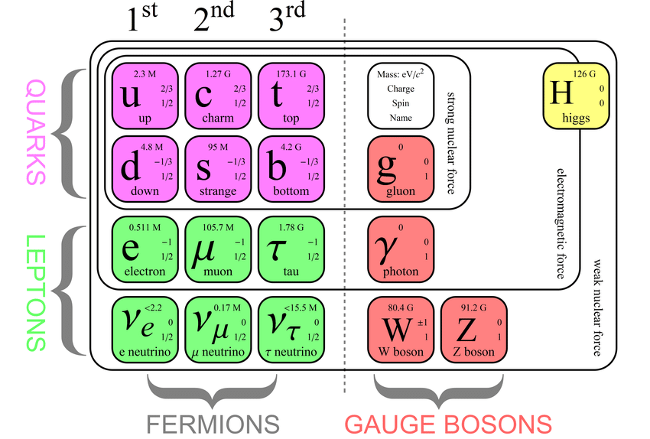
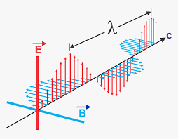
Angira Rastogi Tues 1-2:30
"Physics of photons
from protons".
https://www.google.com/search?q=Higgs+boson+and+Charm+quark&rlz=1C1CHBF_enUS758US758&sxsrf=ALiCzsZy9YmszoIXq_RDrlXf_8Fp-iObDg:1656197890156&source=lnms&tbm=isch&sa=X&ved=2ahUKEwiSkq732cn4AhX2C0QIHXkHBXoQ_AUoAnoECAEQBA&biw=1536&bih=723&dpr=1.25#imgrc=nGutdgOiebhKBM
https://www.google.com/search?q=Higgs+boson+and+Charm+quark&rlz=1C1CHBF_enUS758US758&sxsrf=ALiCzsZy9YmszoIXq_RDrlXf_8Fp-iObDg:1656197890156&source=lnms&tbm=isch&sa=X&ved=2ahUKEwiSkq732cn4AhX2C0QIHXkHBXoQ_AUoAnoECAEQBA&biw=1536&bih=723&dpr=1.25#imgrc=BmxCJoJBY_ek_M&imgdii=6W8JNNpf2RziGM

Slide 5
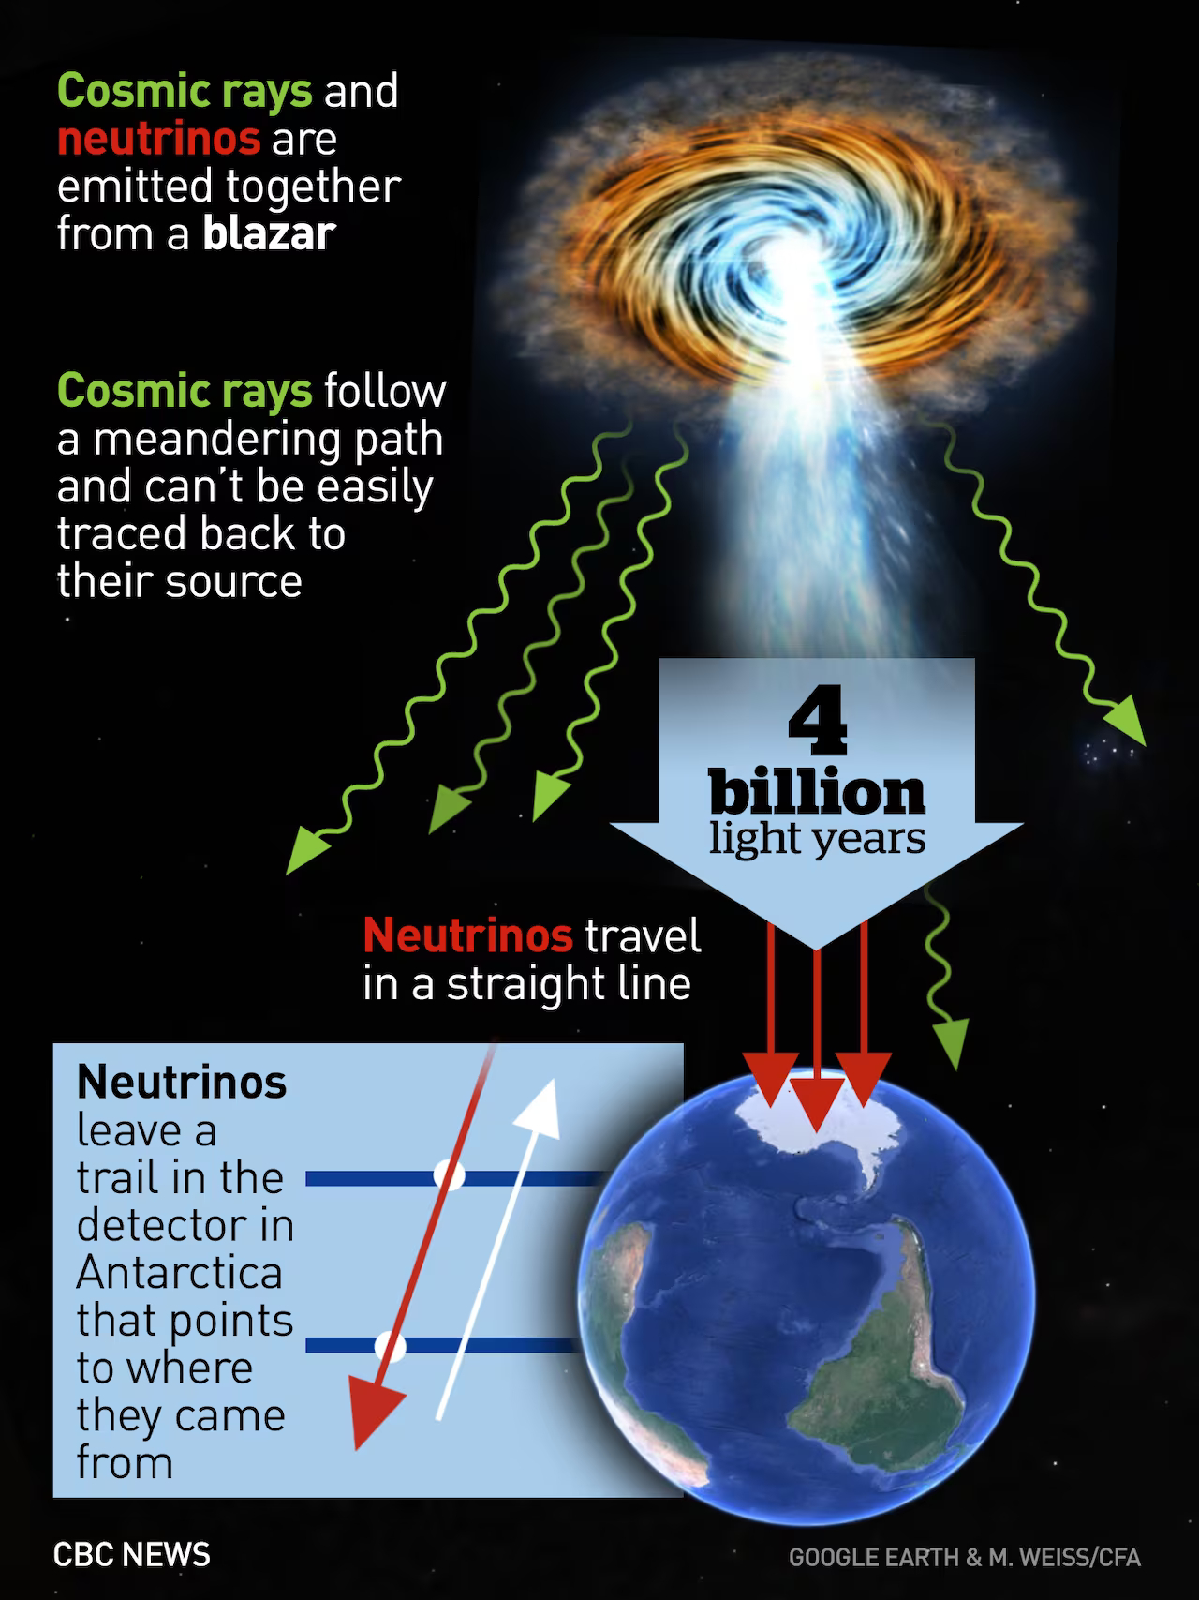
Tues 2:45
ALS 4,5,6.8
Detectors 1,2,7
Interview with Tanvi Wamorkar 3
Wed. morning in Aud 50
learn about machine learning
& Dark Matter
Start work with QuarkNet activities
Teachers – lunch with QuarkNet

Slide 6
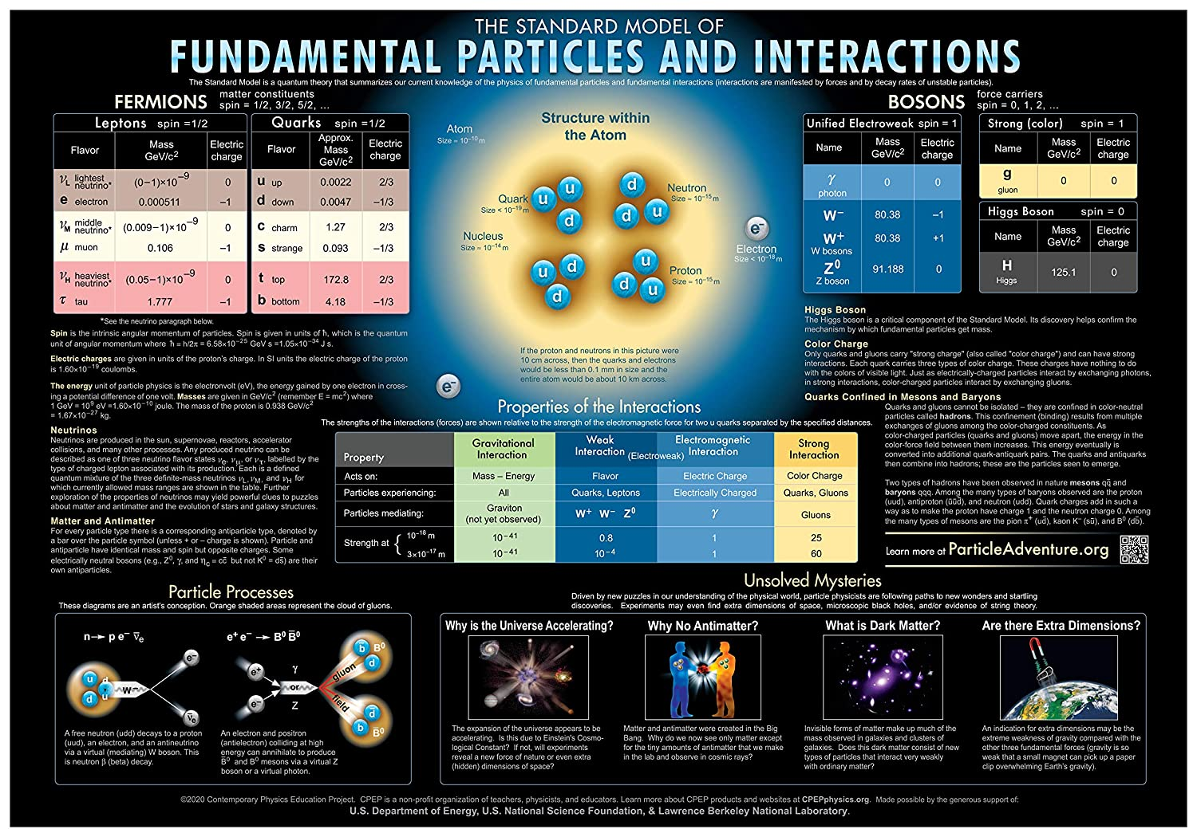
More - Use your sheet on which you filled in names to meet your partner for each term. Then discuss the answer for the question for that term.
7) Dark Matter – Even though we can’t ________it.
Give at least 3 bits of evidence it exists
8) Particle Decay – What is this? Give at least 2 examples.
9) Warping of space – What causes this? What does it explain?
10) Neutrino – What are they? why were neutrinos predicted by Pauli?
11) Electron – Why are they important?
What force doesn’t affect them?
12) Distance Ladders – Describe how each “rung” on the ladder works.

Slide 7
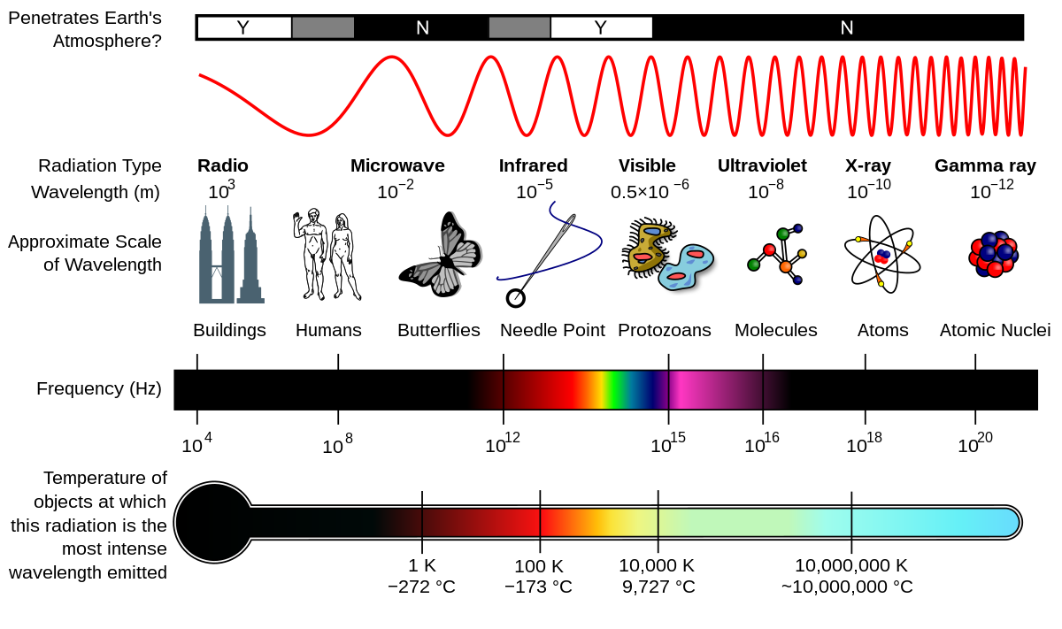
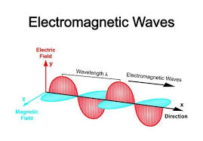
What is white light made of? (after playing with the diffraction grating)
Take a diffraction gradient (little plastic piece) & play with it. What is going on?
Which color clothing (pigment) not light,is the coolest under a hot sun? Why?
Which force does this involve?

Slide 8
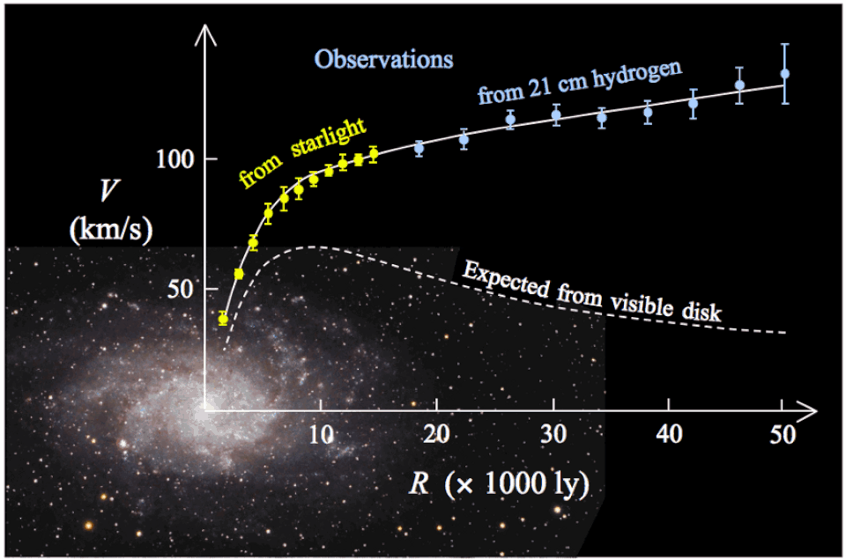
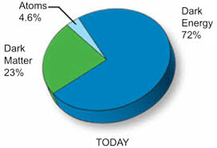
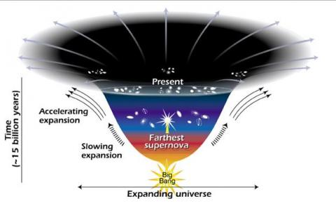

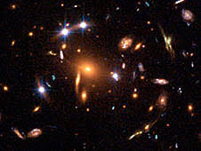
Dan Kodroff "Going Deep Underground for Dark Matter"

Slide 9

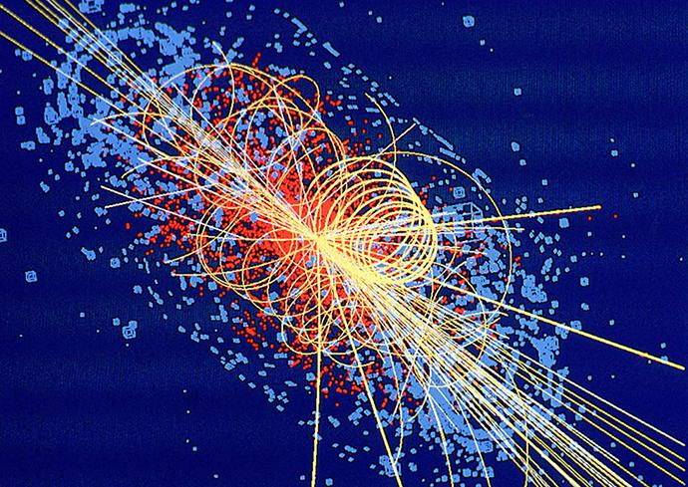
Joel Klammer
QuarkNet
Making Sense of the Fundamental Particles

Slide 10

Sascha Diefenbacher
"Machine Learning in High Energy Physics"
https://www.google.com/search?q=machine+learning&rlz=1C1CHBF_enUS758US758&sxsrf=ALiCzsbC7Pc25LXWy0EOfo9H1mIpGB87Nw:1655498157909&source=lnms&tbm=isch&sa=X&ved=2ahUKEwjVmIOdq7X4AhU0K0QIHVpvDw0Q_AUoAnoECAIQBA&biw=1536&bih=723&dpr=1.25#imgrc=SCVZZpYKEtuUkM

Slide 11
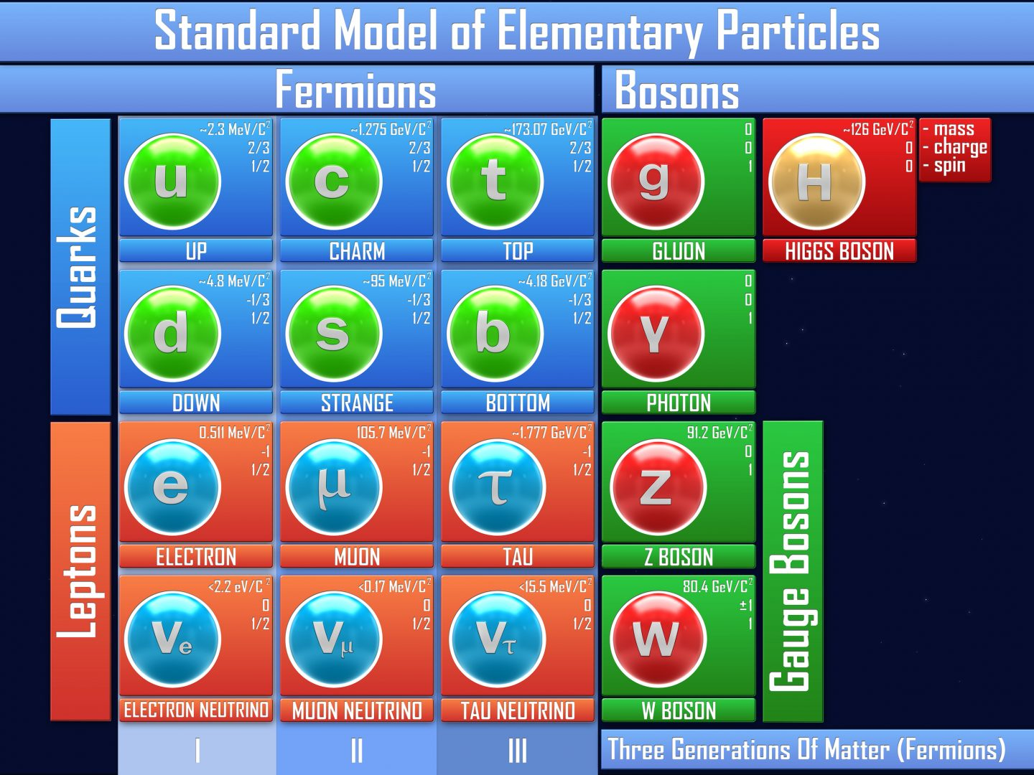
Quarknet activities
Joel Klammer
How to measure
a boson

Slide 12
What are the 4 forces? What does each do? How has each on been involved in the structure of the atom? Universe?
What are quarks? Leptons? Bosons?
https://www.amazon.com/Fundamental-Particles-Interactions-Chart-59/dp/B00O2FWXVI

Slide 13
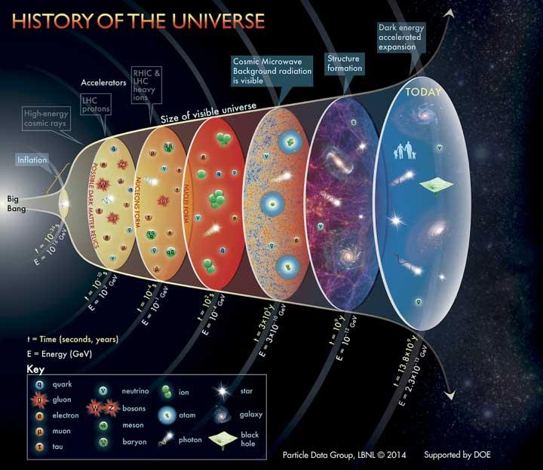
What is the history of the Universe in 1 min?

Slide 14
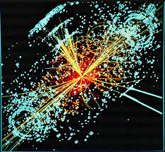
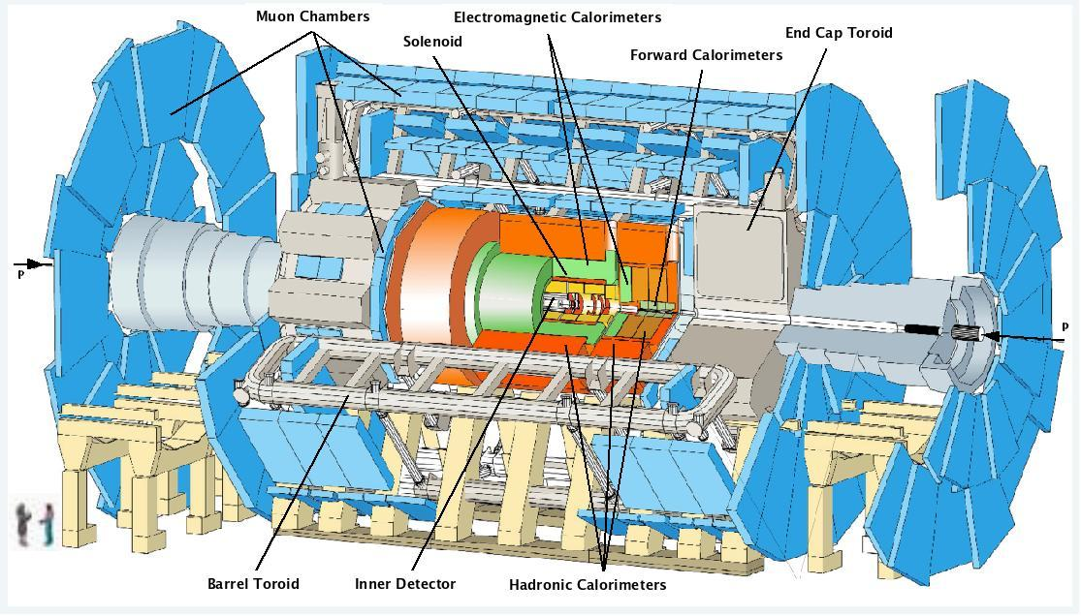
Maria Mironova
"Discovering Invisible: Pixel Detectors in Particle Physics”

Slide 15
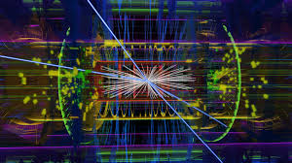
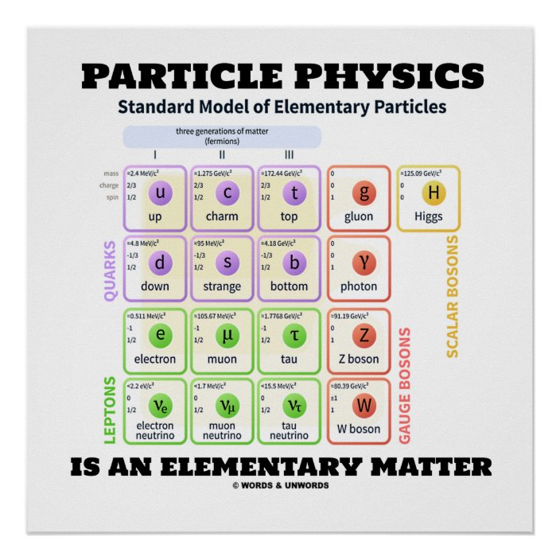
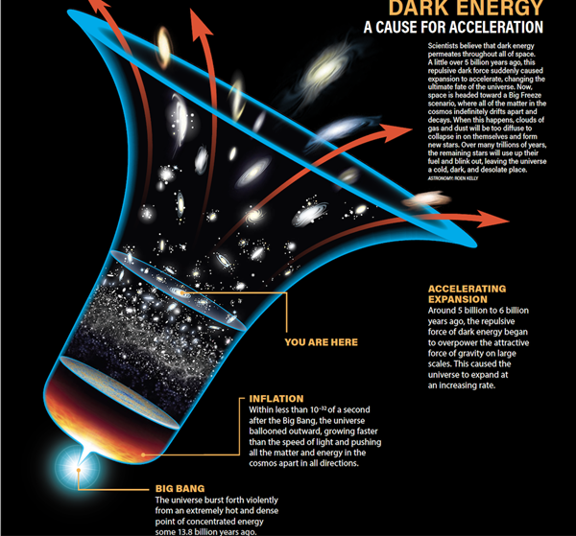
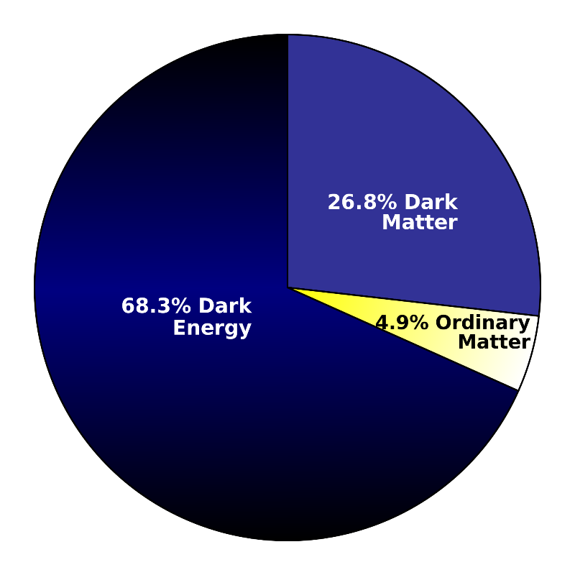
How is this all starting to fit together?
Over breakfast meet with your Type 1a Super Nova person
What is type 1a super Nova, why is it important?
How does all you have learned fit together
https://www.google.com/search?q=dark+energy&rlz=1C1CHBF_enUS758US758&sxsrf=ALiCzsYfZULmoo9cWxHIM8AY_srcG8u0uw:1656199420421&source=lnms&tbm=isch&sa=X&ved=2ahUKEwi7mIbR38n4AhXBK0QIHQQQD5EQ_AUoAnoECAIQBA&biw=1536&bih=723&dpr=1.25#imgrc=OWABB5lyJE-EWM&imgdii=suotuE-LOEDpmM

Slide 16
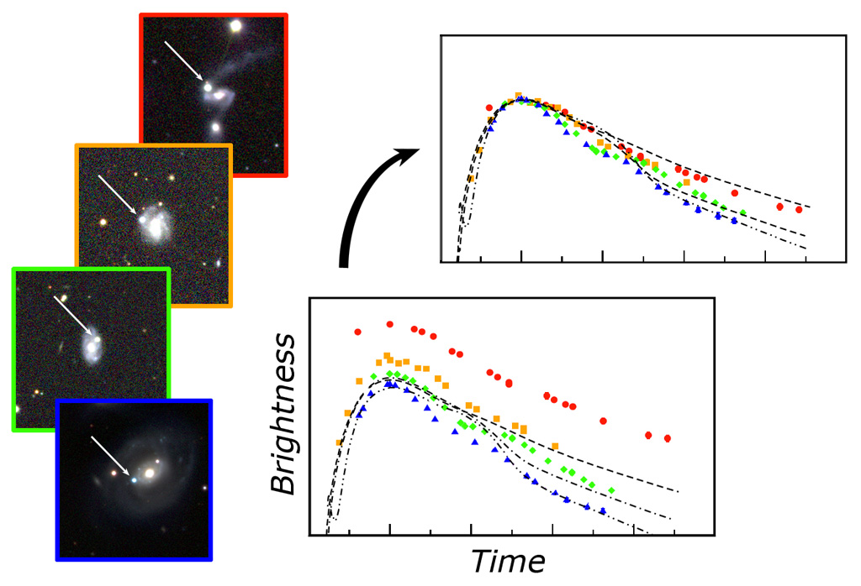
This is the Brightness graph that Saul Perlmutter referred to yesterday. It always follows the same pattern so it can be used as a Standard Candle.
How did his team use it?

Slide 17
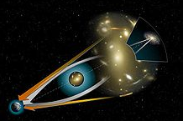

Nicholas Rodd "The Hunt for Dark Matter"

Slide 18
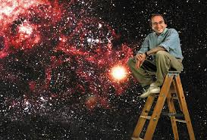
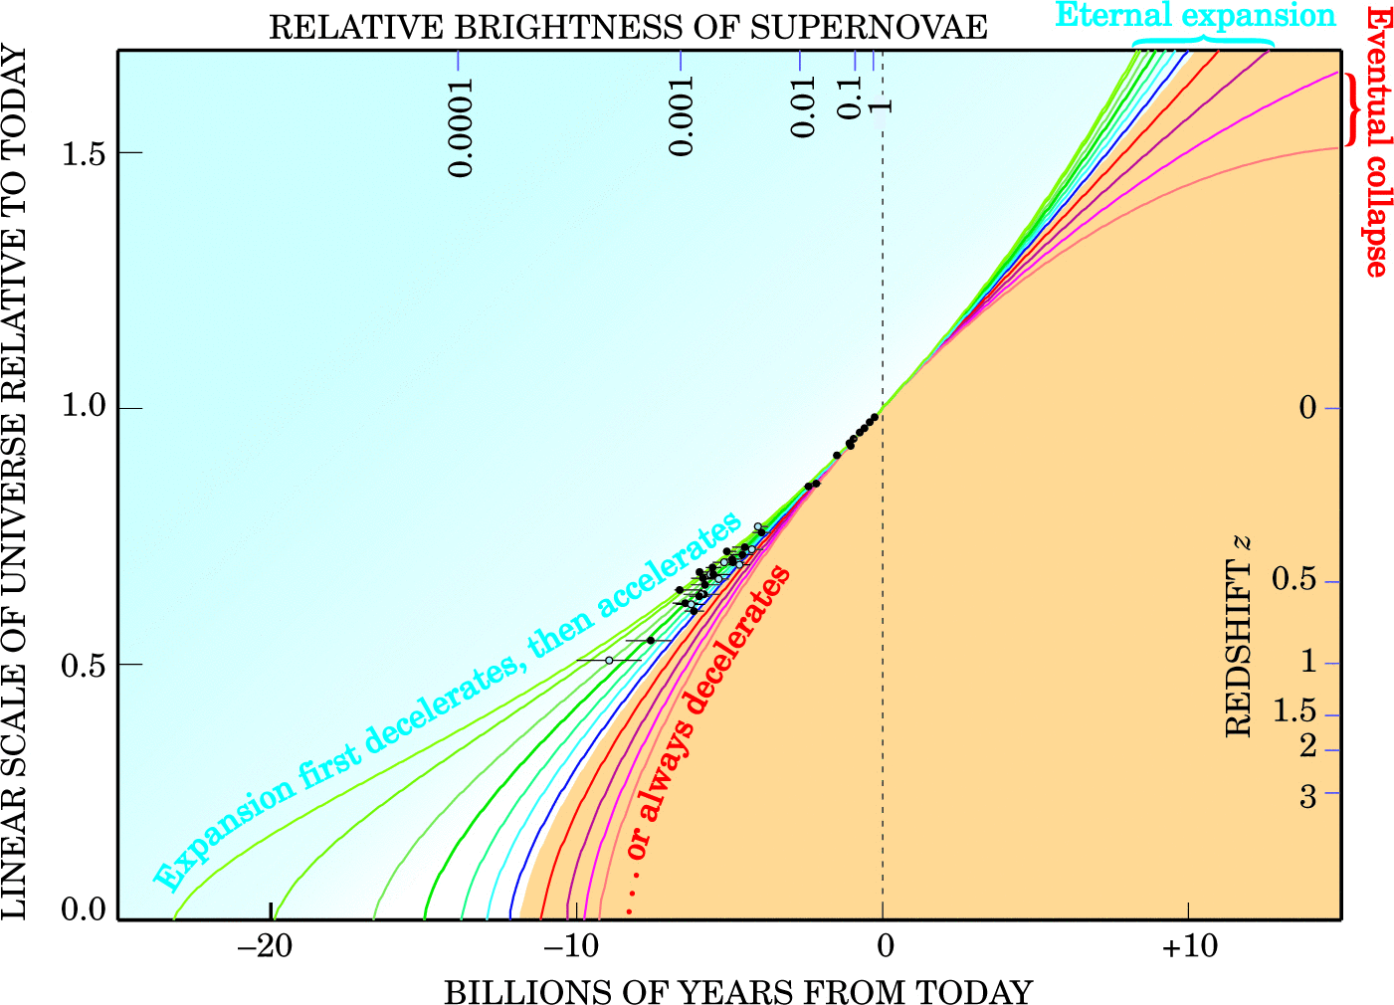
Saul Perlmutter 2011 Nobel Prize Physics
for his discovery of dark energy

Slide 19
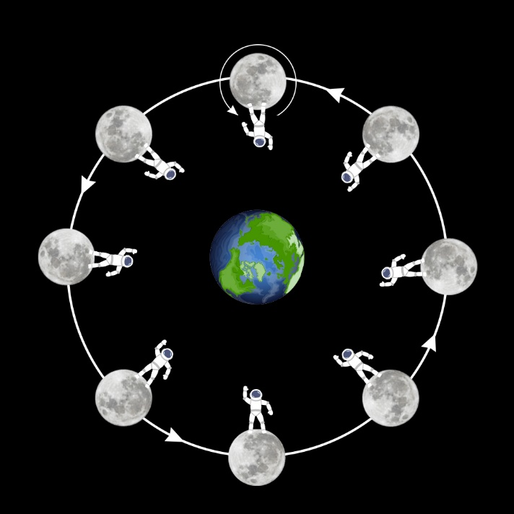
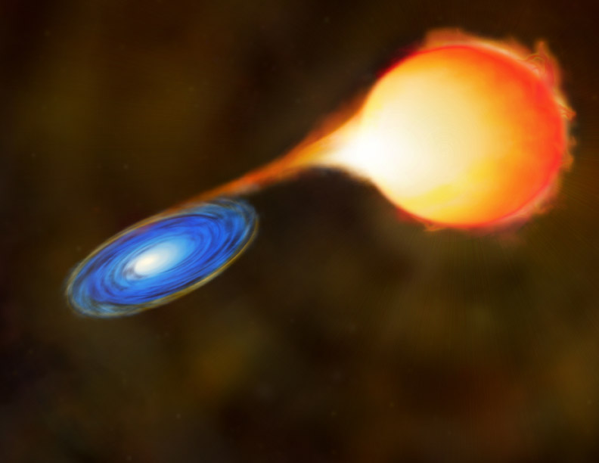
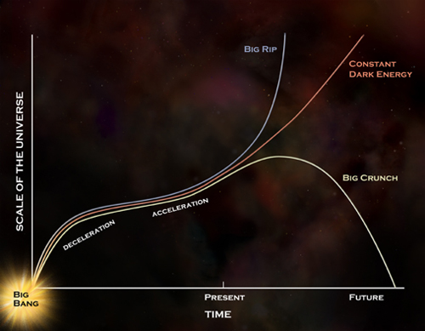
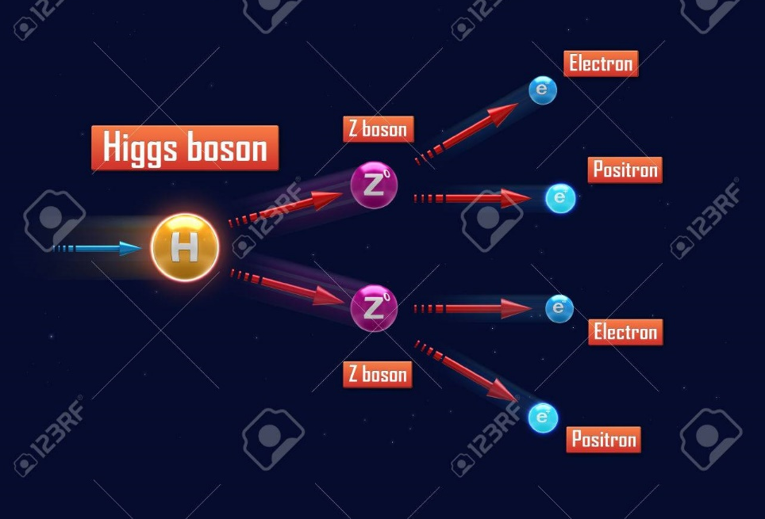
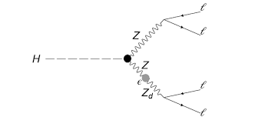
Why do we only see one side of the moon?
How & why where Super Nova 1a
Used in the discovery of Dark Energy
Are these the same? How do they relate to yesterdays calculations?

Slide 20
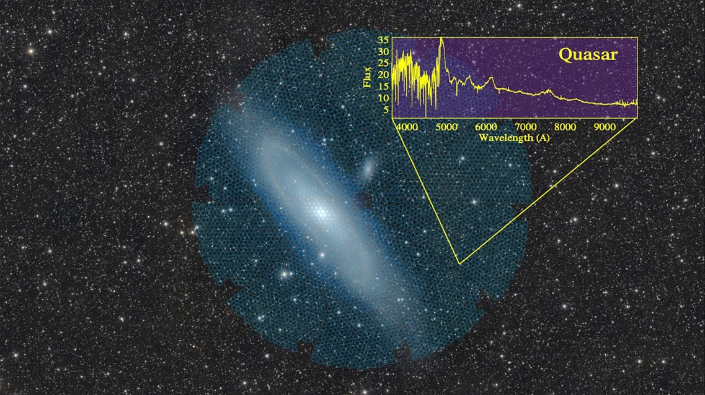
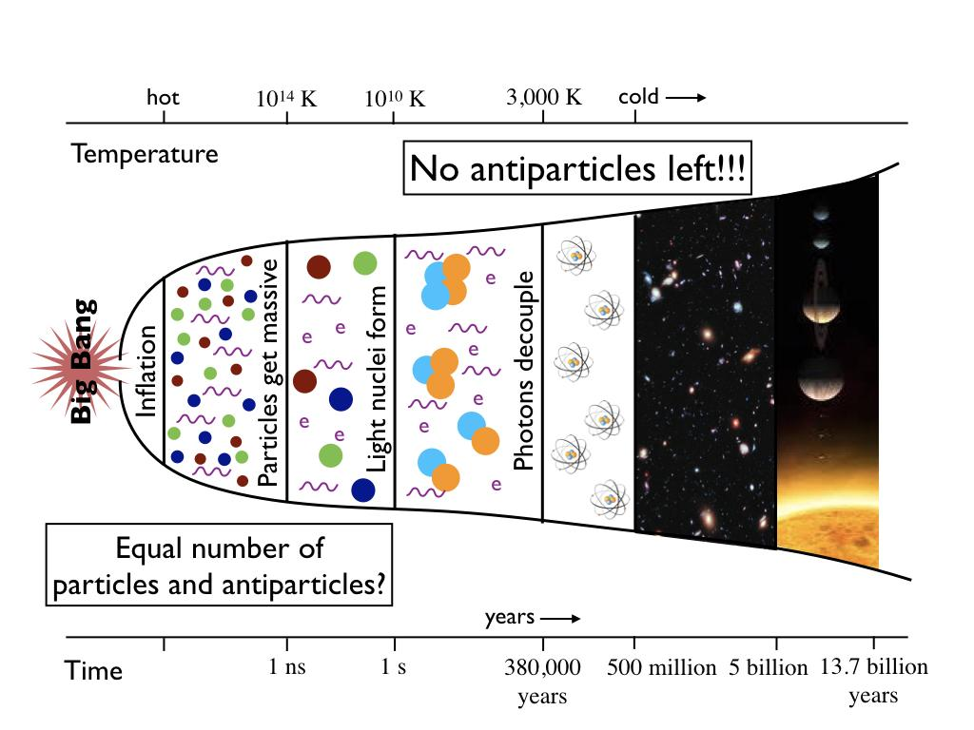
Student presentations.

Slide 21
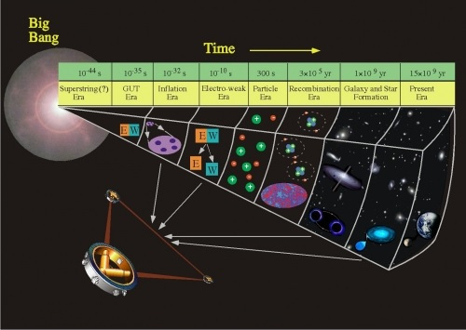
Tomorrow: Round table Q & A session
Think
of
Questions!
Thank- you
groups!

Slide 22
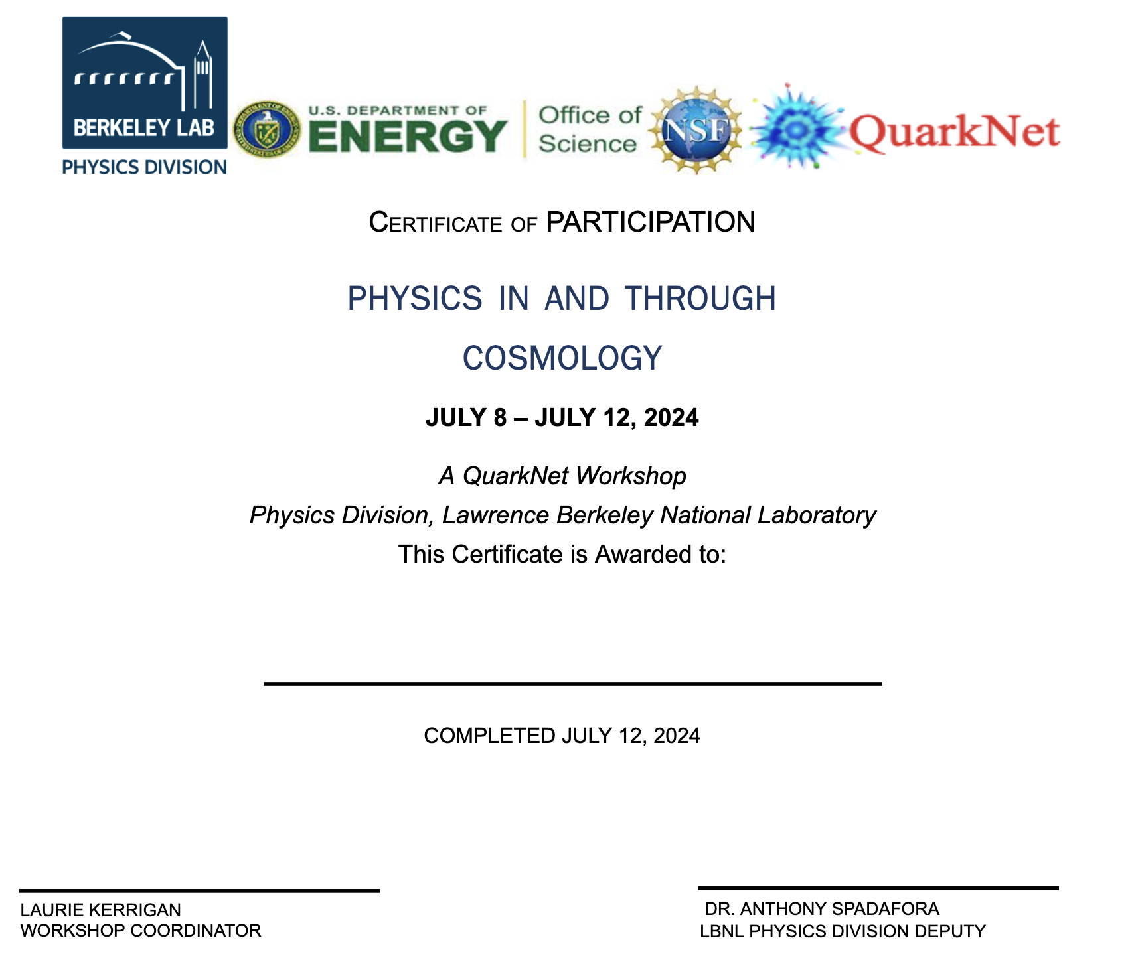

Slide 23
Laurie Kerrigan | Laura Guthrie | Sean Fottrell | Mark Matsuzaki | Bryan Marten | Dorota Sawicka | Portia Sharma | Phil Becker
group 1 | group 2 | group 5 | group 6 | group 7 | group 4 | group 3 | group 8
Jessica Tam | Francisca Li | Ibrahim Nadeem | Jennifer Choi | Daphnée CHÉDRU |  | ZITONG TANG (Thomas) | Muskan Ladhar
Yu Tian Zhang | Ayush Adi | Anveet Patil | Maya Moss | Thelonious Kojan | Brooke Raymond | Aadi Patangi | Hadia Ahmadi
Jerry Peng | Christine Pineda | Sarang Athani | Aryamaan Dash |  |  | Kaushmit Bhowmik | Max Rombakh
Sergio Hernandez | Kimia Amiri | Alina Kustowkska | Isabella Castaneda | Jacob Landman | Teresa Yu |  | Benji Sirota
Lem Taichman-Bernstein | Rishab Ghosh | Sahana Sreekant | Kai Licata | Chloe Faison | Prahlad Vangeepuram Canchi
Bhavya Babbellapati | Chun-Yi Wu(Alfred) | Annika Hattan-Kutter | Remy Minnis

