Slide 1
Welcome to the Berkeley Lab
Physics in and Through Cosmology Workshop!
Tony Spadafora
Division Deputy
Physics Division

Slide 2
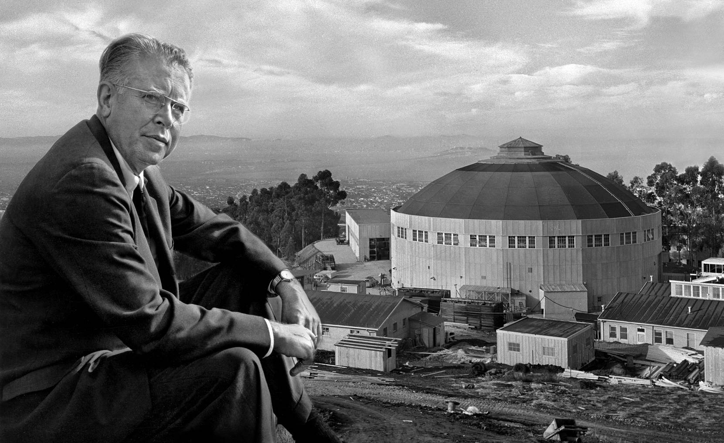
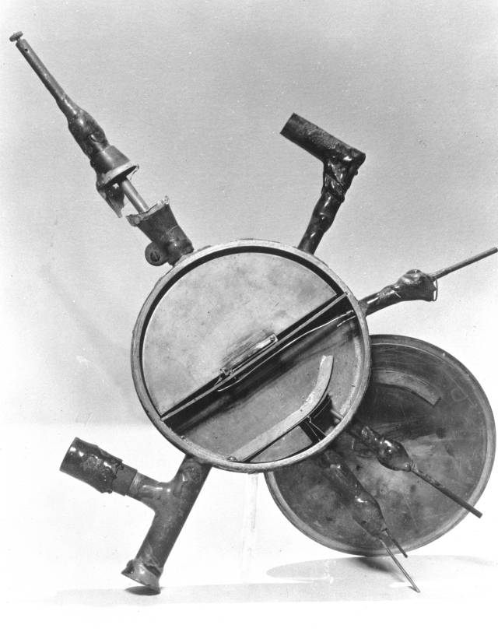
Established in 1931
E. O Lawrence and the 184” cyclotron (circa 1940).
The small seed from
which Big Science grew.

Slide 3
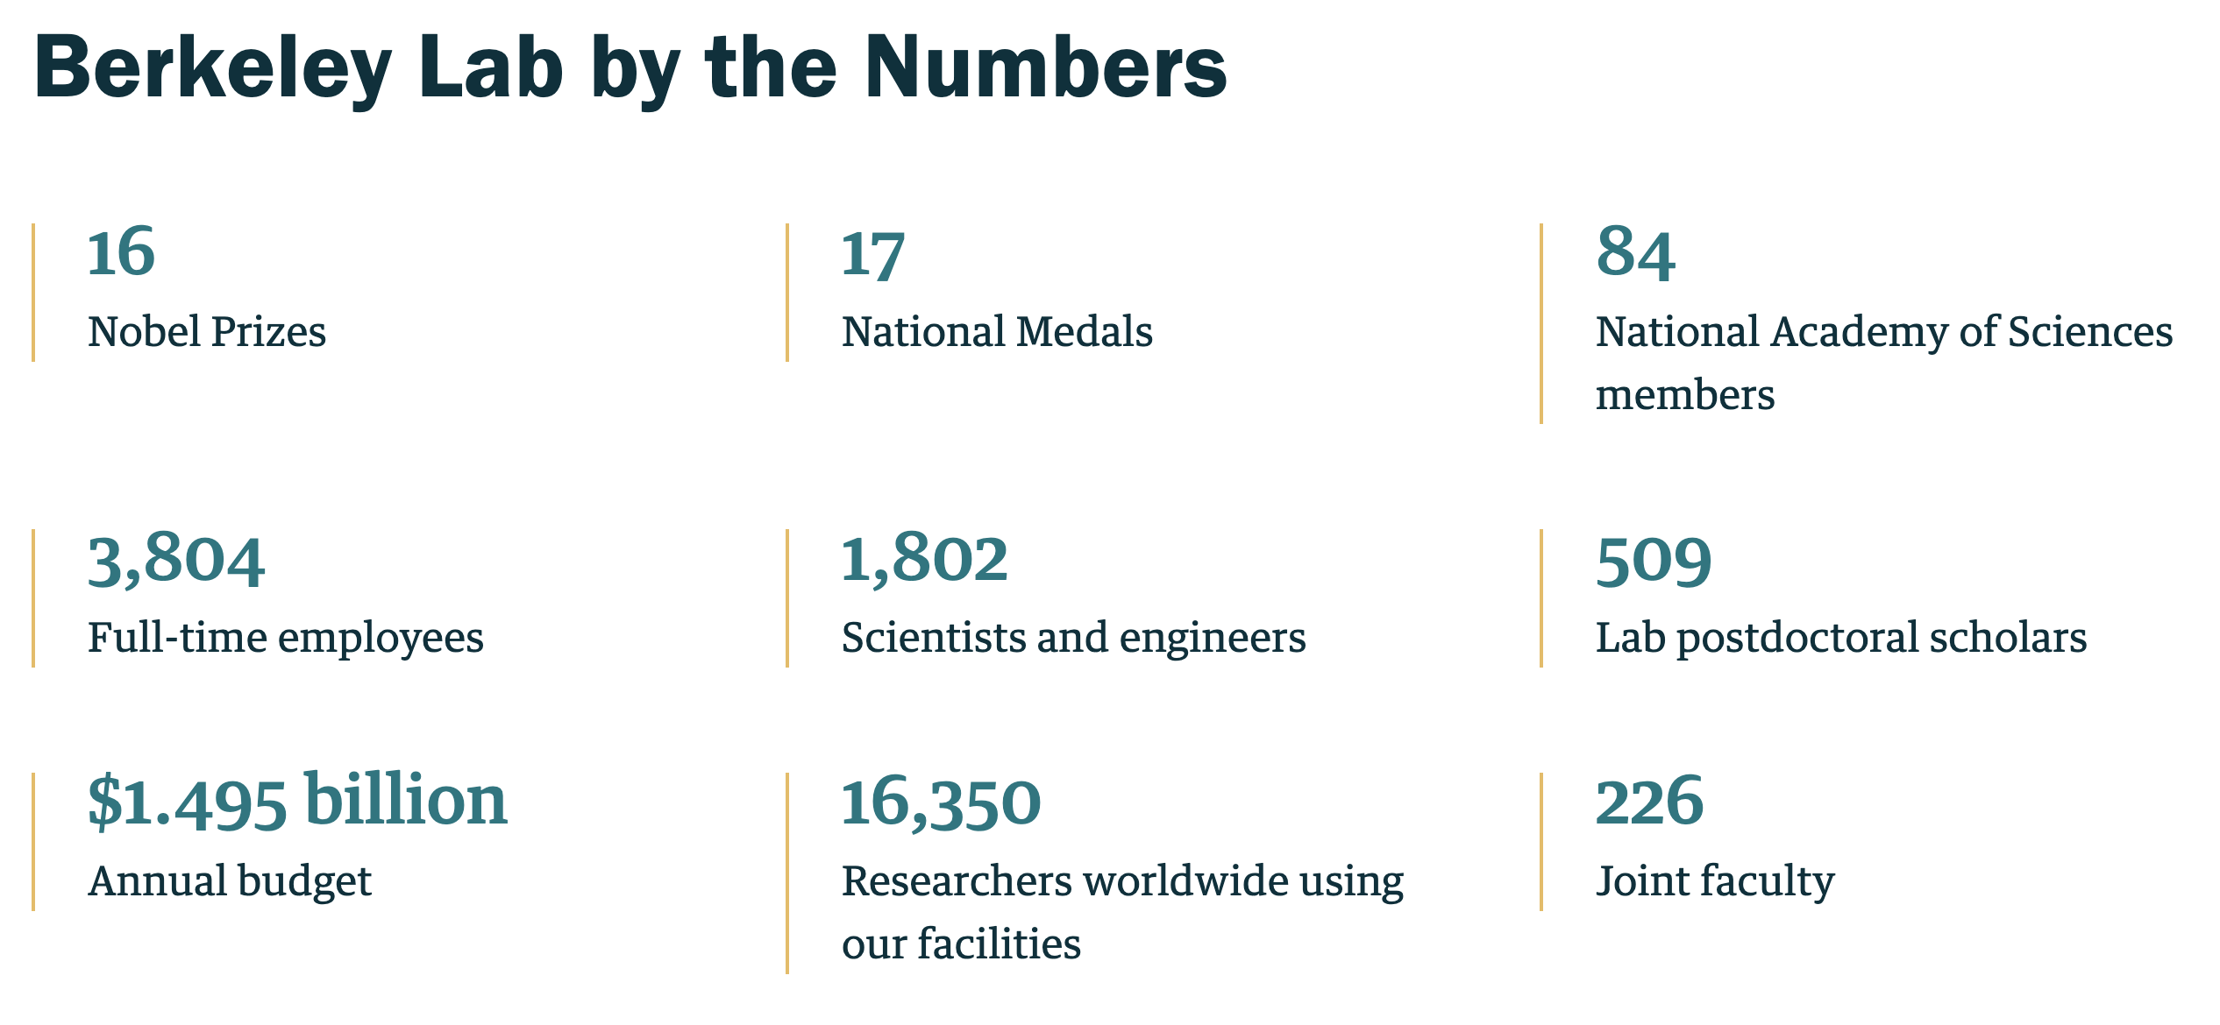
Berkeley Lab by the Numbers

Slide 4
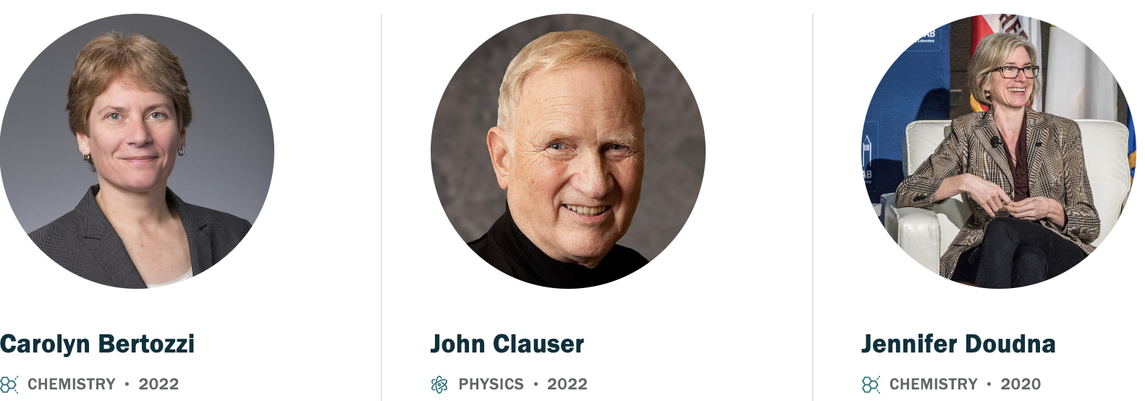
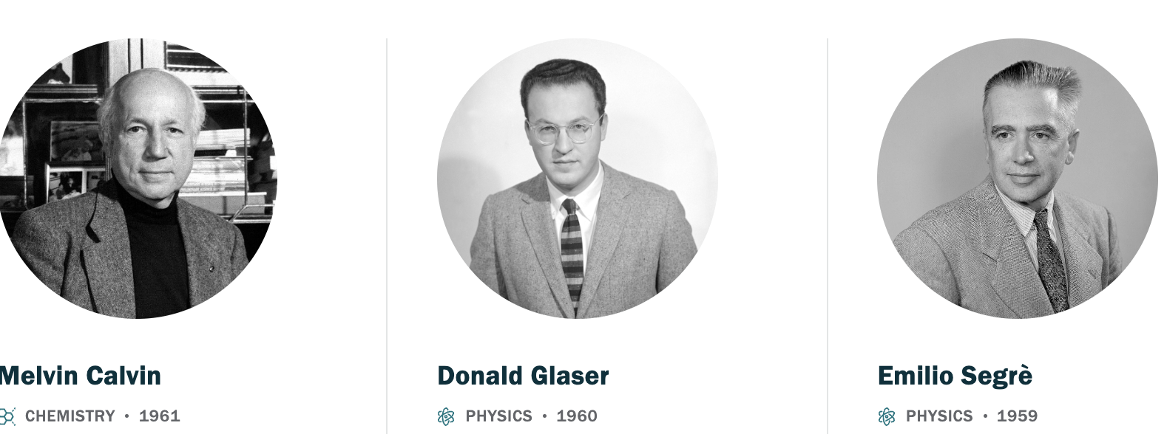

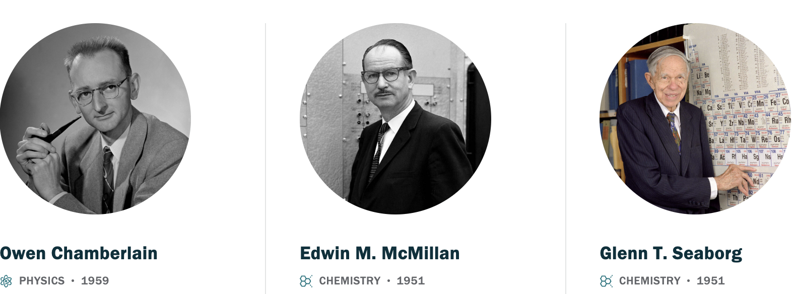
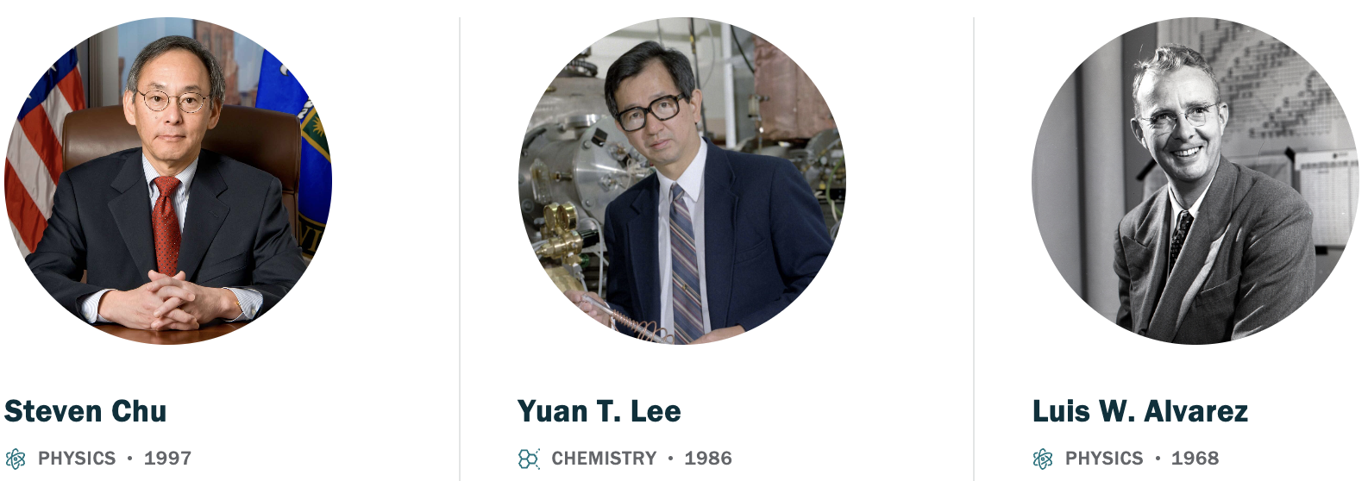
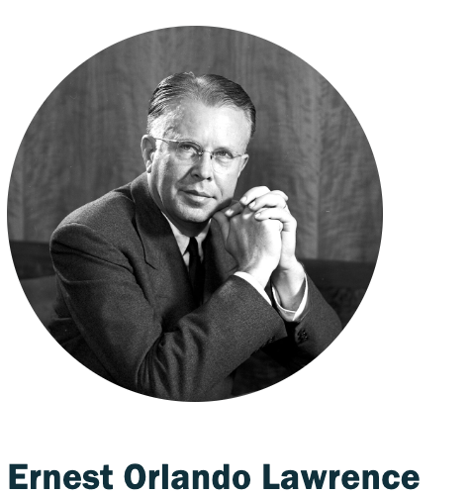
16 Nobel Laureates

Slide 5
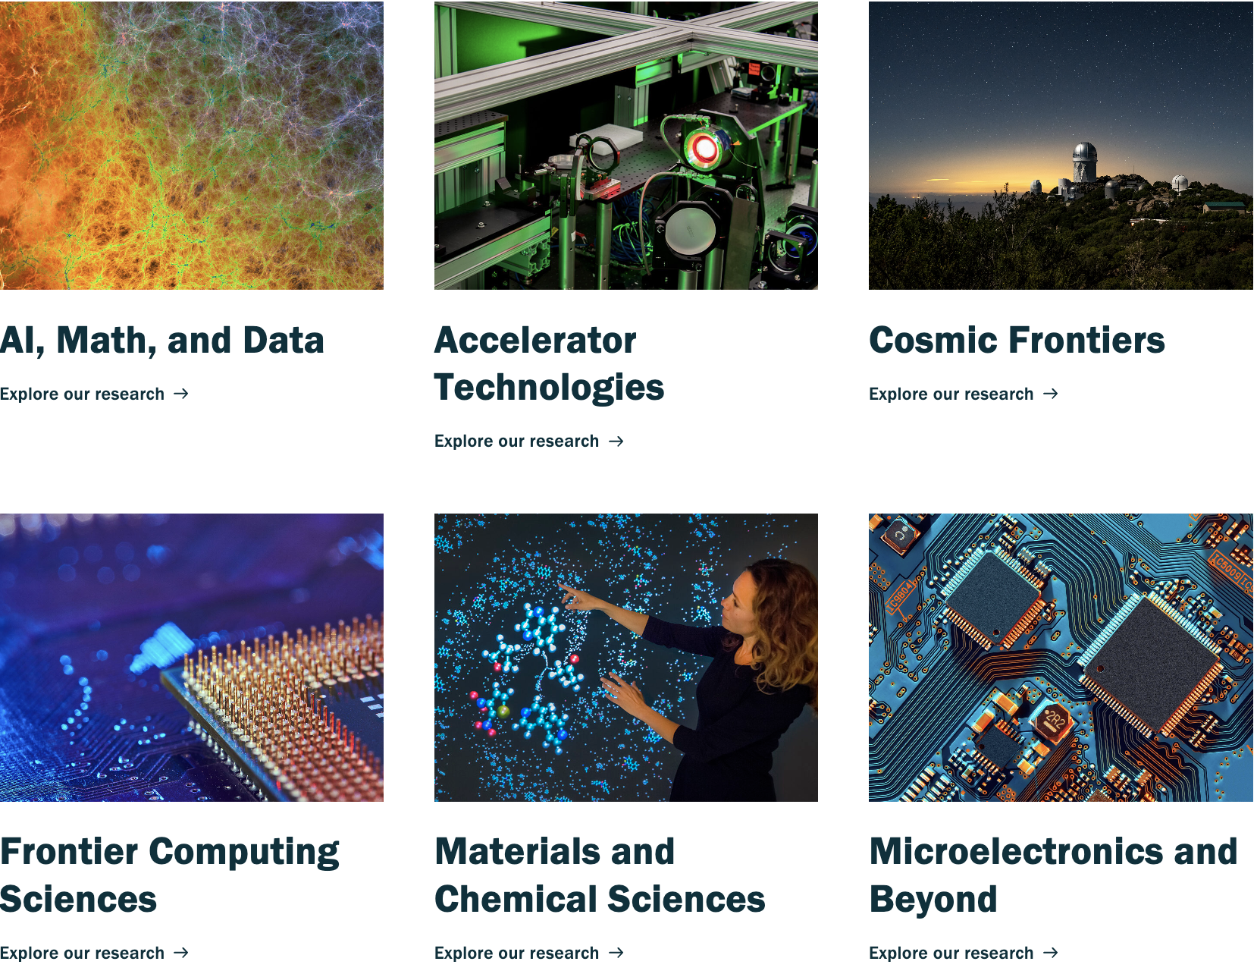
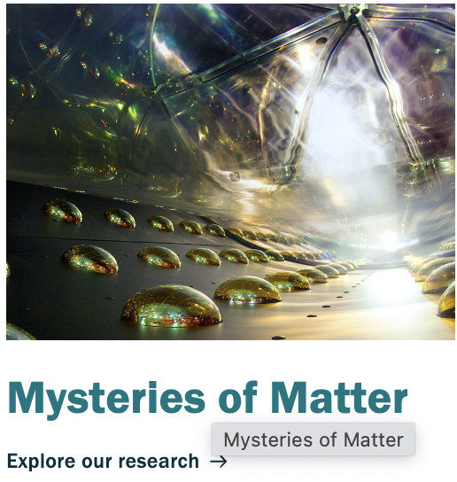
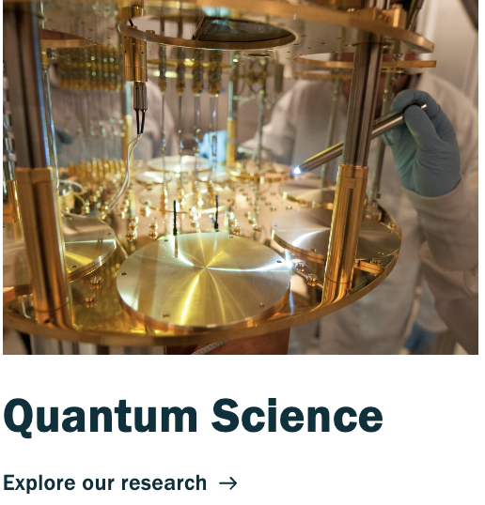
Basic Research in many areas
Discovery Science

Slide 6
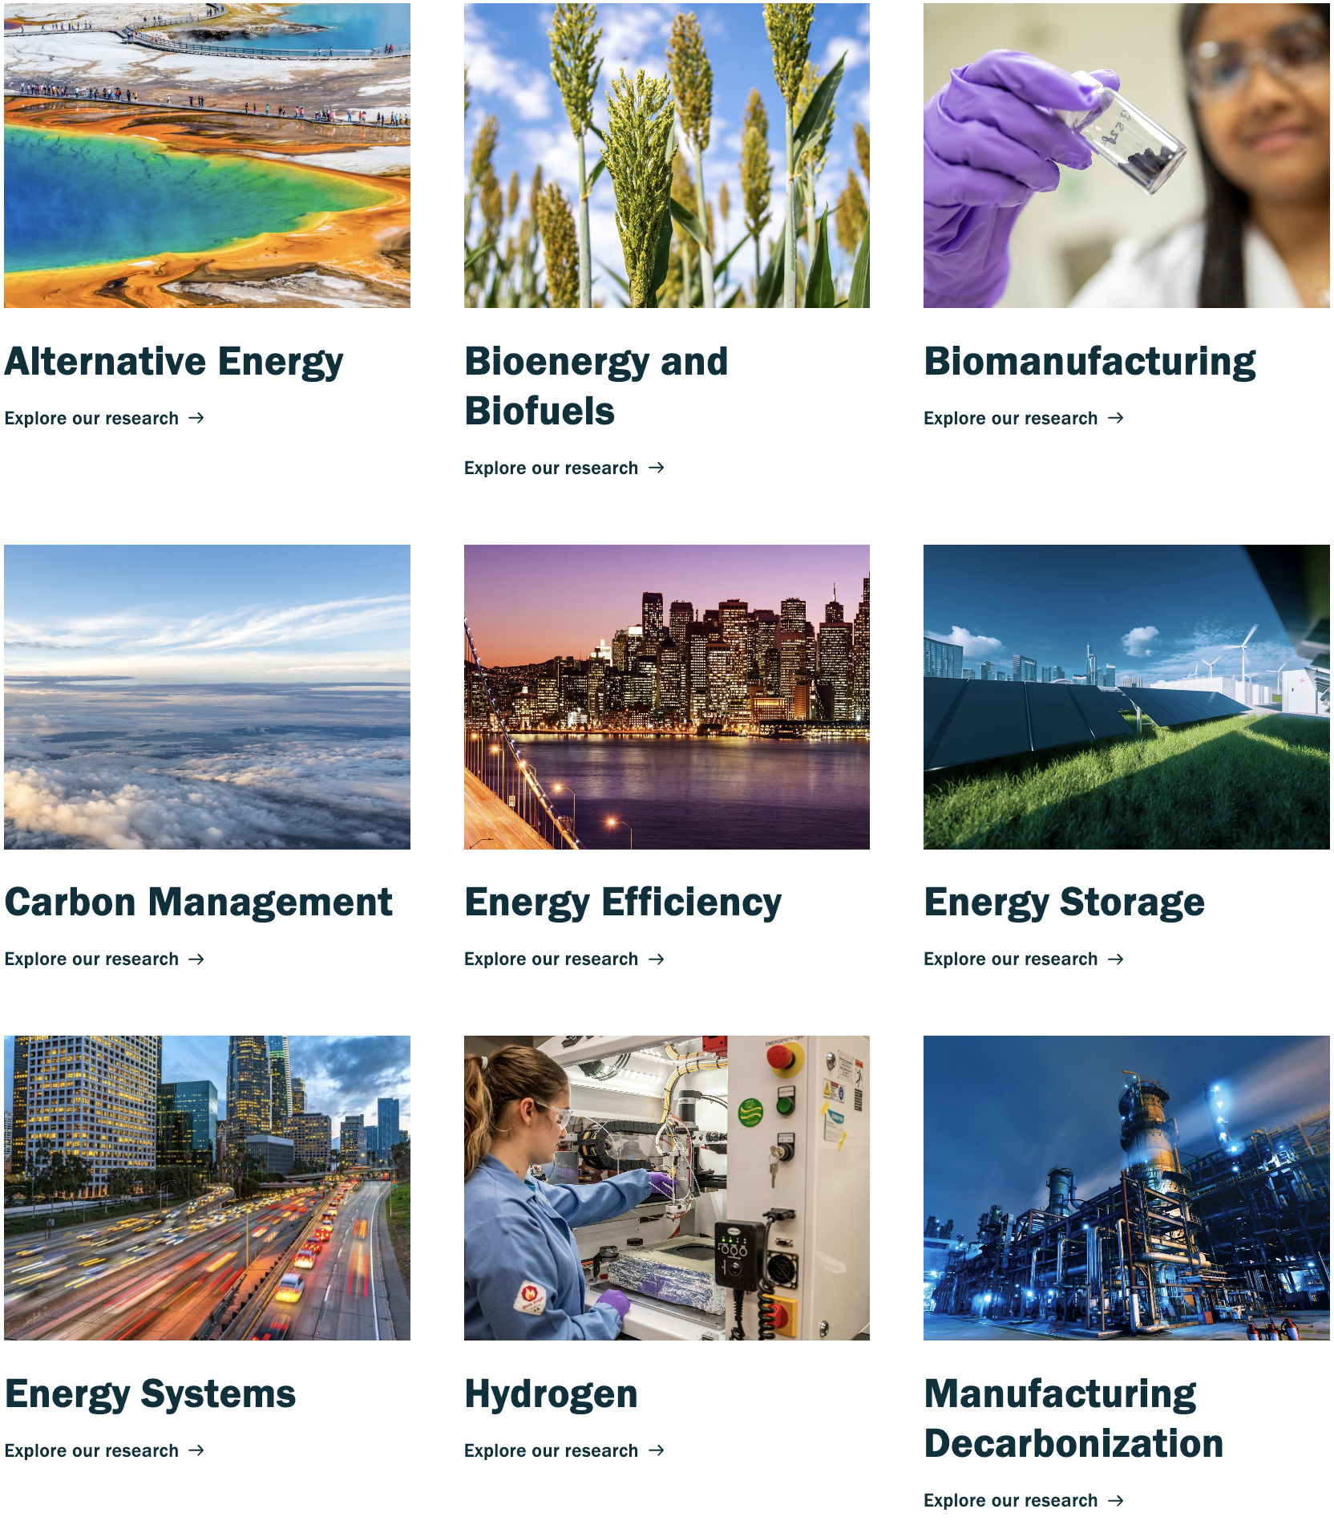
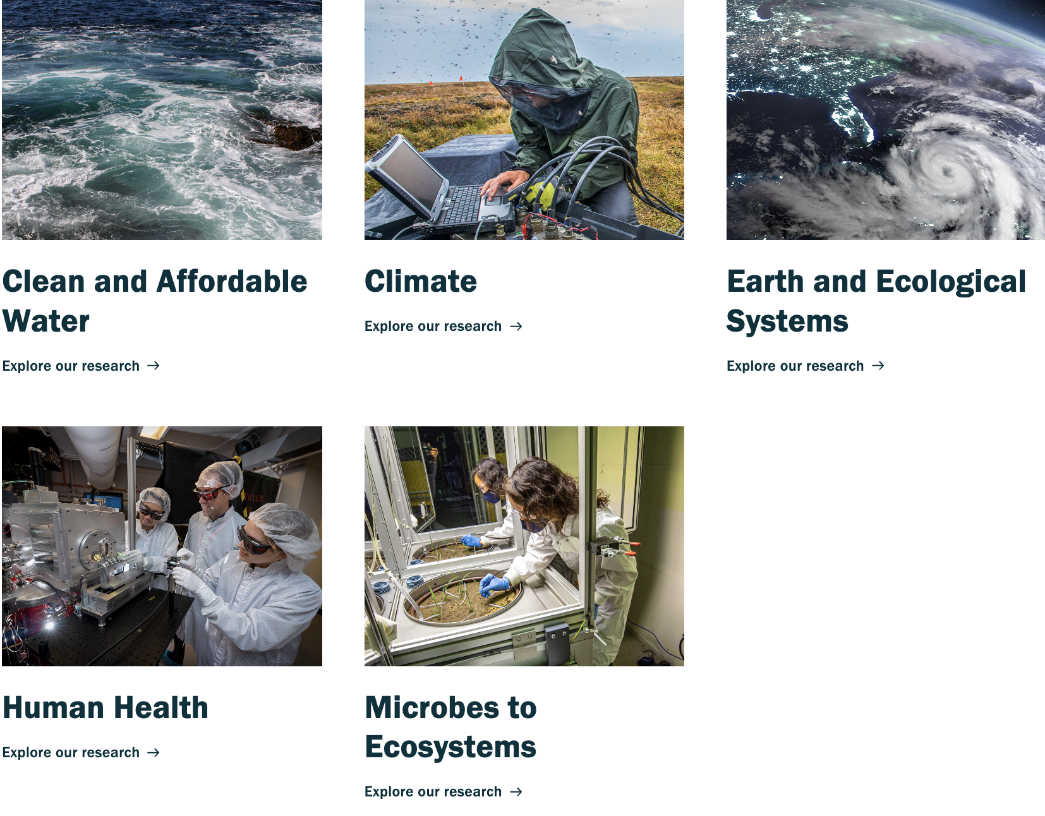
Energy and Environmental Research
Clean Energy
Healthy Earth and Ecological Systems

Slide 7

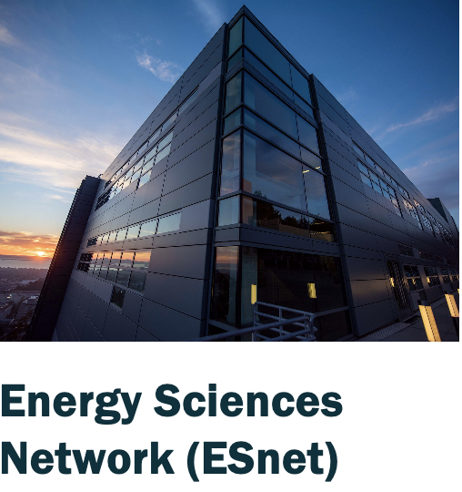
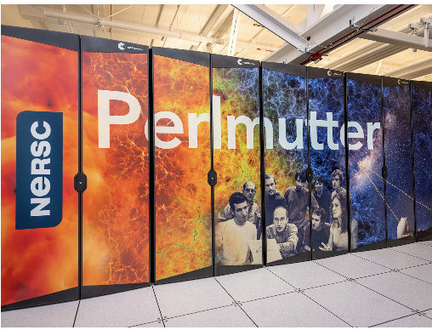
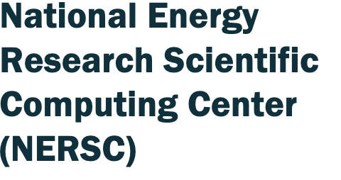
World-Class User Facilities at Berkeley Lab

Slide 8
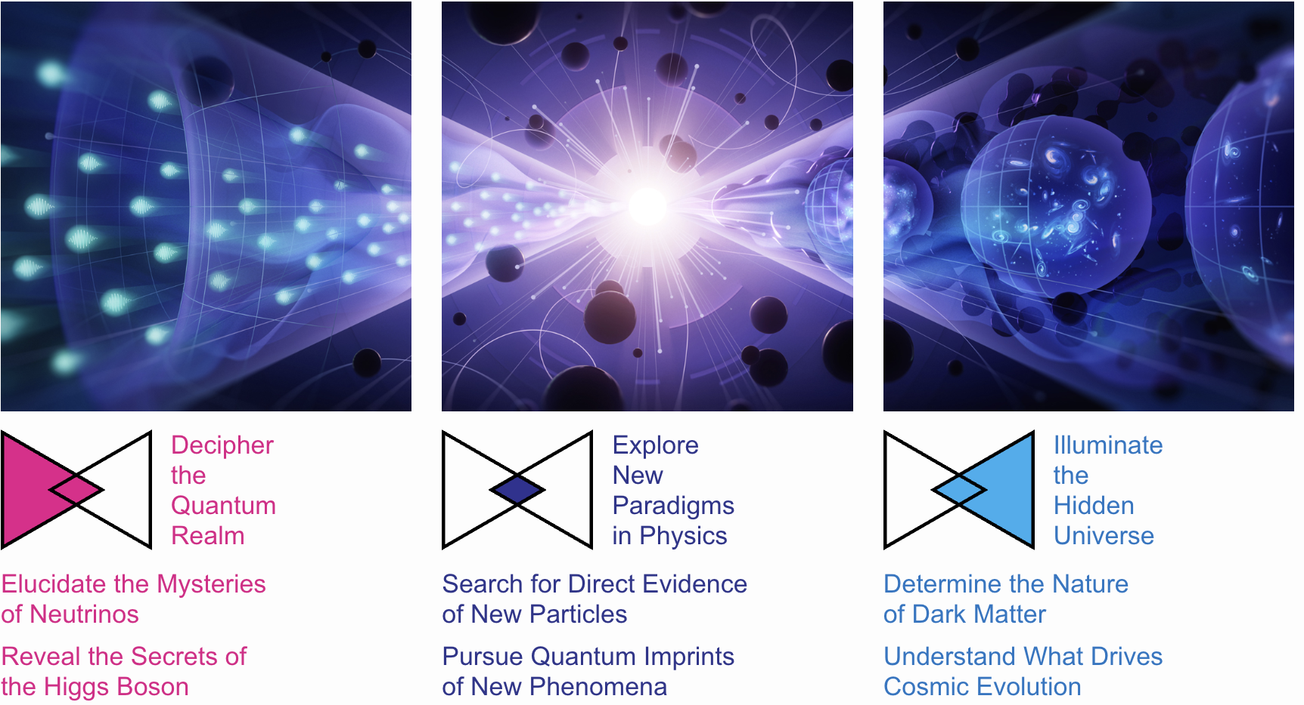
Particle Physics and Cosmology Today

Slide 9
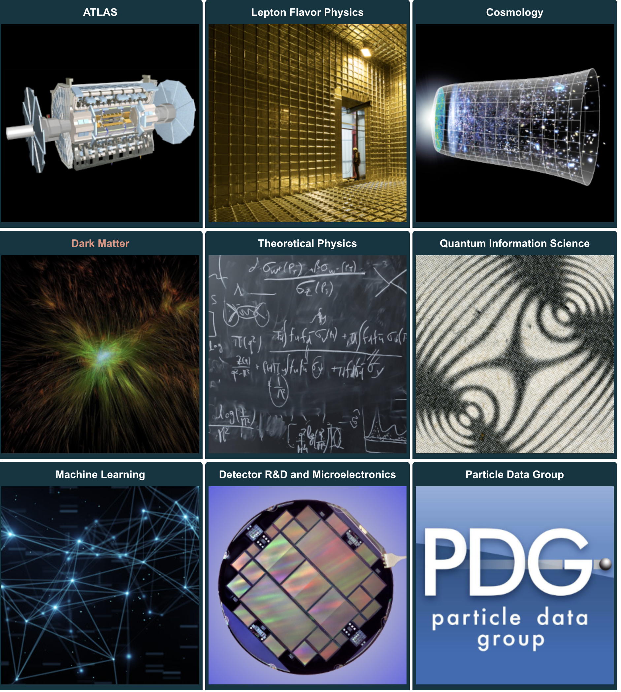
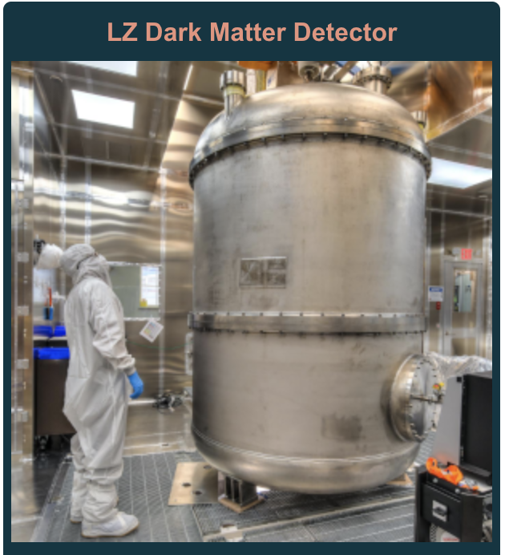
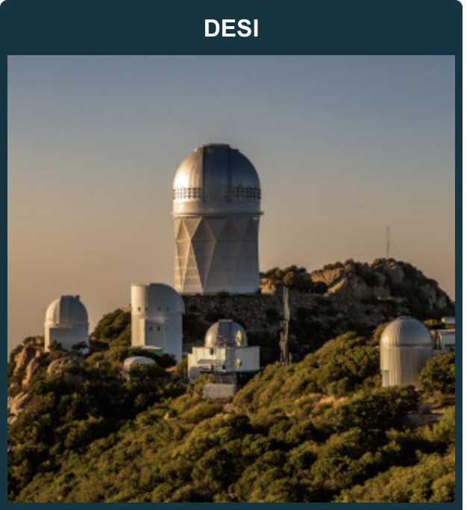
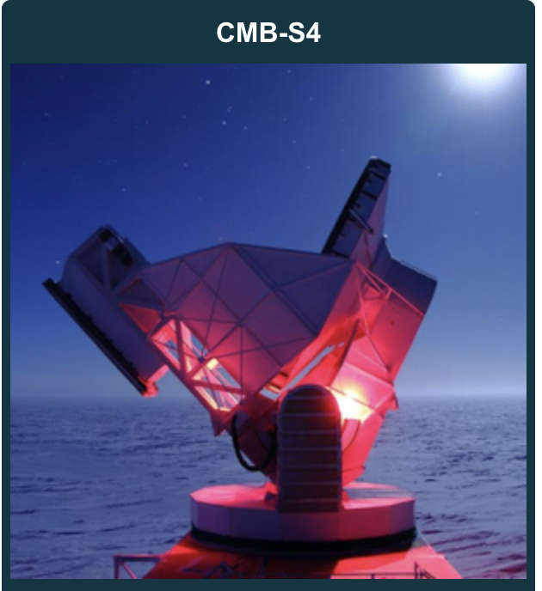
Berkeley Lab Physics Division Research
Research Areas
Major projects

Slide 10
Enjoy Learning about the Universe!

