Slide 1
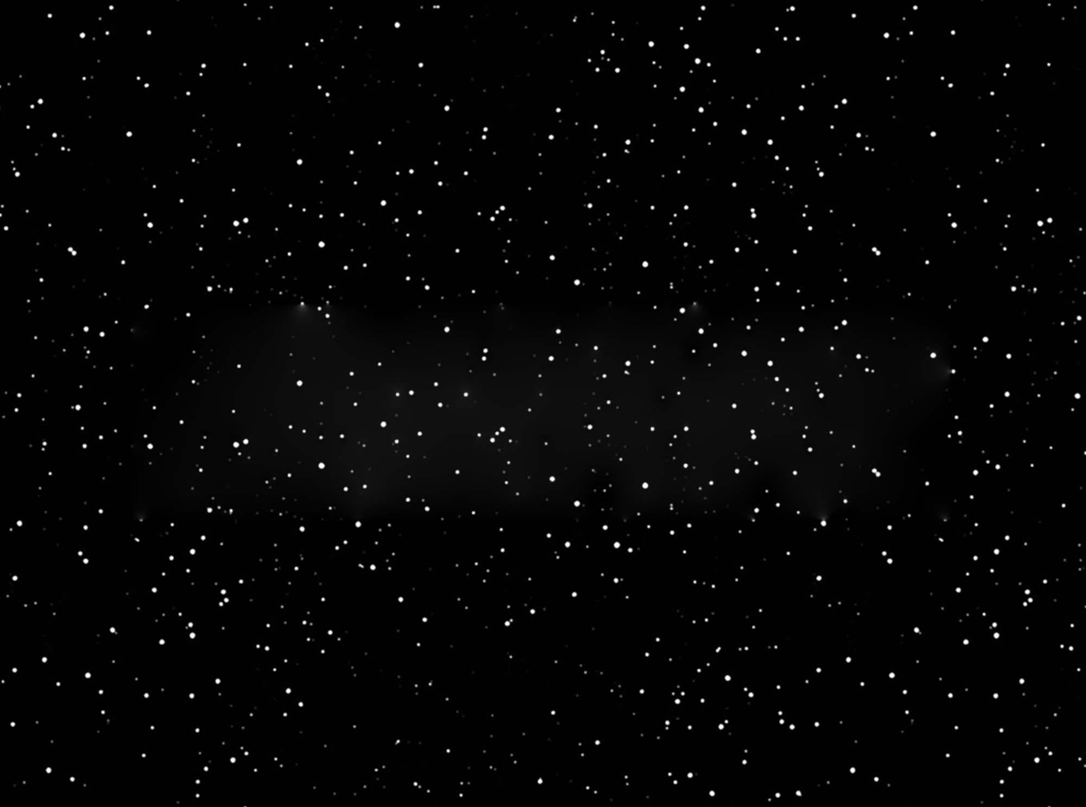
Dark Matter:
The Hidden Sea
Vetri Velan
Postdoctoral Researcher, Lawrence Berkeley National Laboratory
QuarkNet
June 21, 2023
Background image from https://unblast.com/free-night-sky-star-patterns/

Slide 2

My journey to becoming a physicist

Slide 3


Slide 4
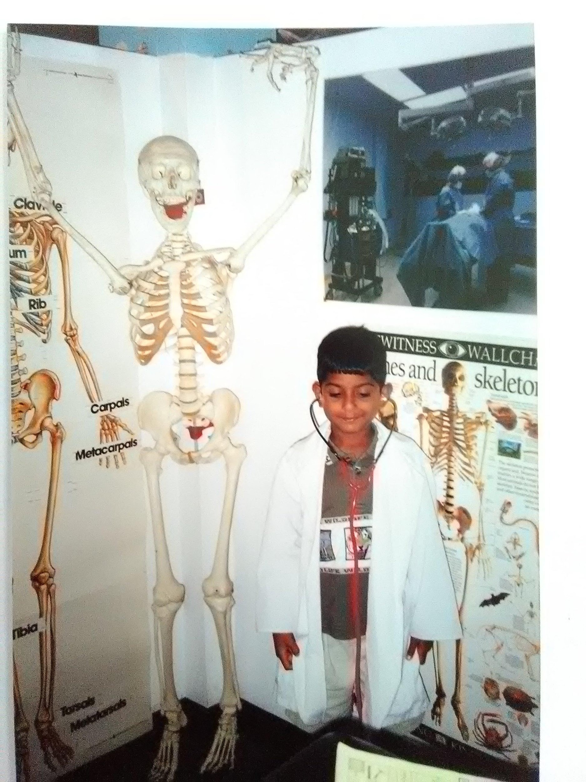

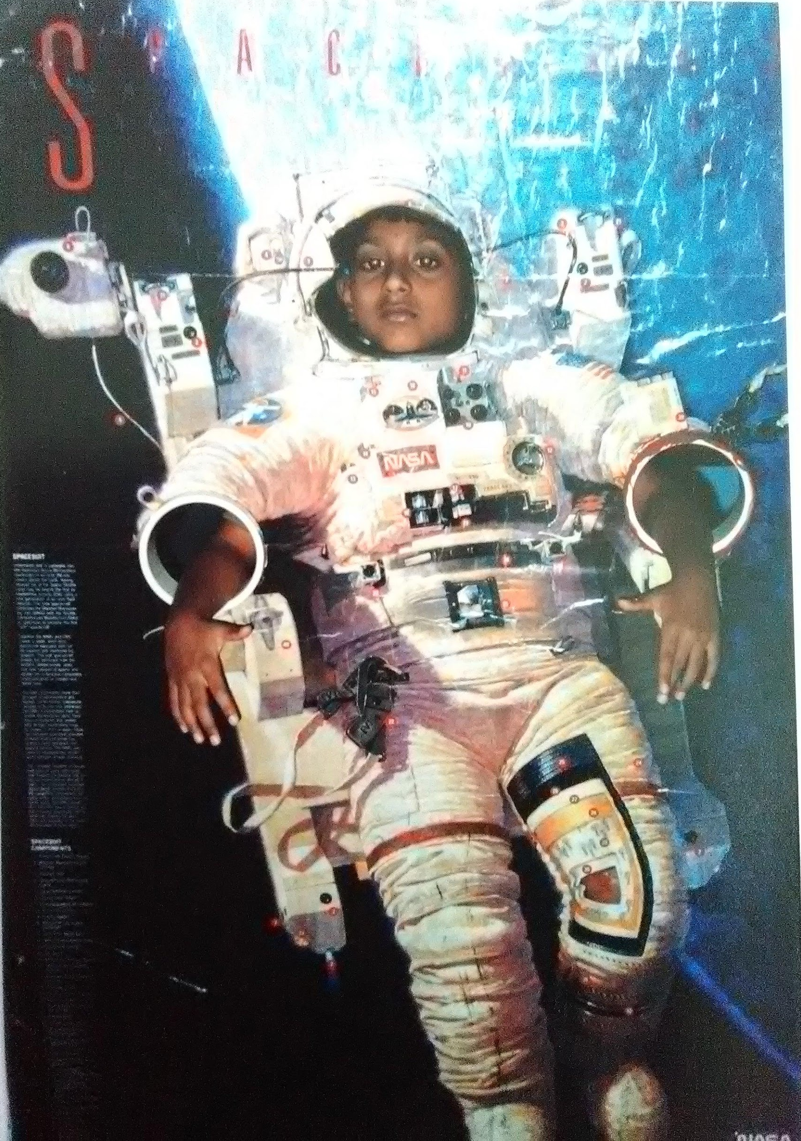
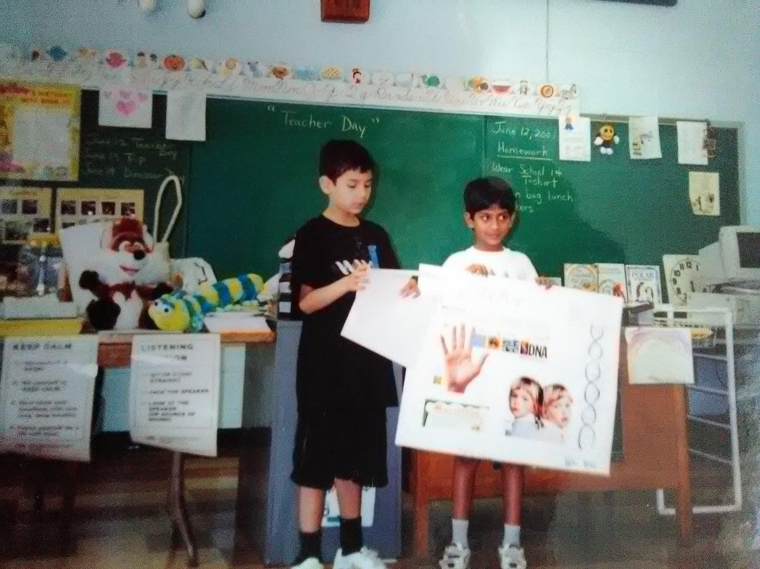

Slide 5
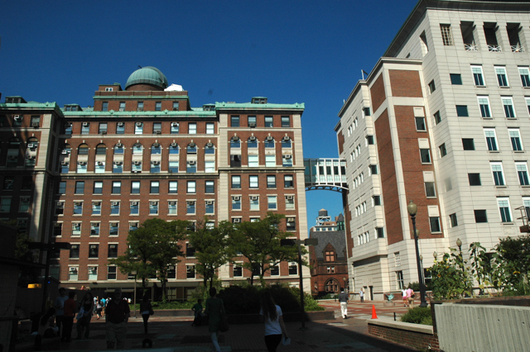


High School
Some things that got me interested in physics
Columbia University Science Honors Program

Slide 6
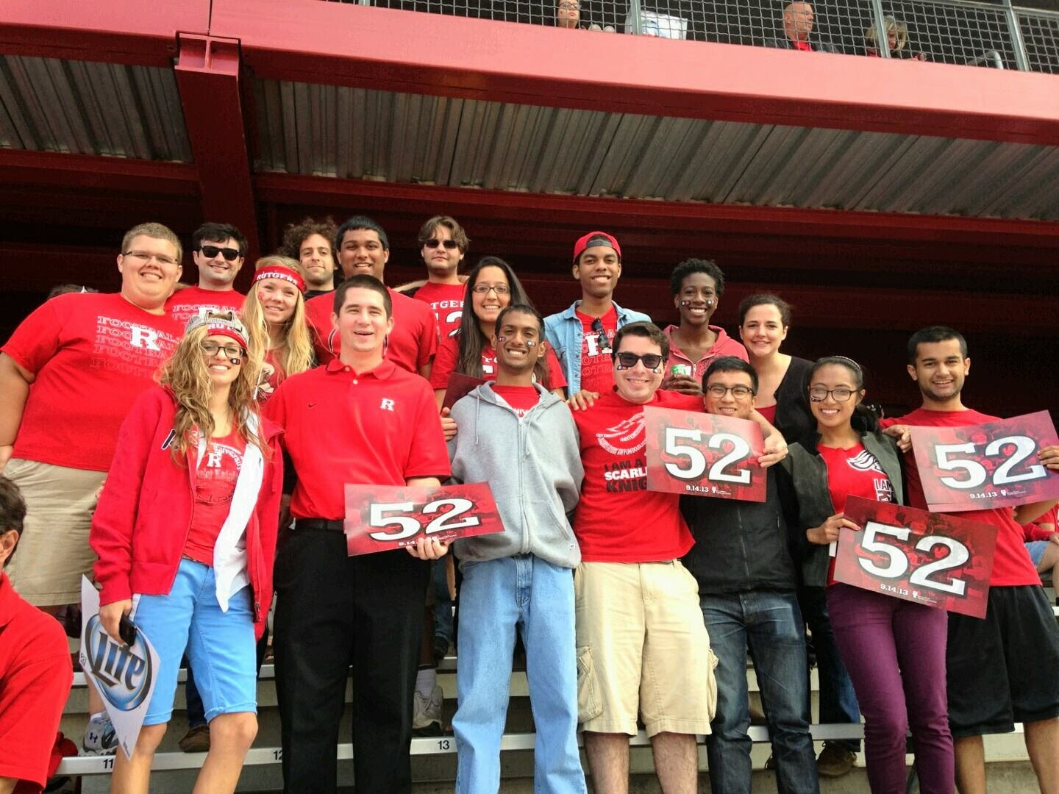

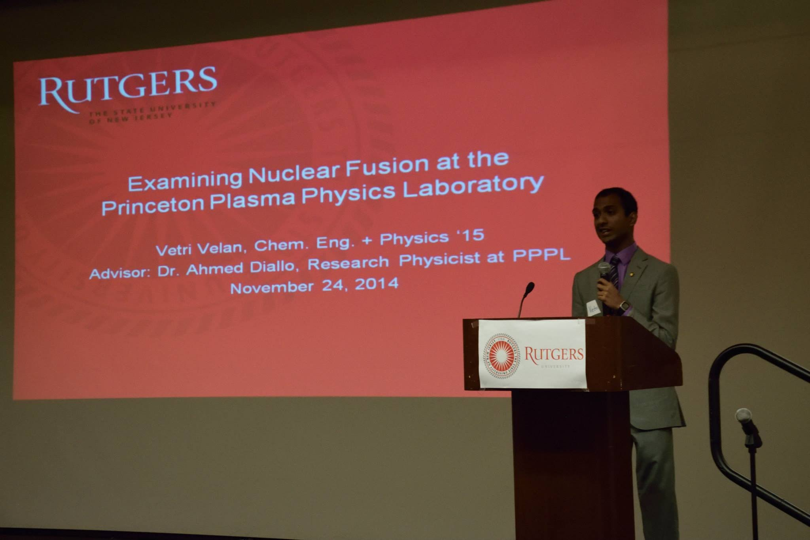
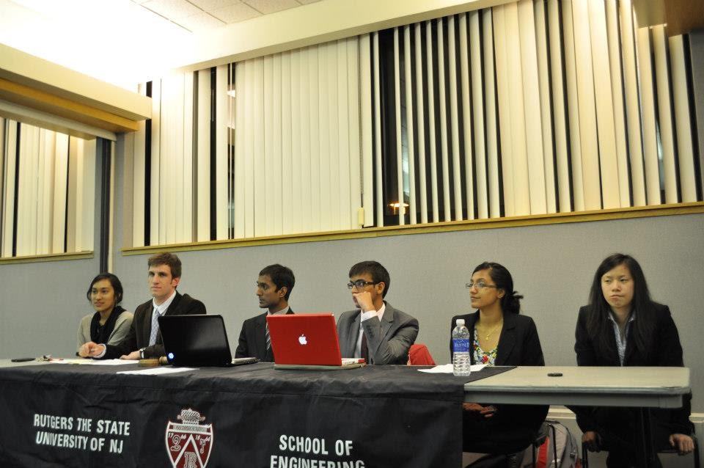
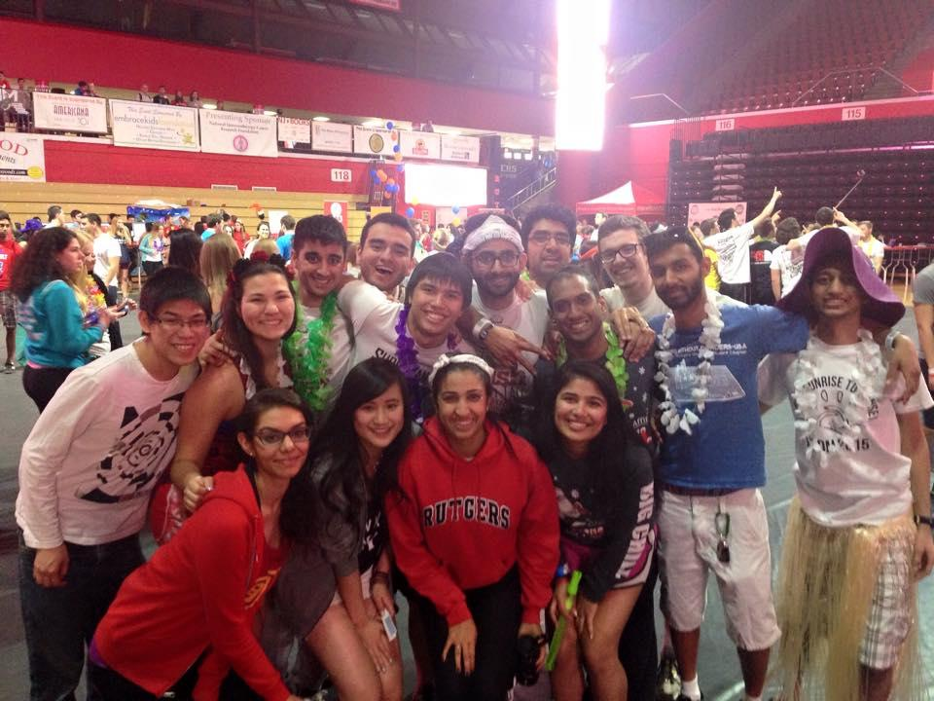
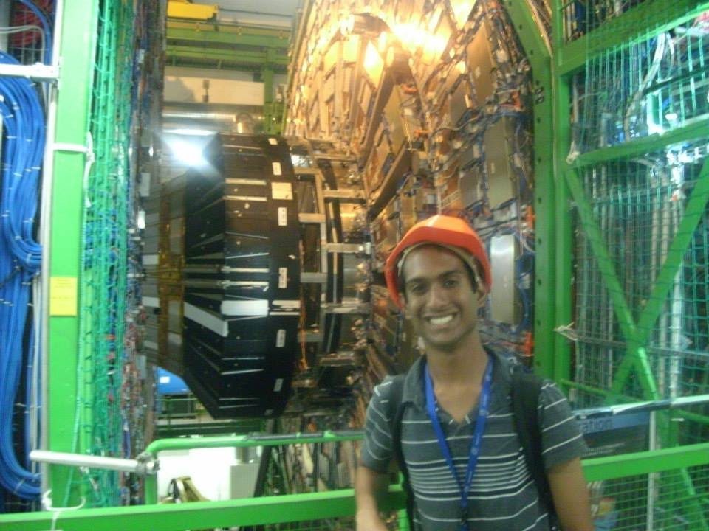
College at Rutgers University
Research
Football Game
Greek Life
Student Government
CMS Experiment

Slide 8
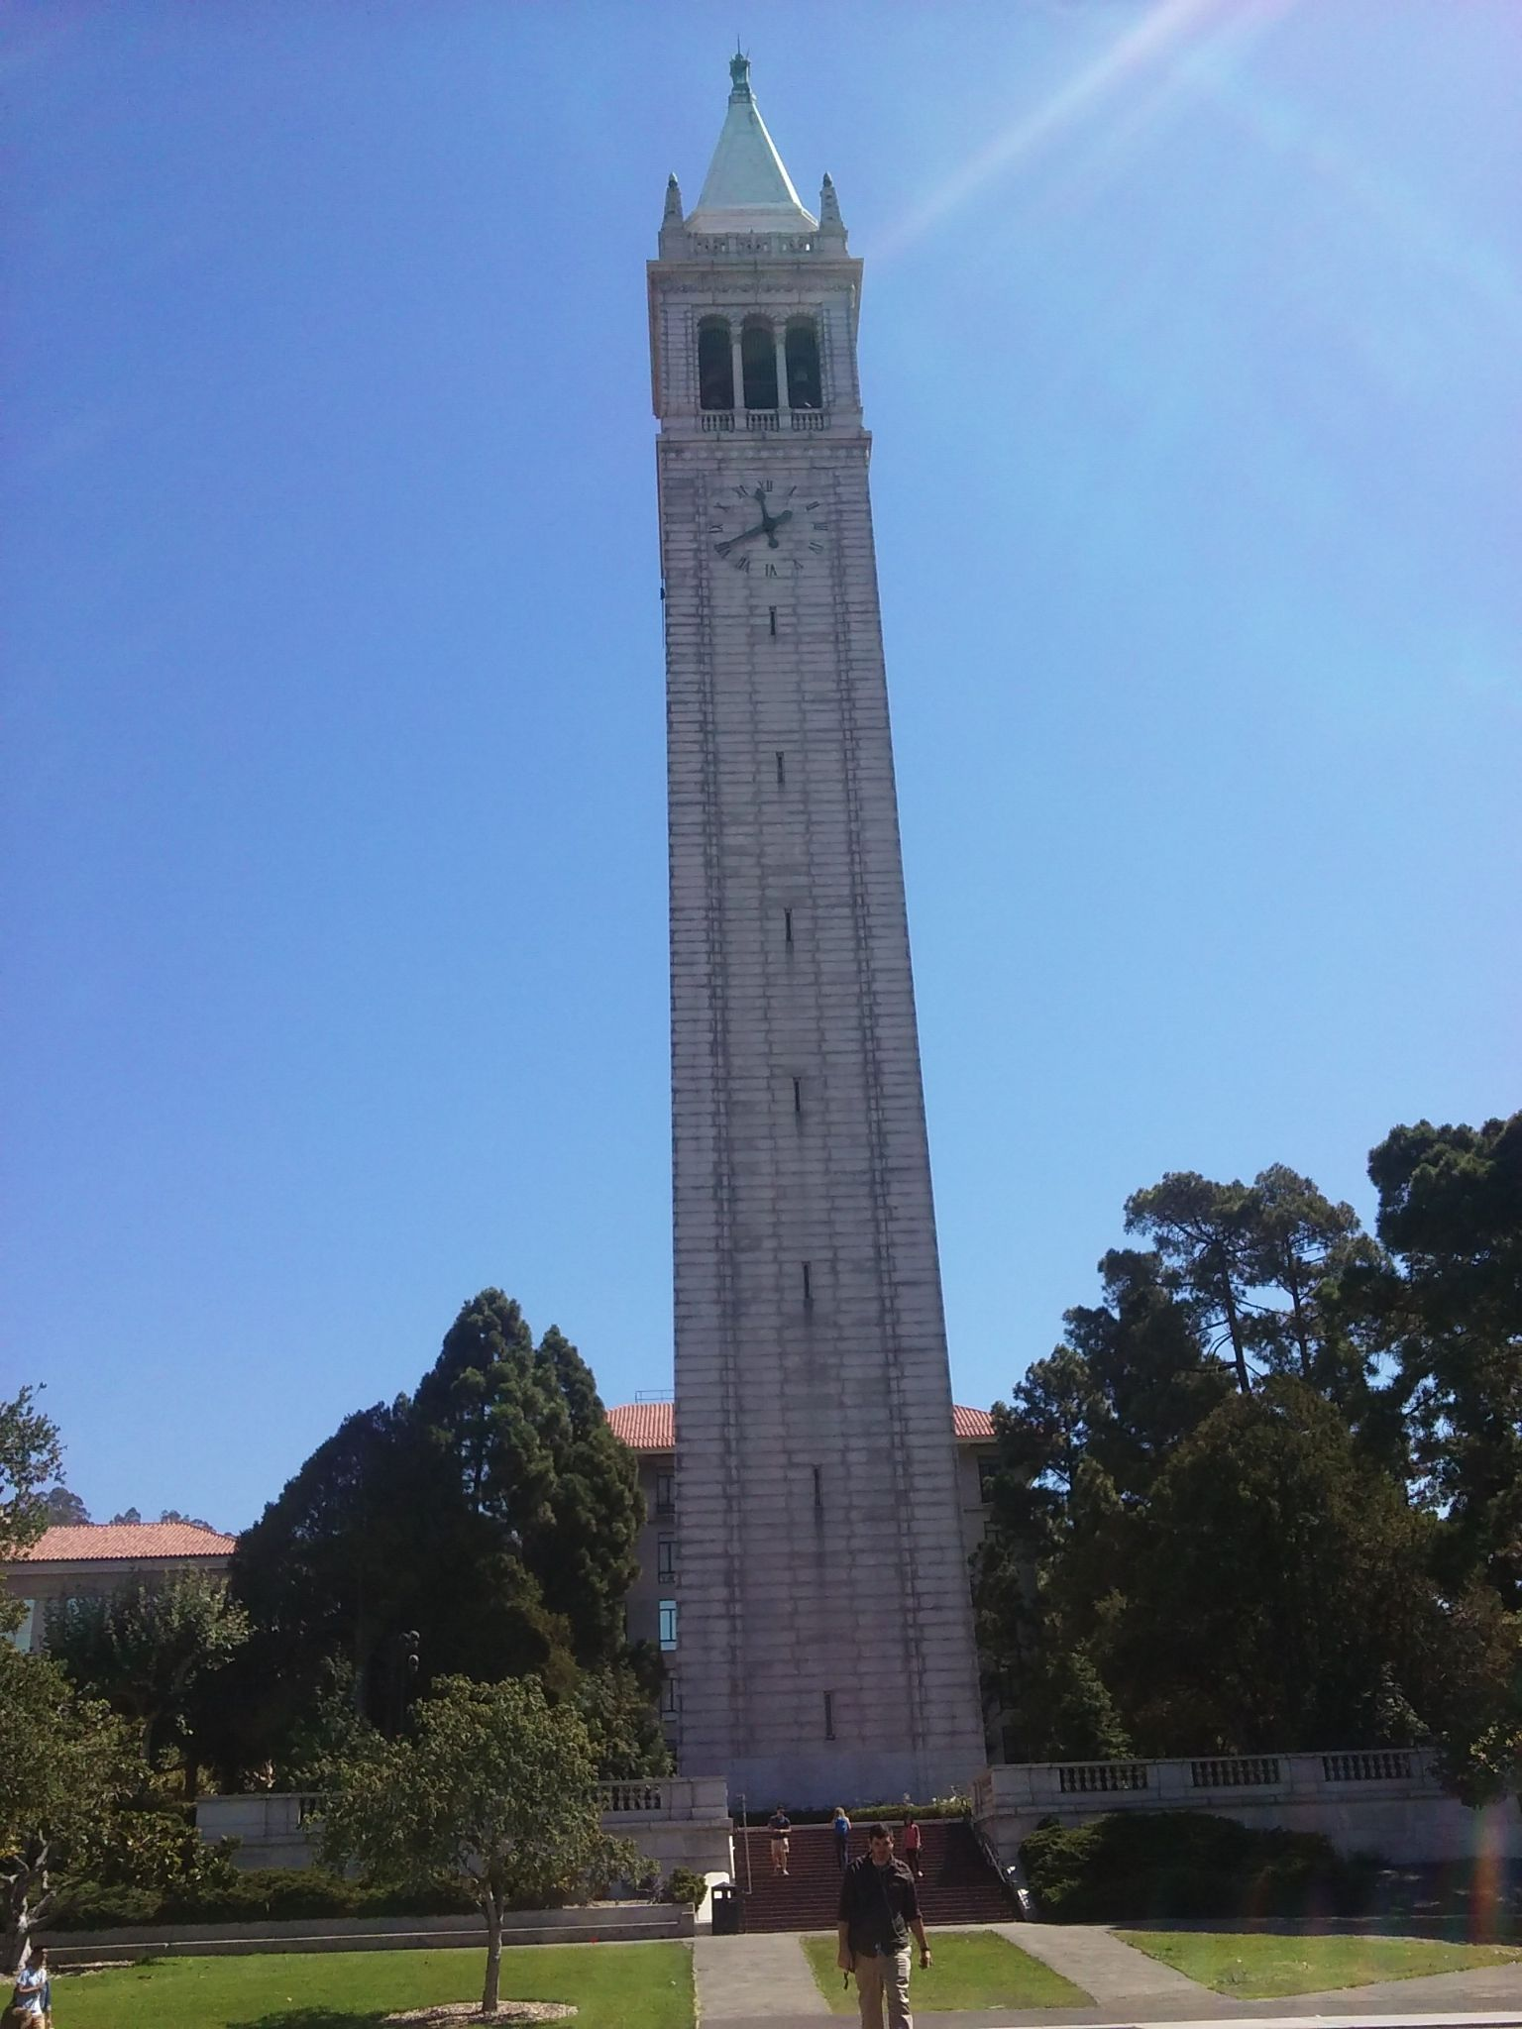

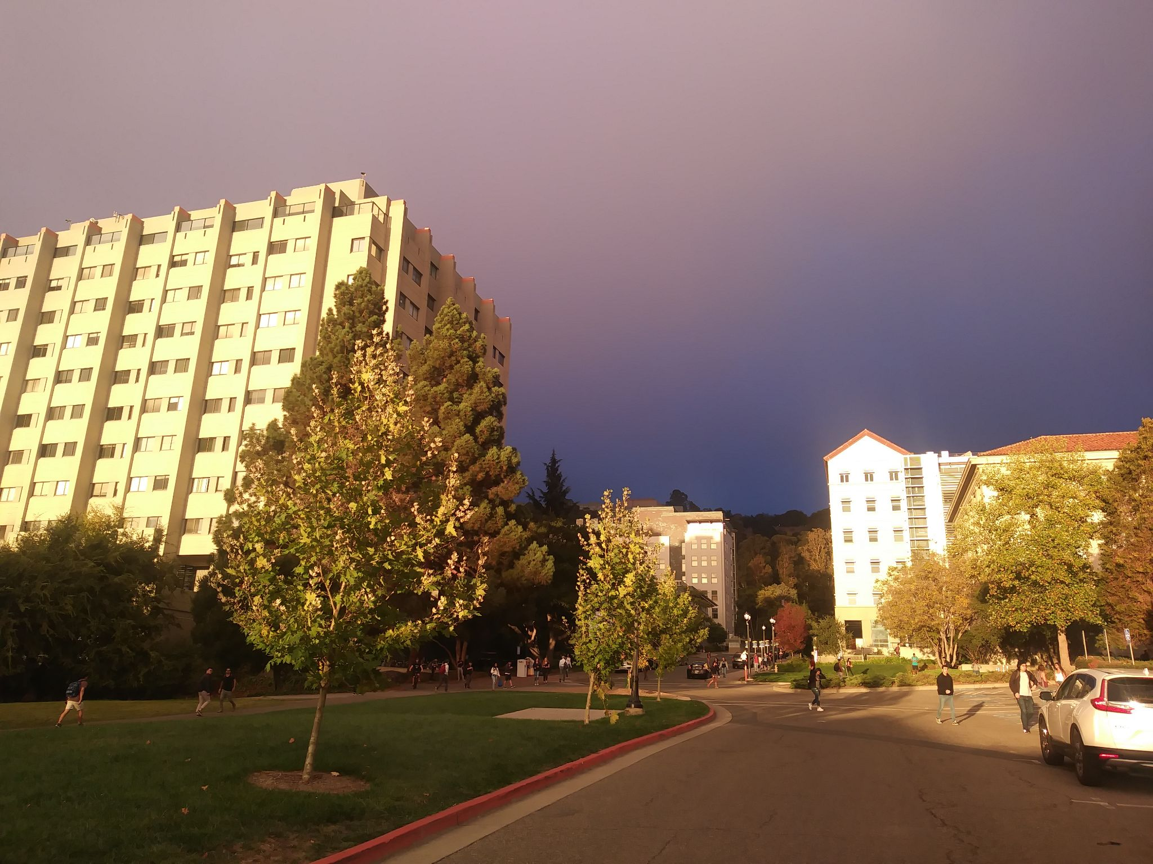

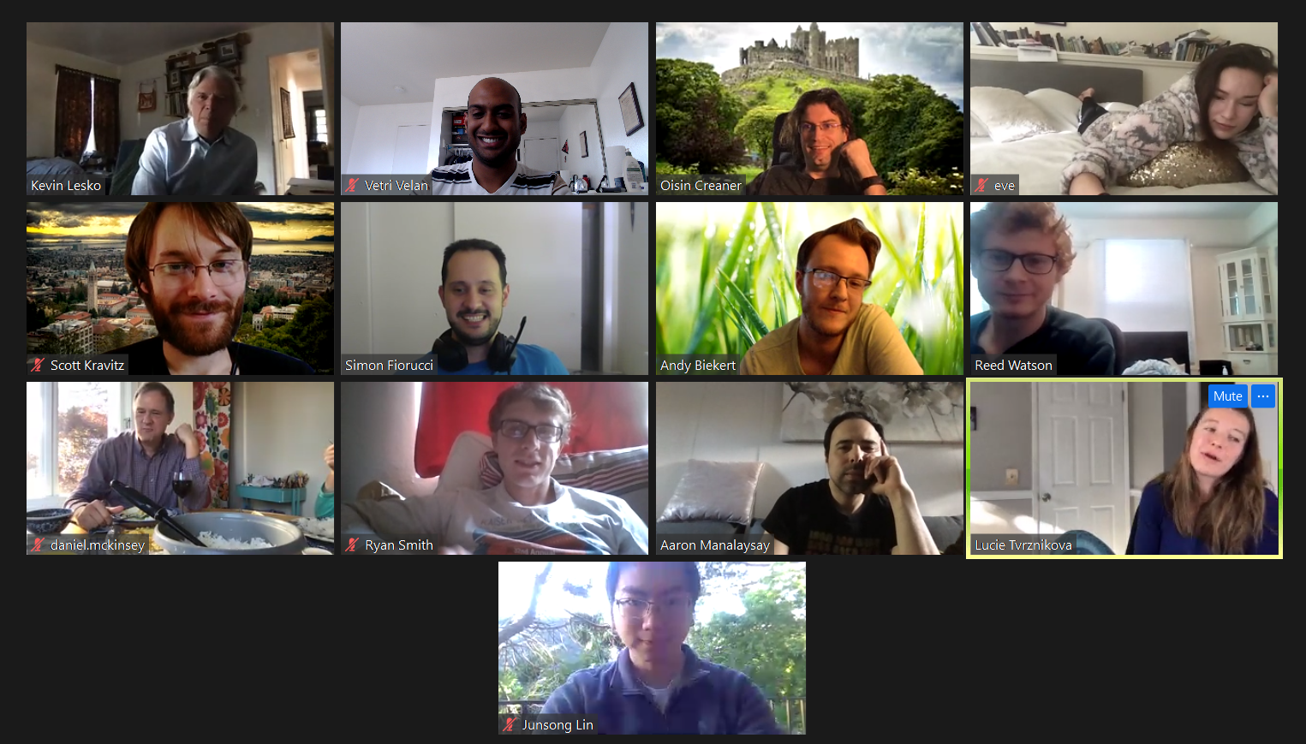
Grad School at UC Berkeley

Slide 9

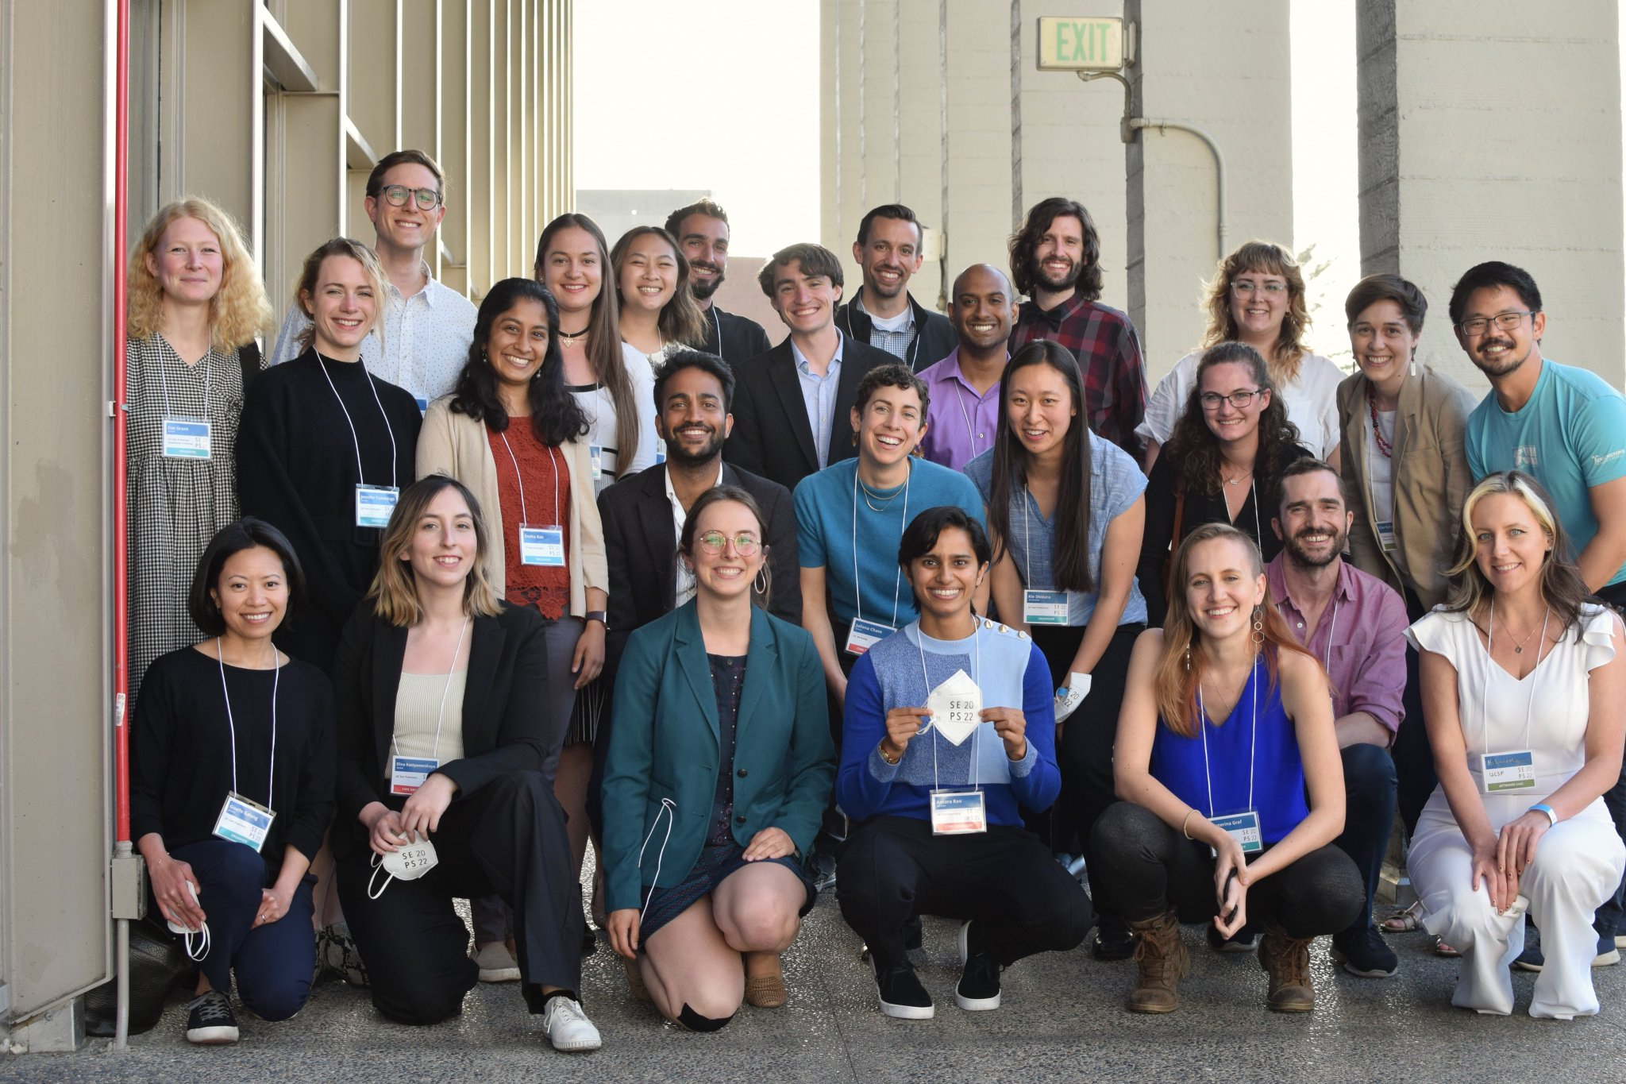



Science Policy + Activism

Slide 10
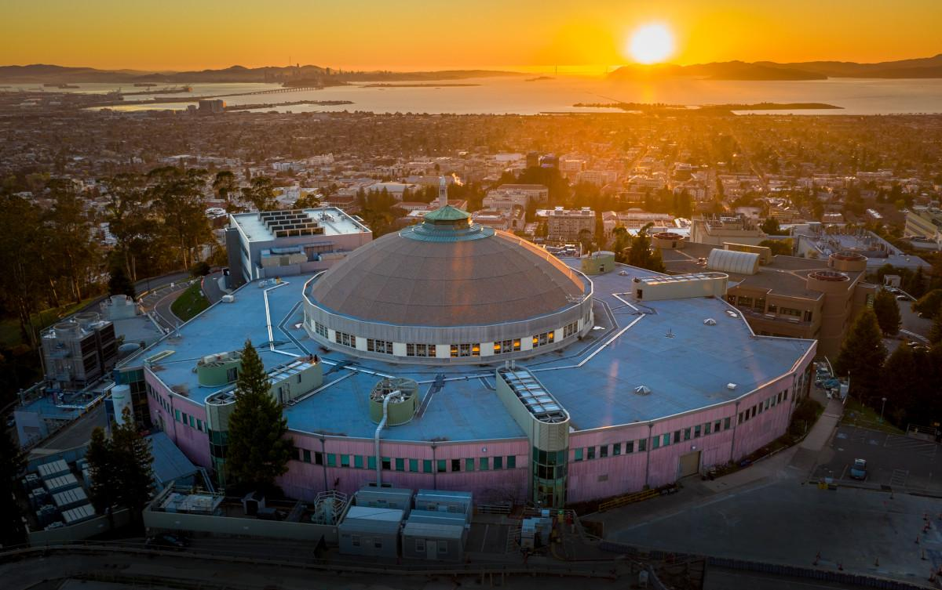
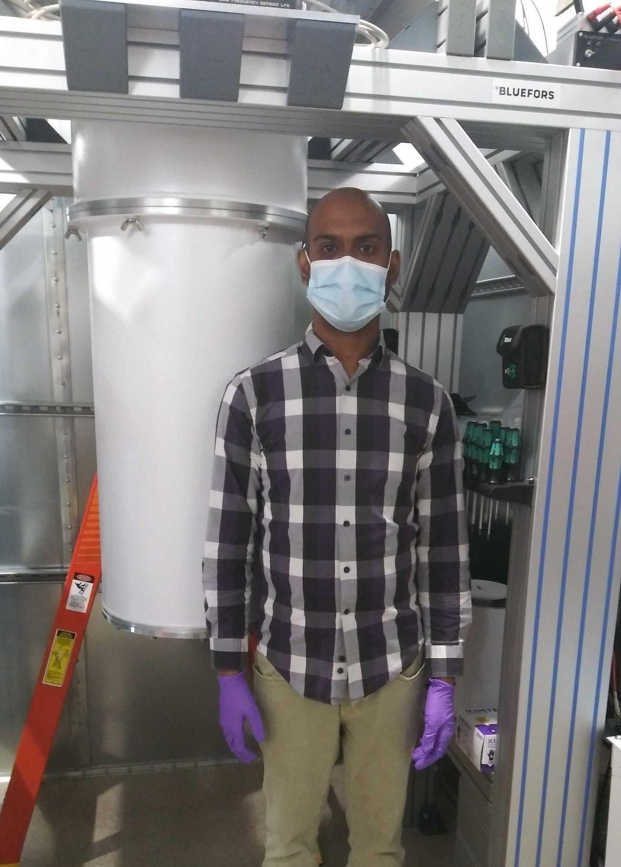


Postdoc at LBNL

Slide 11
Pause for Discussion

Slide 12
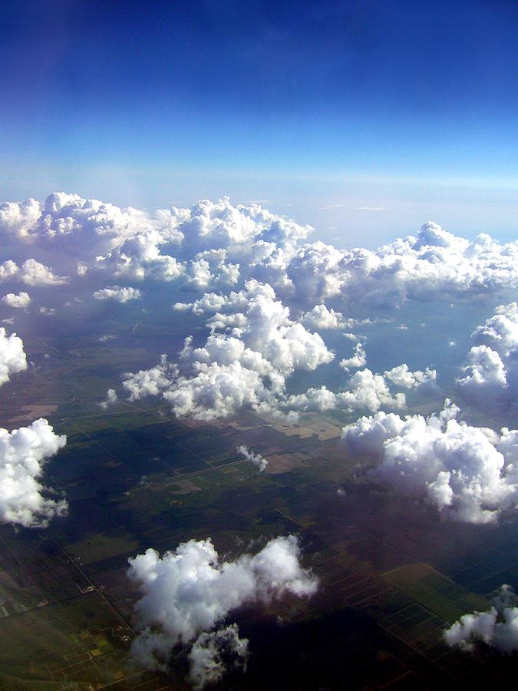
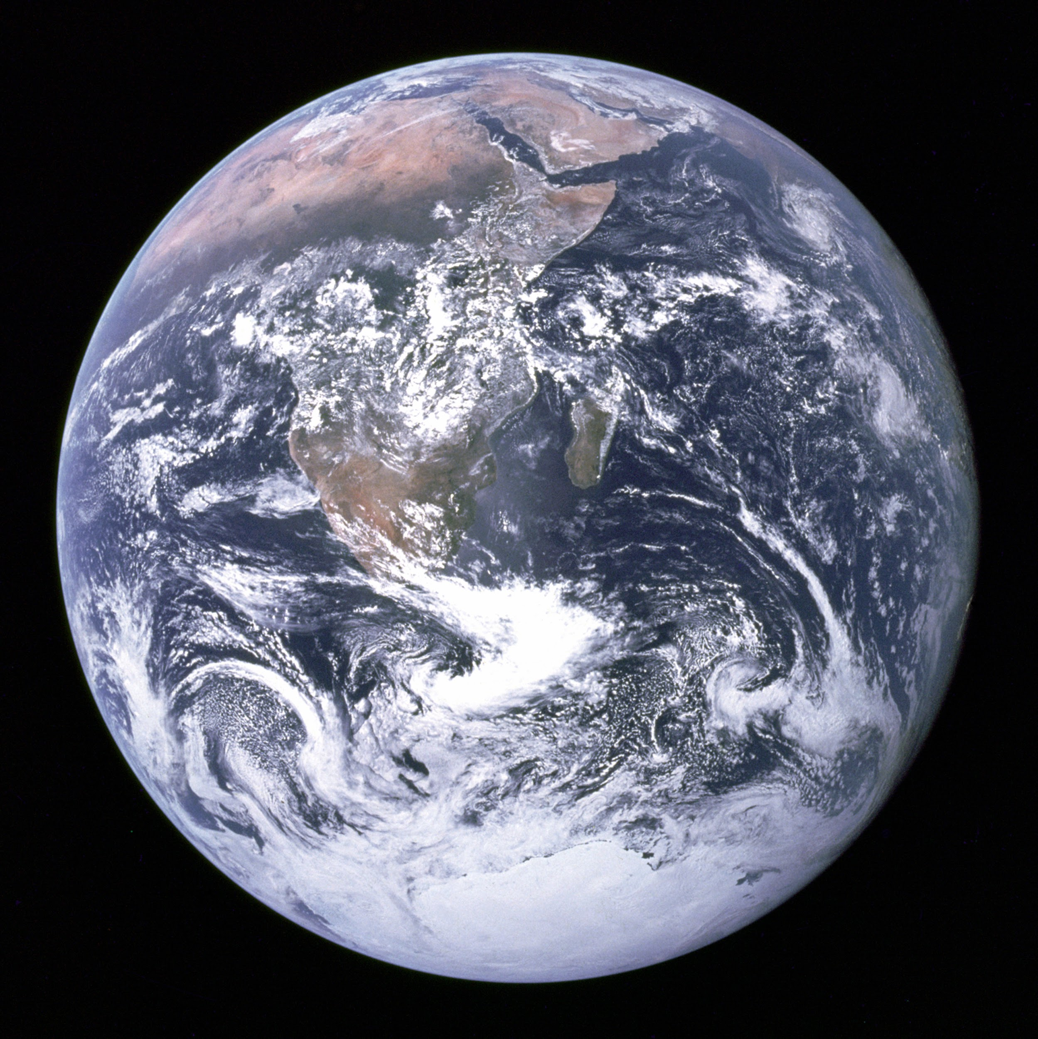




What is matter?
Dark Matter
27%
5%
Dark Energy
68%

Slide 13
What is matter?
Dark Matter
27%
5%
Dark Energy
68%

Slide 14
Where
What is dark matter?

Slide 15
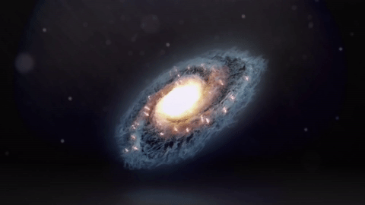
Galaxies rotate.
Source: Dark matter: How does it explain a star's speed? - Don Lincoln
https://youtu.be/sI23cwbbNqs

Slide 16
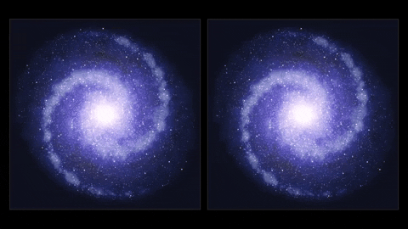
Predicted
Credit: ESO/L. Calçada https://www.eso.org/public/videos/eso1709b/

Slide 17
Observed
Predicted
Credit: ESO/L. Calçada https://www.eso.org/public/videos/eso1709b/

Slide 18
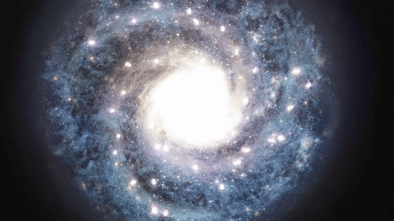
If stars moved as fast as observed...
Source: Dark matter: How does it explain a star's speed? - Don Lincoln
https://youtu.be/sI23cwbbNqs

Slide 19
Conclusion:
There is a missing “dark” matter in these galaxies!

Slide 20
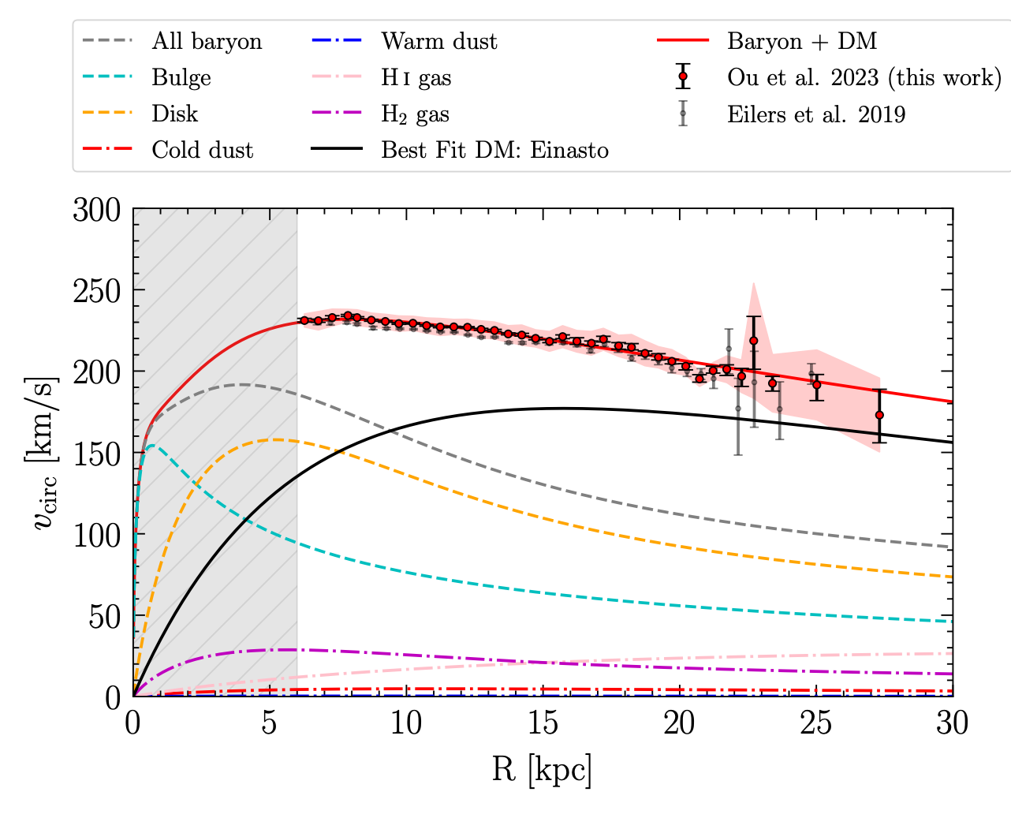
How it looks like in a real analysis
Elements of this plot:
Data
Model(s)
Uncertainty
Work behind this plot:
Motivation for models
Experimental techniques
Data processing + analysis
Assumptions + constraints
Decisions about how to present the results
Source: https://arxiv.org/pdf/2303.12838.pdf

Slide 21
What is dark matter?
Honestly, we don’t know!
As physicists, the question becomes:
How do we learn what dark matter is made of?

Slide 22
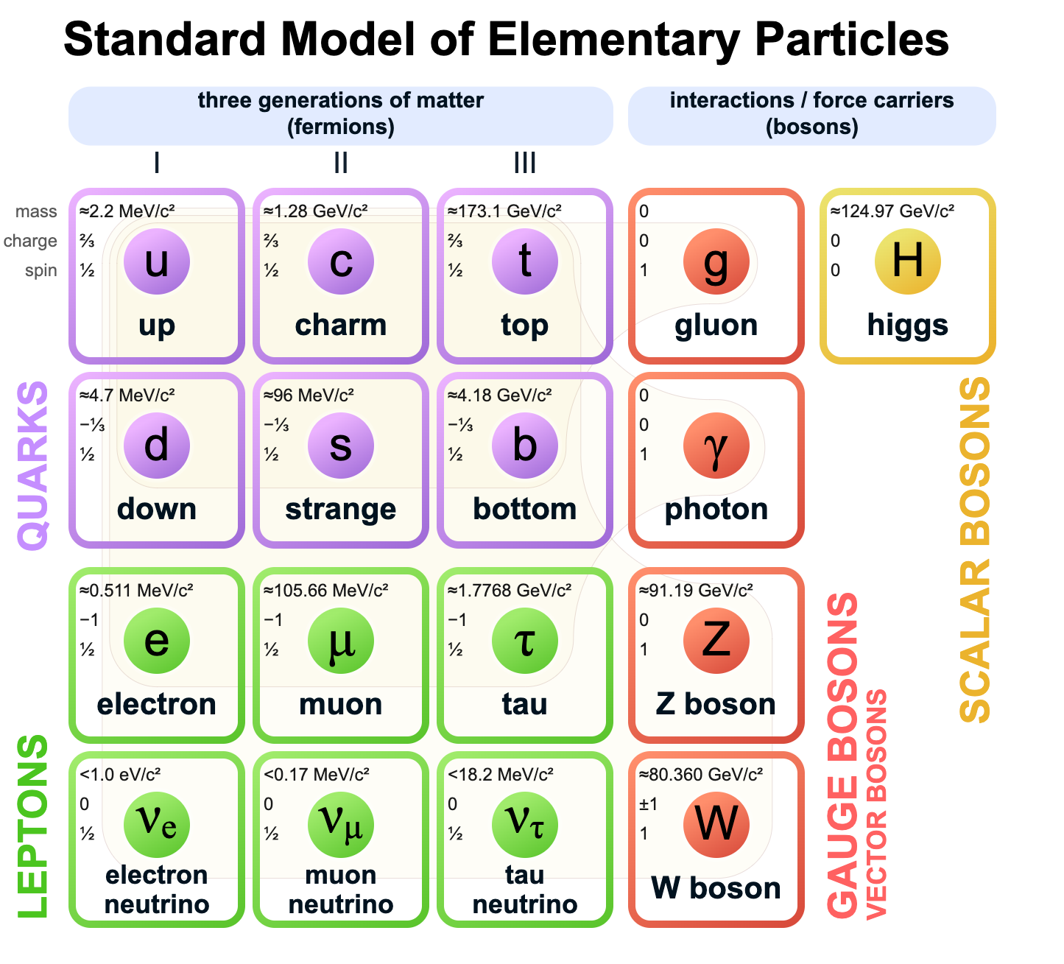
Start with what we already know
What particles can we reject?

Slide 23
Dark matter is…well, dark. So it can’t be electrically charged.

Slide 24
Dark matter must be long-lived. It can’t decay.

Slide 25
Neutrinos were a strong contender early on. But they’re too light and move too fast. Galaxy formation couldn’t happen.

Slide 26
We need a new particle.
We need a generic technique to identify dark matter.

Slide 27
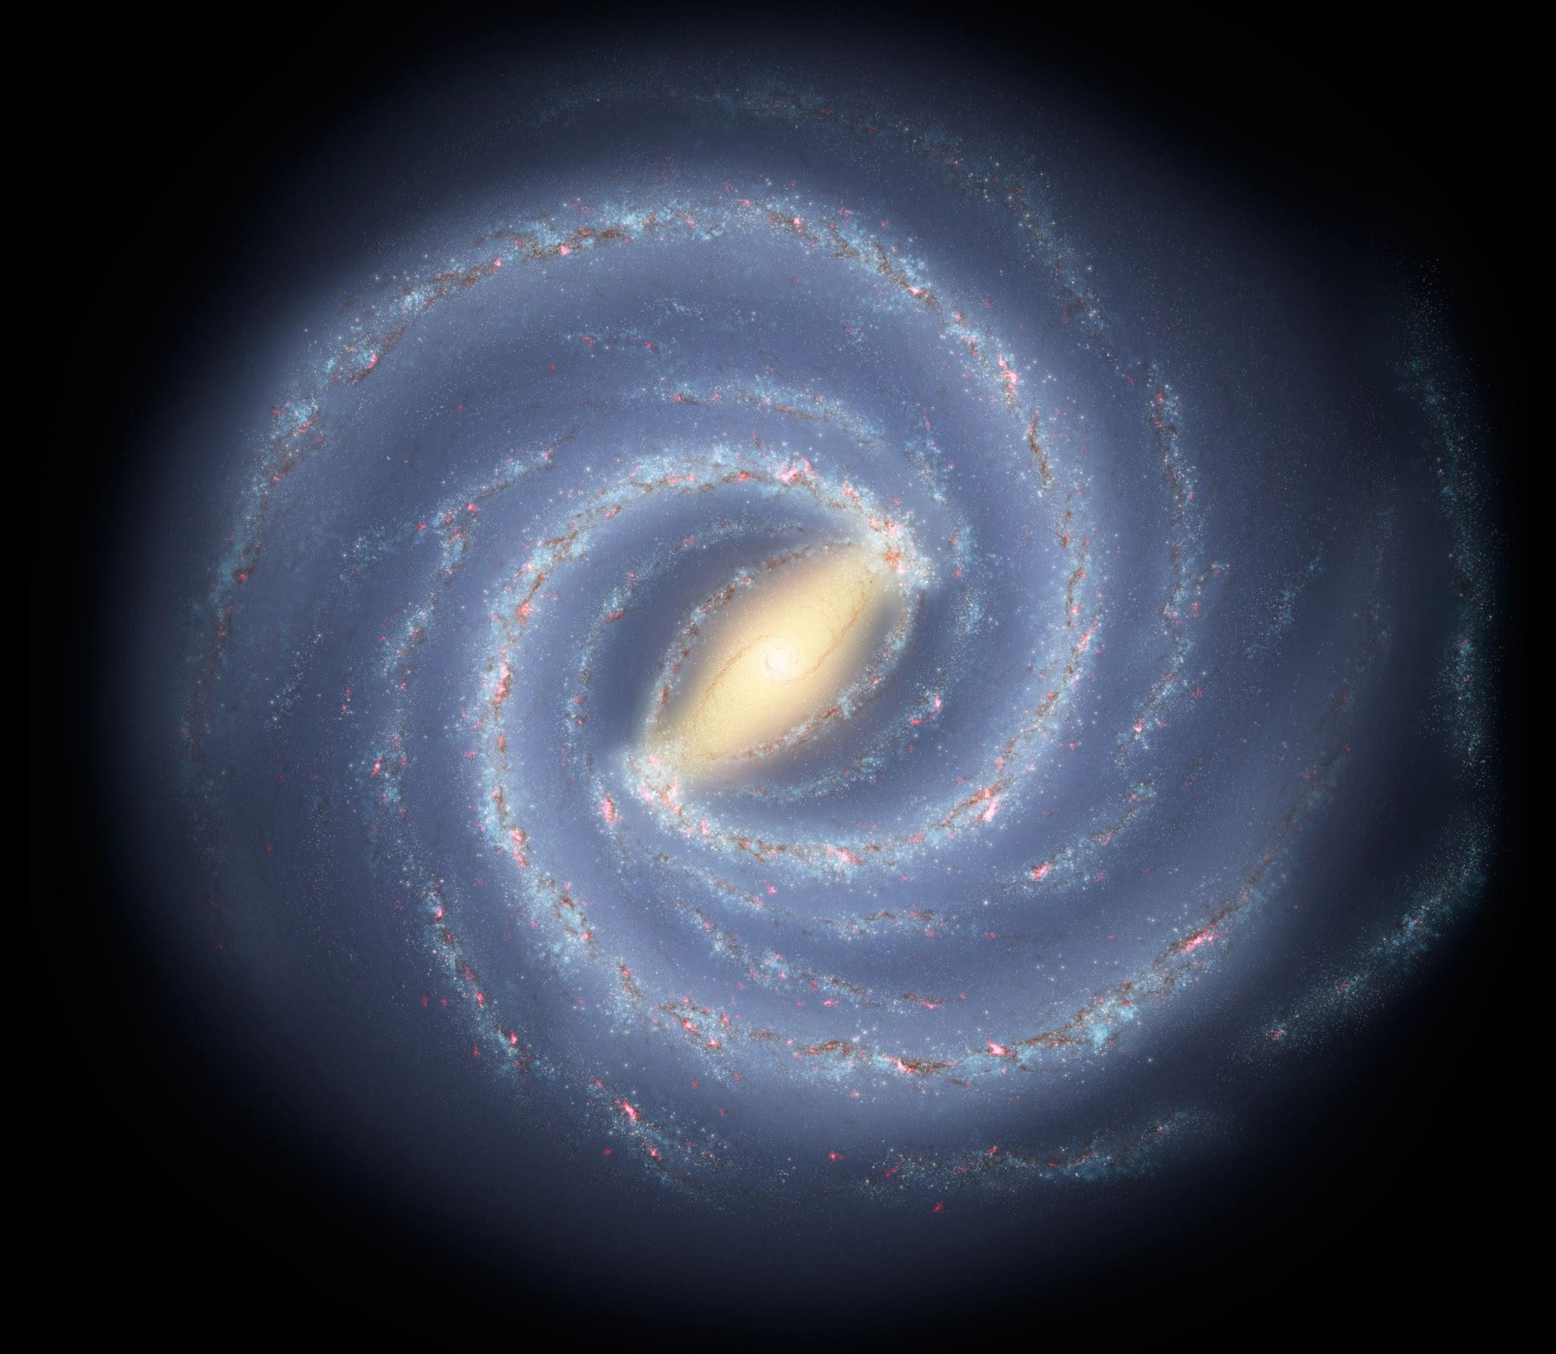
Dark Matter “Halo”
You are here
Source: NASA. https://solarsystem.nasa.gov/resources/285/the-milky-way-galaxy/

Slide 28
New Physics “Portal”
SM
SM
χ
χ
Time

Slide 29
One idea for dark matter:
W
I
M
P
eakly
nteracting
assive
article

Slide 30
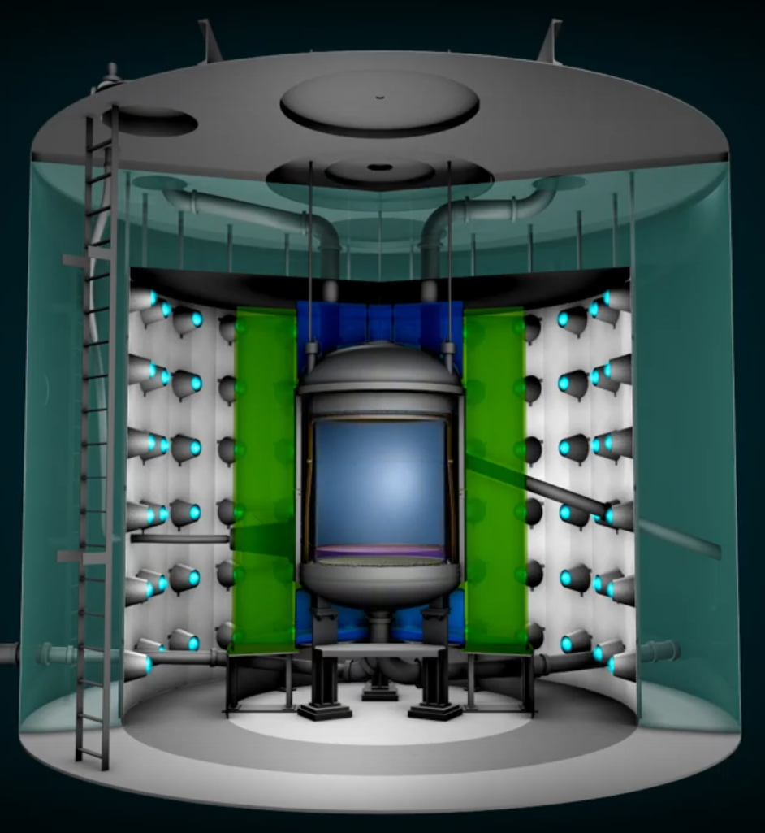
LUX-ZEPLIN (LZ)
Dark Matter Detector
WIMPs
𝜒
𝜒
𝜒
𝜒
𝜒
𝜒
𝜒
𝜒
𝜒
𝜒
𝜒
𝜒
Source: SLAC. https://www.youtube.com/watch?v=bKCsiK4ZZBY

Slide 31
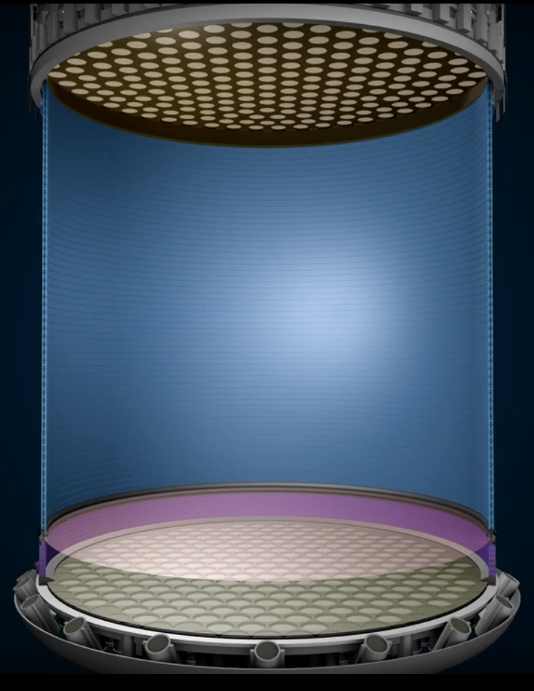

Xenon
Source: SLAC. https://www.youtube.com/watch?v=bKCsiK4ZZBY

Slide 32
Xenon
Electrons
Photons
WIMP
𝜒
Source: SLAC. https://www.youtube.com/watch?v=bKCsiK4ZZBY

Slide 33
But the world is noisy.
Xenon
“Backgrounds” (not dark matter)
Source: SLAC. https://www.youtube.com/watch?v=bKCsiK4ZZBY

Slide 34
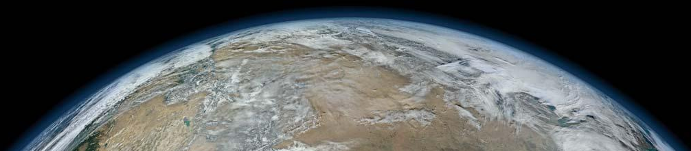
Cosmic Rays
Source: SLAC. https://www.youtube.com/watch?v=bKCsiK4ZZBY
NASA/NOAA/GSFC/Suomi NPP/VIIRS/Norman Kuring. https://www.britannica.com/place/Earth

Slide 35
Real photos of the experiment!

Slide 36

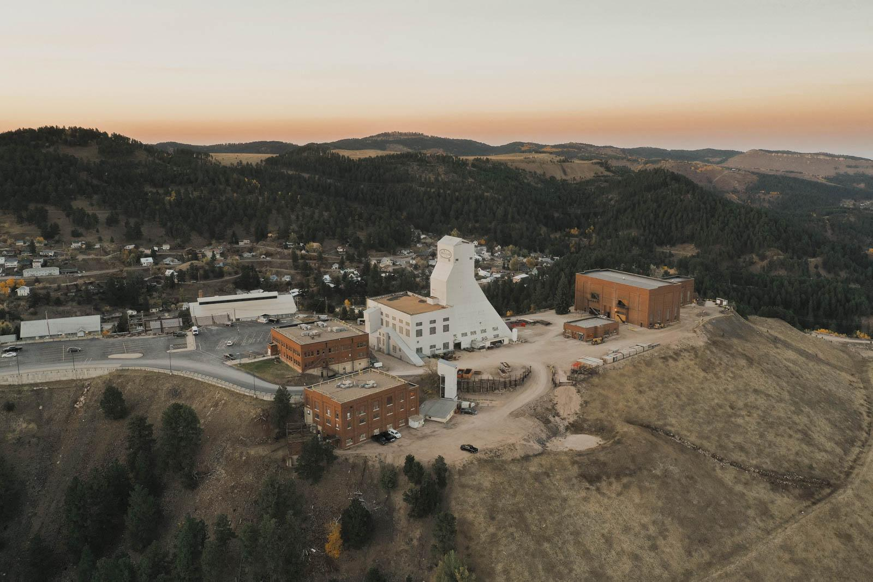
Source: LZ Collaboration

Slide 37
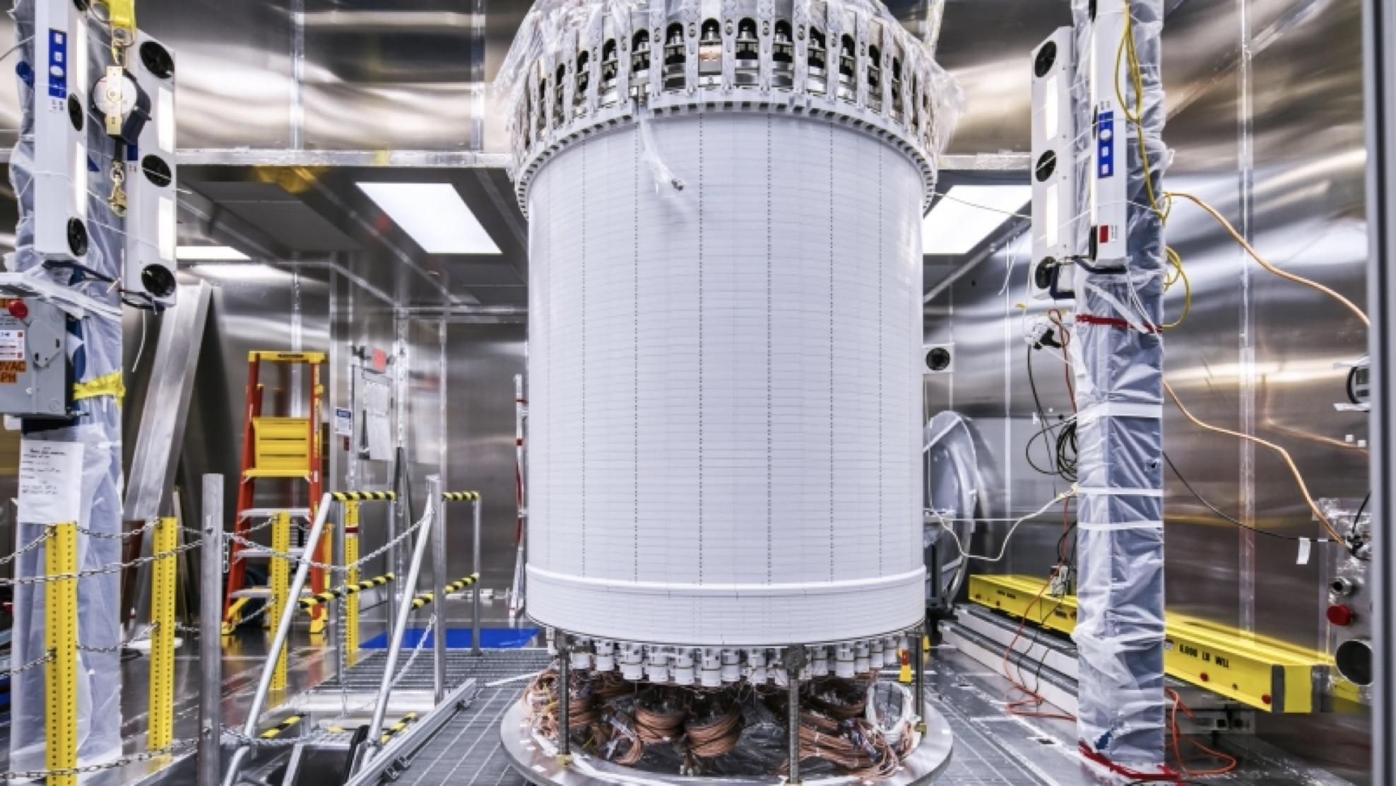
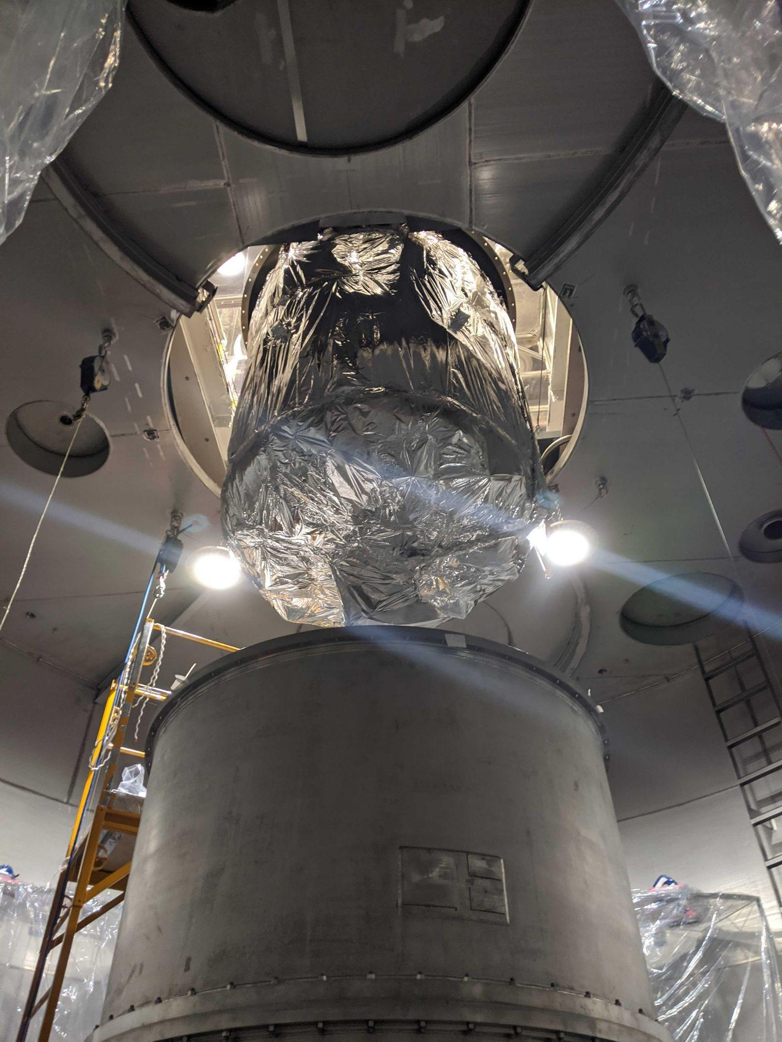
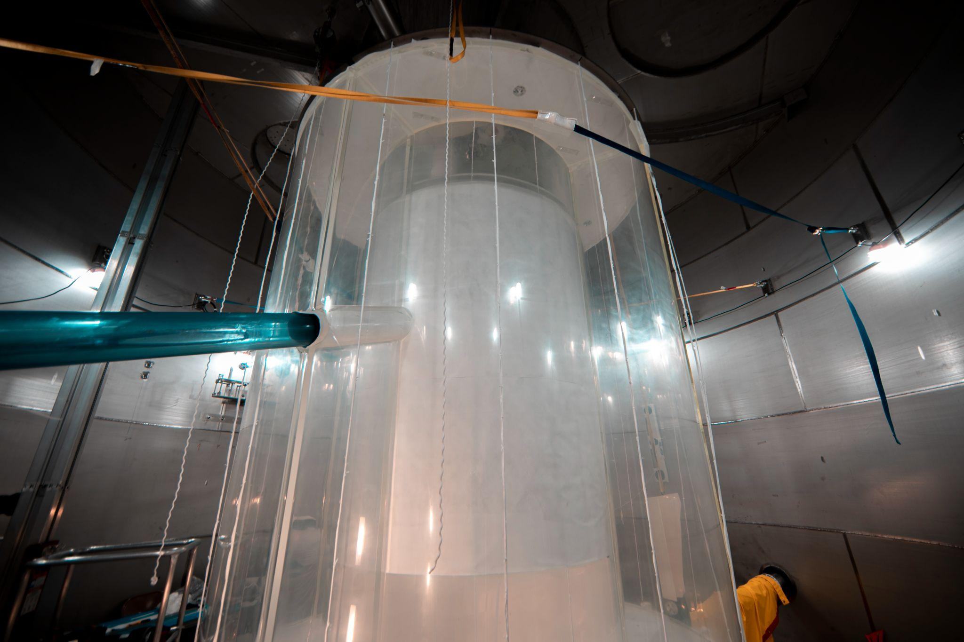
Source: LZ Collaboration

Slide 38
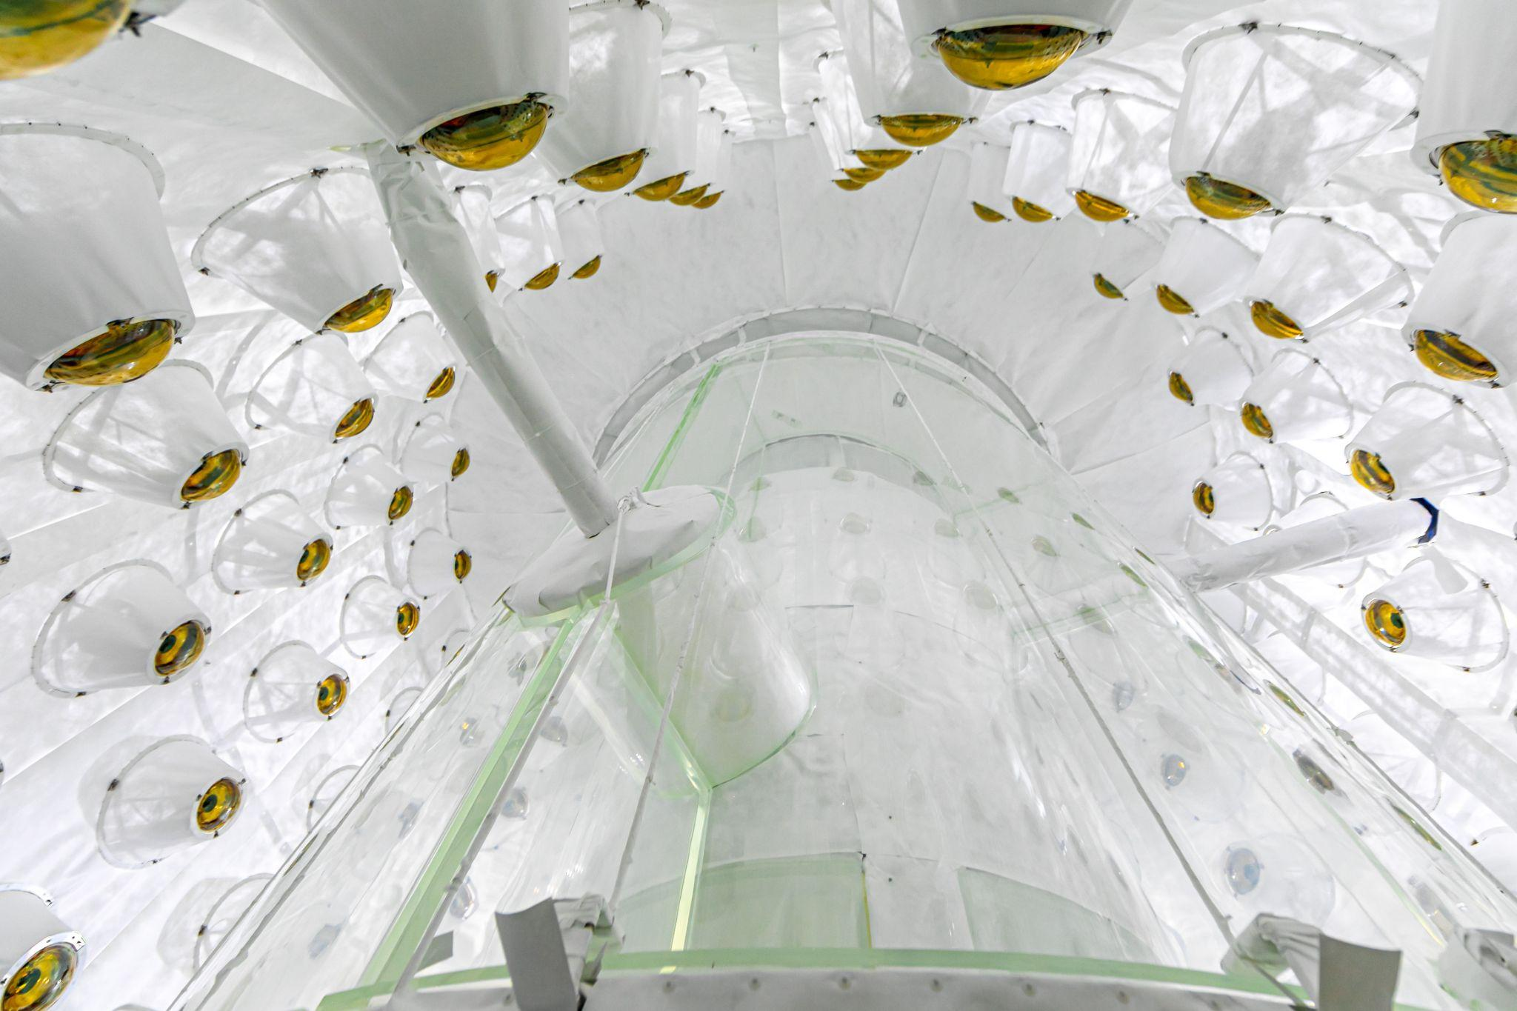
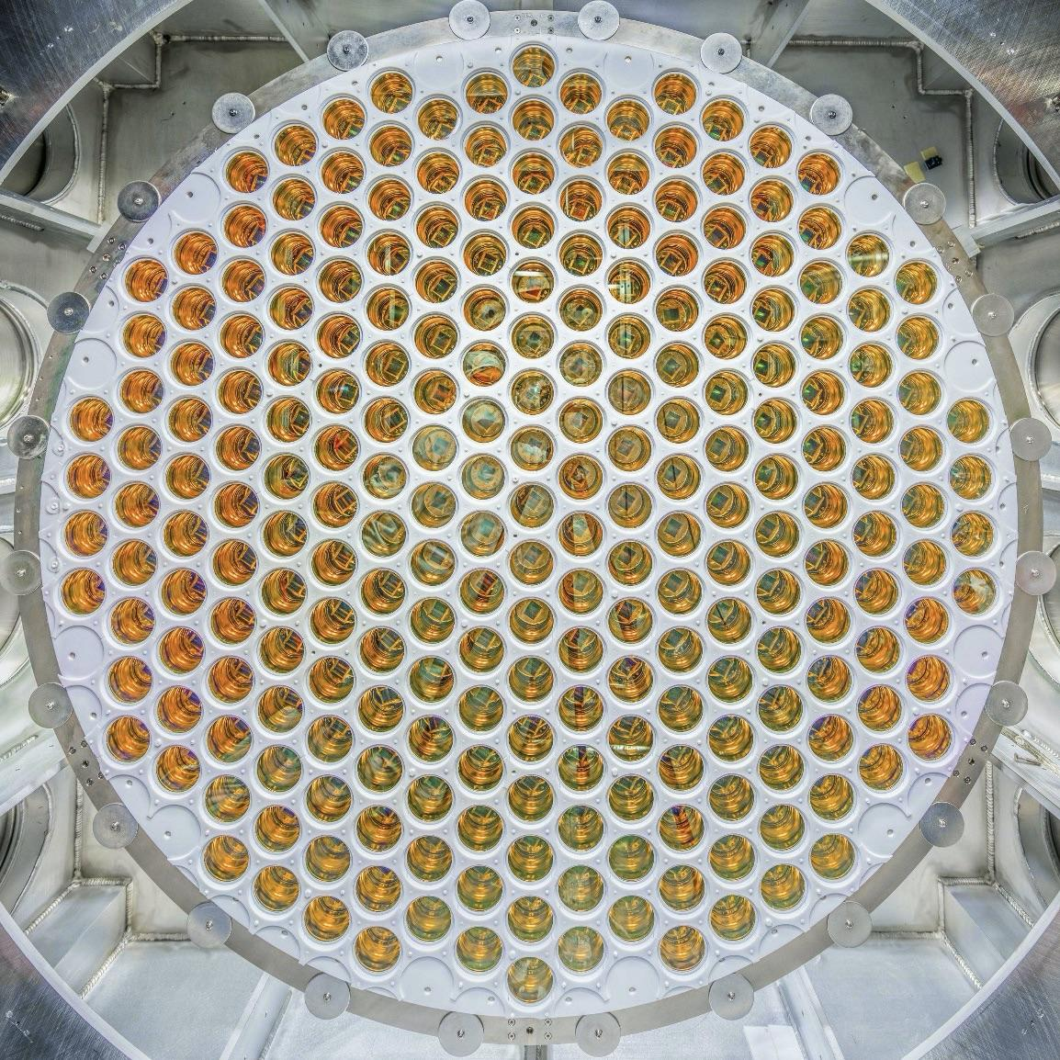
Source: LZ Collaboration

Slide 39
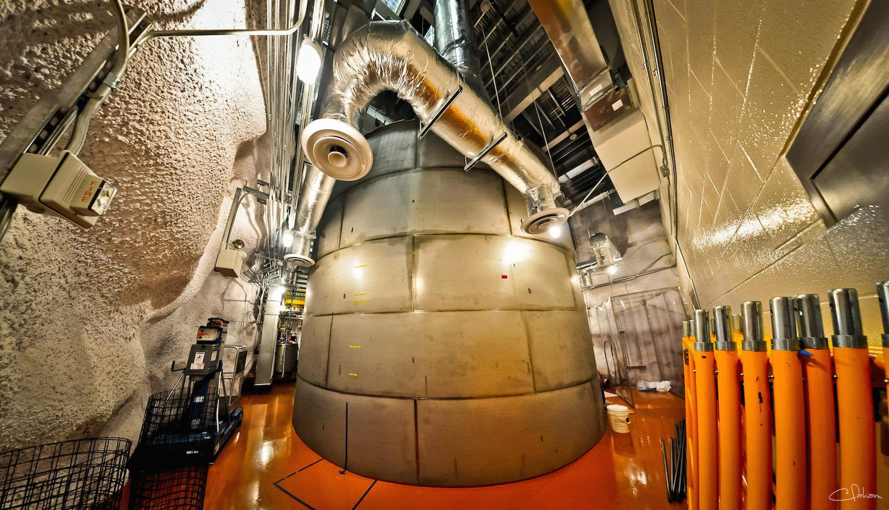
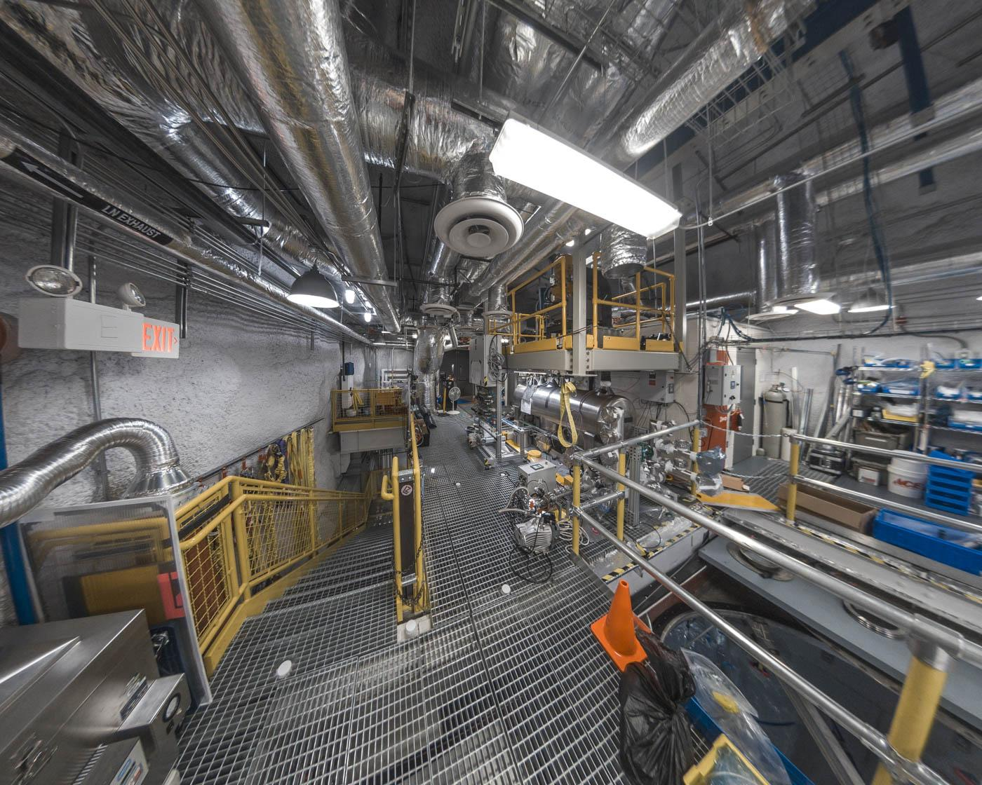
Source: LZ Collaboration

Slide 40
Real data analysis:
We took data for 60 days
We collected 100 million “triggered events”
Removed all of the events that were obviously not dark matter recoils
335 events remaining
Did we find dark matter?

Slide 41
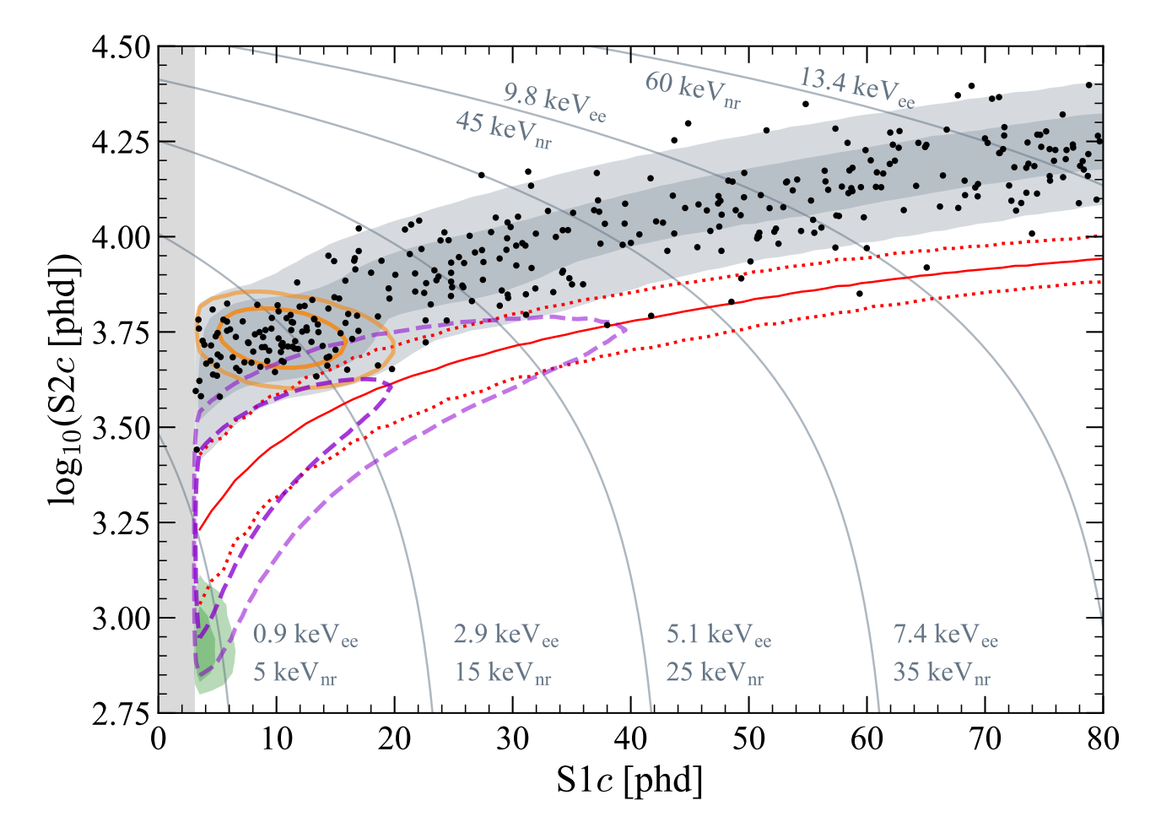
Energy in Electrons
Energy in Photons
Source: https://arxiv.org/pdf/2207.03764.pdf

Slide 42
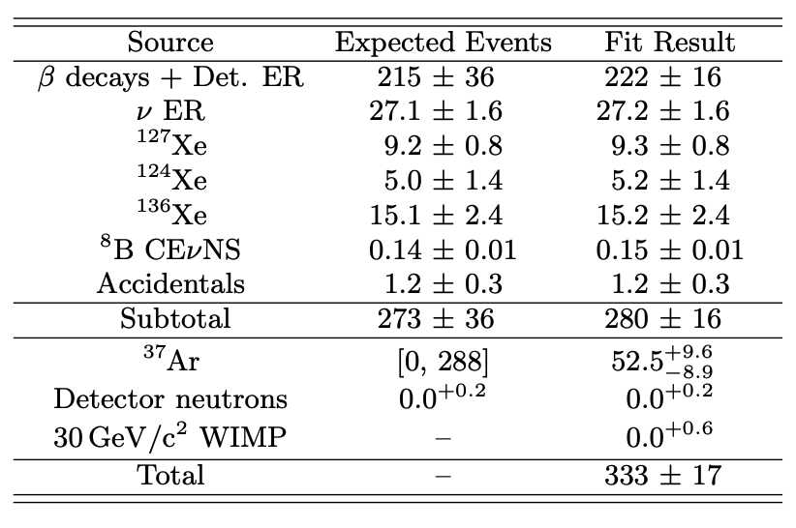
Observations are consistent with background expectations
→
No dark matter found
Source: https://arxiv.org/pdf/2207.03764.pdf

Slide 43
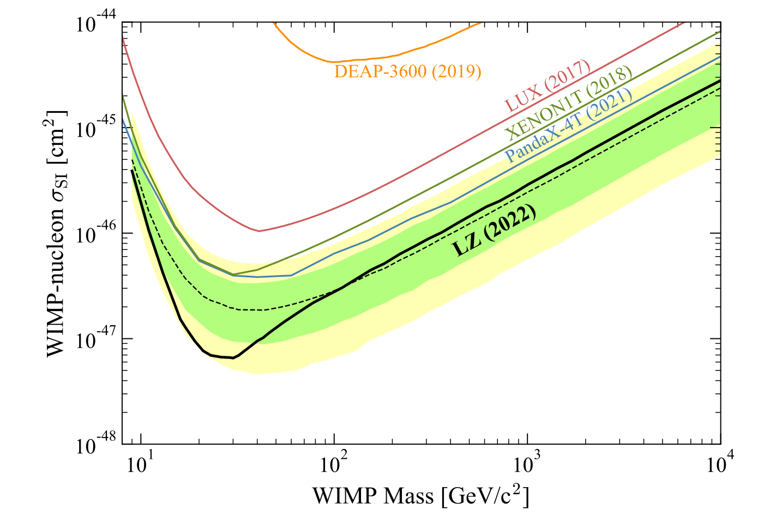
What dark matter models can we disprove?
Source: https://arxiv.org/pdf/2207.03764.pdf

Slide 44
WIMPs are elusive!
The search continues...

