Slide 1
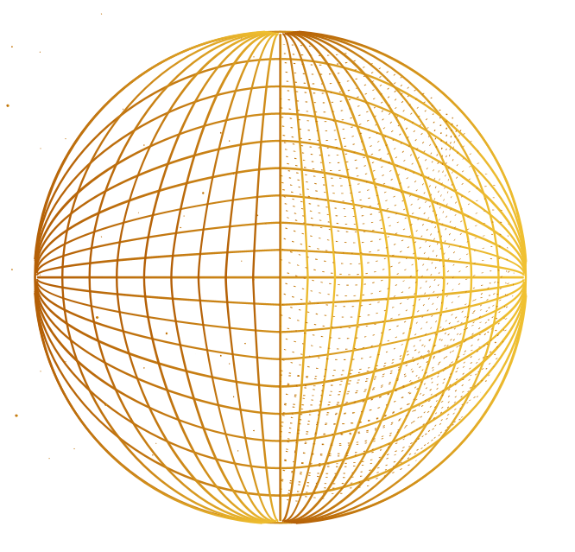
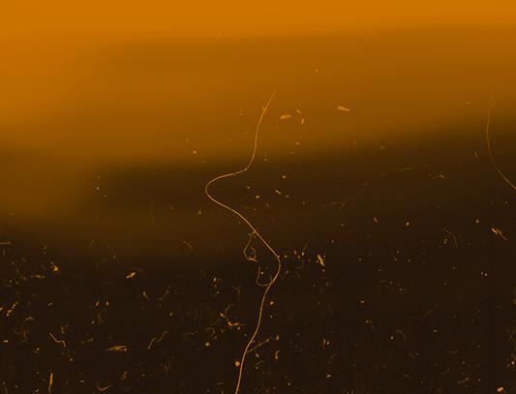
FERNANDO TORALES ACOSTA
QUARKNET WORKSHOP 2023
Presented by Shreya, Kat, Srivalli, and Shreeya
Notes:
gm, we are group 1 and were will be presenting what we learned during our interview with fta, current postdoc researcher at berkeley lab

Slide 2
GROUP 1: PRESENTERS
SHREYA NAIR
KAT STONE
SRIVALLI KATKURI
SHREEYA KULSHRESTHA
T
Rising senior interested in computer engineering and physics
Rising senior interested in physics, astronomy, and cosmology
0
Rising junior who is interested in computer science and physics
Junior who wants to pursue engineering and loves cosmology

Slide 3
01.
ABOUT DR. ACOSTA
T
1
A background on the scientist we interviewed

Slide 4
BACKGROUND
2016
2021
2023
T
1
SUNY
UC BERKELEY
LBNL
Earned Bachelor of Science in Physics
PhD in physics at UC Berkeley
Currently a postdoctoral fellow
Notes:
Earned Bachelor of Science at Stony Brook University (2016)
PhD at UC Berkeley (2021)
Currently a postdoctoral fellow at UC Berkleley

Slide 5
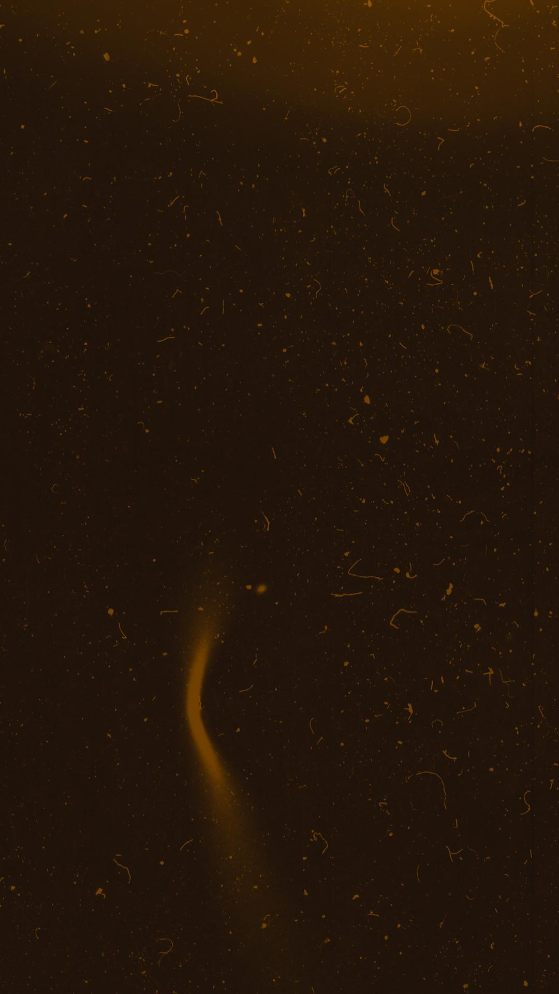
ACOSTA’S POSTDOC AT LBNL
currently working on projects that incorporate machine learning into research in particle physics
postdoc has a more open dialogue based on interest and skills, projects take time
side project using machine learning for the first time only during postdoc, studied pure physics up until that point
T
1
Notes:
Currently working on projects that incorporate machine learning into research in particle physics
Inspired to do this by being short on time and having a lot of tedious work
Machine learning could do some of that tedious work for him
His job as a postdoc has an open dialogue based on interest and skills, projects take time
side project using machine learning for the first time only during postdoc, studied pure physics up until that point

Slide 6
PAST RESEARCH PAPERS & WORK
ISOLATED PHOTON-HADRON COLLISIONS
QUINTUPLE GEM-BASED DETECTOR
ALL-SILICON TRACKING DETECTOR
Photon-hadron collisions correlations using data from the ALICE detector at the LHC
T
1
Successful test of a ring imaging detector that will allow for more accurate particle identification
Concept and simulation for silicon pixel detector to be used in charged-particle tracking

Slide 7
CURRENT RESEARCH
Machine learning in deep inelastic scattering experiments
Studying proton-electron collisions
High performance computing for data simulation & analysis
T
1
Notes:
Dr. Acosta is currently using machine learning in deep inelastic scattering experiments. He has been studying Proton electron collisions from an experiment in Germany
He has also used simulated data to help design the experiment
The high performance computing allows him to Compare methods and better analyze the data.

Slide 8
DEEP INELASTIC SCATTERING
02.
T
2
Understanding Dr. Acosta’s experiments and study of particle physics

Slide 9
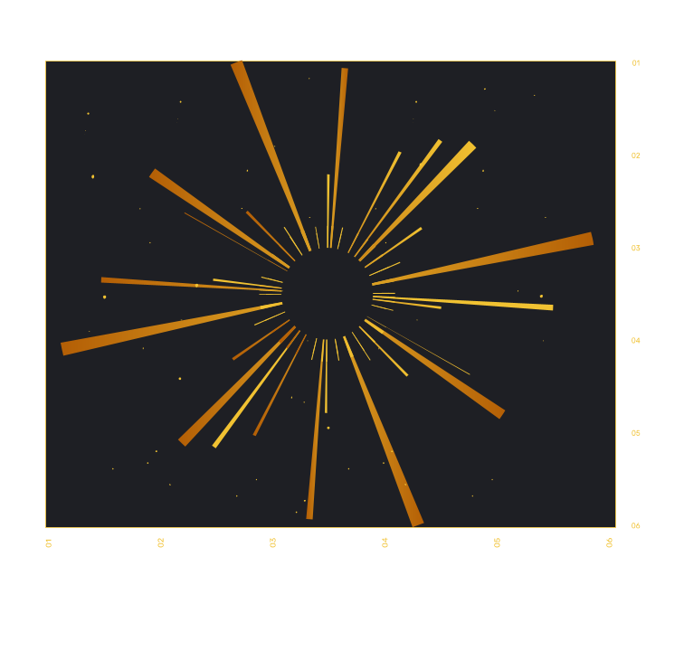
GOALS OF DEEP INELASTIC SCATTERING EXPERIMENTS
We want to understand more about subatomic particles
Observe strong nuclear force that explain interactions between different particles
Understand how these particles are bound together in the first place
How subatomic particles (gluons) make up energy of outgoing matter
T
2
Notes:
before we understand what d.i.s. does, we can study its goals. most importantly, we want to understand more about subatomic particles, including the nuclear force between them that change their interactions and how they’re bound in the first place. dr. acosta’s experiments, for example, focus more on gluons, and how they make up the energy of outgoing matter in these experiments

Slide 10
DEEP INELASTIC SCATTERING – A BREAKDOWN
Two particles are forced to collide/scatter
SCATTERING
T
2
Inelastic collisions => the particles lose energy
D.I.S.
INELASTIC
Particles have high energy, one particle can probe deep into another
DEEP
Notes:
explaining the terminology of deep inelastic scattering:
scattering refers to the two particles that are collided in the experiment. this causes them to scatter, and the angles they deflect to can give info about the particles
inelastic refers to the inelastic nature of the collision, which (remember from physics course) means that the particles lose energy during the collision. that energy goes into creating other observable subatomic particles due to e=mc²
the high energies contribute to the term “deep” which refers to the fact that this particle collision can probe deep into particles to give us information about them

Slide 11
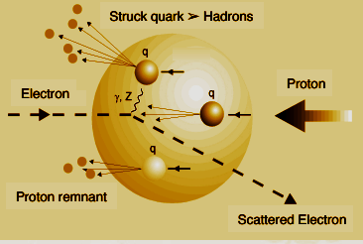
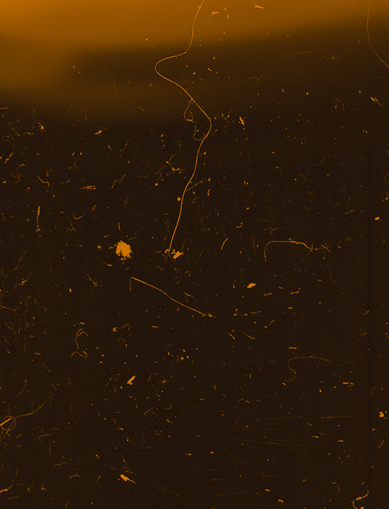
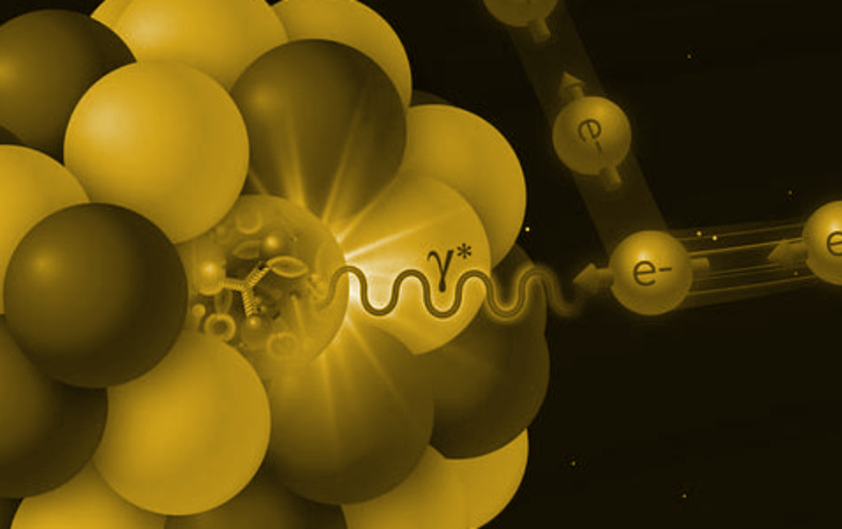
HOW ARE EXPERIMENTS CARRIED OUT?
T
Electrons (leptons) split protons.
Observe resulting behavior of deflected particles & newly created hadrons from the quarks in protons.
Use resulting data to characterize the subatomic particles involved.
2
Notes:
in dr acostas experiments, electrons are sent into protons to split them.
we then observe the resulting behavior of the particles which were sent off in different directions as well as the particles that were created due to the energy lost in the collision, specificially the hadrons from quarks
finally, we can characterize the particles using the data of the experiment, as well as algorithms and datasets, aided by the process of machine learning

Slide 12
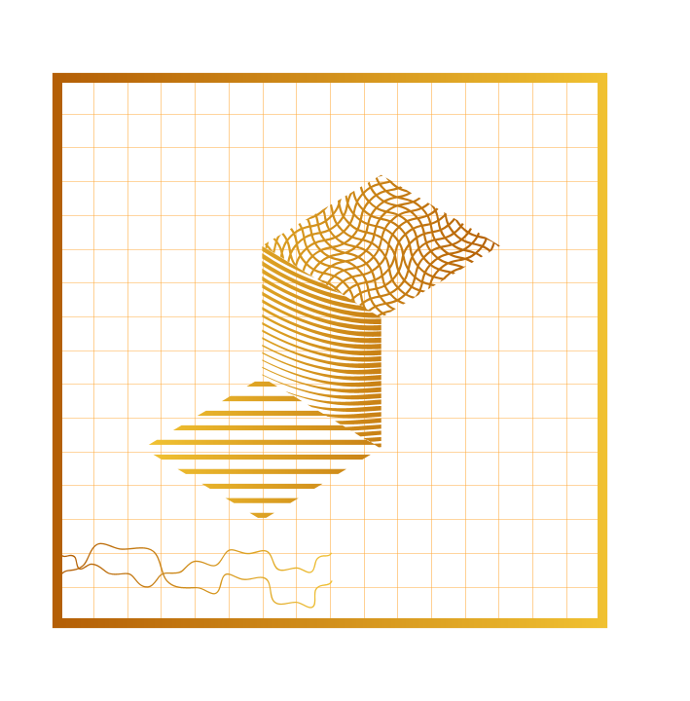
03.
MACHINE LEARNING
T
3
Exploration of machine learning and how Dr. Acosta utilizes it in his research

Slide 13
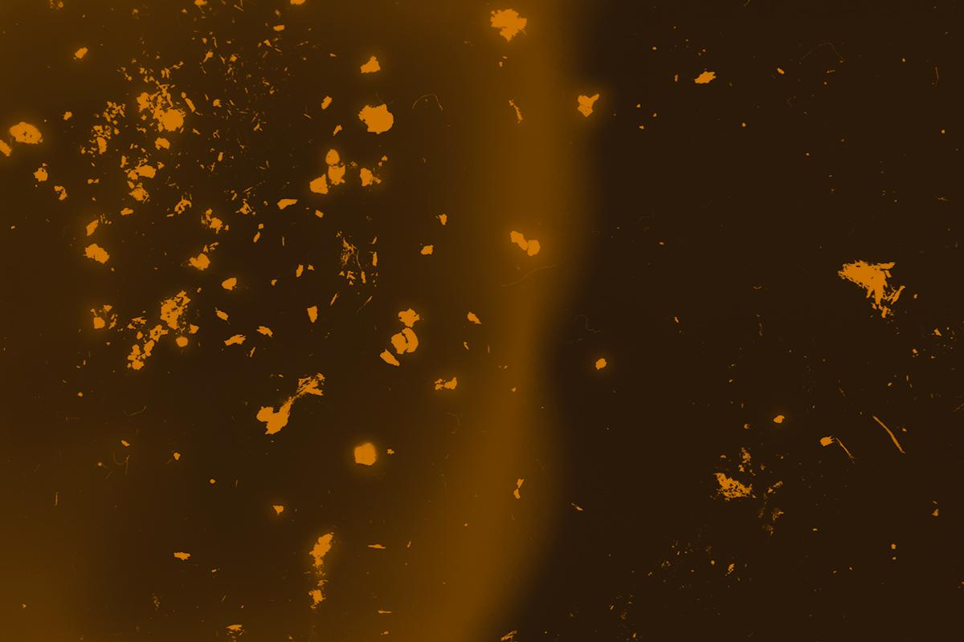
INTRO TO MACHINE LEARNING
What is machine learning?
It isn’t intelligent, it is obedient automation
It is a lab rat that does what it’s told: make calculations, trace connections, find patterns and etc.
Does the same thing as humans but faster, using the logic and algorithms given by humans
It isn’t told what to do, it is told HOW to do it
T
3
Notes:
Like doctoor acosta said before

Slide 14
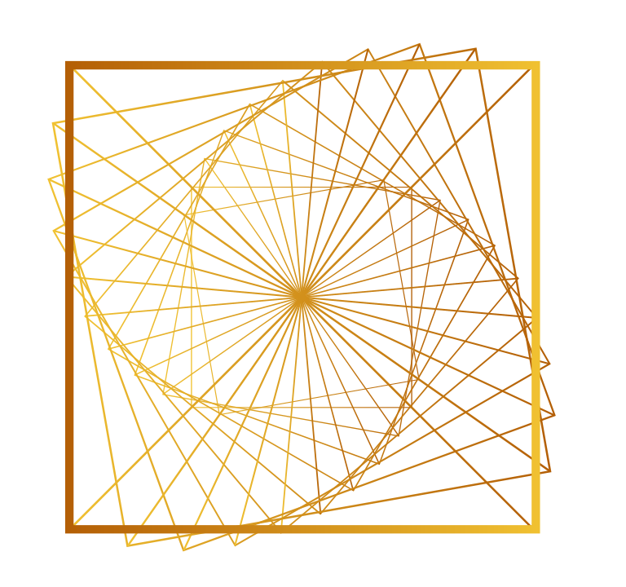
HARD CODE VS. MACHINE LEARNING
HARD CODE
MACHINE LEARNING
T
print(“Hello World”);
The computer directly does what it’s told to do by the code.
Data set with a list of greetings and their popularity -> computer chooses one that it determines is best.
We teach the computer how to do things on its own.
3

Slide 15
EXAMPLE OF ML IMPLEMENTATION
Rather than telling the rocketship directions to the planet, tell the computer the logic to find the most efficient route.
T
3
LOGIC TO FEED INTO THE COMPUTER
Two legs of a right triangle added up is greater than the hypotenuse

Slide 16
MACHINE LEARNING IN D.I.S. EXPERIMENTS
Calculating the amount of kinetic energy “lost” from the collision and how it manifests
Automatization for conclusions based off of the events
(computer is told specifically what to recognize rather than a scientist sitting there and recognizing something that can be automated)
Detectors & correcting error
T
3
The more data points —>> The better the connections!
The input of all the data from the scattering projects is the training!

Slide 17
APPLICATIONS OF MACHINE LEARNING IN PHYSICS
IDENTIFY
CLASSIFY
DETECT
SIMULATE
T
3
Identify objects and cosmological events during surveys
Classify sources, extract info from images, optimize observation
Detect and characterize objects in space such as dark matter
Simulate to help understand mechanisms of physical process
Notes:
identifying and classifying objects and cosmological events during surveys like the Baryon Oscillation Spectroscopic Survey (BOSS)
To study day-to-day changes in the sun in an effort to understand solar weather.
Detecting and classifying cosmological sources, extracting information from images, and optimizing observing strategies
The detection and characterization of strong gravitational lenses applied to data from the Dark energy survey (DES) and Dark energy spectroscopic instrument (DESI)
simulations can be used as a laboratory to identify unrecognized patterns that can help our understanding of the underlying mechanisms behind the physical process being studied.

Slide 18
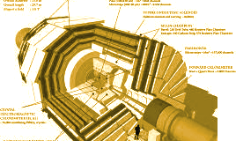
DR. ACOSTA’S OTHER ML & PARTICLE EXPERIMENTS
ALL SILICON TRACKING DETECTOR
Study internal structure of proton and heavy nuclei
Can fulfill several physics studies – partonic structure of light & heavy ions, parton transport, hadronization
Uses high end technology to track with high resolution over a large range -> measure heavy quarks.
Also aids the deep inelastic scattering experiment
T
3
Notes:
ALL SILICON TRACKING DETECTOR
Different from the usual machine learning experiments
To study internal structure of proton and heavy nuclei
Can fulfill several physics studies at the electron ion collider (EIC) like partonic structure of light and heavy ions, parton transport in nuclear matter, the hadronizaton process
Makes use of the state-of-the-art technology to provide tracking with high resolution and good vertex reconstruction over a large range enabling measurements of heavy quarks.
Aids the deep inelastic scattering experiment

Slide 19
TAKEAWAYS & ADVICE
04.
T
4
Dr. Acosta’s advice for high schoolers and future undergraduate/graduate students

Slide 20
ADVICE FOR STUDENTS WITH PHYSICS INTERESTS
If not majoring in physics, take physics classes for physics majors
Always take classes that match your interests, on top of classes required for your major
Approach professors during office hours -> get help and opportunities
Aim for research-oriented universities
Join research programs every chance possible (undergrad summer research programs are very valuable)
Projects and education take time. Stay patient and resilient!
T
4
Notes:
Do research in undergrad
If not majoring in physics, take physics classes for physics majors (rather than physics for engineers). it’ll be more difficult, but will give you ideas on what the major is like
Take classes that match your interests
intimidating to approach professors, office hours. they are always very preceptive, they are really accepting and help students out.
aim for research universities
summers after freshman year, join research programs. researches know skillsets and make things manageable for students
Projects take time, so keep that in mind when choosing which ones to do

Slide 21
THANK YOU!
T
0

