Slide 1
Interview with Miao Hu
Zhicheng Wei, Roan Arendtsz, Ashley Huang, Joyce Xu, Nishant Rout

Slide 2
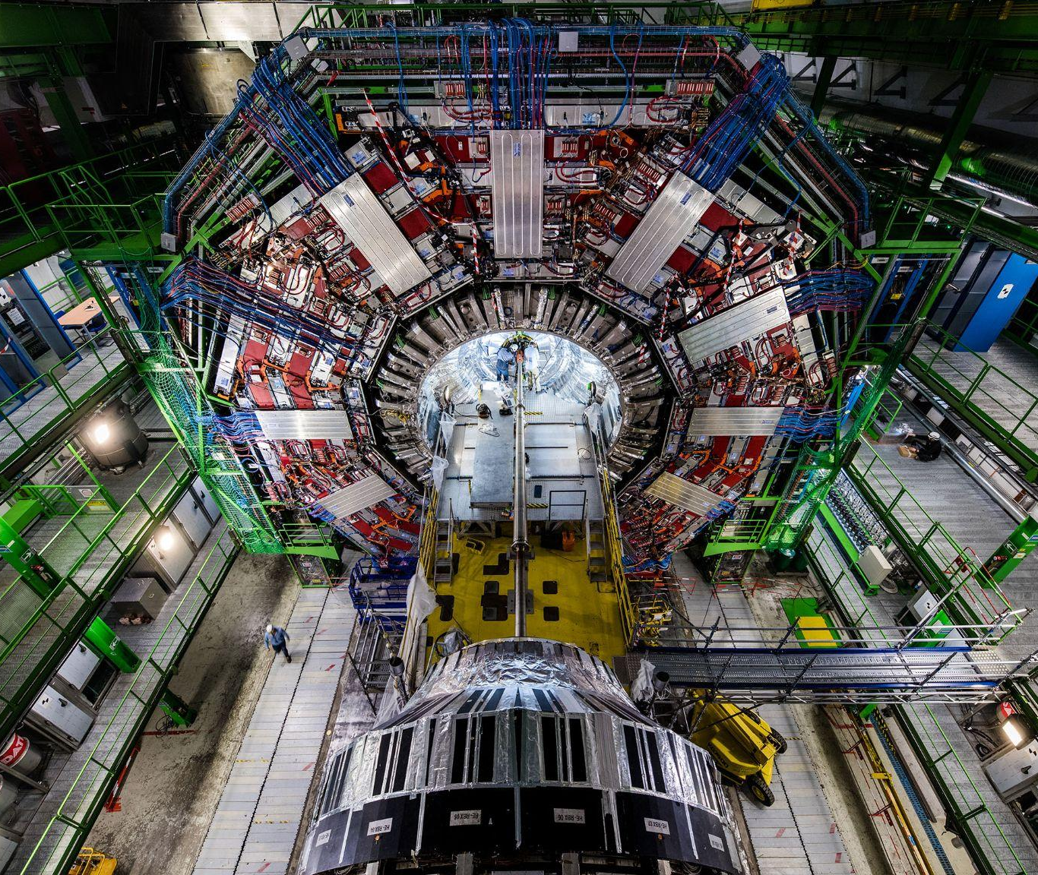
Large Hadron Collider
It was created in 2008 across the border of France and Switzerland
It basically a big loop that accelerate two beam of protons to collide with each other, simulating the big bang.

Slide 3
Proton-Proton, Pb-Pb in the Collider
After the proton collide with each other sending their elementary particles out.
A lot of the time the particles might have delay, but their path can still be extrapolated
By studying the path of those particles, physics can improve their understanding of physics,

Slide 4
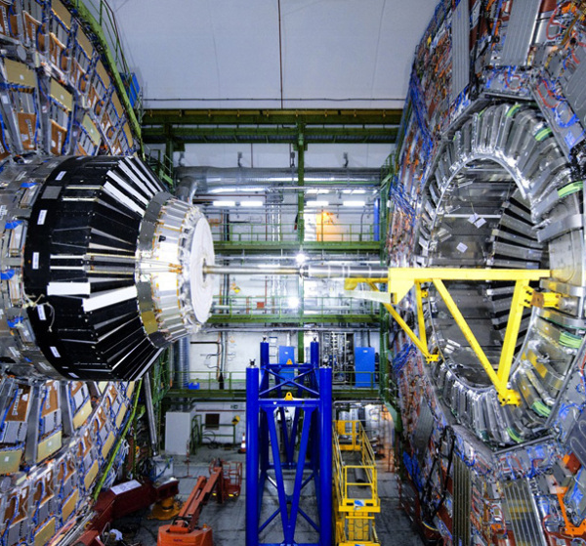
Work Cycle of the collider
The collider operates by rounds
Each round last around 2 to 3 years then rest for 2 to 3 years
There is a collision once per 25 nanoseconds
It sends billions of protons and around 30 of them actually collide each time, but the rest stay in the loop and keep accelerating until they collide
Fun facts, the information they collect every second is the same as the information uploaded to youtube in a day

Slide 5
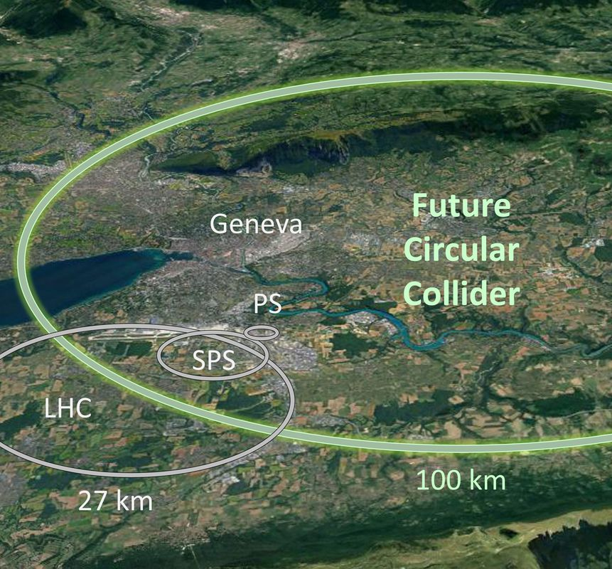
Upgrading The collider
After each round ends, there is a nine month period to upgrade the collider.
Upgrading the collider allows it to have a higher √s, or the the center of energy. This allows increasing the amount of energy carried by each proton beam
It also allows higher rate of the collision and more data to be collected
Better detection equipments for better and more procese data to be collected.

Slide 6
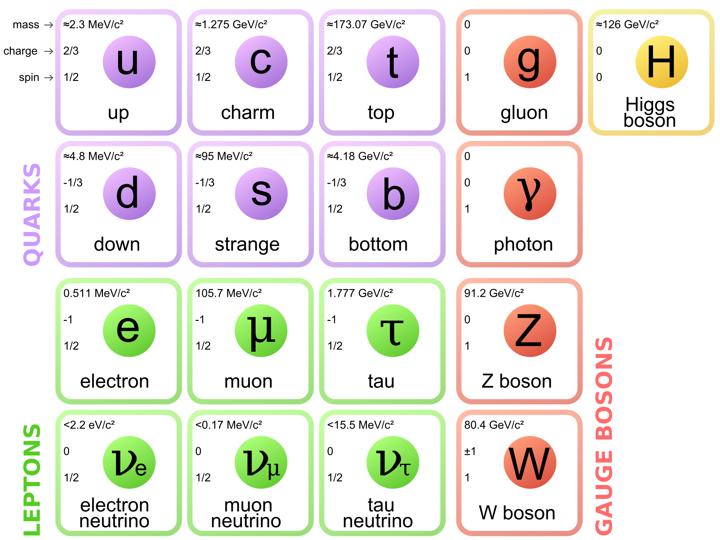
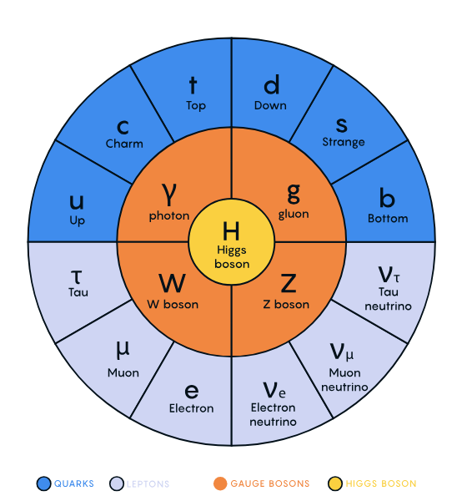
Gauge Bosons
Particles that carry the forces for quarks and leptons (or just fermions)
Really just vector fields; each has a spin of 1
Think of as an excitation of its corresponding field, e.g. proton to EM field

Slide 7
Lagrangians
Issues with gauge theory
In this context, basically a function that tells us how particles operate under certain parameters
Lagrangians of gauge bosons follow local symmetries (gauge invariance)
A gauge boson is invariant under those local transformations
ℒ(ᵩ, ⛛ᵩ, x, t)
This framework for gauge particles was something in theory, but heading into 1960 there were some flaws, particularly with the lagrangians
Algebraically, this was forcing physicists to predict that the gauge bosons were massless, when in reality all of them (except for the photon) were massive particles.

Slide 8
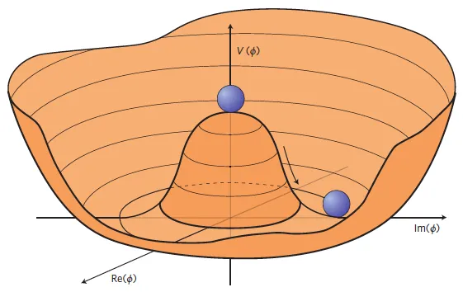
The Higgs Field/ Particle!
Symmetric!
Symmetry broken ~spontaneously~
Proposed 1960
Assigns mass to particles
It lets the gauge bosons maintain their system’s symmetry while also having mass
Through spontaneous symmetry breaking!
Where will I end up 😭
Infinite minima

Slide 9
Miao Hu
Always been interested in physics
Enjoys pushing limit of human knowledge
Macroscopic and Microscopic combination
High expectations fulfilled

Slide 10
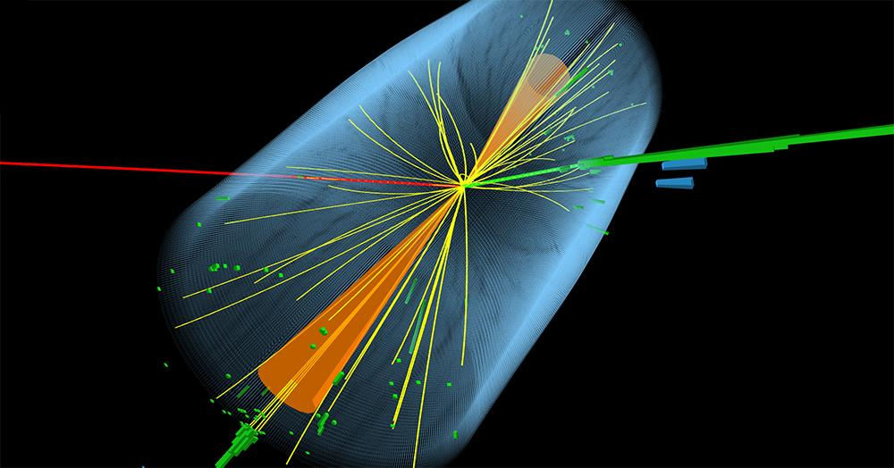
Vector Boson Scattering Process
Vector boson ↔ force carrying boson
Vector bosons scatter into other vector bosons
Use proton beam to produce collisions and scattering between vector bosons
Cross section → expected number of collisions

Slide 11
Why of importance?
Known contributions to VBS process
Self-couplings of vector bosons
Mediated by Higgs Boson
If observed number of collisions > expected → new physics at play
An unexplained force or interaction influencing vector bosons
Charged Higgs Boson
Hypothetical particle that could result in discrepancies between theory and experimental results

Slide 12
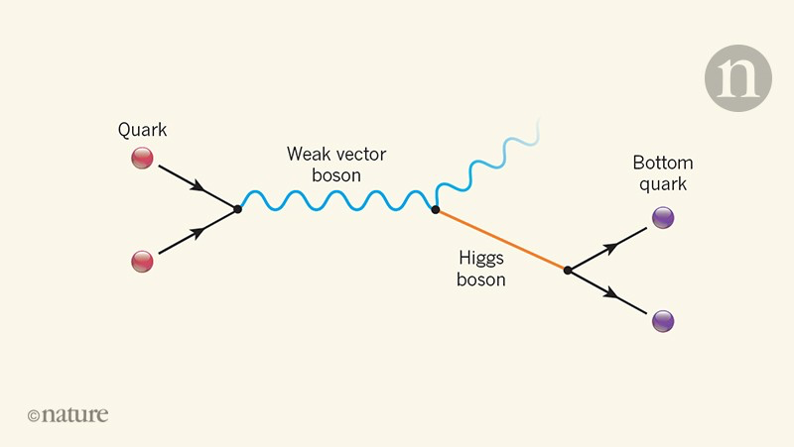
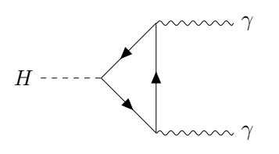
Particle Decay
Most particles are unstable, which leads to decay
Decay rate
Molecules travel a certain distance
We can trace it back to the collision point
Expected/Predicted value
Even after particles decay, it can continue to decay into different particles
Particles are able to reconstruct
Particles can be created
Neutrino
Vector boson
Notes:
Most particles are unstable, for example, many isotopes are unstable because of the number of neutrons. We are able to know the decay rate of particles, through processes such as using the Large Hadron Collider. Molecules travel a certain distance before decaying. Tracing that back to the original location of the collision, we are able to know the decay rate. The collider is also able to predict the value and result of each collision. Even after decaying into a different particle, it is able to keep decaying, which creates difficulty when studying certain particles. Particles are also able to reconstruct. During collisions, particles can be created, such as decaying into a neutrino, or a vector boson.
image (top): https://www.nature.com/articles/d41586-018-07405-x
image (bottom): https://physics.stackexchange.com/questions/426243/what-dictates-how-the-higgs-boson-will-decay

Slide 13
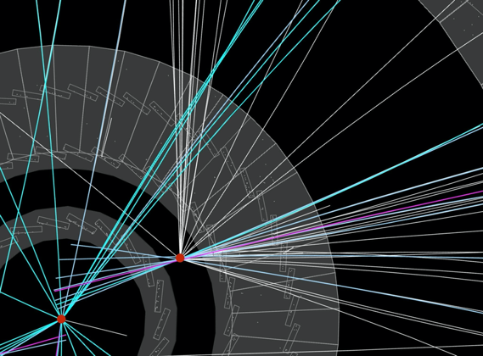
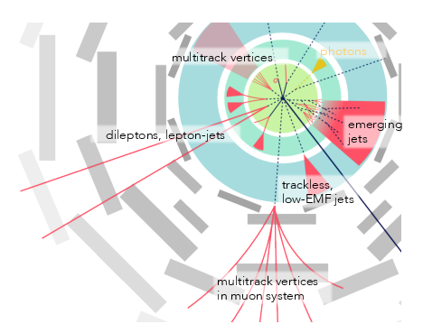
Long-Lived Particles
Last longer than other decaying particles
Last from milliseconds to seconds
Travel a distance before decaying
Known long-lived particle: bottom quark
Identification: when spray is far away from collision point (in LHC)
LLP are used to identify “new particles” in our universe
In the experiment, if the results are not the b-hydron, then it might be a “new particle”

Slide 14
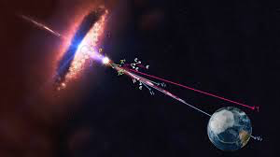
Future of Particle Physics
Find fundamental laws governing the universe
Origin of the universe
Evolution of the universe
Better understanding of the standard model
Mass of neutrinos
Dark matter and dark energy
Astrophysics: use cosmic waves
Higher energy in colliders
Notes:
Some of the hopes for the future of particle physics include finding the fundamental laws that govern the universe, the origin of the universe, how the universe has evolved, a better understanding of the standard model, finding the mass of neutrinos, developing a better understand of dark matter and dark energy. There is also a possibility of using cosmic waves to enhance our understanding of astrophysics. Colliders, such as the Large Hadron Collider, as mentioned before, could have advancements, such as higher energy levels. These high energy levels would allow us to new collisions, and possibly better our current understanding of physics.
image (top): https://www.quantamagazine.org/a-new-map-of-the-standard-model-of-particle-physics-20201022/
image (bottom): https://www.space.com/41156-cosmic-ray-source-multimessenger-astronomy.html

Slide 15
Sources:
https://www.extremetech.com/extreme/108799-cern-no-higgs-boson-yet
https://home.cern/news/news/knowledge-sharing/cms-collaboration-releases-its-first-open-data-heavy-ion-collisions
https://www.nature.com/articles/d41586-018-07405-x
https://physics.stackexchange.com/questions/426243/what-dictates-how-the-higgs-boson-will-decay
https://mammothmemory.net/maths/algebra/the-quadratic-equation-factors-and-parabolas-read-1st/parabola.html
https://www.livescience.com/large-hadron-collider-third-run-begins
https://cerncourier.com/a/vector-boson-scattering-probes-quartic-coupling/
https://atlas.cern/updates/briefing/search-long-lived-particles
https://atlas.cern/updates/feature/vector-boson-scattering
https://www.quantamagazine.org/a-new-map-of-the-standard-model-of-particle-physics-20201022/
https://www.space.com/41156-cosmic-ray-source-multimessenger-astronomy.htm
https://towardsdatascience.com/a-no-nonsense-explanation-of-how-the-higgs-gives-particles-their-masses-639a0aba6d54
https://youtu.be/j0OC7e45k5c
https://youtu.be/lpdmmZ4qFUw
https://www.supercoloring.com/coloring-pages/sombrero-2
https://quantum.lassp.cornell.edu/sites/mueller-courses/files/images/standard.png
https://d2r55xnwy6nx47.cloudfront.net/uploads/2020/10/SM_graphic-FINAL_T02.svg

