Slide 1
Dr. Louis-Guillaume Gagnon
His work at the ATLAS Detector at CERN
Group #3

Slide 2
ABOUT OUR SCIENTIST AND SUPERSYMMETRY
PhD in researching supersymmetry - a theory which if true, would explain some of the current unsolved questions in physics
Supersymmetry hypothesizes that elementary particles have superpartners, for fermions this would imply having a bosonic superpartner and for bosons, having a fermionic superpartner
According to the supersymmetry theory, the neutralino would be the fermionic superpartner of the Higgs Boson.
Neutralinos are electrically neutral and weakly interacting - candidate for dark matter.
The hierarchical problem - the large discrepancy between the weak scale and the Planck scale.
The presence of the neutralino, along with other superpartners, can help stabilize the mass of the Higgs boson at a lower value, closer to the experimentally observed mass.
Notes:
Currently doing his post-doc at UC berkeley and was a doctoral student at the university of montreal as part of the ATLAS group. During his PhD, he researched extensively about the theory of supersymmetry, which hypothesizes a symmetry between fermions and bosons. About neutralinos as dark matter candidates: . In many supersymmetric models, the lightest neutralino (χ₁⁰) is stable and could be the lightest supersymmetric particle (LSP). This property makes it a good candidate for dark matter since it would be long-lived and could exist throughout the universe.
The hierarchical problem: there exists a large discrepancy between the weak scale (where the Higgs boson mass resides) and the Planck scale (the scale at which gravity becomes significant). Through interactions with other particles the higgs gains mass, but its actual mass value is much lower.The neutralino would cancel out the effects of the quantum corrections that would otherwise give the Higgs boson additional mass, and stabilize the Higgs boson mass at a natural and relatively low scale.

Slide 3
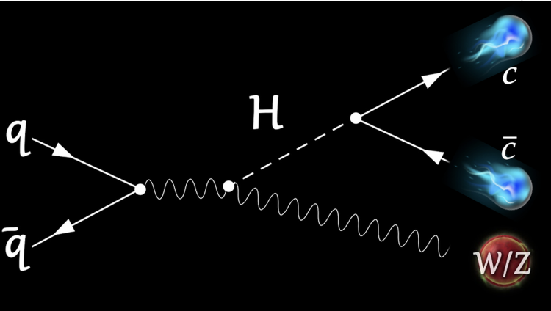
Does the Higgs Boson Decay into Charm Quarks Remain Consistent with Current Theories?
The Higgs was purely theoretical for a long time and has many properties that we don’t know about yet.
It is commonly accepted that the Higgs decays into charm quarks.
So far, research seems to match this prediction.
If we find something that does not match the current theory, that shows flaws and could possibly disprove the current theory. This opens up the opportunity for further research.

Slide 4
Basic Laws of Physics Involved
Elementary particles carry matter or forces
Fermions make up matter, bosons carry force
The Higgs boson is a carrier of the Higgs field, a field that permeates space and allows elementary particles to pass through it
The more strength with which an elementary particle interacts with the Higgs field, the more massive it is
The photon does not interact with the Higgs field, giving it a mass of zero
The Higgs field completes the Standard Model
The Higgs Mechanism unifies the electromagnetic with the weak force through the mass of their particle carriers
The field causes spontaneous symmetry breaking, which triggers particles to interact with the Higgs field, giving them mass
The Higgs field contributes to our understanding of the origin of mass

Slide 5
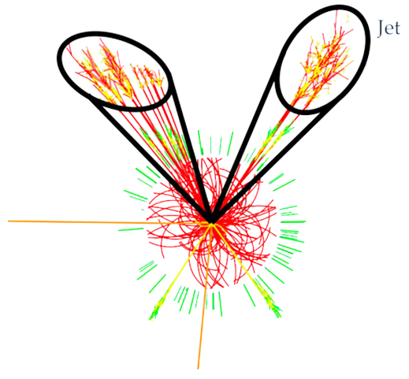
Basic Laws of Physics Involved
Jet
Jet
Particle jets are the result of decaying particles - collective energy shows what the original particle was
The luminosity of a collision is based on the number of particles produced
Are not related to the number of photons produced
The LHC uses proton-proton collisions because there is a larger range of possible energies and therefore particles that could result from a collision, and so it’s better for the discovery of new particles, like the Higgs
This is because of the quarks inside of the protons - they are the result of the variability
Center of mass energy is not fixed
Colliders using different particles have been proposed, like electron-electron collisions, to focus on specific particles that have already been discovered to find out more about their properties

Slide 6
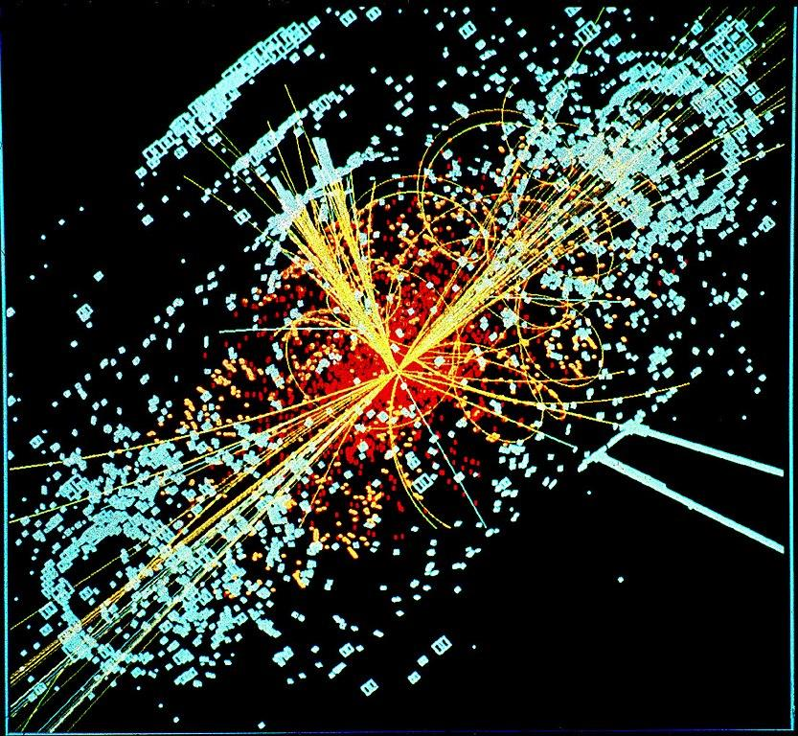
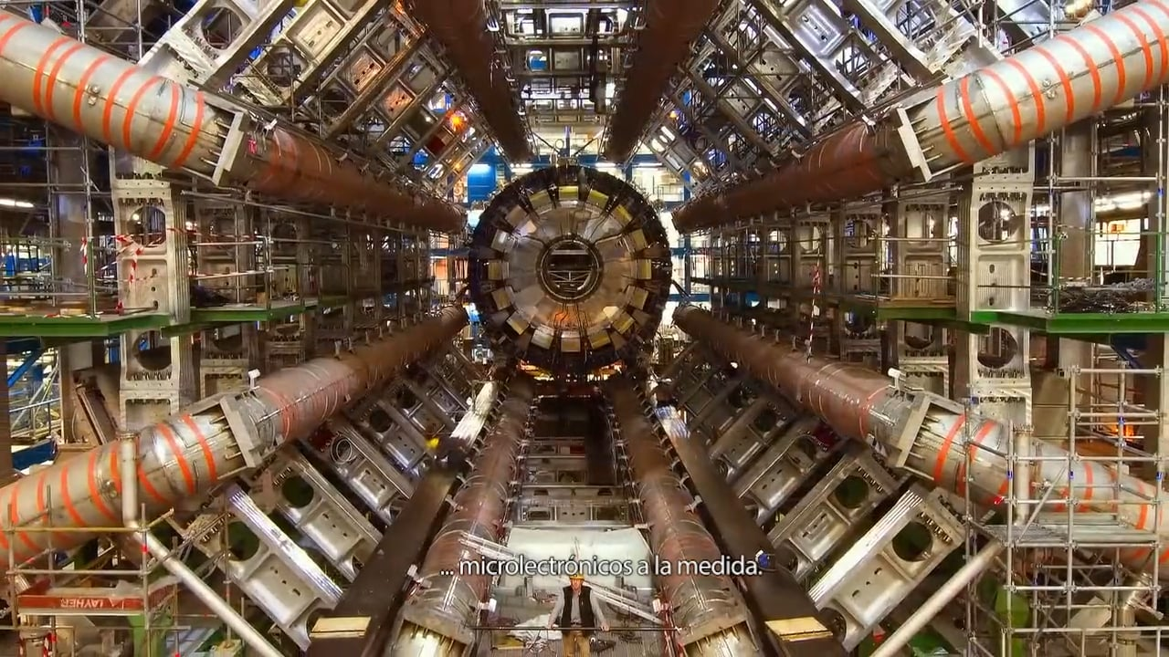
How is this question being investigated?
The Hierarchy Problem- The Higgs has relatively low mass, but it is expected to be much higher. A computation must be done by multiplying a big number by a number very close to zero in order to correctly fine-tune the mass of the Higgs- this is because the Higgs is very sensitive to every particle that has mass, and will react with every particle with mass (this increases the mass of the Higgs)
Proton-proton better for a hypothetical particle (where we don’t know the mass). If we used electrons, these are point particles and we must know the point/ center of collision. However, because protons are made of quarks, we are essentially having the quarks and gluons interact in order to find the supersymmetry. The quarks inside the proton are constantly moving, and each individually only have a fraction of the energy of a proton. The center of mass energy is not fixed, so we can get something very low or very close to the energy of the beam. With the same machine parameters, we get a range of different energies, so we can look for particles of many different masses. This helps with discoveries and hypotheticals.

Slide 7
THANKS!
Do you have any questions?

