Slide 1
Dark Matter & Machine Learning
Tem B, Nigel P, Kurtis B, Shubh J, Ishmeet D, Sumanth J
Notes:
tem

Slide 2
Ibles Olcina Samblas
Immediately interested in dark matter after learning about it in college
CERN, LHC project
Smashing protons together to hopefully find information about dark matter
Neutrino Detector
Kilometer long telescope with photon sensors detecting light from nuclear fusion happening in water
LUX ZEPLIN
Vat of Xenon
Notes:
tem

Slide 3
What We Know About Dark Matter?
Notes:
Sumanth J

Slide 4
Notes:
Sumanth J

Slide 5
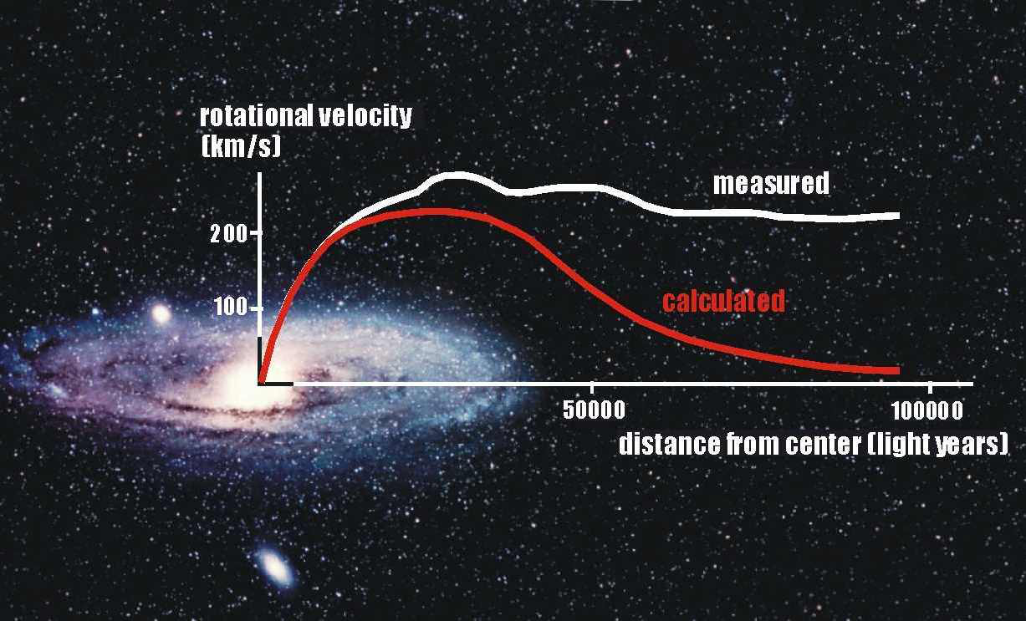
Notes:
Sumanth J

Slide 6
- Dark matter is thought to:
Barely interact with normal baryonic matter and radiation except through gravity
Be non-baryonic and it may compose of some undiscovered subatomic particles
Cold (moving slowly compared to the speed of light)
- Biggest theories involve Dark matter composing of WIMPS or axions (which is a hypothetical subatomic particle)
Notes:
Sumanth J

Slide 7
EXPERIMENTS GOING ON NOW
LUX-ZEPLIN
Uses liquid Xenon to see possible Dark Matter interactions.
Located 5000 feet below to reduce background noise + cosmic radiation.
Produces large amount of results.
NEUTRINO DETECTOR
KM3NeT under Mediterranean Sea, will be world’s largest Neutrino detector set up.
Water serves as a perfect medium, making it easier to detect Neutrinos. *Cherenkov rad.
Being underwater reduces background noise & radiation.
CERN
International research organization focused on particle physics.
Includes Large Hadron Collider (LHC), Key facility at CERN for high-energy particle collisions
World's largest and most powerful particle accelerator
Notes:
Nigel Purvis

Slide 8
CHANGING KNOWLEDGE…
LUX-ZEPLIN
2. NEUTRINO DETECTOR
3. CERN
Notes:
Kurtis
–Confirmation of dark matter existence from the LZ experiment would strengthen the case for dark matter exploration and experimentation and help verify its contribution to the gravitational effects observed in the universe.
The LZ experiment aims to measure various properties of dark matter particles, such as their mass and interaction strengths. By gathering this information, scientists can refine theoretical models and constraints, which would help in identifying the nature of dark matter and its role in the cosmos.
The detection of dark matter particles and the measurement of their properties could have implications for particle physics beyond the realm of dark matter. It could provide constraints on supersymmetry or other theoretical frameworks attempting to extend the Standard Model of particle physics.
The LZ experiment's sensitivity might enable the detection of unexpected interactions between dark matter and ordinary matter. This could open up new avenues for research and potentially uncover previously unknown particles or forces.
—--Neutrino detectors are valuable tools for studying neutrinos and high-energy astrophysics, but their direct impact on our understanding of dark matter is more limited. Dedicated experiments and detectors designed specifically for dark matter detection, such as the LUX-ZEPLIN experiment mentioned earlier, are better suited to investigate the properties and nature of dark matter.
—Although dark matter particles have not been directly detected at the LHC, the collider experiments can potentially produce new particles that could be connected to dark matter. If these particles have interactions with dark matter, their properties and behaviors could provide clues about the nature of dark matter.
The experiments conducted at CERN, such as ATLAS and CMS, aim to discover new particles and phenomena beyond the Standard Model of particle physics. These experiments explore a wide range of energy scales and interactions, which may indirectly shed light on dark matter. If certain proposed theories or models that involve dark matter have associated particles or signatures that can be observed at CERN, the experiments can help validate or constrain those models.

Slide 9
Future Research/Possibilities
As one of the most useful tools in today’s world, machine learning has a lot of potential to help with future research in dark matter.
As Ibles stated, “Machine learning is very useful in searches we do at our company.”
Theories aligning with the nature of invisible dark matter and the scale of the cosmic web
Colliders for different particles like muons & antimatter

Slide 10
Closing Statements
In conclusion:
Thank you for your attention!
Questions in the chat please
Here are some links to further explore Ibles’s research -
https://spiral.imperial.ac.uk/handle/10044/1/76523
https://indico.cern.ch/event/666809/contributions/3029006/attachments/1667168/2673937/LZsens_Chalmers_Ibles.pdf
Notes:
Ishmeet & Shubh

