Slide 1
ATLAS and Particle Physics
Interviewing: Emily Thompson
By: Taj Sandretto, Amaliya Nalitkina, Prithvi Vegesna, Justin Ely

Slide 2
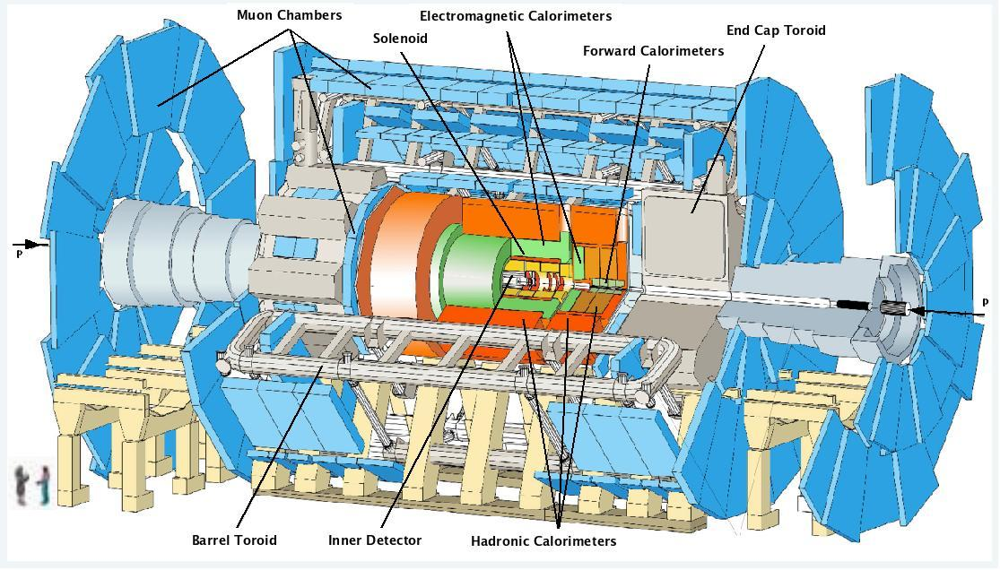
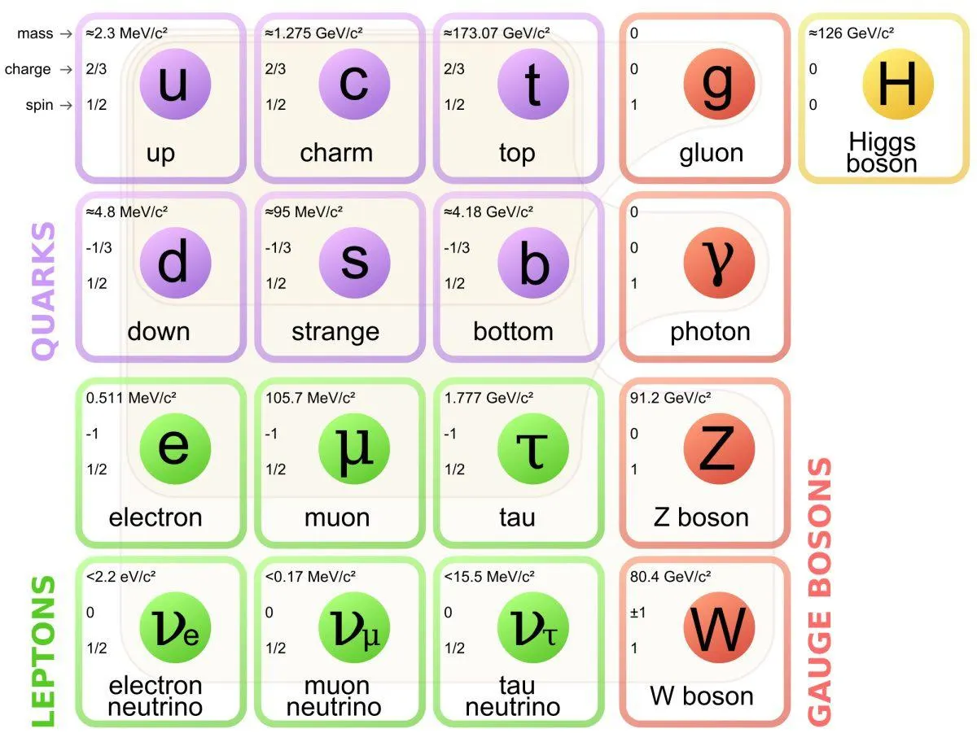
Background
Emily Thompson
Post-doc Fellow at Berkeley Lab
Undergraduate from South Carolina in Physics, minor in Mathematics
Masters and PhD from Germany in Physics
What does she do?
Ms. Thompson is trying to find new physics beyond the Standard Model with ATLAS at CERN
Specifically, she is trying to find dark matter or other bosons and particles in ATLAS
Her work is focused on improving the detection of particles and pathing when the particles collide

Slide 3
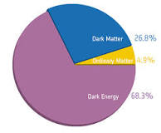
Dark Energy
Responsible for the accelerating growth of the universe
Dark energy accounts for roughly 68 % of the universe
Very little is known about dark energy
Neither dark matter nor dark energy fit into the standard model and cannot yet be fully explained
Dark matter
Universe is spinning much faster than it should given are current understanding of gravity
We must either redefine our rules of gravity or there must be some type of “dark” matter that provides the additional mass
DARK - not much is known about it and it doesn't absorb light

Slide 4
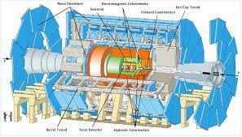
What is ATLAS?
ATLAS is a detector created to test protons speeding at almost the speed of light
They need to accelerate the beams in a long tube that goes in a circle around 100 meters underground. The protons are accelerated to roughly 99.9999991% the speed of light.
The LHC (Large Hadron Collider) is supposed to try and detect new particles and potentially dark matter.
Since momentum is conserved when the protons are fired at each other, any unusual reaction resulting with momentum not being conserved would be a sign of dark matter (or another interfering particle)

Slide 5
What has ATLAS detected so far?
The LHC smashes H⁺ (protons) together to detect the different particles created in the collision.
Protons are not fundamental particles, meaning that when they collide, they often generate lots of heavy debris that are uninteresting and well-documented.
Instead, CERN wishes to detect lighter particles, such as bosons.
Gluons
W, Z bosons
Notes:
Mention how gluons cannot exist on their own due to their color charge, which makes them especially difficult to detect. They were detected in Jets.
W and Z bosons are easier to detect, and were detected via conservation of momentum.

Slide 6
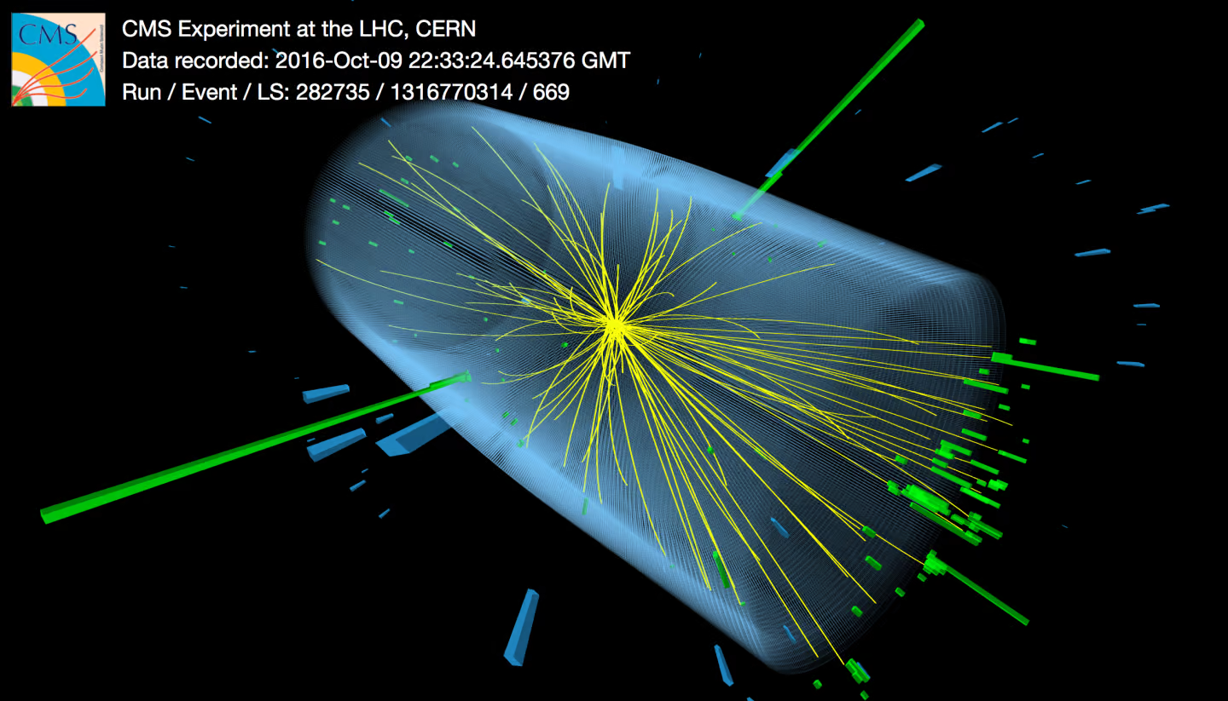
Source: Thomas McCauley, CMS/CERN

Slide 7
What has ATLAS detected so far? (Higgs Boson)
The most recent and biggest achievement of ATLAS was the discovery of the Higgs boson
The most significant discovery of 2012 and was only a theory before this
The Higgs boson confirmed the existence of the higgs field which was theorized to be responsible for mass in fundamental subatomic particles (gave name of GOD particle).
More interactions with the field, more mass.
Ex: Photons are massless particles and this is because they don't interact with the higgs field
The interactions are what causes a gain in mass.
Notes:
-higgs field
- gives mass
-exitation in the higs field - Higgs boson
-confirms the higgs field
More interaction with higgs field= more mass
Less interaction = less mass Ex: Photons

