Slide 1
Claire Poppett & DESI
FOR PHYSICS IN AND THROUGH COSMOLOGY
By: Evan, Samyak, Veryan, Maria, Dayna

Slide 2
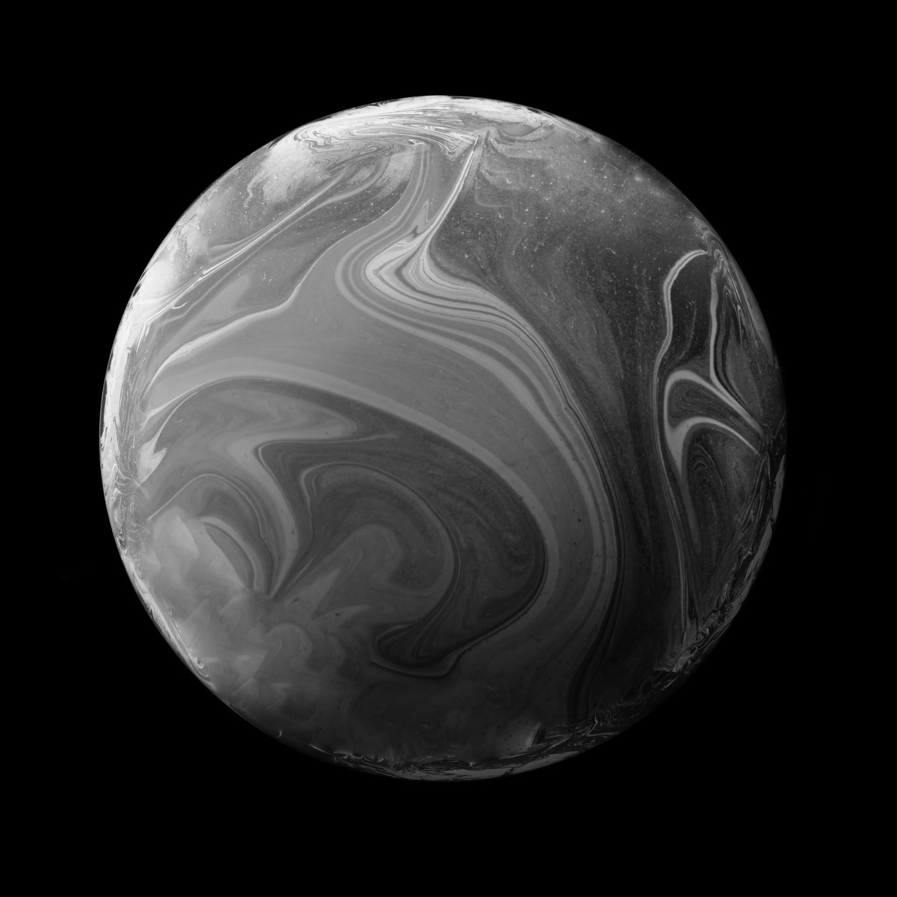
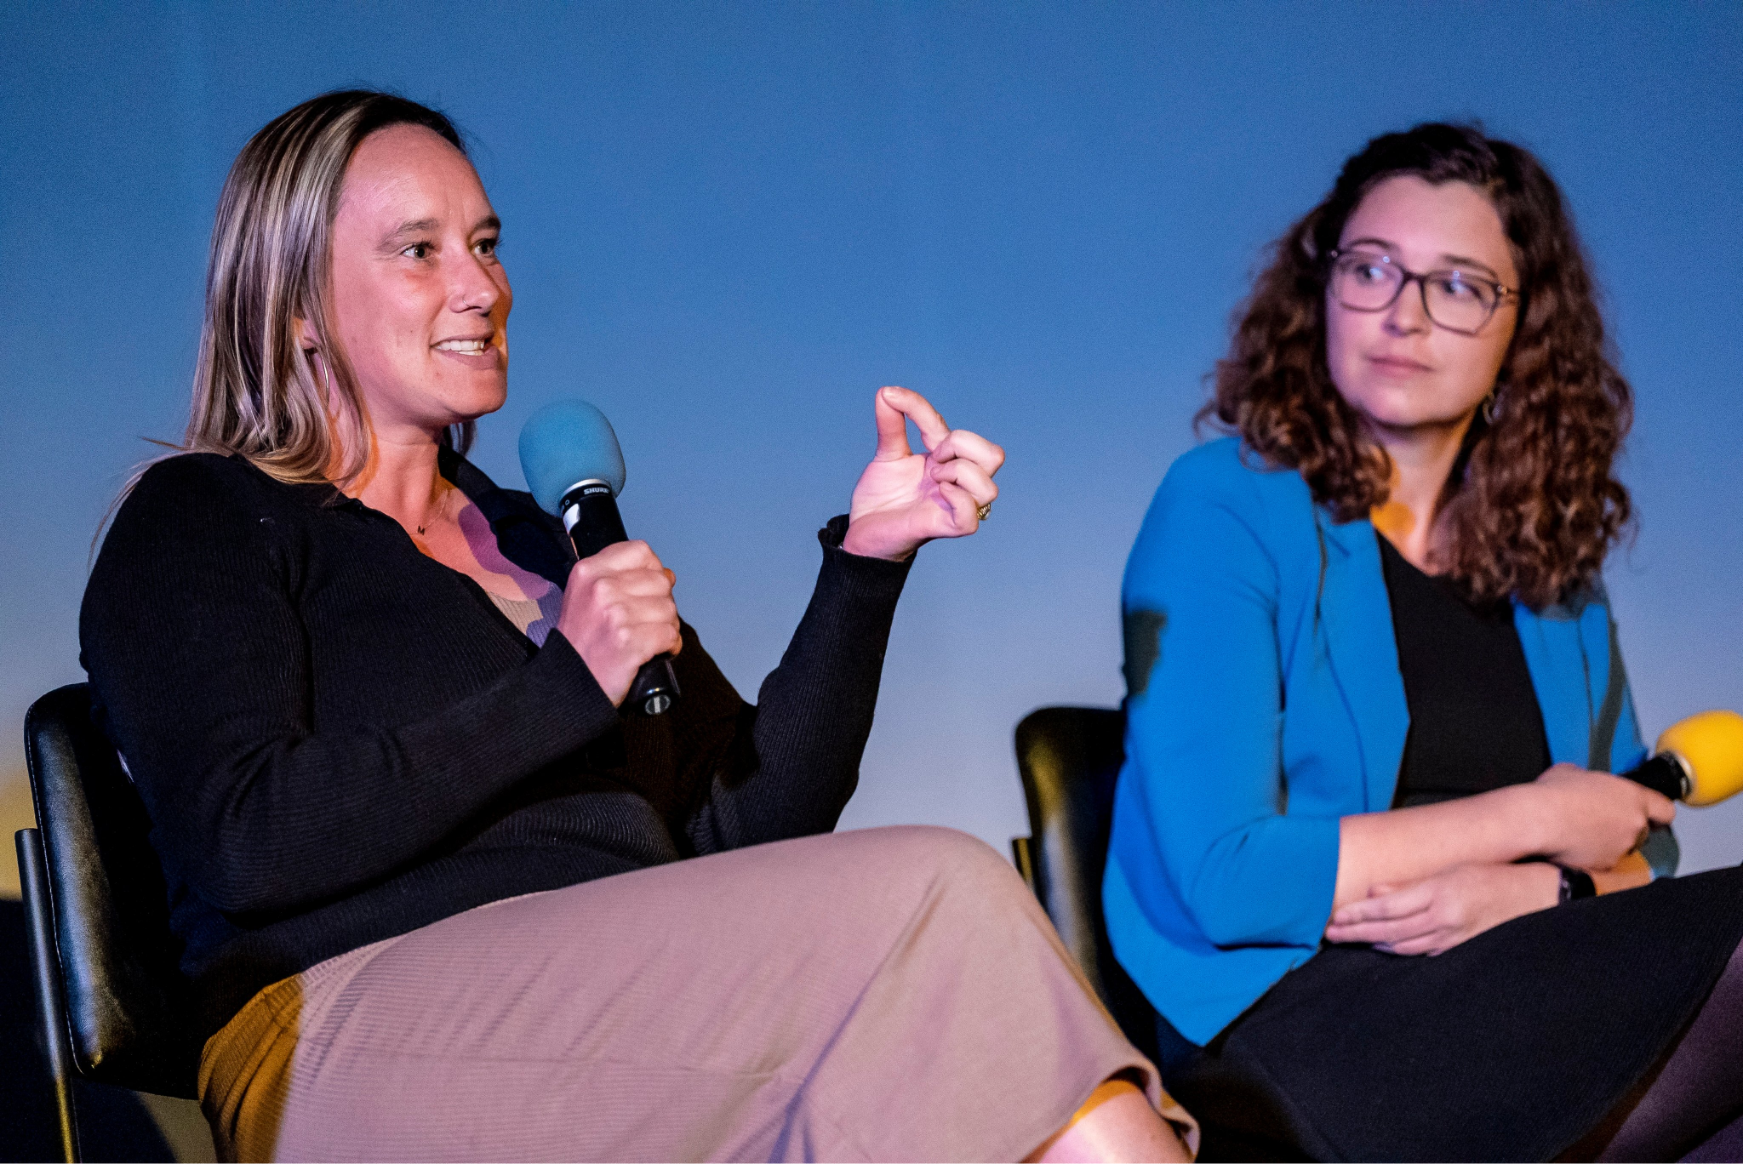
01
This is Claire Poppett
Goated Scientist and Rock Climber

Slide 3
EDUCATION
M.Sc. (Master of Science) in Physics and Astronomy from Durham University in Durham, England
PhD in Astronomy from Durham University: “A new approach to Highly Multiplexed Spectroscopy”

Slide 4
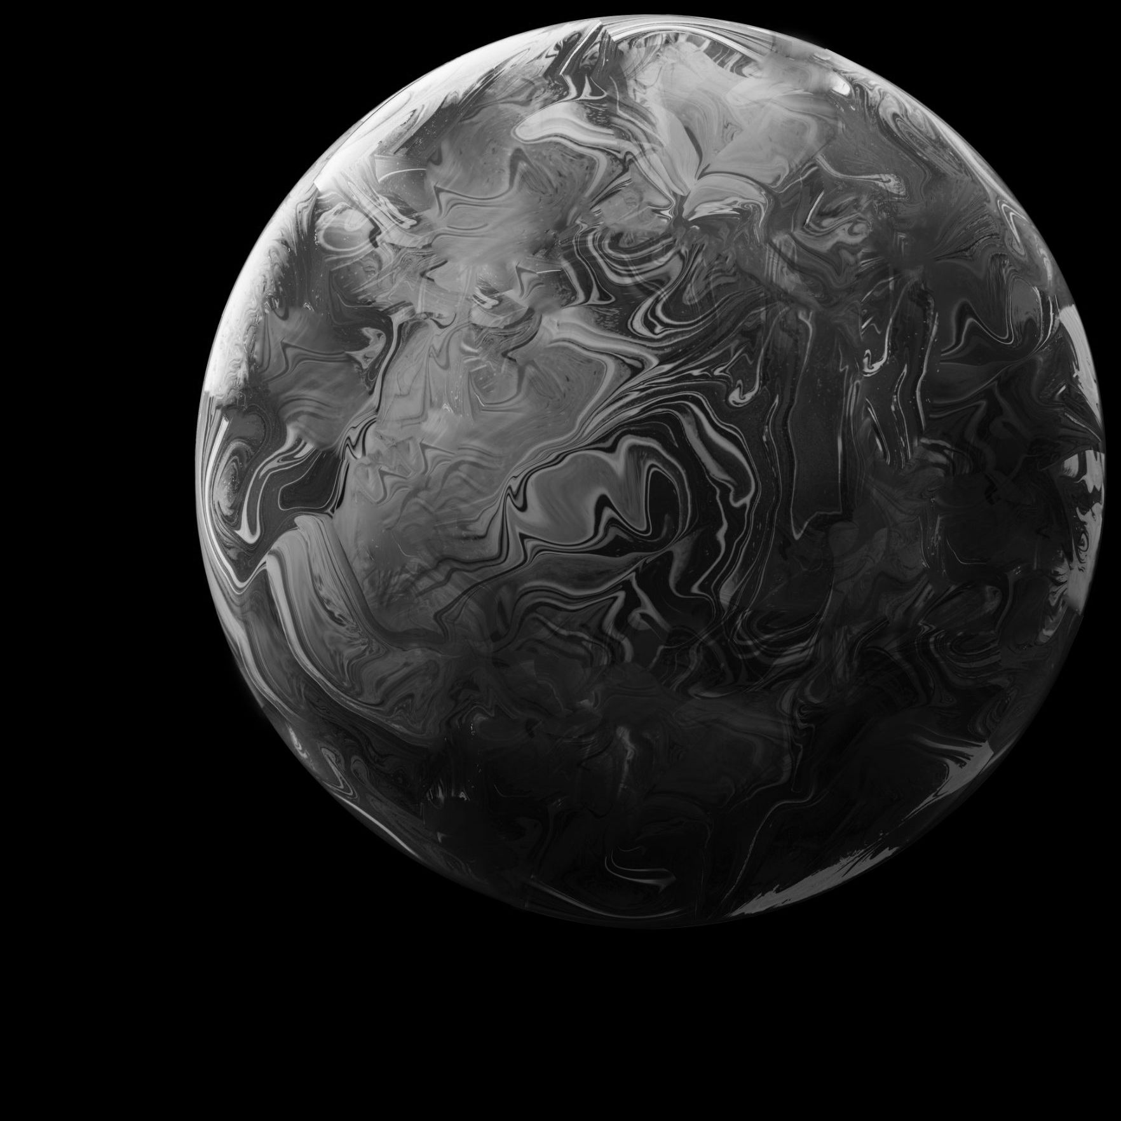
CAREER HISTORY
Postdoc at LBNL
Research physicist in ground and space based instrumentation at UC Berkeley

Slide 5
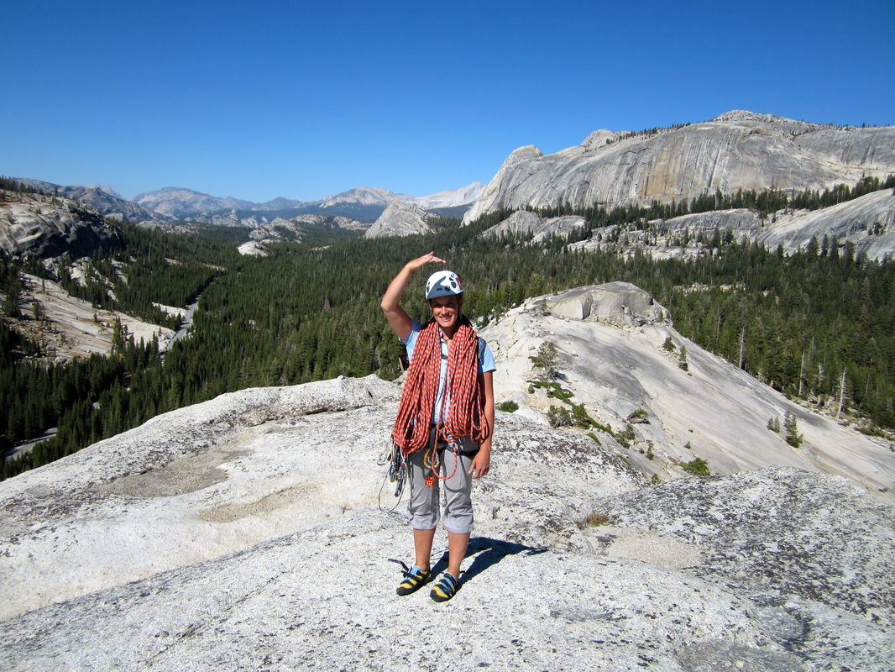
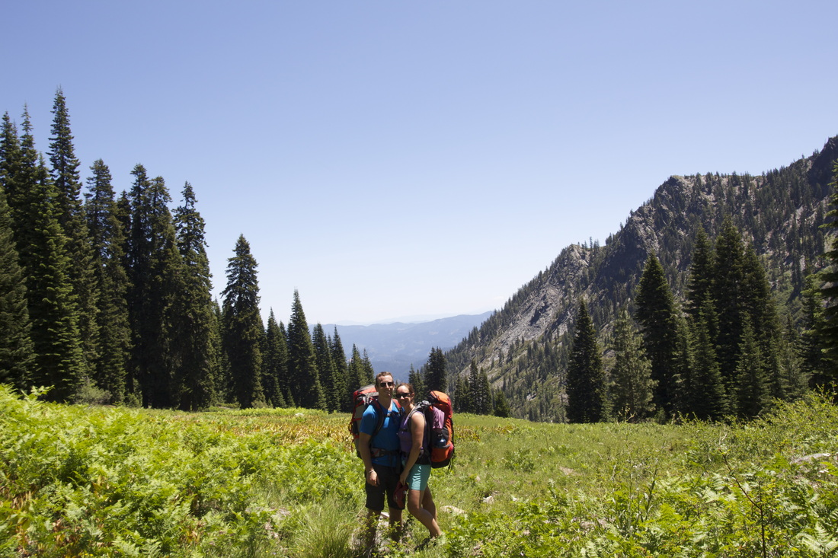
PERSONAL
LIFE
01
ROCK CLIMBING
02
MISSING THE UK (PROBABLY)
03
FAMILY
Claire enjoys rock climbing
Claire is British
Claire is married to another physicist and
has two kids

Slide 6
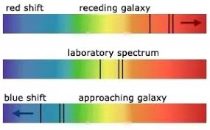
REDSHIFT
Redshift is the increase in the wavelength of light traveling away from us, meaning the color is shifted towards the redder end of the electromagnetic spectrum
Redshift is significant in proving that the universe is expanding at an accelerating rate, since we observe most objects to show red shift. (Meaning everything is getting further away from us!)

Slide 7
A PICTURE IS WORTH A THOUSAND WORDS

Slide 8
WHAT IS
DESI
DESI is a Dark Energy Spectroscopic Instrument
It snapshots galaxies at certain ages and compares the ages and the distance between the galaxies at the respective times/ages
This comparison is known as a two-point correlation function

Slide 9
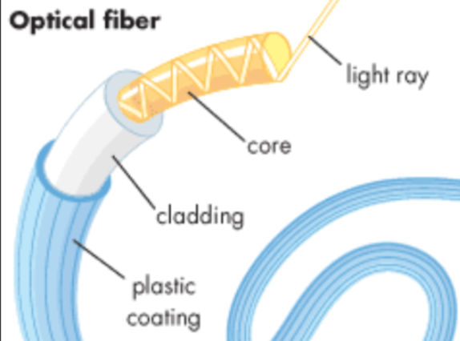
CLAIRE’S WORK ON DESI
Dr. Poppet helps manage the optical fibers that transport the captured light of the galaxies to the spectrograph.
The fibers need to be very stable and consistent to not interfere with the light as it reaches the spectroscope.

Slide 10
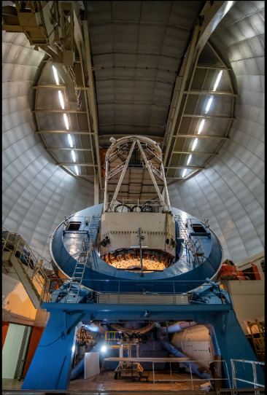
BUILDING DESI
SOFT SKILLS
LEADERSHIP
DESI took ~2 years to design and ~2 years to build
International collaboration:
UK (Durham, UCL…..)
US (Michigan, Fermilab, Berkeley…..)
France
Jupiter is the biggest planet in the Solar System
Saturn is a gas giant and has several rings

Slide 11
DESI has 6 lens
Thousands of fibers below the lens where each fiber takes all the light from one galaxy
Spectroscope breaks the light from the fibers into its components

Slide 12
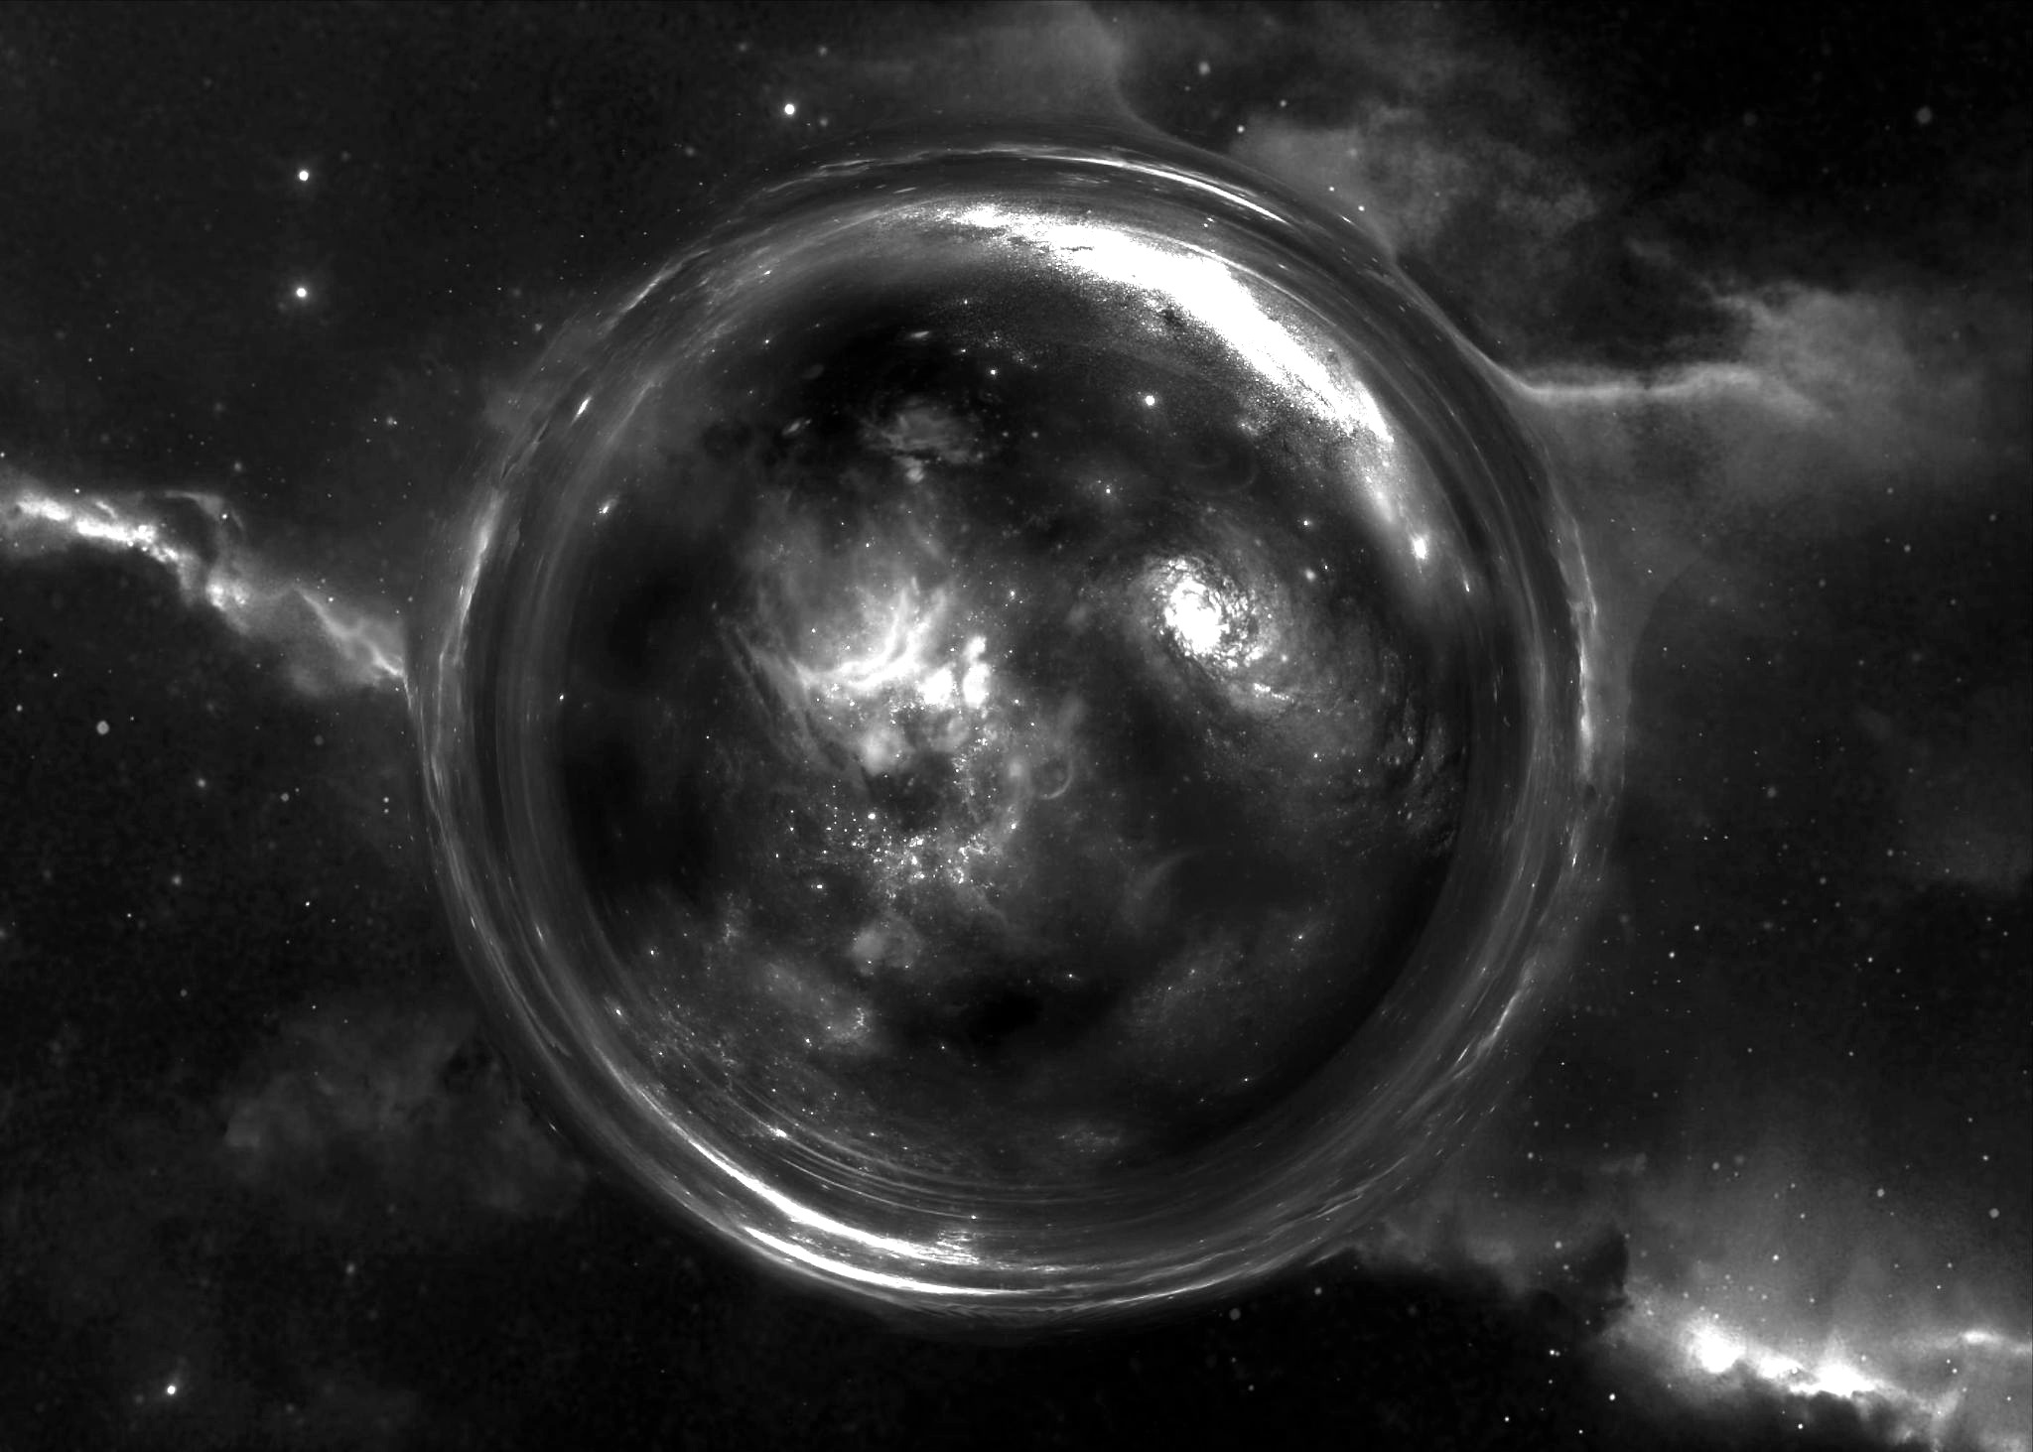
2 of the lenses on DESI rotate in opposite directions in order to counteract chromatic aberration near the horizon. In other words, light from galaxies near the horizon is distorted, but the two lens fix that.

Slide 13
What does DESI measure?
Effect of dark energy on the expansion of the universe
Constructs a 3D map that extends the observable universe to 11 billion light years

Slide 14
ACCURACY OF DESI
360 to 980 nanometers of accuracy for the spectra
91% of the light from the fiber makes it to the spectrograph

Slide 15
DESI
FUNDING
DOE contributed ~$50M to DESI
The DOE Office of Science sponsors basic research at
over 300 institutions across the country
High Energy Physics department gave DESI a budget of 1.1 billion

Slide 16
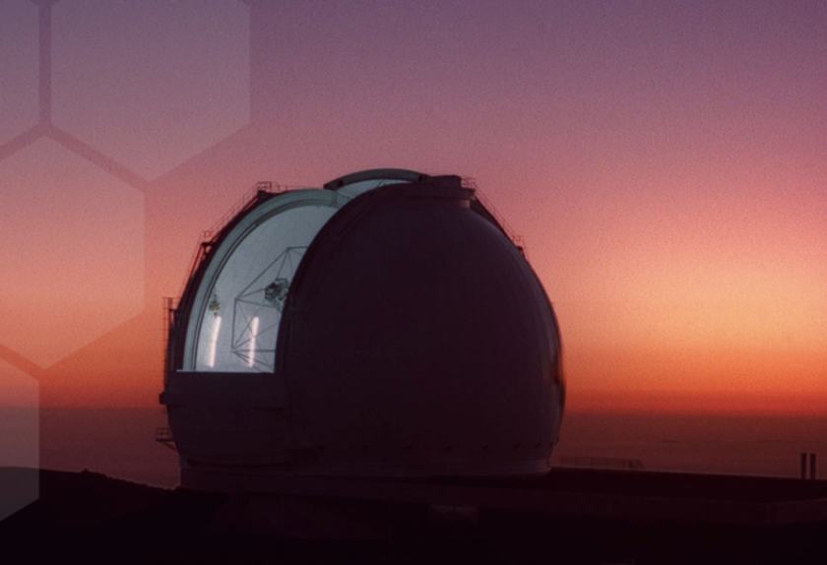
PAST PROJECTS
DESI
KPF
ICON
OBVIOUSLY
A planet finder located in Hawaii
A satellite project focused on collecting data about the Ionosphere

Slide 17
FUTURE
PROJECTS
Fobos
Fobos is a program that will send some probes to one of Mars's satellites: Phobos. Researchers want to collect samples of the icy moon to see if there is/was any life in and around Mars! As of right now the project faces funding issues, so it is largely at a stand still :(

Slide 18
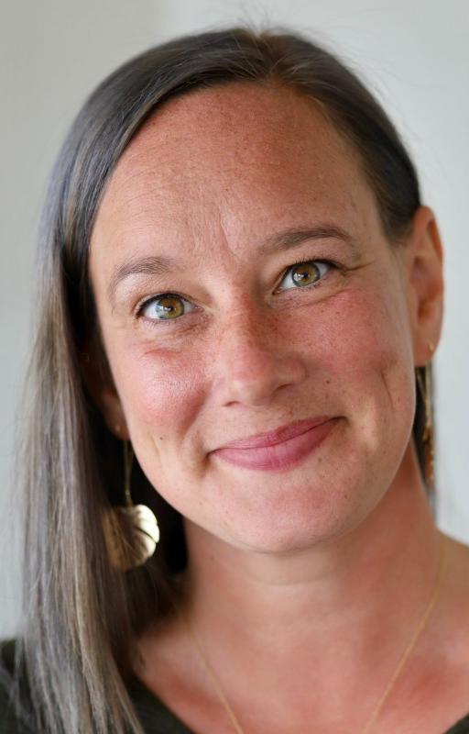
—Claire Poppet
“Keep doing whatever you are interested in and it will always lead you in a direction that is interesting
to you!”

