Slide 1
Dr. Angira Rastogi
THE STANDARD MODEL & ATLAS
By: Cyan, Edwin, Valentina, Zero, and Zoe

Slide 2
01
BIO
Early Life / Education

Slide 3
Early Life / Education
As a kid, always fansicanted with the universe, originally interested in astronomy and astrophysics
Had all education in India
Undergraduate in Delhi University where she was introduced to particle physics and nuclear physics in final year of undergraduate
Integrated masters at Indian Institute of Science Education and Research (IISER) in Pune, India
Joined Lawrence Berkeley National Lab last year in May for her postdoc on CMS experiment

Slide 4
Top 10 Gravity Moments:
02
PHD WORK
Analysing Alternative Theories to The Standard Model of Physics

Slide 5
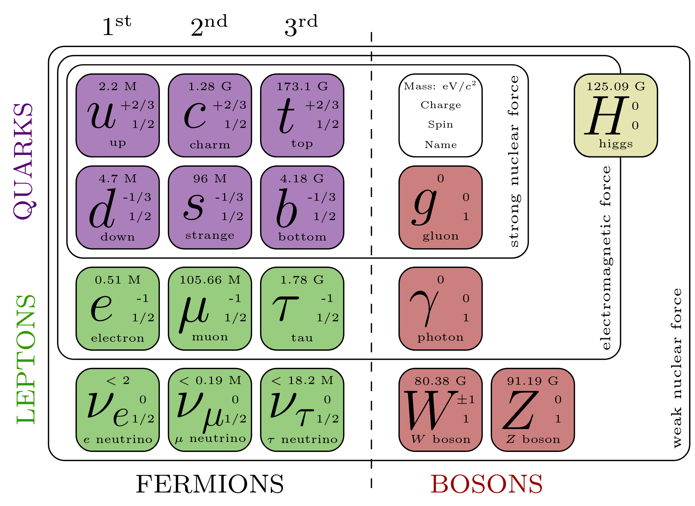
PhD Work
Chose particle physics for PhD program because she liked computer programing
Worked primarily on the CMS for PhD experiments
Worked mainly to search for beyond the Standard Model (BSM) phenomena
Neutrino oscillations and their non-zero masses?
Muon anomalous magnetic dipole moment?
Dark matter candidate?
Matter-antimatter asymmetry?
Mass hierarchy among the three generations?
Why only three generations of matter particles?

Slide 6
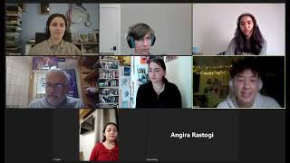
PhD Thesis: “Inclusive nonresonant multilepton probes of new phenomena”
Third Generation Vector-Like Leptons (VLL)
May account for the mass hierarchy between the different generations of matter particles in the SM and provide a dark matter candidate
Type-III Seesaw Mechanism
Attempts to answer the origin and smallness of the neutrino masses
Rastogi’s “seesaw metaphor”: https://youtu.be/_Lp3XcaKvvw?t=179
Third Generation Leptoquarks
Meant to explain observed b-anomalies

Slide 7
PhD Work - Conclusion from Experiment
Did not find new particles to explain holes in Standard Model
Concluded that with current possible energies, the CMS was not sensitive to new particles, perhaps with higher energy it would be possible to detect new particles
Result from PhD work:
Was awarded CMS PhD Best Thesis Award of the year in 2022
https://cms.cern/sites/default/files/field/image/CMS%20Ph.D.%20Thesis%20Award%20Winners%202022_0.png

Slide 8
Top 9 Gravity Moments:
03
ATLAS
Current Work at CERN on ATLAS

Slide 9
Things about ATLAS that haven’t been covered (mostly)
One of 2 large multipurpose detectors at the LHC
However, ATLAS has a transition radiation tracker
+ ATLAS Employs silicon trackers
Allows very fine-grain recording of Quark-Gluon plasma collisions
Notes:
ATLAS is one of 2 large multipurpose detectors at the Large Hadron Collider alongside CMS
Unlike CMS, ATLAS has a transition radiation tracker, essentially a series of thin gas layers with sensors capable of detecting ionization, this allows the detector to measure the trajectory of particles after collisions.
ATLAS uses a combination of silicon pixels and silicon strips to detect particle collisions
Dr. Rastogi’s work focuses on the analysis of Quark-Gluon plasma, a high energy state where protons and neutrons break down, allowing analysis of elementary particles like quarks and gluons

Slide 10
Dr. Rastogi’s work at the ATLAS detector
Member of the ATLAS group at LBNL
Works on hardware + software
High-Luminosity Upgrade
→ Installing Fiber-Optic data collection
→ New software
Notes:
Dr. Rastogi is a member of the ATLAS group at LBNL
Works on hardware for the inner tracker of ATLAS
→ Reconfiguring data collection system from electrical to fiber-optic
→ Also works on software for the new data collection system, reducing latency (mitigate conflict with the next event)

Slide 11
Top 12 Gravity Moments:
04
CURRENT WORK
Using Software & Hardware to Resolve Gaps in Standard Model of Physics

Slide 12
Software
Hardware
Python vs. C++
Constant Improvement
C++ makes up the source code, but requires compiling
Python is used more in day-to-day analysis
detector
Increase collision energy
Built new pixel modules
Notes:
-read slide then: this means that after collecting data // changes in hardware require changes in software

Slide 13
Preparing for
LHC Phase 2
Photon-Photon Collisions
Currently we read electrical signals with wires
Heat up / noises
Energy losses
Interferences
This cannot be sustained in phase 2
Angira’s focus is in the software
Allows us to explore beyond the Standard Model
Notes:
-read slide then: this means that after collecting data // changes in hardware require changes in software // photon-photon collisions later this year

Slide 14
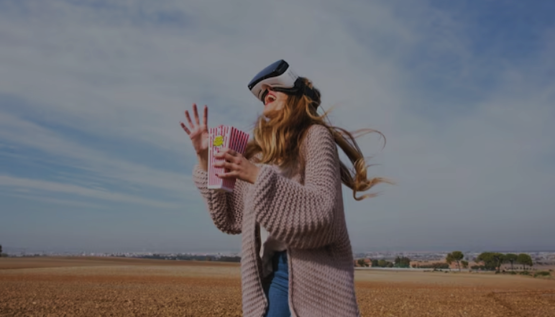
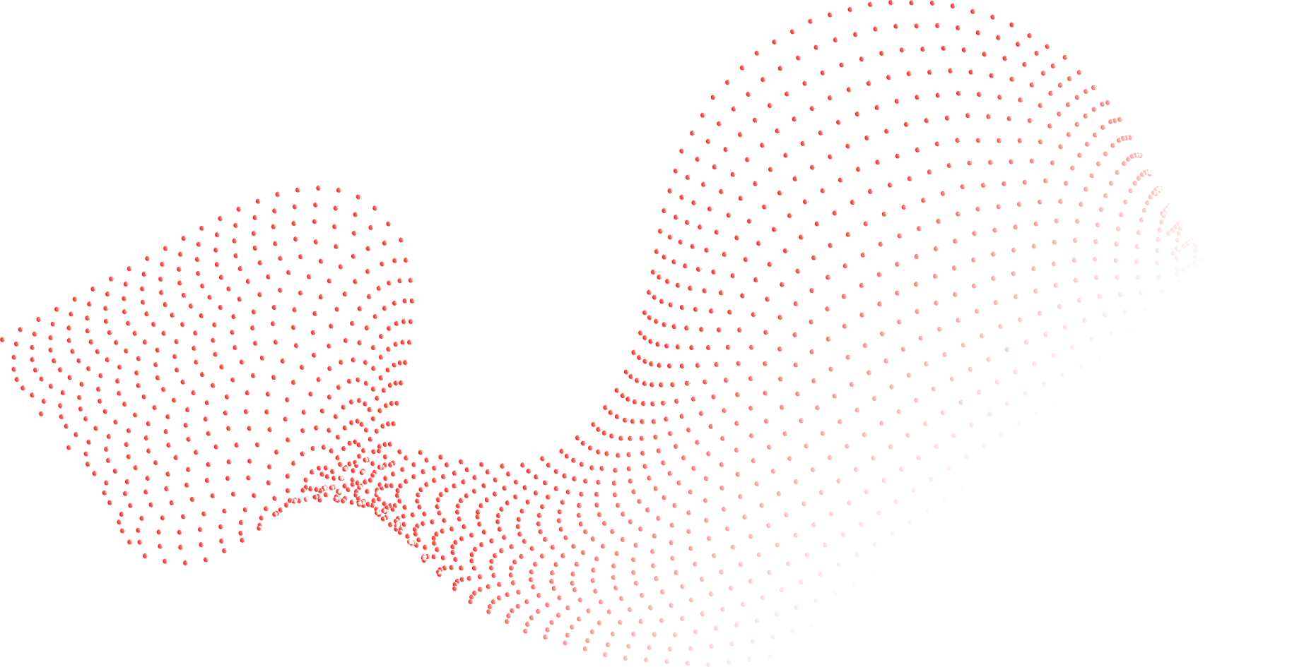
THANK YOU!
- Any questions?

