Slide 1
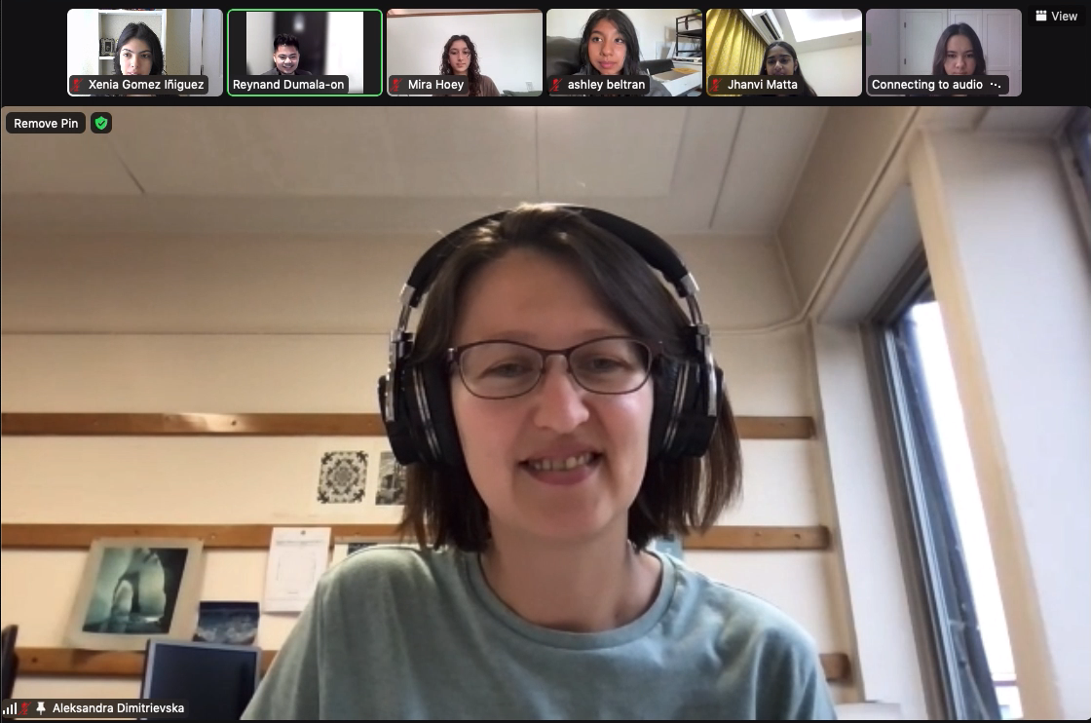
Aleksandra Dimitrievska
Finding and measuring the W boson at ATLAS
Notes:
From serbia and always loved math and science - Recipient of an Owen Chamberlain Postdoctoral Fellowship in Experimental particle Physics & Cosmology (Five years)
Grad school in serbia: member of atlas collaboration at cern
Phd thesis @ cern: measuring the w boson through the atlas experiment
Starting in 2017 working with LBNL for her postdoc

Slide 2
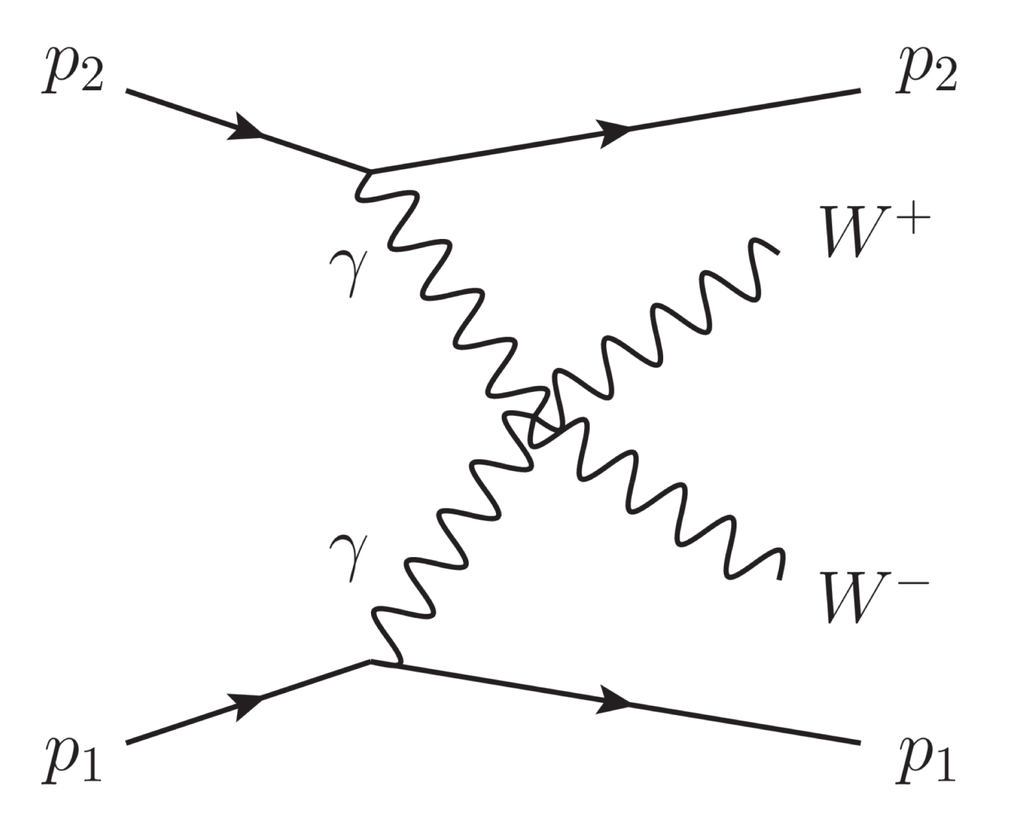
Creating matter from light
proton
The basic laws of physics involved is Einstein’s famous equation E = mc^2
Energy and mass (matter) are interchangeable
Particle accelerator:
Protons pass by close to each other, creating a large electromagnetic field and scatter off photons (light carrying particles)
Photons collide to create w bosons (photons interacted and created matter)
Out of billions of events, approximately 150 times was light created
photon
w boson
https://atlas.cern/updates/briefing/observation-w-pair-from-light

Slide 3
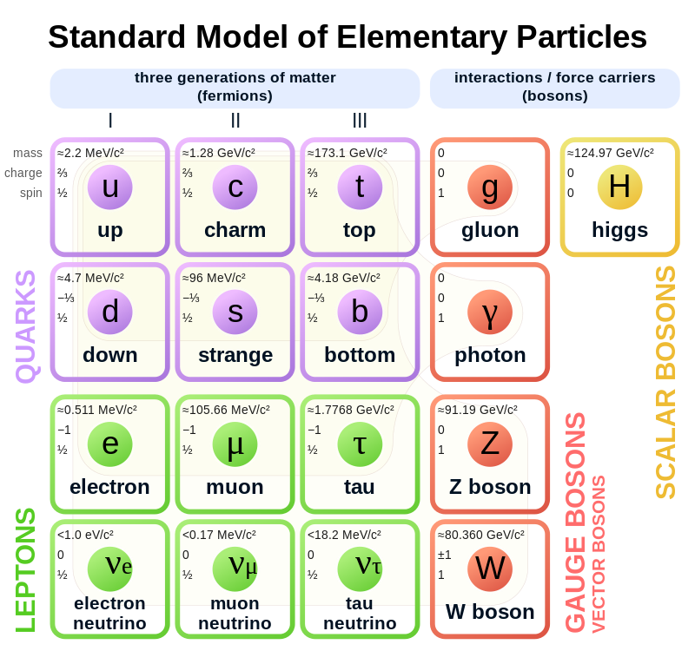
Expanding the Standard Model
Four fundamental forces:
Strong force
Weak force
Electromagnetism
Gravity
ATLAS was the experimental proof of unification of forces (electromagnetic force and weak force)
Antiproton: antiparticle of proton
Waves aren’t matter (have no mass) but we can create matter out of waves
Creating a W boson out of 2 photons

Slide 4
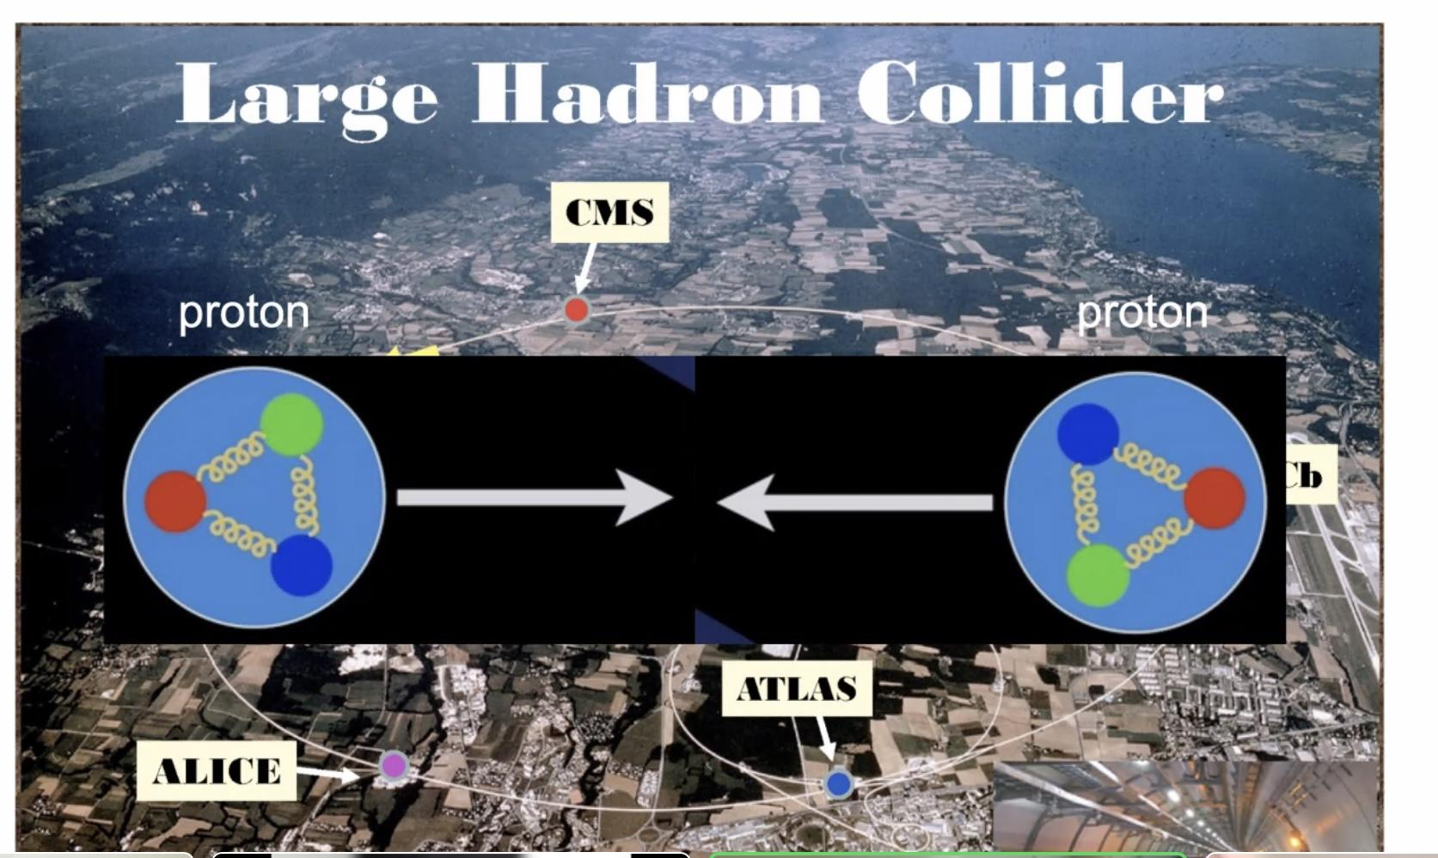
Atlas - LHC - CERN
CERN- Prototype chips for a planned upgrade. Testing 2-centimeter-by-1 prototype computer chips for the planned High luminosity LHC at CERN
Largest general purpose particle detector experiment at the LHC
Designed to record high-energy particle collisions by detecting the interaction
Between it and other materials at discrete points.
Notes:
One of the world’s largest and most respected cnetres for scientific research. CERN borders two countries, France and Switzerland. This will crank up the performance of the LHC

Slide 5
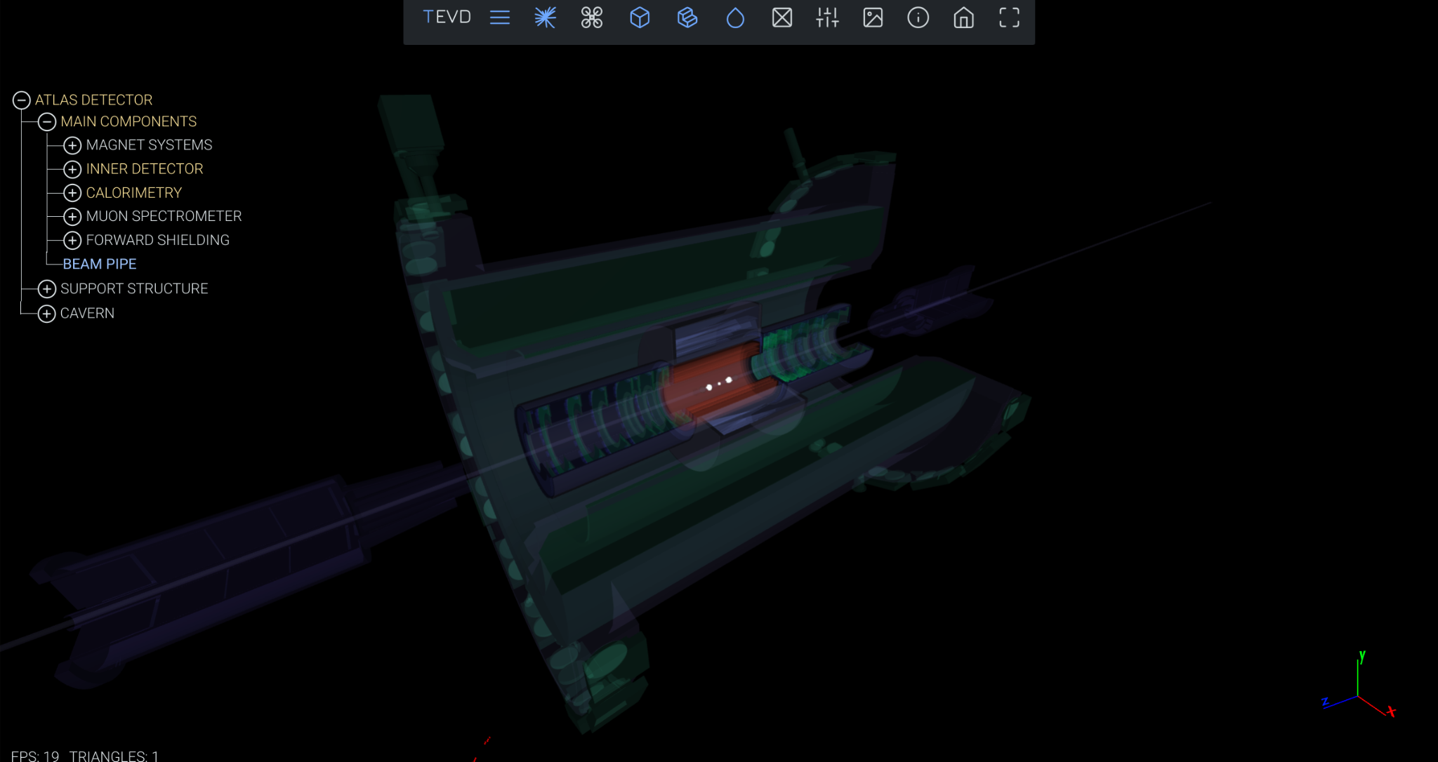
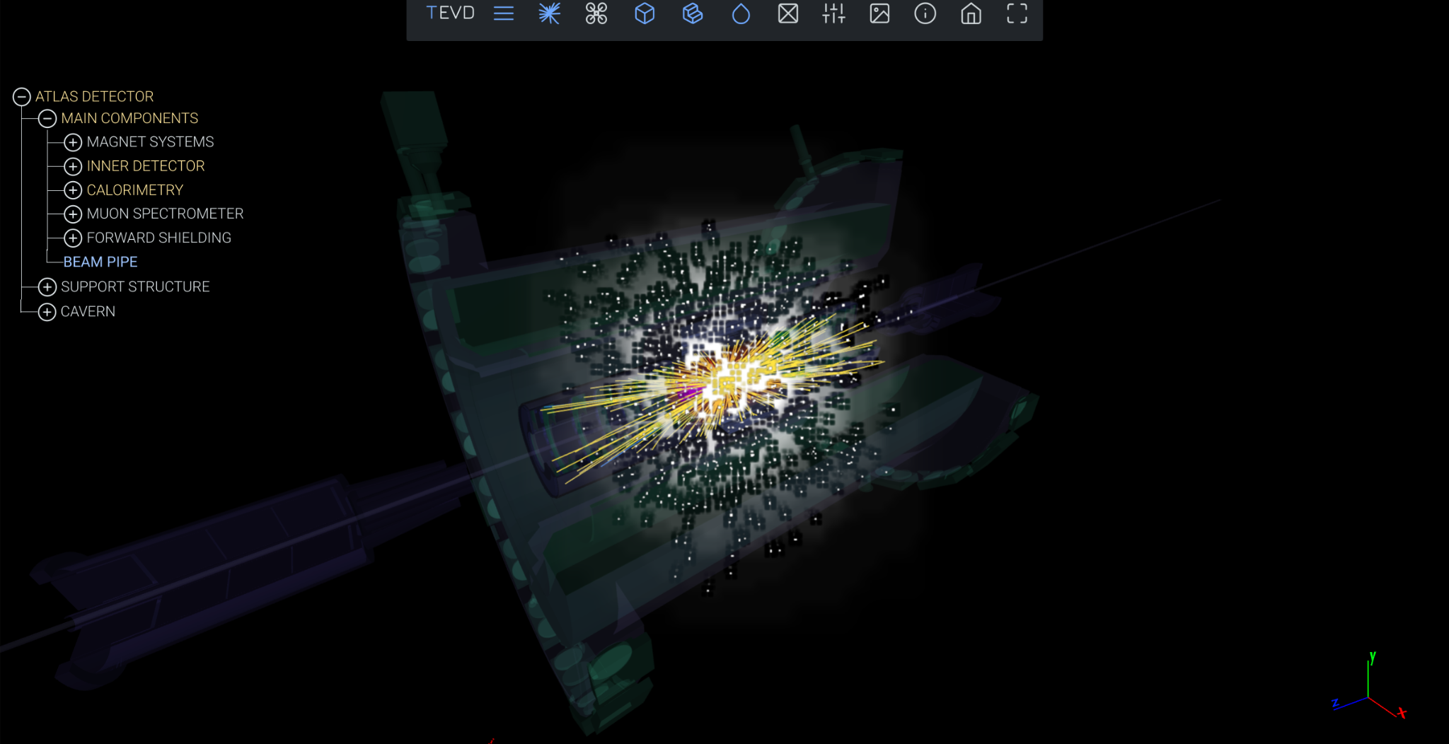
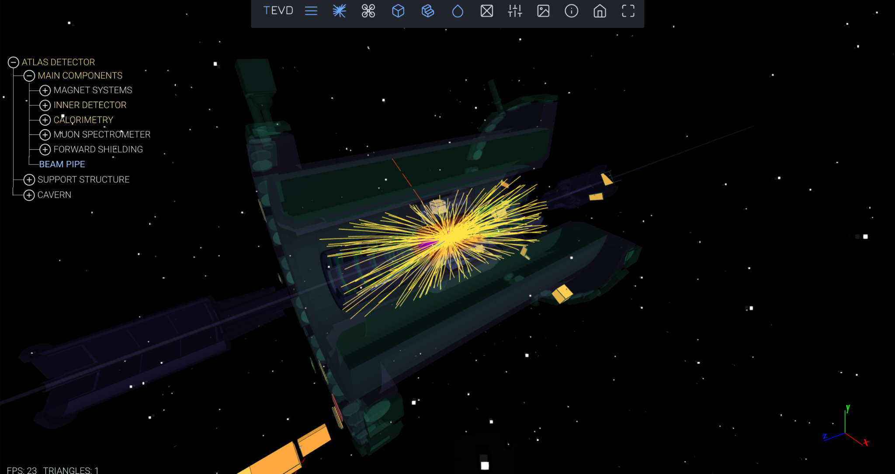
Conclusion
Researching the mass of the W boson and creating matter from light using principles like E = mc^2
Shared some resources and opportunities
Program called International Masterclasses for high school students
Held worldwide in 60 countries for one day
Work on particle physics with data from CERN
https://physicsmasterclasses.org/
Simulations at CERN on the ATLAS detector
https://tracer.web.cern.ch/tracer/

