Slide 1
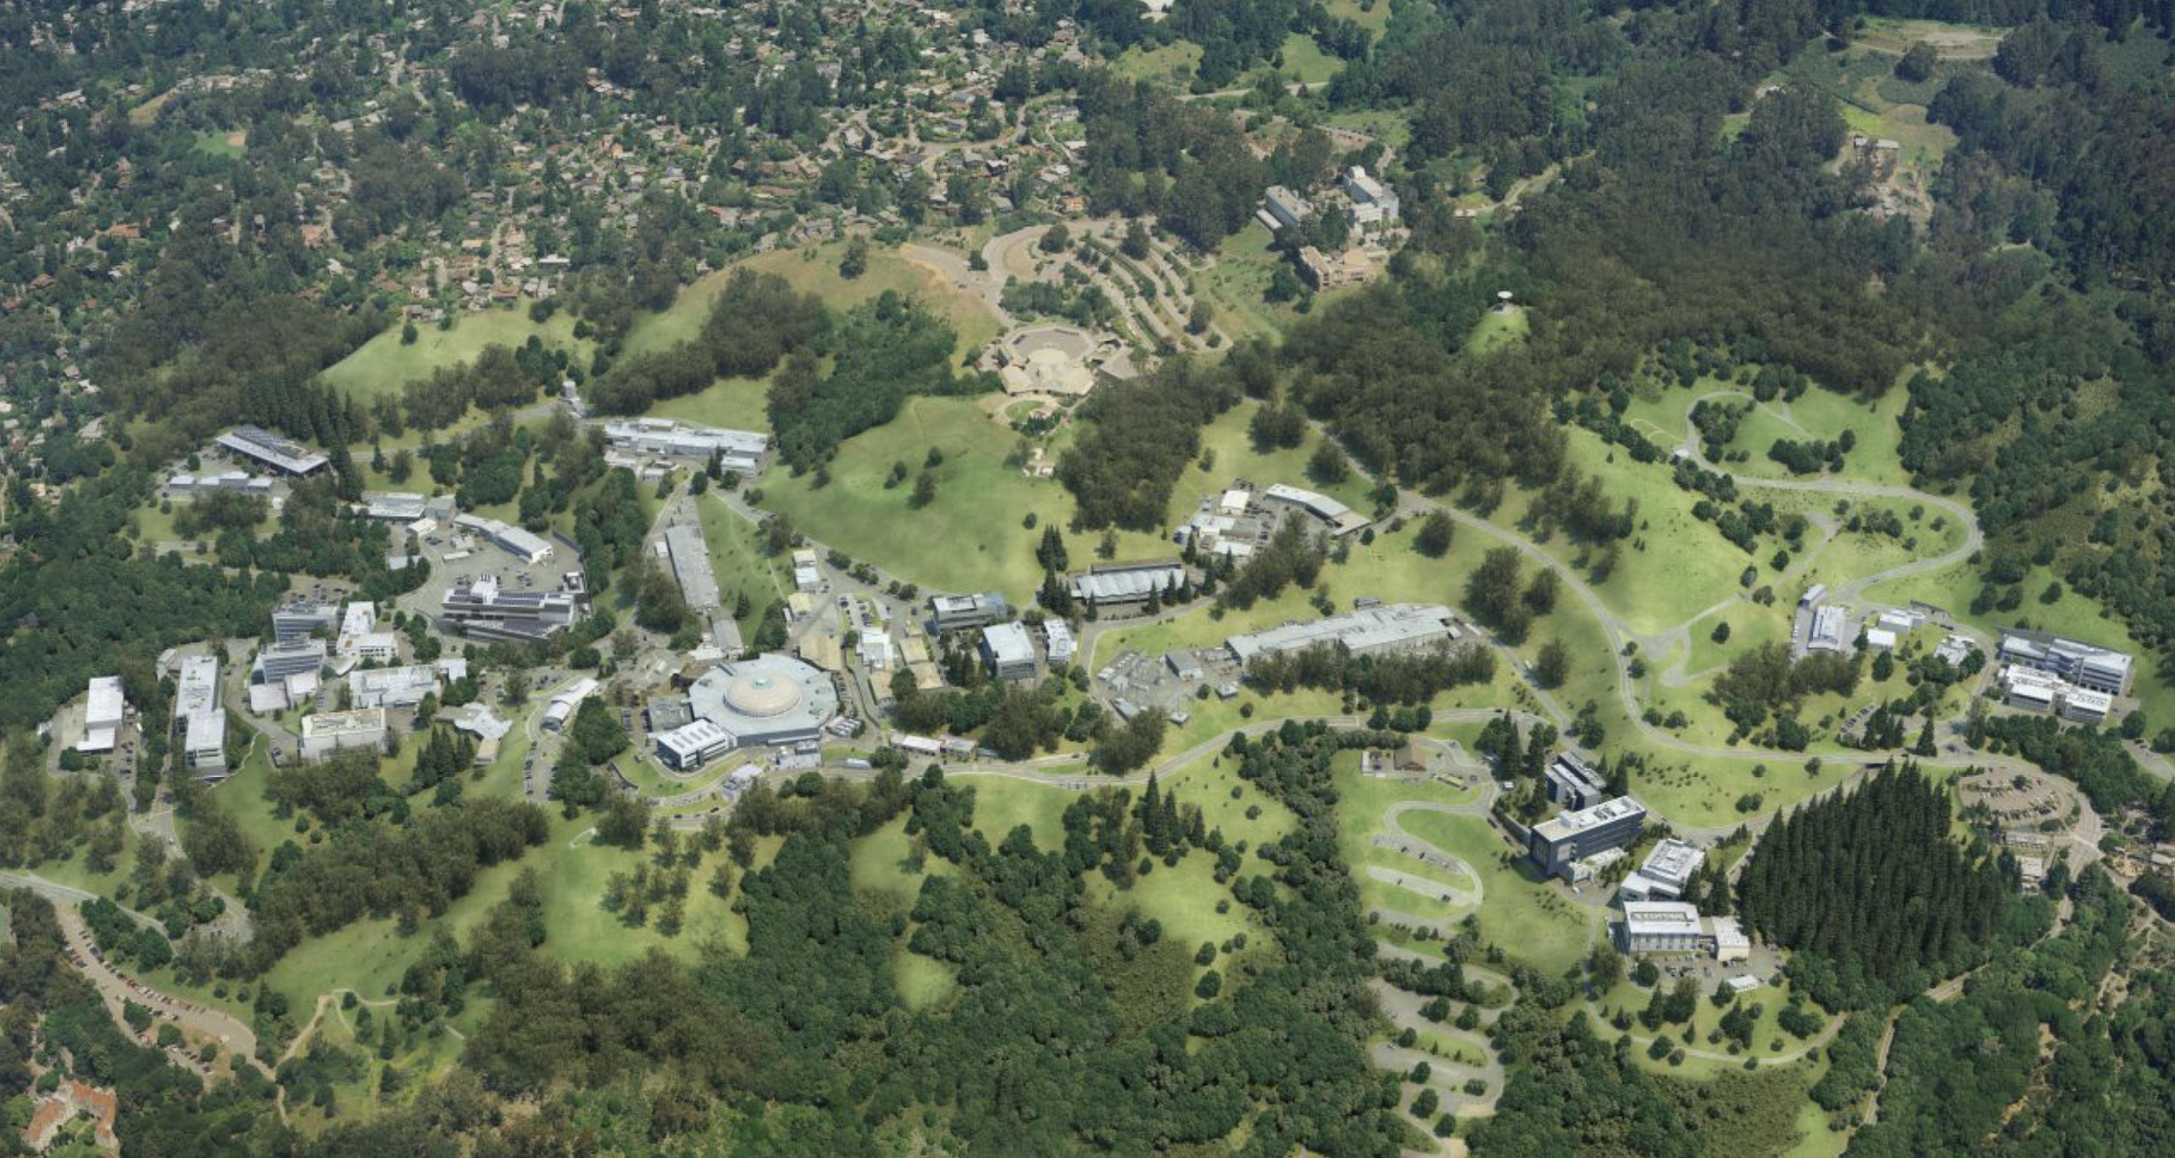
Welcome to the Berkeley Lab Physics in and Through Cosmology Virtual Workshop!
Tony Spadafora
Division Deputy,
Physics Division

Slide 2
Berkeley Lab
Department of Energy National Lab
~ 2000 Scientists and Engineers, many visiting scientists, postdoctoral fellows, students
6 Research Areas
Physical Sciences (including Physics Division), Computing Sciences, Biosciences, Earth and Environmental Sciences, Energy Sciences, Energy Technologies
Major Research Facilities
88” Cyclotron, NERSC Supercomputer Center, ALS X-ray light source, Molecular Foundry (Nano-science center), etc.

Slide 3
Particle Physics and Cosmology
Current Research
What is Dark Matter?
What is Dark Energy?
What can we learn about the Early Universe?
What are the properties of elementary particles?
Testing the Standard Model at the CERN LHC and looking for new physics
Studying the properties of neutrinos

Slide 4
Enjoy Learning about the Universe!

