Slide 1
Big Bang, Big Data, Big Iron
Julian Borrill
Computational Cosmology Center, Berkeley Lab
& Space Sciences Laboratory, UC Berkeley

Slide 2
Cosmologists are often in error
but never in doubt
Lev Landau

Slide 3
My Story

Slide 4
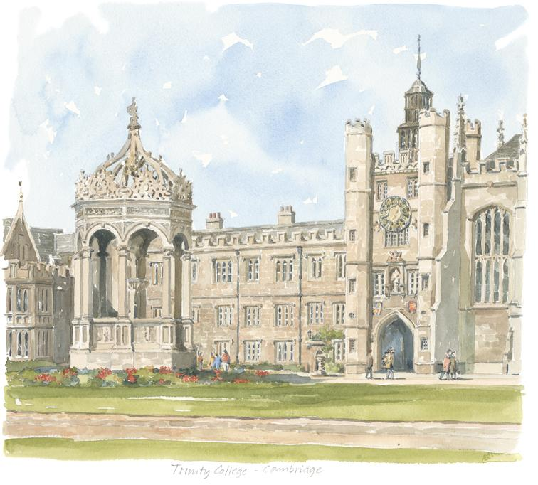
From Elementary School To College
From the age of 5 I knew I wanted to be a mathematician.
My middle school ran out of maths books for me.
I wrote my first computer program (on punch cards!) when I was 10.
In high school I never had to study for math exams and routinely got 100%.
For my “3” A-Levels (cf. NEWTs) I did Maths, Further Maths, Higher Maths, Physics & Chemistry.
My only college application was to read Maths at Trinity College, Cambridge.
In the UK university students study a single subject, chosen when applying.

Slide 5
Trinity College, Cambridge
When I arrived at Trinity I was one of a tiny minority of students who had not been to a “public” school - the most exclusive private schools in England.
These schools included an extra year to prepare their pupils for the special Oxford & Cambridge entrance exams.
From the outset I was a year behind my peers, and Cambridge had a sink-or-swim, teach-to-the-top-of-the-class, approach.
For the final exam of my 2nd year all I could do was write my name!
For my 3rd year I switched to Social & Political Science, and moved out of college accommodation into a halfway house run by Social Services, mixing students and people coming out of mental handicap institutions.

Slide 6
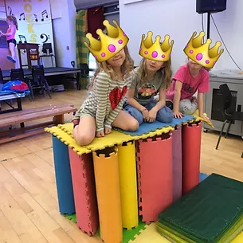
Out Of Academia
After graduation I stayed in Cambridge working at the After School Playcenter where I had volunteered as a student.
I joined the appropriate trade union and was immediately made shop steward for all employees in the non-profit sector in Cambridgeshire.
Employees of non-profit organizations face a very particular set of challenges.
After a year I was offered a full-time job in the union office, and also became active representing union employees
Employees of unions also face a very particular set of challenges.
Although representing people having problems at work was very rewarding, I missed the intellectual challenge of academia.

Slide 7
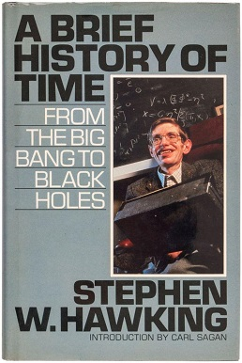
Returning To Academia
During my union office lunch breaks I started sneaking in to Stephen Hawking’s undergraduate cosmology lectures.
The lectures were amazing; the book is unreadable!
During my long weekend commutes I started reading popular particle physics & cosmology books like Steven Weinberg’s “The First 3 Minutes”.
I was accepted onto a 2-year part-time (evenings) Masters Degree in Astrophysics at Queen Mary College, London and got a temporary job at a nearby union office.
As that job expired, I was also accepted onto a 1-year full-time Masters Degree in Computer Science at Queen Mary College.
Doing 2 Masters Degrees simultaneously is challenging!

Slide 8
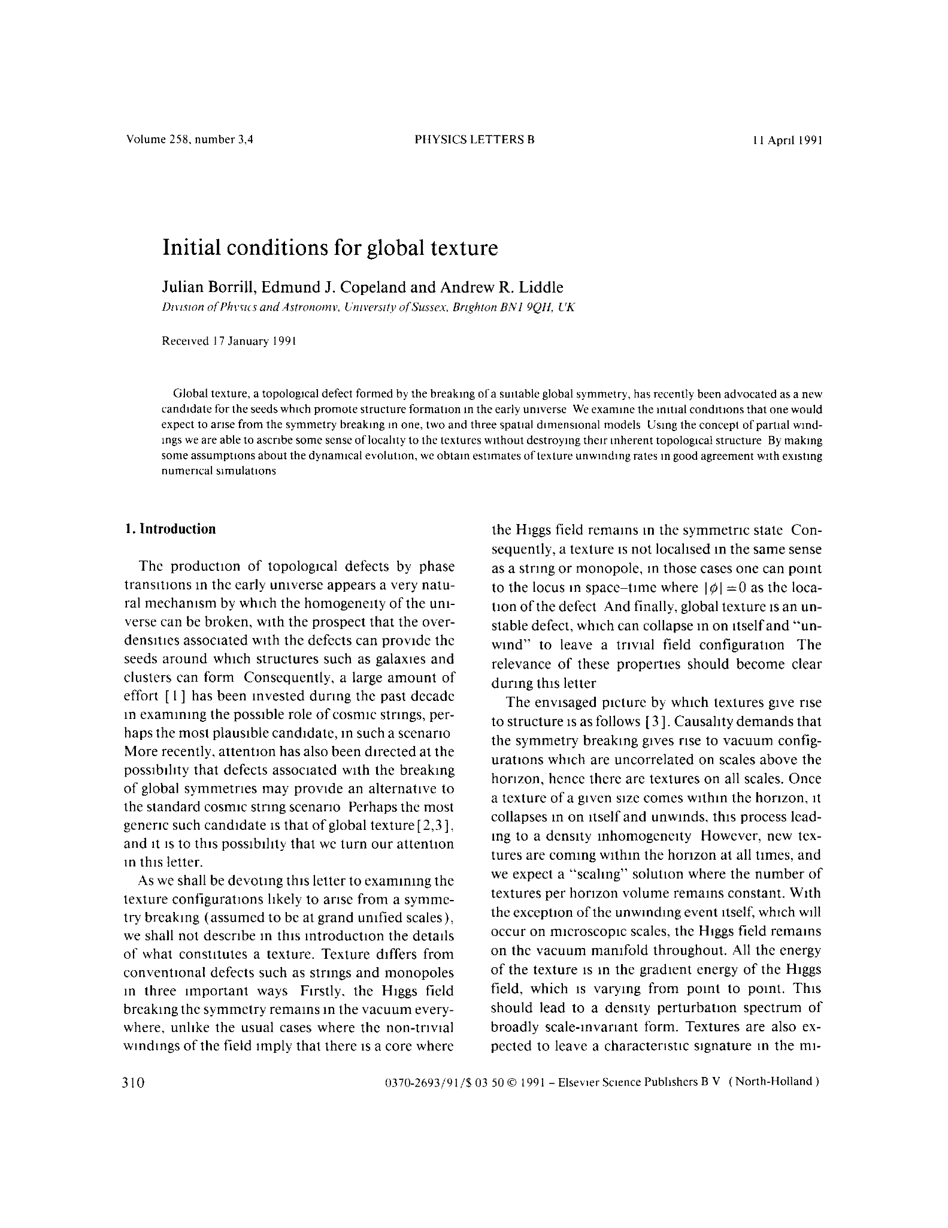
Doctoral & Postdoctoral Work
After double-graduating, I was accepted into a 3-year PhD program in Cosmology at the University of Sussex, studying topological defects.
My computing training was extremely useful - within weeks I was running numerical simulations of defect formation and evolution, and within 3 months had published my first academic paper.
2-year postdoctoral positions followed at Imperial College, London and then Dartmouth College, in both cases working on numerical simulations of early-universe phase transitions.
Based on my cosmology + computing skills, I was then offered a postdoctoral position in cosmological data analysis at UC Berkeley.

Slide 9
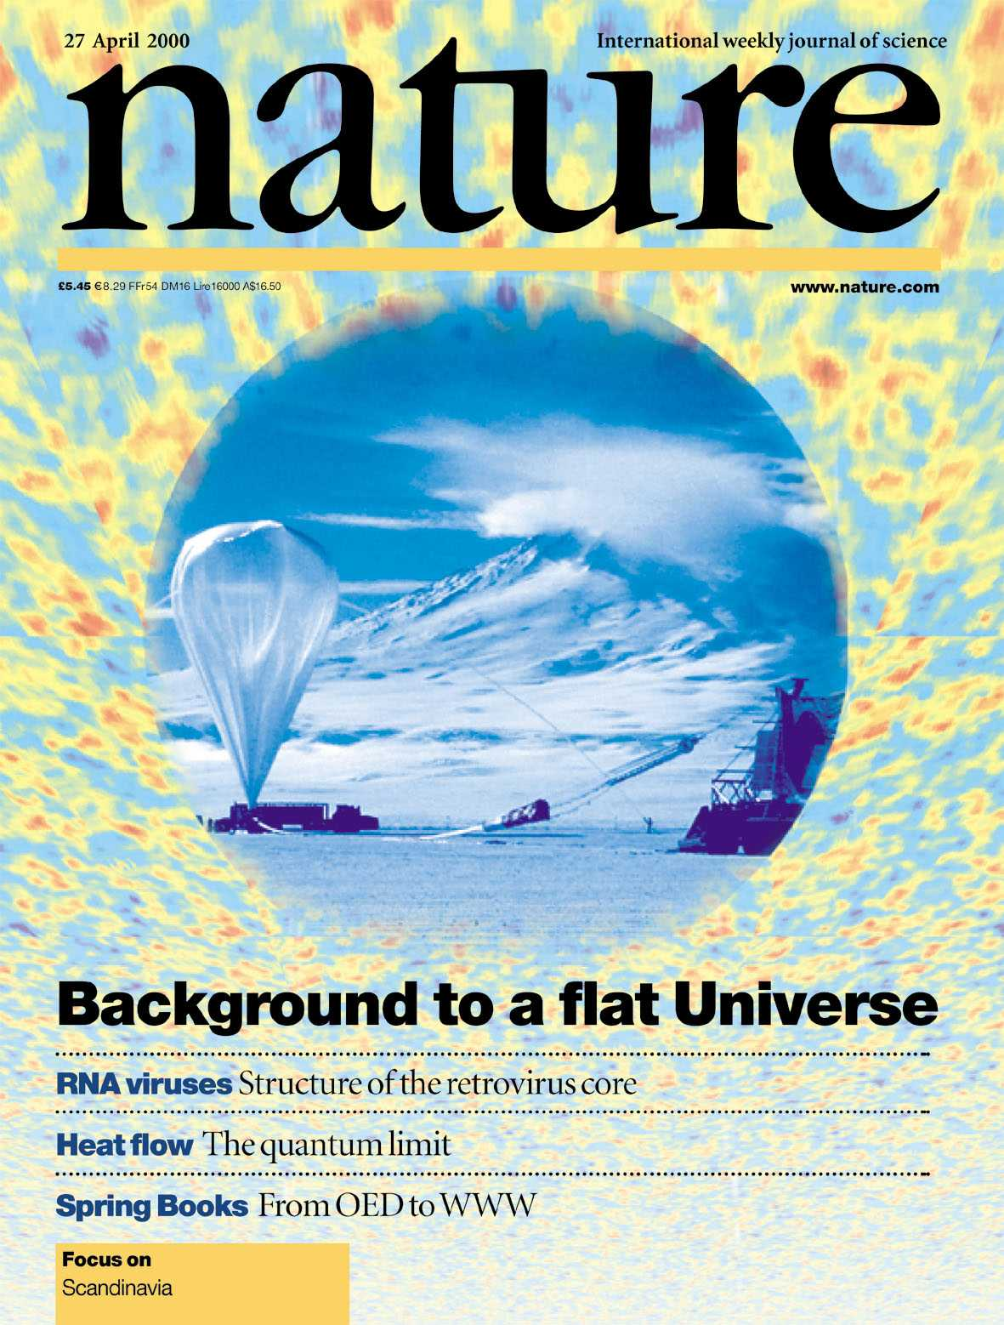
A Series Of Fortunate Events
In 1997, just as I moved to Berkeley, the DOE’s flagship supercomputer center (NERSC) was being relocated to Berkeley Lab, and I was immediately offered a postdoc position doing cosmological data analysis there instead.
In 2000, just as Berkeley Lab had to decide whether to promote me to a long-term position, we published the BOOMERanG results showing that the Universe was flat, which made the front page of Nature.
In 2001, just as I needed a Green Card to stay in the US, the rules were temporarily changed to fast-track people in computing and I received mine in only 6 months.

Slide 10
Being a Lab Scientist
I have now been a scientist at the lab for over 20 years.
Many lab position are supported by so-called “soft money” (short-term funding to do a contracted piece of work); in Computing Sciences they all are.
Even when my position was made permanent, I still needed to raise the funds to support myself and my group.
Over the years this has meant constantly needing to secure new funding - from experiments (Planck, Simons Observatory, CMB-S4) and from general research programs (NASA, NSF, DOE, LBL).
Over time, there is an inevitable transition from just doing science to also doing the work needed to enable other people to do science.

Slide 11
Questions?

Slide 12
Cosmology

Slide 13
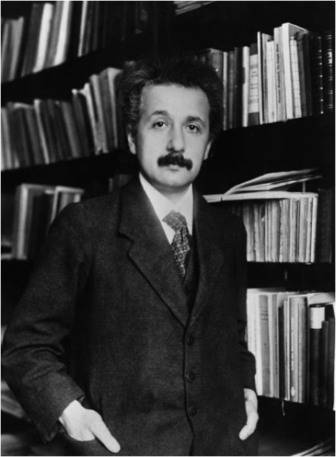
1916 - General Relativity
Space tells matter how to move
Matter tells space how to bend
G_{μν} = 8 π T_{μν} - Λ g_{μν}
Space Matter CC
This implies that the Universe is dynamic, but everyone knows it is status …
… so Einstein adds a fine-tuned Cosmological Constant, even though the result is an unstable equilibrium.

Slide 14
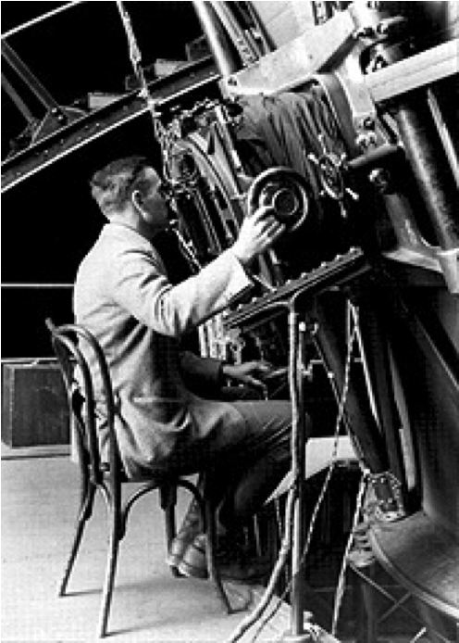
1929 - The Expanding Universe
Hubble measures nearby galaxies
Velocities (from redshifts)
Distances (from Cepheid variable stars)
and finds velocity proportional to distance.
Space is expanding and the Universe is dynamic!
Einstein calls the cosmological constant his biggest blunder.

Slide 15
1930-60s - Steady State or Big Bang
What does an expanding Universe tells us about its origin and fate?
Steady State Theory:
new matter is created to fill the space generated by the expansion, and the Universe as a whole is unchanged and eternal (past & future).
Big Bang Theory:
the Universe (matter and energy; space and time) is created in a single explosive event, resulting in an expanding and hence cooling & rarifying Universe.
endorsed by Pope Pius XII in 1951: “Fiat lux”.

Slide 16
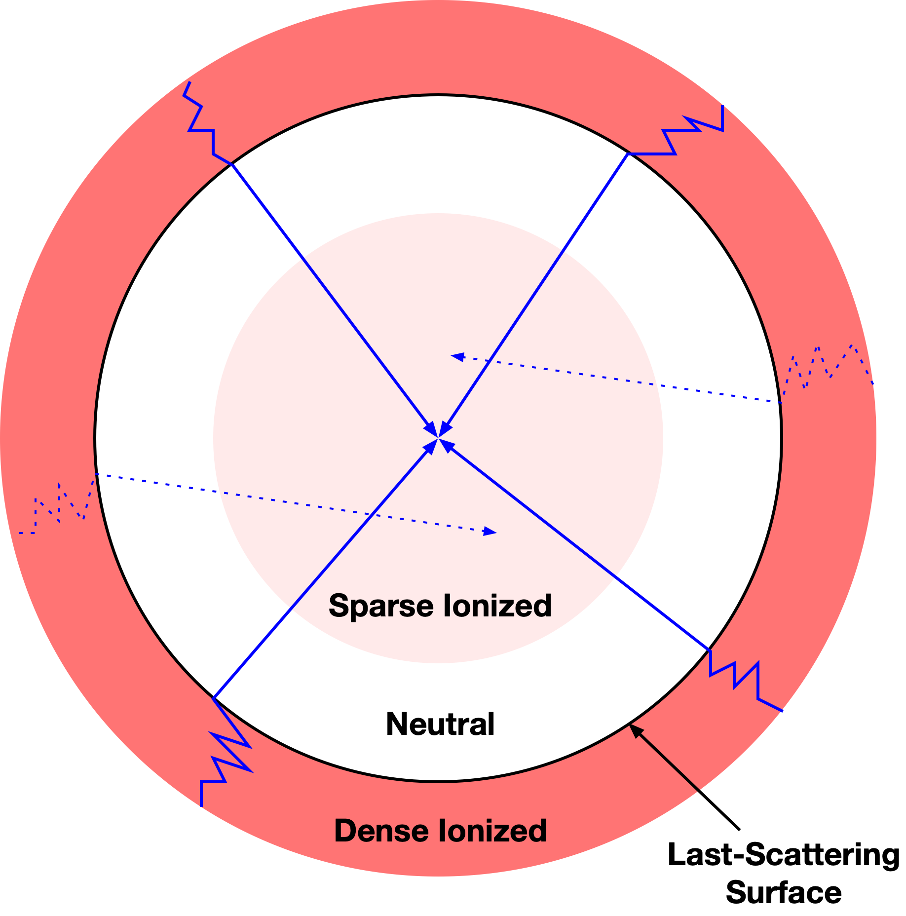
1948 - Cosmic Microwave Background: Prediction
After a Big Bang the Universe expands and cools, eventually dropping below the ionization temperature of hydrogen.
The protons and electrons form hydrogen atoms, and the primordial photons stop scattering and free-stream to us today.
Alpher & Herman predict a 5K residue.
COSMIC: filling all space
MICROWAVE: redshifted from 3000K to 3K
BACKGROUND: “behind” all other sources

Slide 17
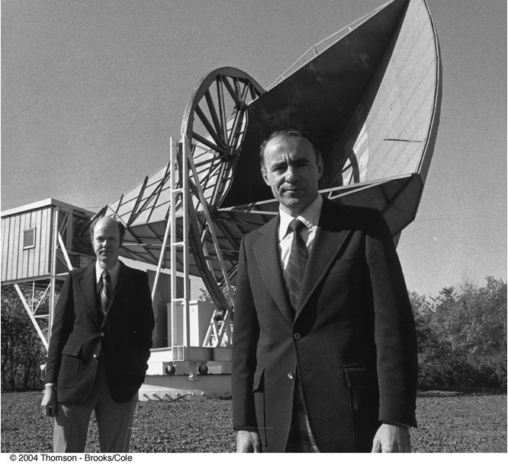
1964 - Cosmic Microwave Background: Detection
Penzias & Wilson find a puzzling signal that is constant in time and direction.
They determine it isn’t a systematic – not terrestrial, instrumental, or due to a “white dielectric substance”.
Dicke, Peebles, Roll & Wilkinson explain to them that they’re seeing the Big Bang.
Their accidental measurement kills the Steady State theory and earns them the 1978 Nobel Prize in Physics.

Slide 18
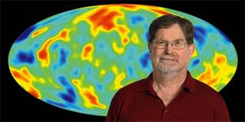
1992 - Cosmic Microwave Background: Fluctuations
For structure to exist in the Universe today the very early Universe cannot have been perfectly uniform.
Despite its apparent uniformity, the CMB must carry the imprint of these imperfections.
After 20 years of searching, fluctuations in the CMB temperature are finally detected by the COBE satellite mission.
COBE also confirms that the CMB has a perfect black body spectrum, as a residue of the Big Bang would.
Mather & Smoot (LBL) share the 2006 Nobel Prize in Physics.

Slide 19
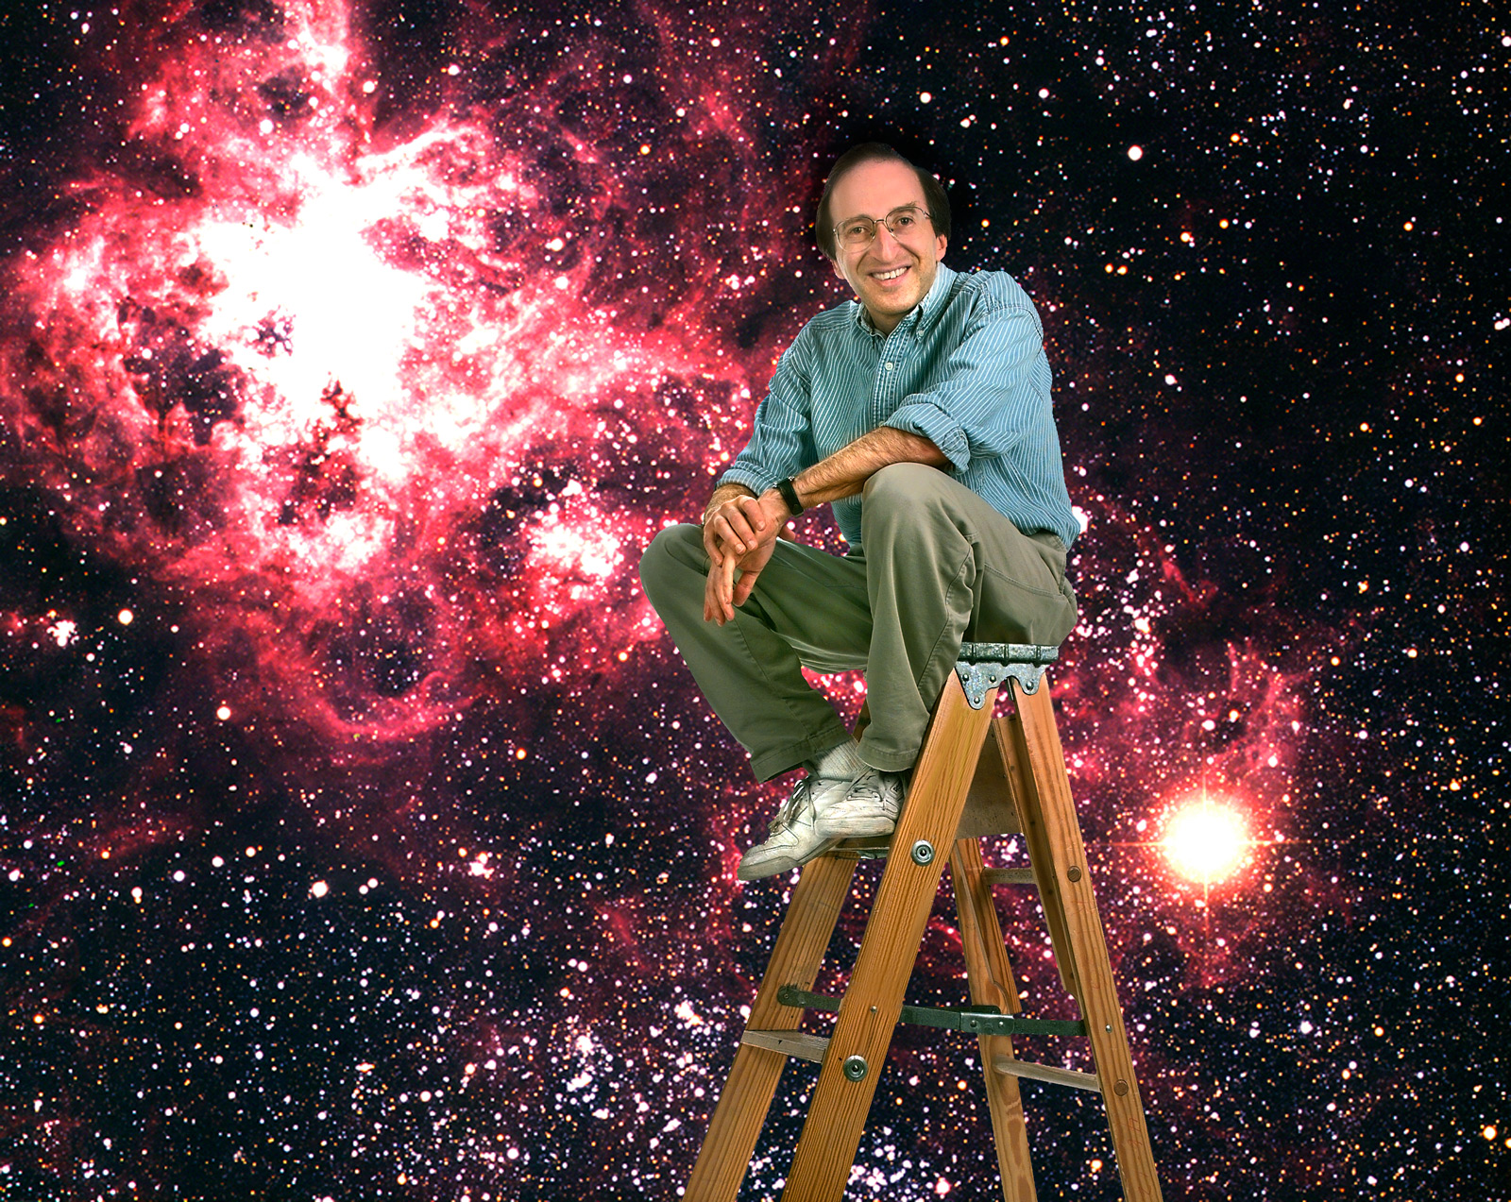
1998 - The Accelerating Universe
Both the dynamics and the geometry of the Universe are thought to depend solely on its overall density Ω:
Critical (Ω = 1): expansion rate asymptotes to zero, flat Universe.
Subcritical (Ω < 1): eternal expansion, open Universe.
Supercritical (Ω > 1): expansion to contraction, closed Universe.
Measurement of supernovae show that in fact the expansion of the Universe is accelerating!
This acceleration may be driven by a cosmological constant!
Perlmutter (LBL) + Riess & Schmitt share the 2011 Nobel Prize in Physics

Slide 20
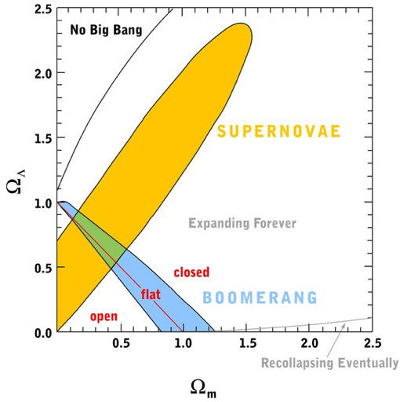
2000 - The Concordance Cosmology
The BOOMERanG & MAXIMA balloon experiments measure small-scale CMB fluctuations, demonstrating that the Universe is flat.
CMB => cosmic geometry: Ω_{Λ} + Ω_{m} ≃ 1.0
Supernovae => cosmic dynamics: Ω_{Λ} - Ω_{m} ≃ 0.4
Their combination breaks the degeneracy.
The concordance cosmology
70% Dark Energy
25% Dark Matter
5% Baryonic Matter (ordinary stuff)
95% Ignorance!
What and why is the dark Universe?

Slide 21
Questions?

Slide 22
Decoding The CMB

Slide 23
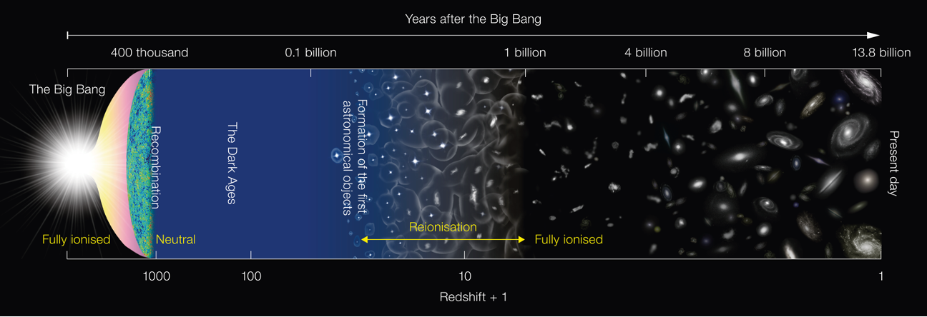
CMB Science
CMB photons have seen the entire history of the Universe, and everything that happens leaves its imprint on them.
Primordial anisotropies: fluctuations in the CMB imprinted in the very early Universe, tracking fundamental physics and cosmology
Secondary anisotropies: fluctuations in the CMB imprinted as its photons interact with clusters of galaxies, tracking structure formation and evolution

Slide 24
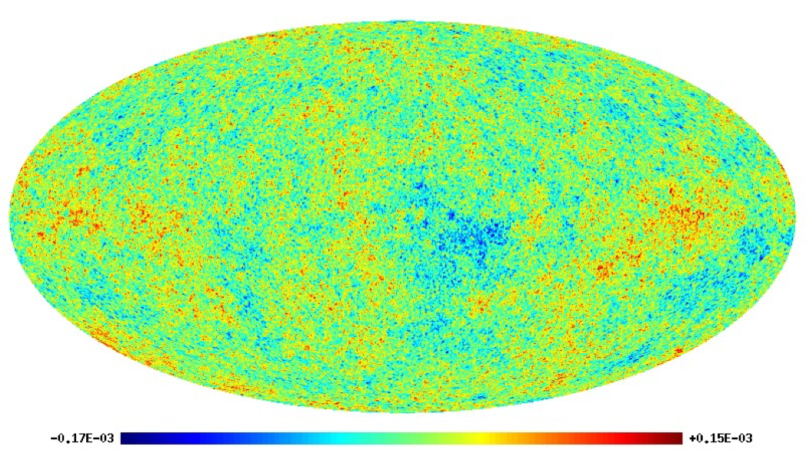
CMB Maps
We see a specific realization of the CMB particular to our place and time.
To compare our observed CMB with the predictions of any theory we need a generic statistical description.

Slide 25
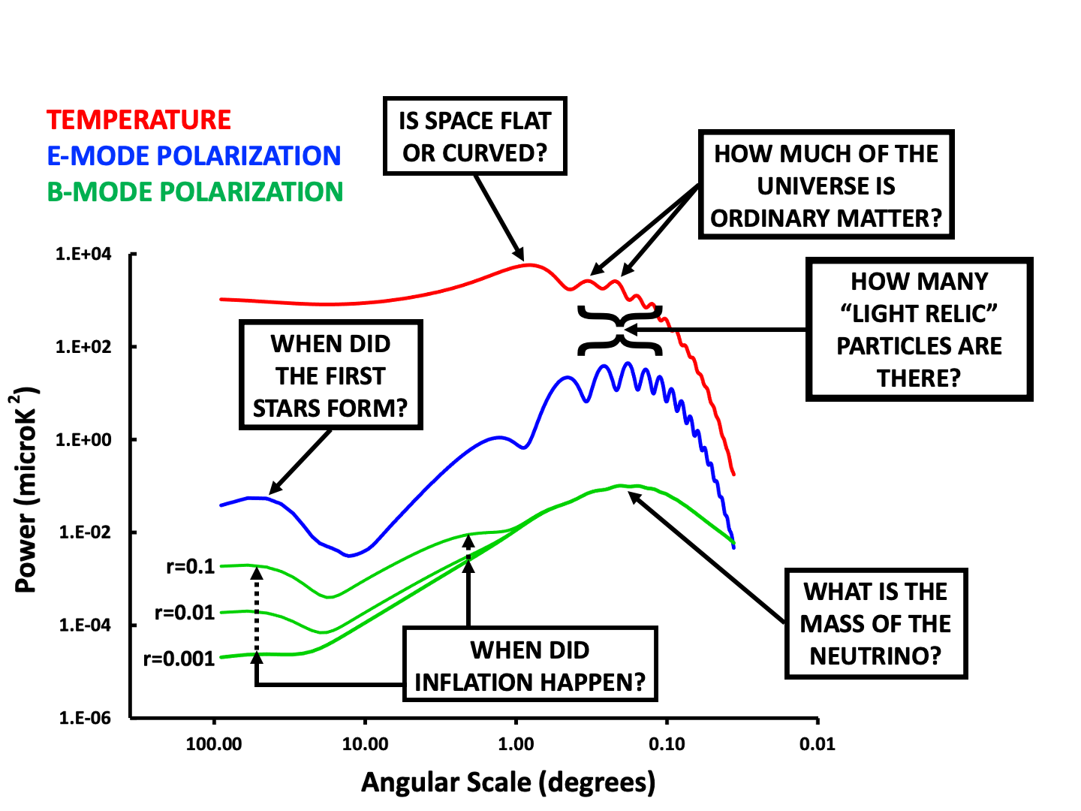
CMB Power Spectra

Slide 26
CMB Signals
COMPONENT | AMPLITUDE (K) | ERA (EXPERIMENT)
TT : Monopole | 1 | 1968 (Penzias & Wilson)
TT : Anisotropy | 10⁻⁵ | 1990 (COBE)
TT : Harmonic Peaks | 10⁻⁶ | 2000 (BOOMERanG, MAXIMA)
EE : Reionization | 10⁻⁷ | 2005 (DASI)
BB : Lensing | 10⁻⁹ | 2015 (SPT, POLARBEAR)
BB : Gravitational Waves | < 10⁻⁹ | 2020+
These are extremely faint signals!

Slide 27
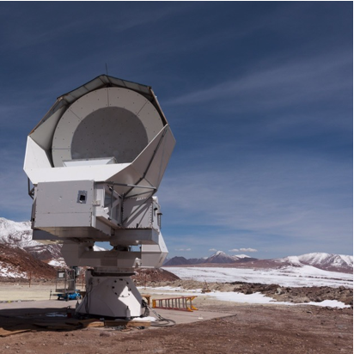
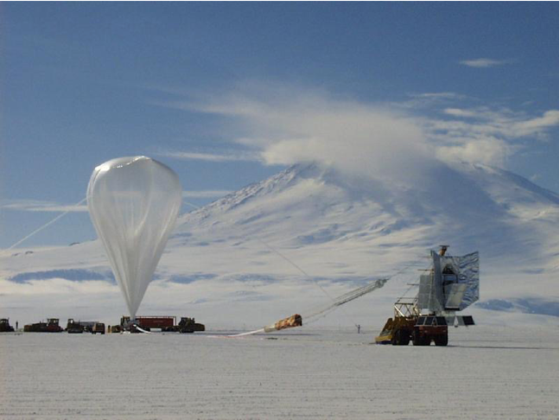
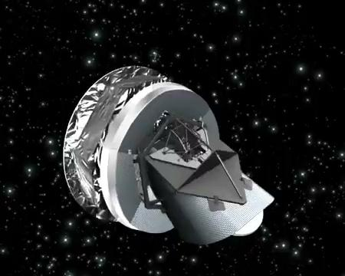
CMB Observations
We are searching for tiny (μK - nK) fluctuations on a very cold (3K) background.
We need very many, very cold, detectors.
We scan part of the sky from high dry ground or the stratosphere, or all of the sky from space.

Slide 28
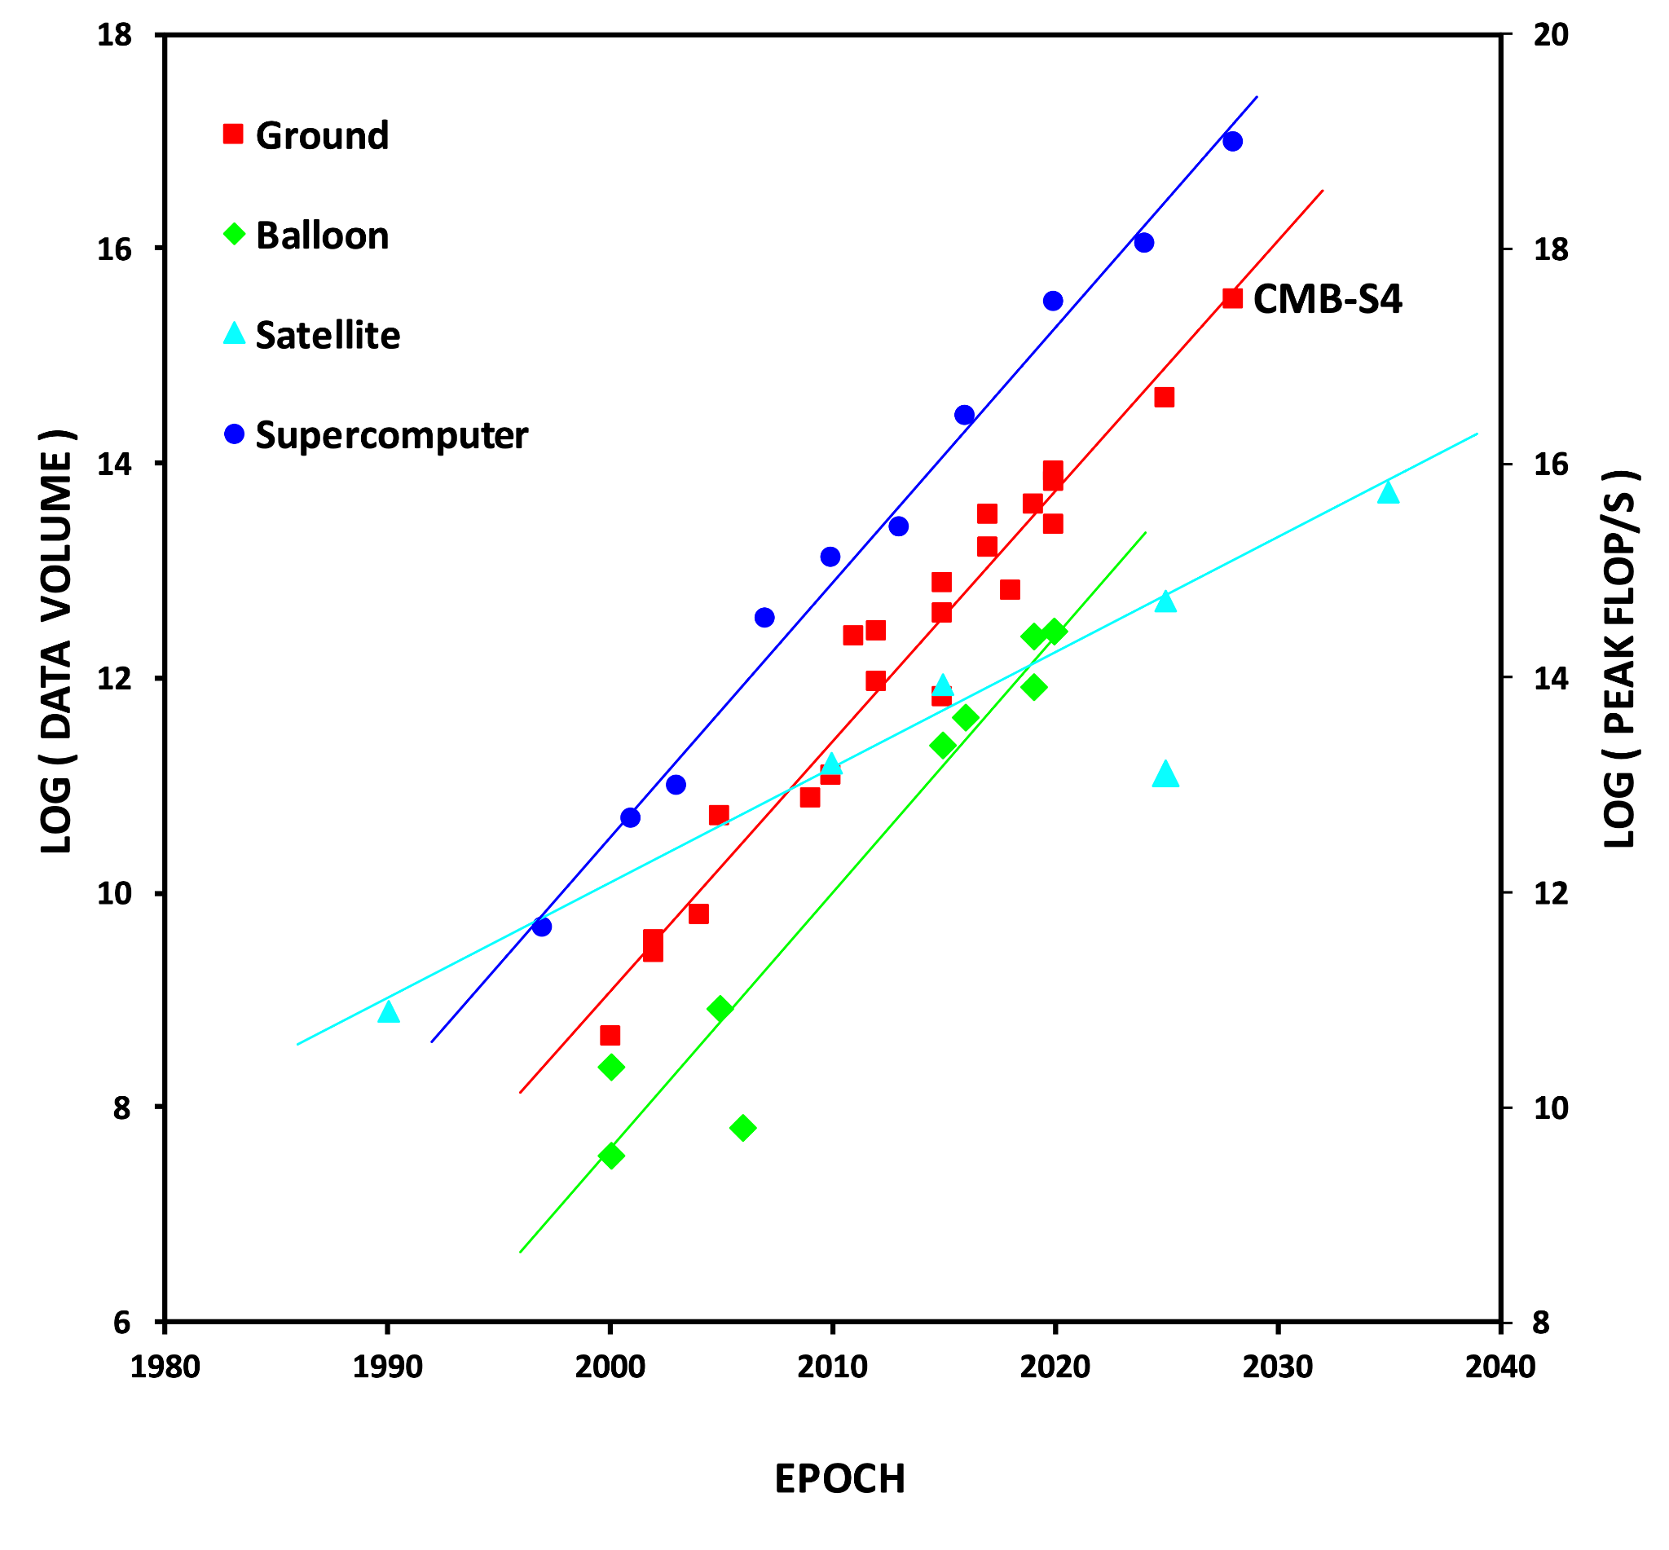
CMB Data Sets
To detect fainter signals we have to gather larger datasets.
Like computing power, CMB datasets have been growing exponentially for over 40 years.
Unlike computing power, they will continue to!

Slide 29
Quick Quiz …
How many arithmetic operations does it take to multiply:
two vectors each with N elements?
a matrix with NxN elements and vector with N elements?
two matrices each with NxN elements?
Take a 2-minute break to stretch and think.

Slide 30
Supercomputers & The CMB

Slide 31
Data Analysis
In an ideal Universe, we would make measurements that were purely the signal we wanted.
In practice there are two kinds of contaminants:
Statistical, which can be averaged down simply by collecting more data - eg. random noise fluctuations
Systematic, which don’t average down but have to be explicitly removed - eg. galactic foregrounds
The fainter the signal we want to measure, the larger the dataset we need to gather (statistical) and the more precisely we have to understand it (systematic)

Slide 32
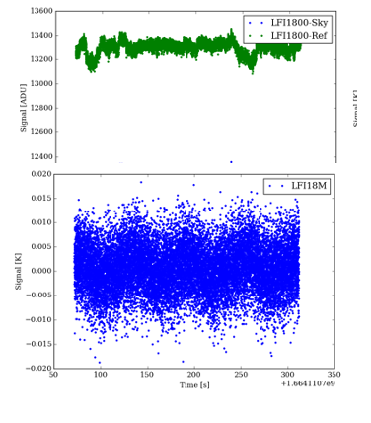
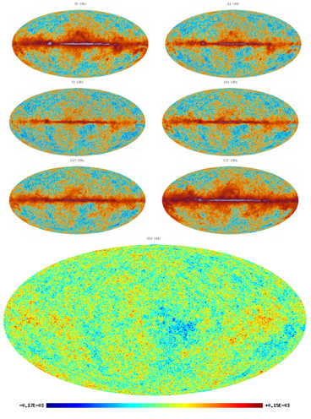
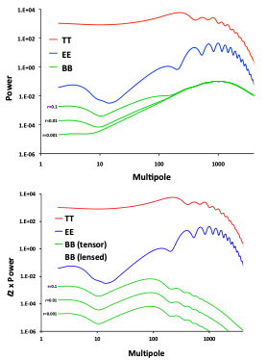
CMB Data Analysis
To convert our raw CMB data into science we have to progressively compress it:
Time streams
Maps
Power spectra
At each step we first mitigate the systematic effects in that domain, then compress to the next domain.

Slide 33
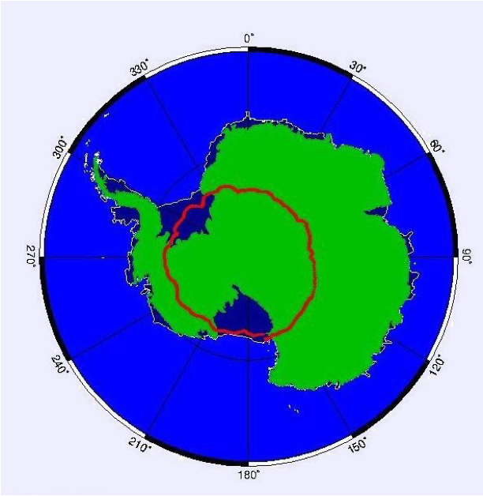
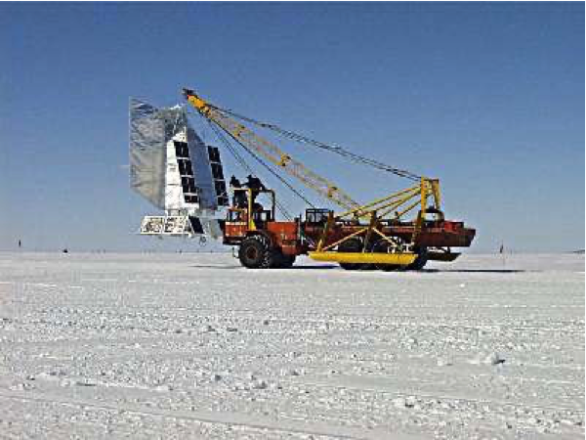
Case 1 - BOOMERanG
Balloon experiment flown from McMurdo Station.
10 days with 16 detectors at 35km, circumnavigating Antarctica.
Temperature data at 4 frequencies: 90 - 400 GHz

Slide 34
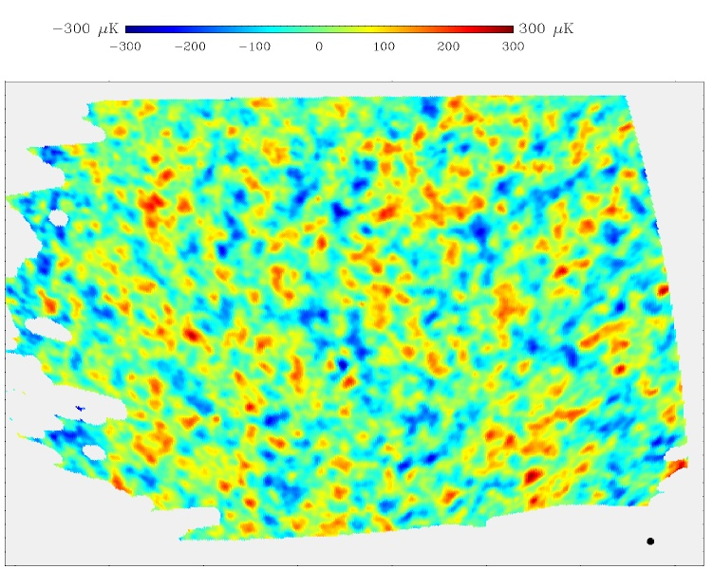
BOOMERanG Analysis
There are straightforward Gaussian likelihood equations that tell us
The most likely maps given the timestream data and their statistics
The most likely power spectra given the maps and their statistics
Although these dense linear algebra equations were too big to solve on a laptop, they would fit on a supercomputer - this is what I was brought to Berkeley Lab to do.
I implemented the MADCAP software package, ran it on NERSC’s 600-core Cray T3E, and got to be the first person to see the Big Bang!

Slide 35
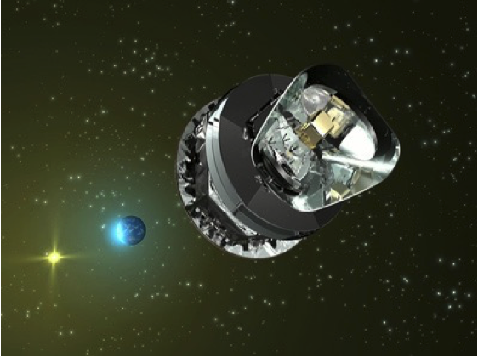
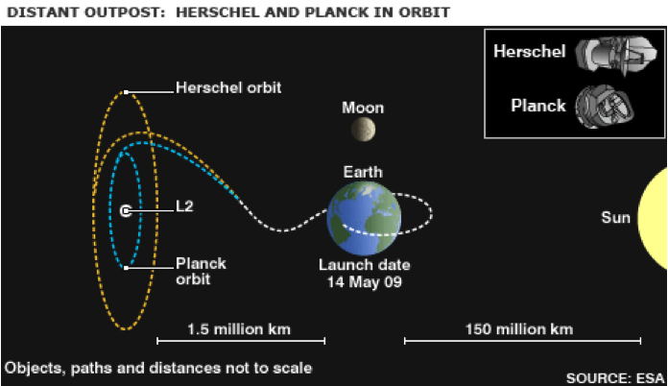
Case 2 - Planck
ESA/NASA satellite mission.
4 years with 72 detectors at L2.
Temperature and polarization data at 9 frequencies: 30 - 857 GHz

Slide 36
Planck Analysis - The Challenge
 | BOOMERanG | Planck
Sky fraction | 5% | 100%
Resolution | 20 arcminutes | 5 arcminutes
Frequencies | 1 | 9
T/P Components | 1 | 3
Pixels (N) | O(10⁵) | O(10⁹)
Operations (N³) | O(10¹⁵) | O(10²⁷)
Exact methods are no longer computationally feasible.

Slide 37
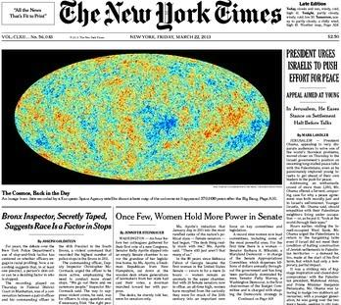
Planck Analysis - The Solution
Since we cannot use exact methods we must approximate and quantify the impact of our approximations.
This typically means using Monte Carlo methods, generating and reducing many realizations of the dataset to understand its statistics.
For Planck we generated 10,000 detailed mission realizations using NERSC’s 130,000-core Cray XC30.

Slide 38
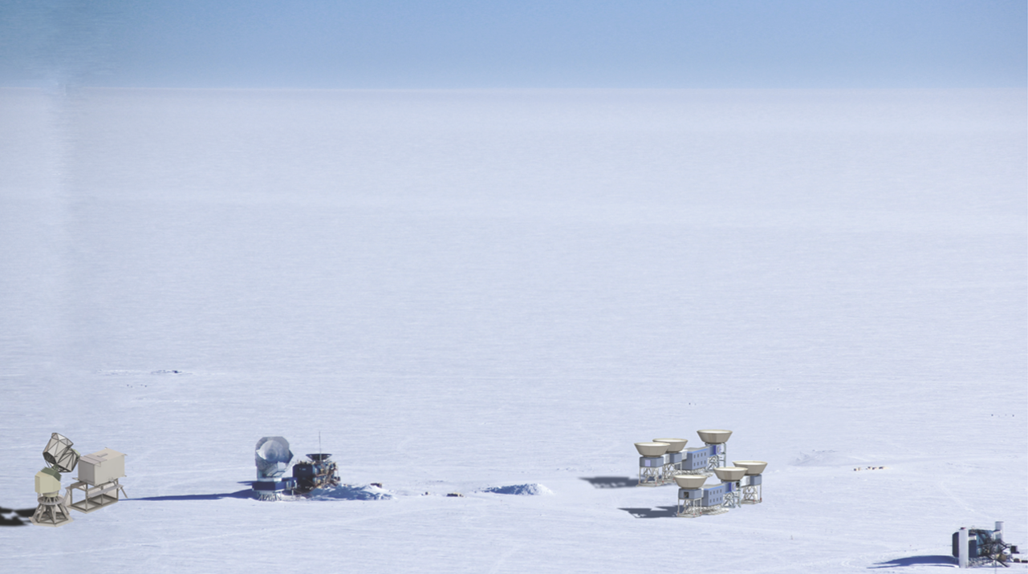
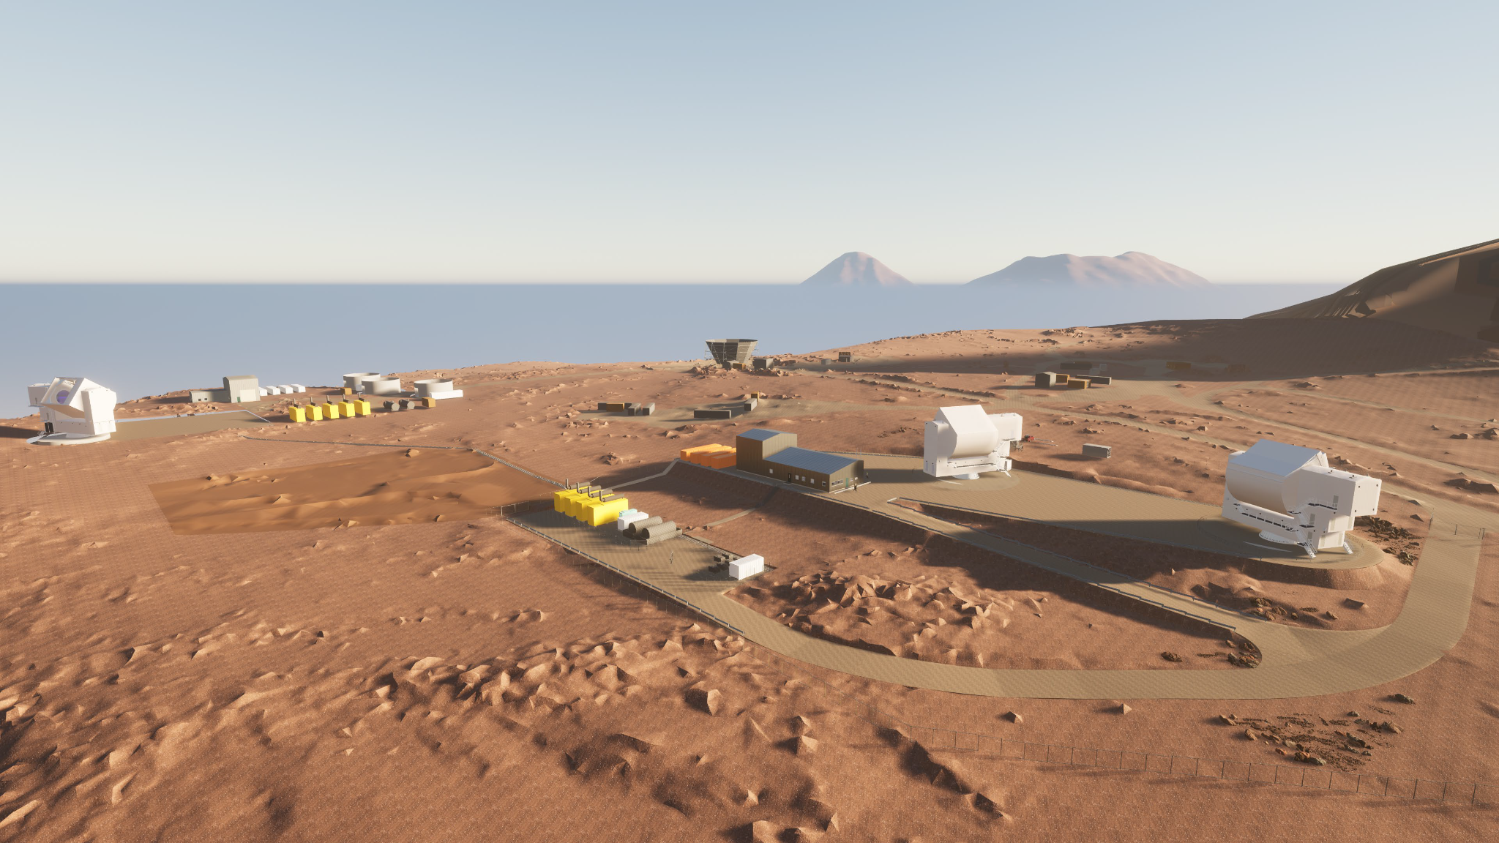
Case 3 - CMB-S4
CMB-S4 will be the ultimate ground-based CMB experiment.
7 years with 550,000 detectors on 21 telescopes at the South Pole and in Chile
Temperature and polarization data at 8 frequencies: 20 - 280 GHz

Slide 39
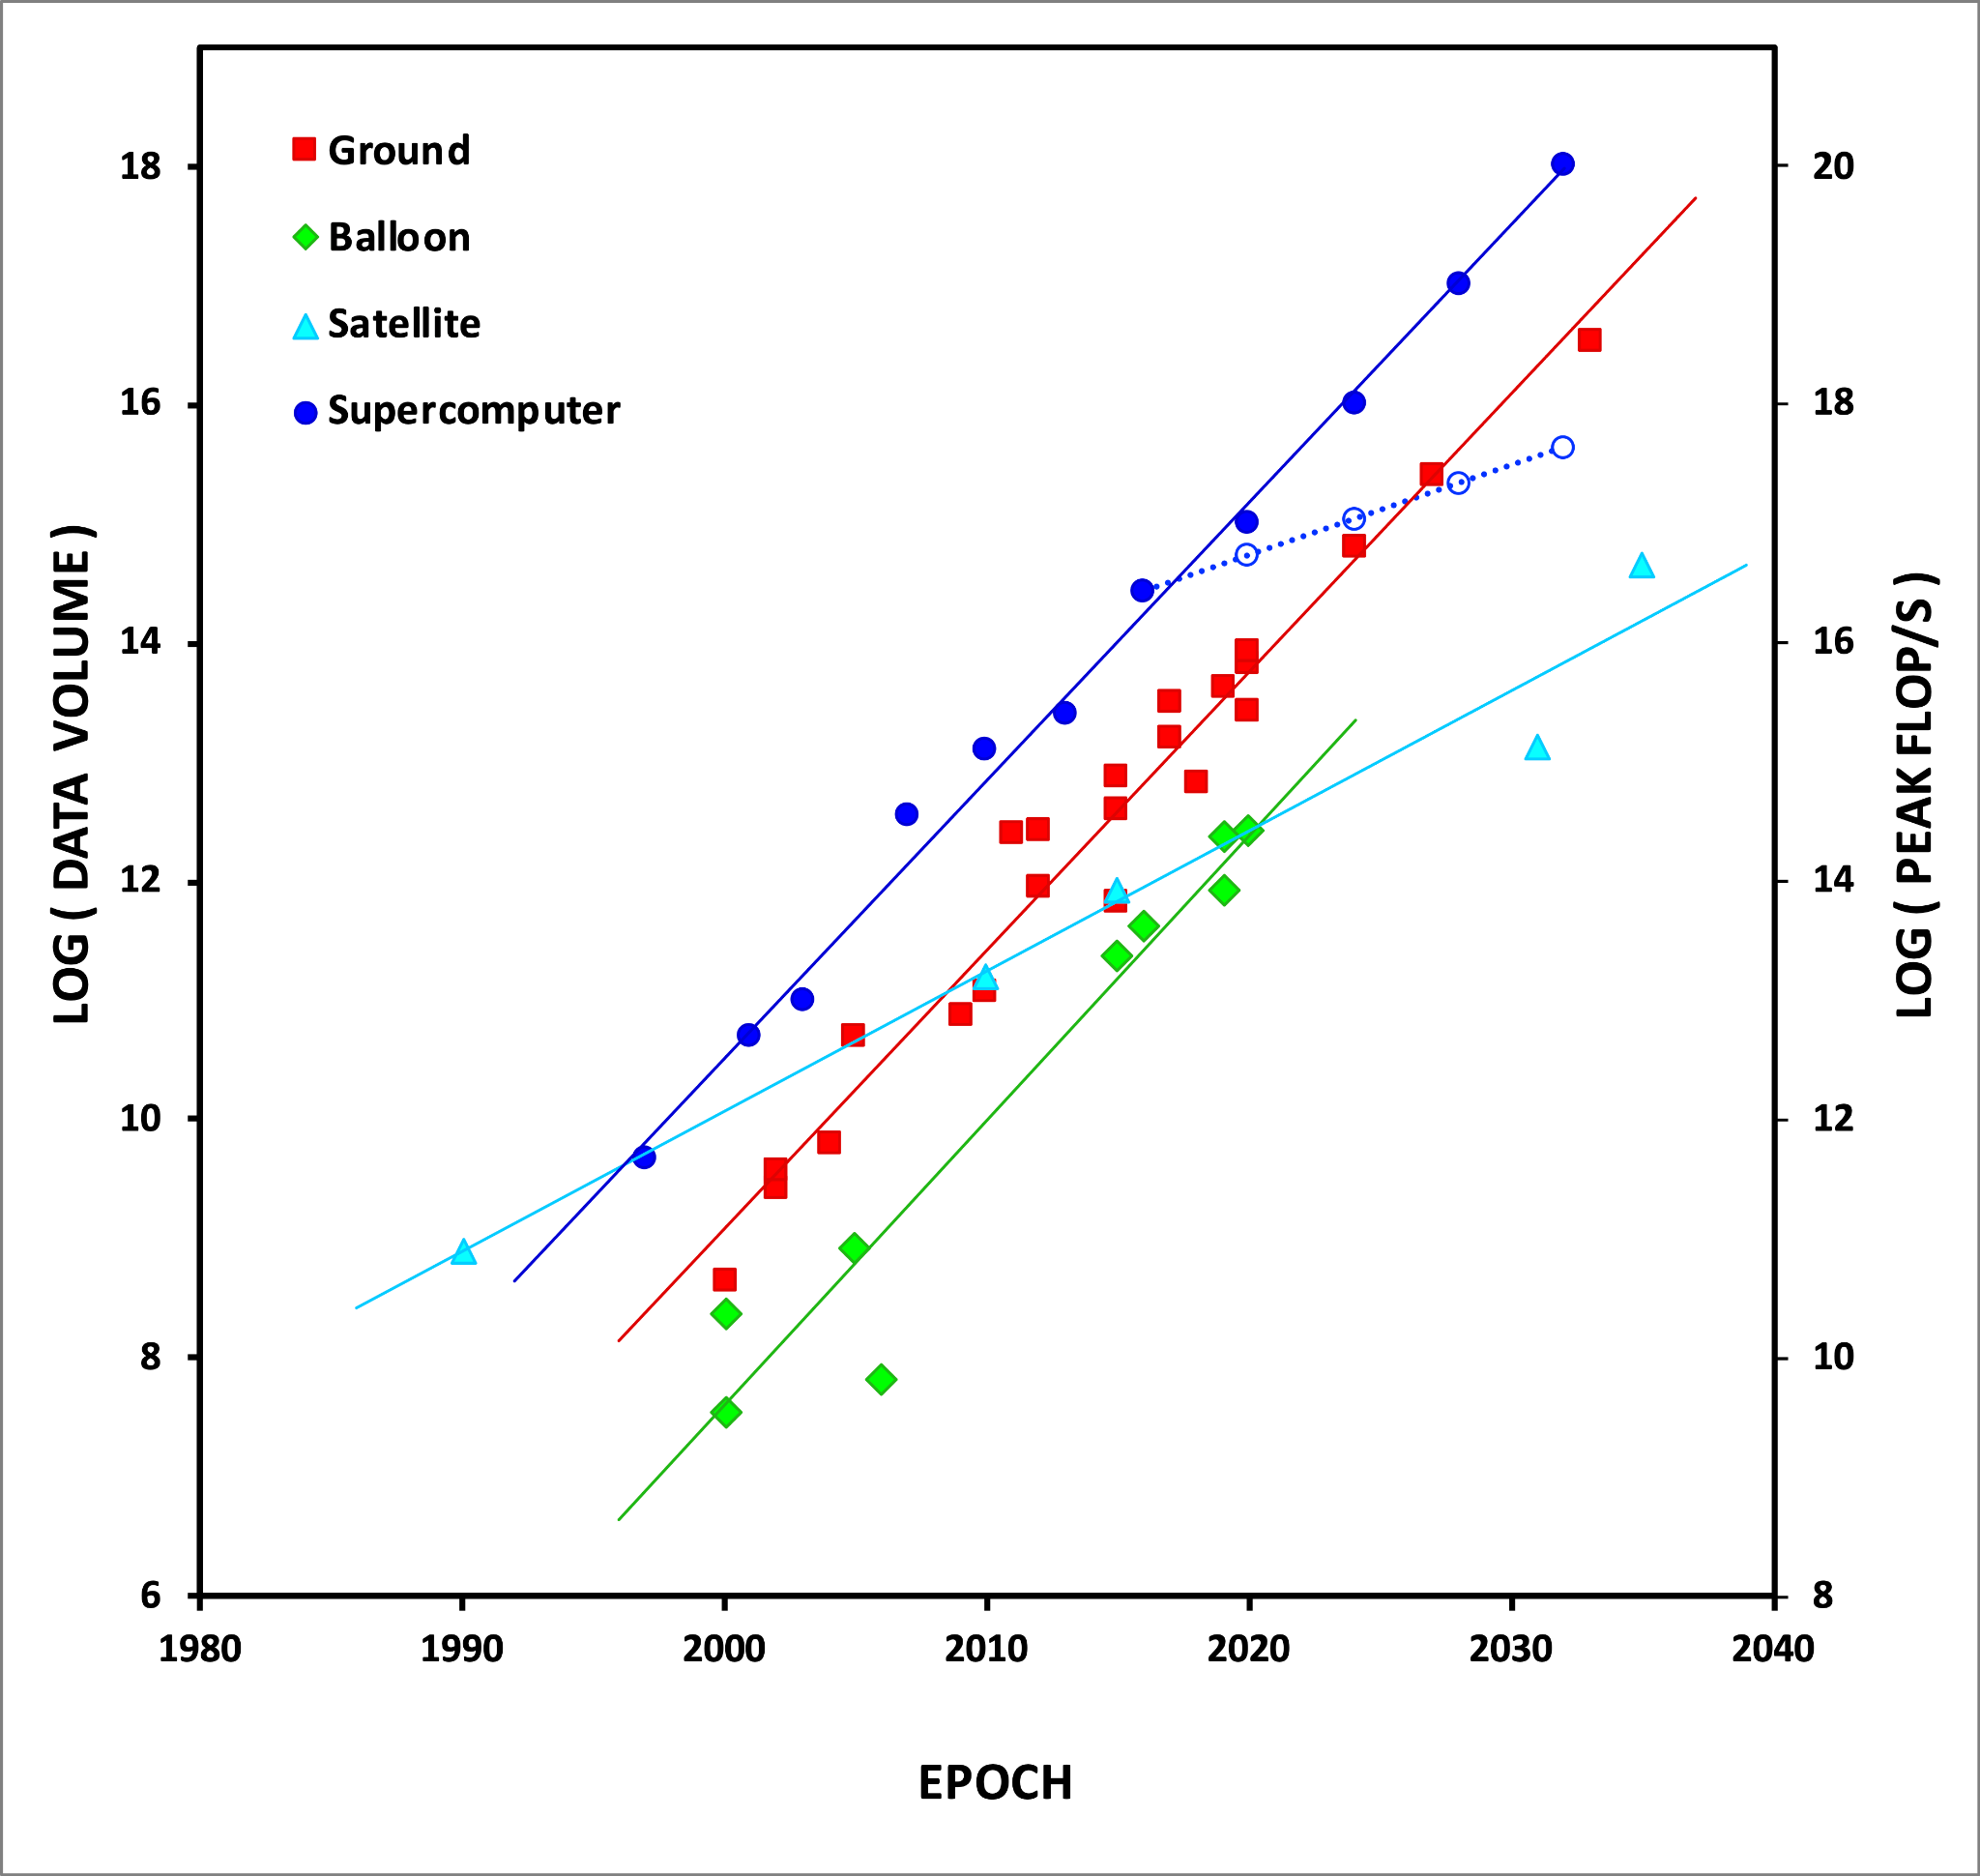
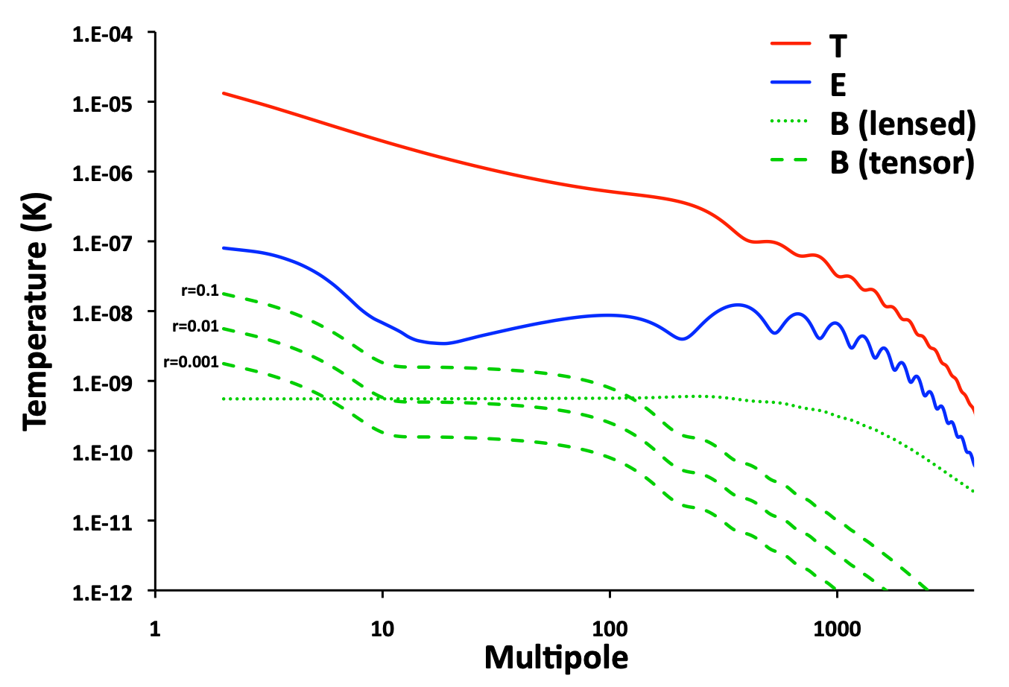
CMB-S4 Analysis - The Challenges
PRECISION - ALGORITHMS
1000x higher systematics
Atmosphere
Ground pickup
Polarization modulator
100x lower systematics threshold
PERFORMANCE - IMPLEMENTATIONS
1000x larger data volume
100x fewer watts per FLOP
Overall we will need a 10¹⁰-fold improvement in our computational efficiency!

Slide 40
CMB-S4 Analysis - The Solution
Research in progress!
All we know is that it will involve combining computer & computational science, experimental & theoretical cosmology.

Slide 41
Summary
The Cosmic Microwave Background radiation provides a unique probe of the entire history of the Universe.
Our quest for fainter and fainter signals requires
bigger and bigger data volumes, and
tighter and tighter control of systematics.
Exponential data growth and increasingly complex analyses compels us to stay on the leading edge of high performance computing.
Our analysis methods, algorithms and implementations necessarily evolve with both the data volumes and HPC architectures.
CMB-S4 and power-constrained, post-Moore’s Law, HPC pose the most challenging data/architecture combination we have yet faced.

Slide 42
Questions?

