Slide 1
Scientist Interview Project
Haein Lee, Evan Rose, Loula Barnes, Neal Hamilton, Eric Yin

Slide 2
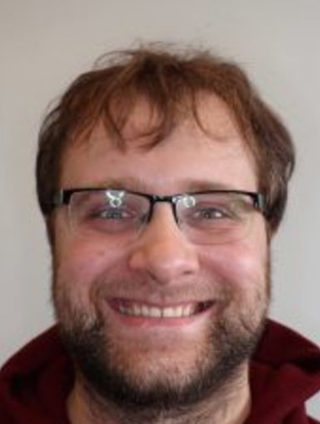
Our Scientist: Karol Krizka
Particle Physicist
Experimental High Energy Physics
Postdoc at Berkeley Lab with ATLAS

Slide 3
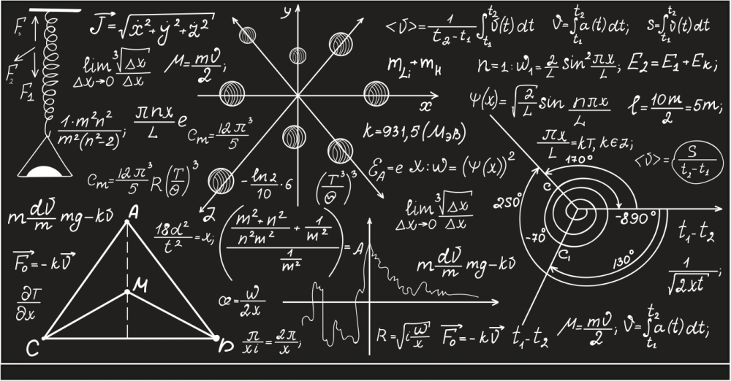
Career Path
Highschool → Comp Sci. Independently
Undergrad → Major in mathematical physics, minor in comp sci.
Did summer projects on theory
Graduate → @ University of Birmingham
Chamberlain Postdoctoral Fellow @ Berkeley Lab
Fundamental Physics

Slide 4
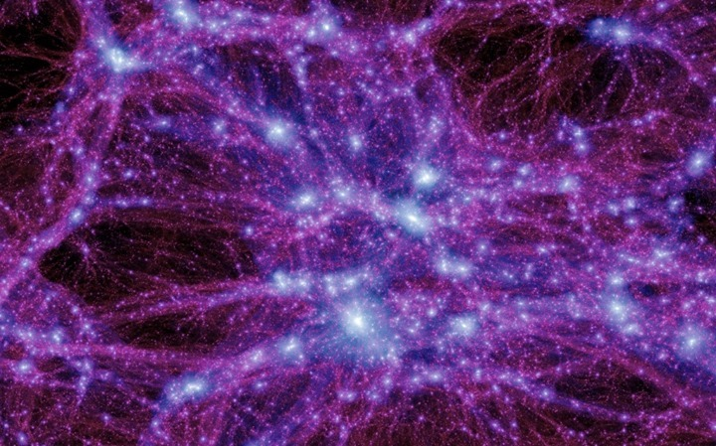
Field
e⁺
Particle physics/High energy physics
Biggest goal: reconciling the standard model with astrophysics, dark matter, matter/antimatter asymmetries
e

Slide 5
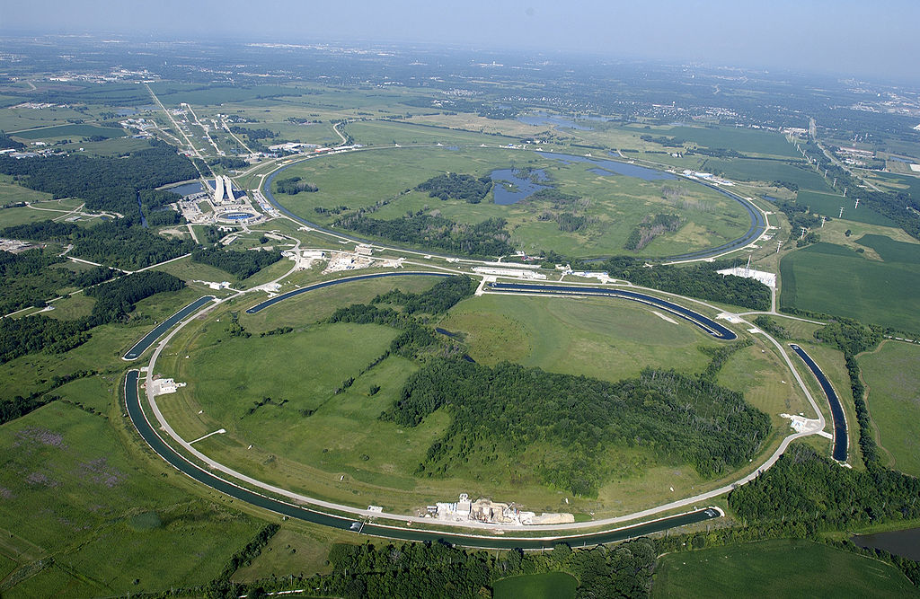
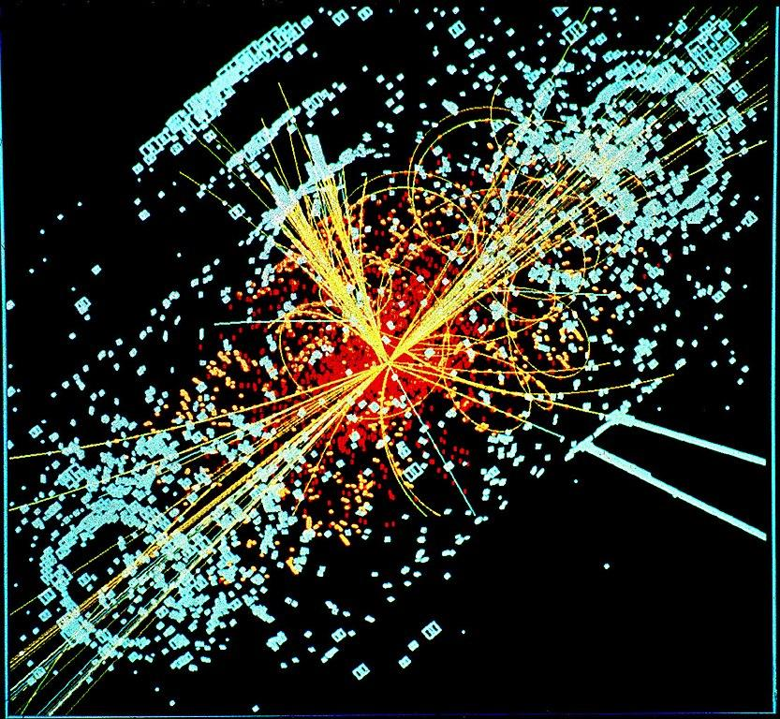
Field
Uses particle colliders to measure precisely + discover particles with high energies
Experimentalist → Doesn’t push a certain theory, but presents findings without bias to theorists

Slide 6
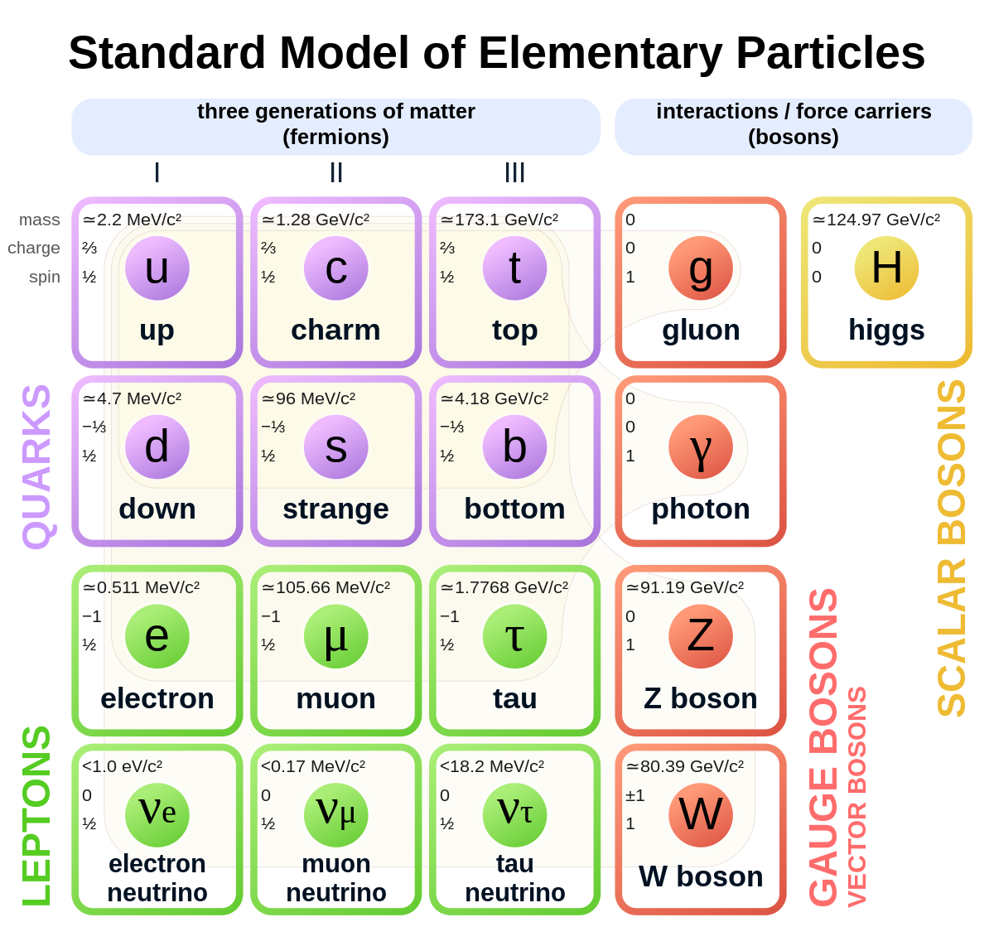
Current study
Currently studying on measurements of Higgs Boson
What is Higgs Boson?
A scalar boson in standard model that gives mass to particles (discovered 2012)
Upgrade on detector (silicon based tracker)
Detect the paths that charge particles take with high precision
https://www.researchgate.net/profile/Karol-Krizka
Notes:
discovered via particle collider

Slide 7
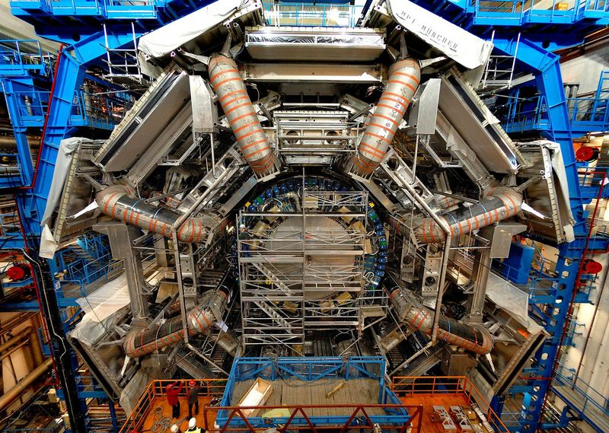
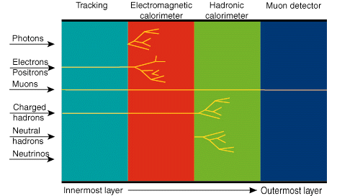
Current Study
Works with LHS data from:
tracking detectors
calorimeters
muon spectrometers
Steps:
Reconstruct objects + trajectories
Calibrate
Analysis: looking for patterns
Statistical procedures
Work divided among many specialists
muon spectrometer

Slide 8
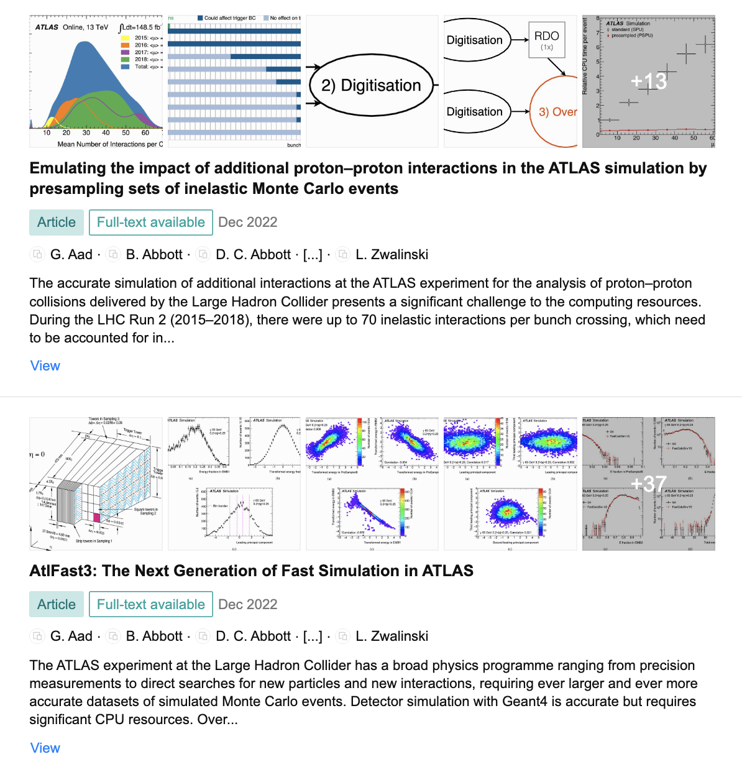
Co-authored papers on Researchgate.net

Slide 9
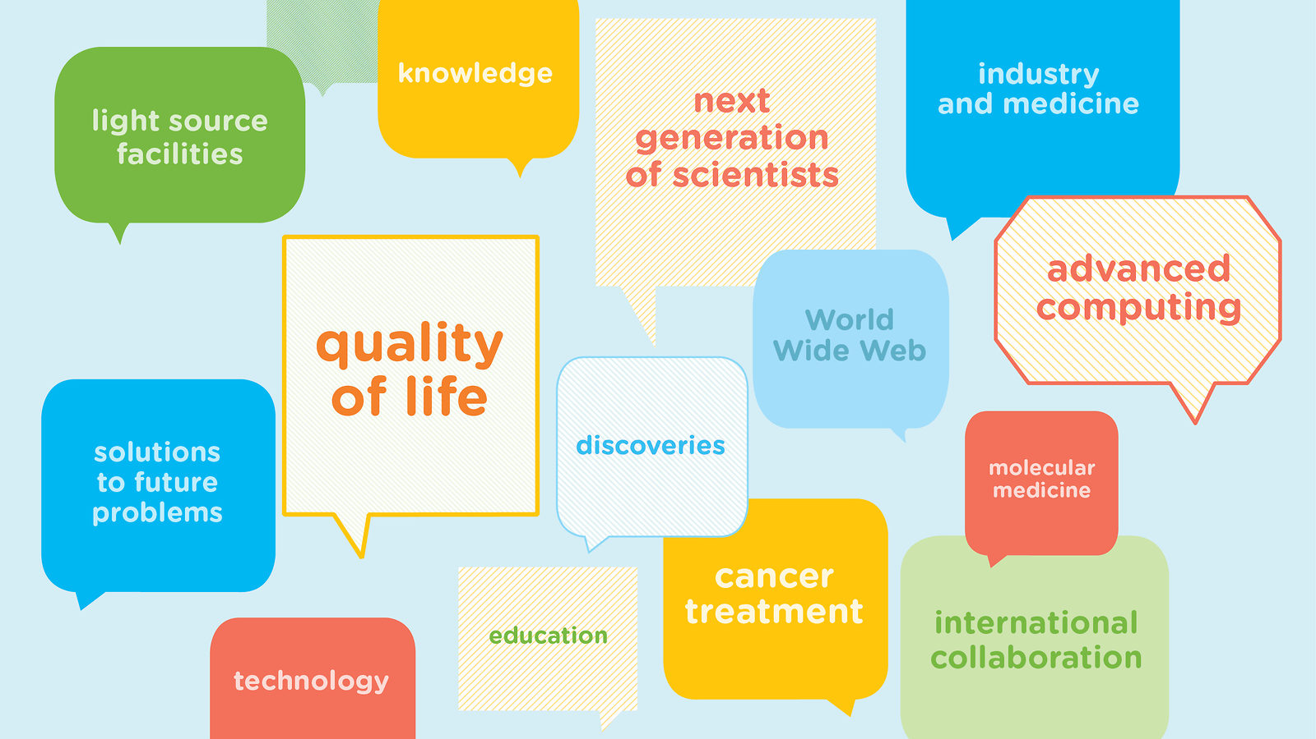
Why is Particle Physics important?
Discover and understand the building blocks of the universe (matter)
Also many technical and real life uses of this study:
Discovery of antimatter
Radiation treatment for cancer
Biomedicine development
The technology used to build accelerators and other labs can be used in other fields as well.

Slide 10
Challenges
Due to the large number of people working on the project, time zones become a huge challenge for collaboration.
The projects require huge computing requirements.
Lots and lots of computer data is needed to store the information from the experiments, and most physicists don't have the necessary equipment or training for those kind of massive computing projects.

Slide 11
Why particle physics?
Enjoys particle physics because he likes having freedom to research whatever he chooses.
Loved working at CERN and being part of the research team and meeting people.
He would recommend the field of particle physics to lot of people because the training you get from studying it is useful in many fields, like computing and engineering.

Slide 12
Thank you!

