Slide 1
Ryan Roberts
Brendan, Marcus, Amrutha, Jia, and Minsung
Notes:
Question they are investigating, basic laws of physics involved, how the question is being investigated

Slide 2
Who is Ryan Roberts?
“Math kid” in school
Liked tangible results and big machines
Works with Atlas Group At LBL
4th year of PhD in Physics
Deeply involved in many areas of research
Area of Research: Higgs Boson
Interaction with Top Quark
Notes:
Brendan
Then brother had a book that introduced him to physics in middle school
At berkeley. He has roughly three years left.
During the last couple of years, has been involved in machine learning, statistics, and many more aspects of research in particle physics. He does hope to actually go to Cern as Covid has greatly hindered that.
Tries to get as much as can out of data
HIs area of research is the Higgs Boson and how it interacts with matter particles, in particular, the Top Quark because it is the heaviest. This research has the potential to even help identify differences between matter and antimatter.

Slide 3
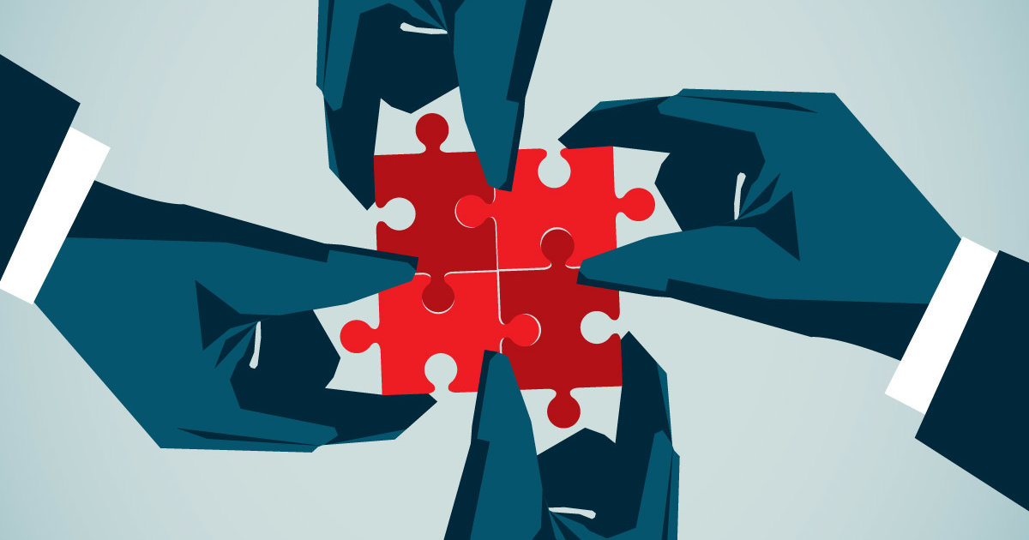
Ryan’s Daily Routine and how he collaborates with others
Typical Daily Routine
European time zone
Breakfast
Work
Meetings
Dinner
Collaboration
Meetings
Skype or Slack
In Person
Visiting friends
Notes:
Daily routine
Flexibility as grad student in terms of what he does but on a normal day, he tries to work as much as possible
European time zone meetings start at 7 am and therefore Ryan is up at 6:45
At around 9/9:30 Ryan makes breakfast and goes up to the Lab
He then sets up his laptop and works for a few hours
Around noon he has lunch in a big group
Ryan then attends a few more meetings from 2-4. Ryan attends lots of meetings as they are about 3000 collaborators on his project
He then works some more ans heads home
He has meetings everyday but he tries to keep Wednesdays and Fridays free
Collaboration
Meetings
He discusses any progress he has made in the research and they share suggestions and ideas
He also uses slack or skype to communicate with his smaller project groups
For his colleagues that are at the Berkeley Lab, they meet up in pearson in the office
For his colleagues that are working international they usually meet online
With his Grad students that are working on the same projects, he usually meets them at their homes or his home

Slide 4
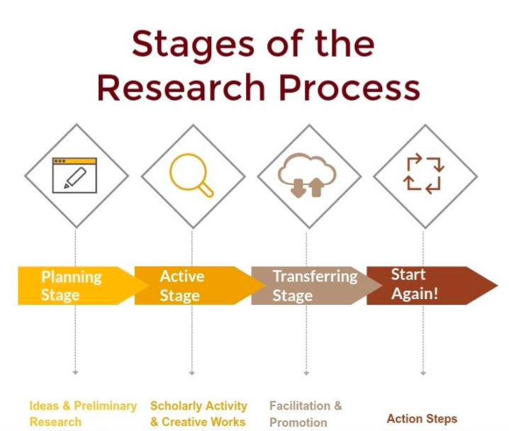
Stages of Research
Timeline for particle physics projects are extremely long
Stage 1
Stage 2
Stage 3
Ryan’s Favorite Stage
Notes:
Started this experiment before he was born and discovered the Higgs Boson when he was in highschool
Even the projects he works on involve a lifetime of research
Stage 1: The beginning of the r&D stage when they are trying to figure if this can work – a lot of thing to do to get ready
S2: After you figure out that this can work, you have to figure out how to best make it work, lots of ideas, trials
S3: Last part is finalizing where you get ready to perform the experiment and explain to people why and how you are planning to do this. He also says that you have to make good plots with data and detail what they did
Favourite stage: Stage 1

Slide 5
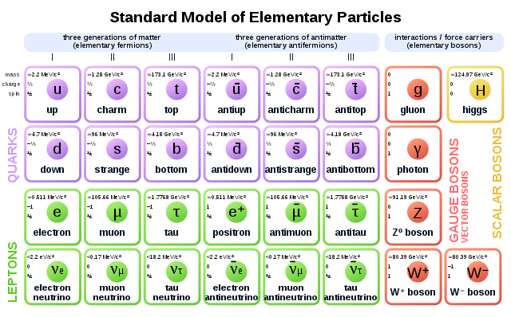
Project 1: Data Analysis with 4 Top Quarks
Production of 4 top quarks at the same time
Can involve the Higgs Boson
Looking for deviations from the Standard Model
Approaching its final stage (finalizing what to do and then executing it)
Notes:
amrutha

Slide 6
Project 2: Data Analysis with Higgs boson and Top Quark
Production of Higgs boson at the same time as a top quark
Looking for CP violation (antimatter and matter do not behave as you would expect)
Preliminary stage - not sure if it will work yet
Notes:
amrutha

Slide 7
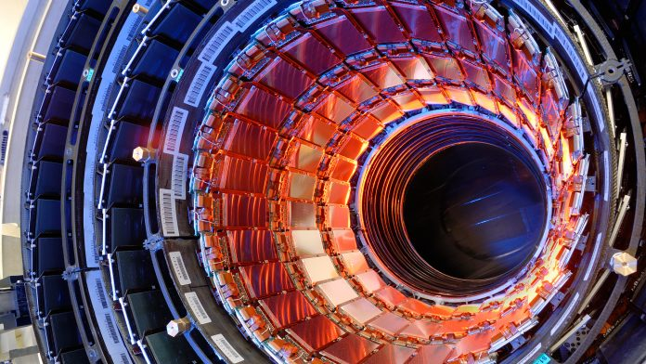
Project 3: Hardware Development
There will be upgrades to the accelerator to increase collisions in the future, and the particle detector will be upgraded with it
Custom computer chips will go in the upgraded detector
Recently testing the radiation hardening of these computer chips
In a “weird stage”; hasn’t been worked on in a while

Slide 8
How does the Higgs Boson give mass to other particles and what gives mass to the Higgs Boson?
Notes:
Brendan

Slide 9
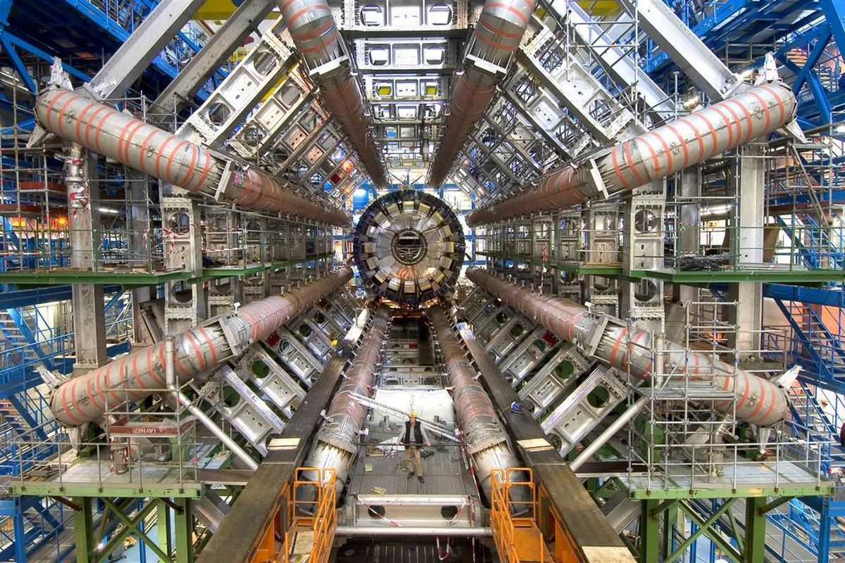
Future of Research
There’s going to be a large amount of new data very quickly after the LHC turns on again
“Outstanding anomalies” in data that will have developments in the coming years
Possible discrepancies from the standard model
A lot of things that might be something new

Slide 10
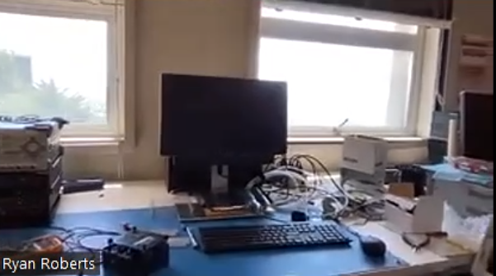
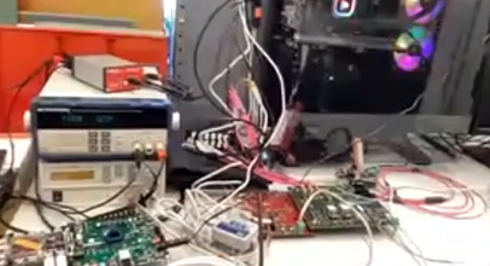
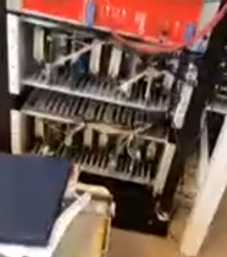
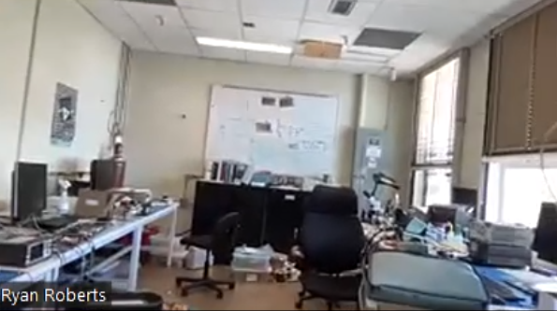
Lab Equipment + Final Advice
It’s a fun job!
Not as hard as you think to be apart of research
People scared away by the math in physics
Doing research ≠ being in class
Notes:
Brendan

Slide 11
Thank You!

