Slide 1
Greg Ottino
Shruti Senthilram, Jonathan Lin, Marie Ishida, Miguel Morales, Shohom Chakraborty
Notes:
marie

Slide 2
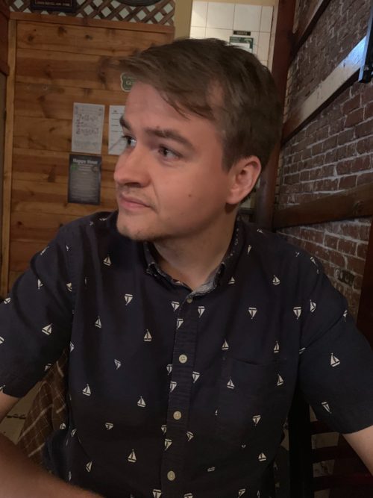
Education
Undergraduate: University of New Mexico
Majored in physics
Graduate: University of California, Berkeley
Taught undergraduate physics courses
Notes:
marie

Slide 3
Path to Physics
Grew up in Albuquerque, New Mexico
Enjoyed Physics in High School
Liked math and physics because it was challenging and fun
Lots of Complex Theories that were interesting
Explored different fields of Physics but decided to go with Particle Physics
Notes:
Shohom

Slide 4
Challenges in the Physics field
Gap between physics research and classroom problems
Steep learning curve for developing an intuition for physics
Impossible to teach how build an intuition for physics research in the classroom
Noneless, classroom physics is important for building a strong foundation in physics
What is your least favorite part of physics?
You need to understand every single part and detail of what you’re working on. When you can’t figure something out your work gets stuck and it is very frustrating.
Notes:
Jonathan

Slide 5
Positives in the Physics field
Collaborative aspect; as mentioned before, finding discoveries is a group effort
Finding and discovering new things together as a group
Talking through topics or things that are challenging to get a better idea of them
Key part of Physics is working with others
Notes:
marie

Slide 6
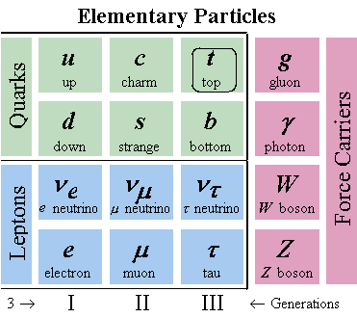
Current Research
Atomic Nucleus
Oscillation of quarks at super small timescales
Heisenberg uncertainty principle and violation of conservation of energy
strange quark specifically
Difficult to measure, very high energy and small time
Collaborate with other scientists to create a global fit with research related to other quarks like the strange quark
Takes everything into account
Notes:
Shruti

Slide 7
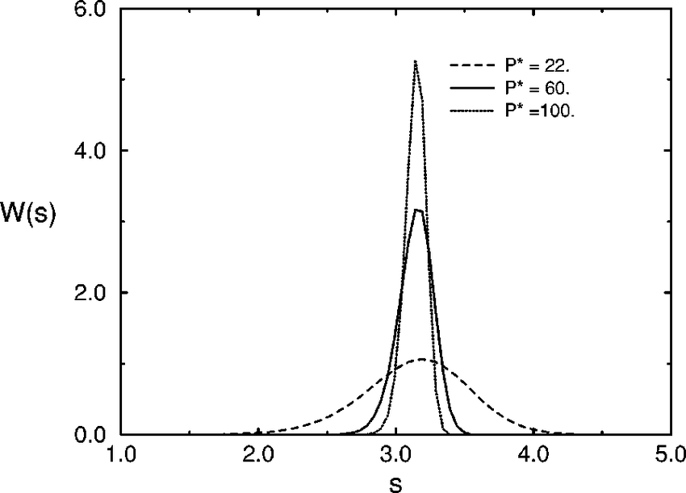
Current Research Cont.
PDF: particle distribution function
Cannot be calculated → need to take into consideration experimentally
Used to describe instabilities and interactions
Benefits from research:
Can reduce uncertainty of analysis
Research results can be used by other scientists in future
Lead to stronger understanding of particles
Importance of collaboration
Notes:
Shruti

Slide 8
ATLAS Research
300 members of group
Impossible to achieve the work by yourself, and would constantly need to help as well as get help from others
When being in ATLAS, you are forced not just find easy answers, but to go beyond and achieve the answer with the highest quality in your experiments
Notes:
Miguel

Slide 9
Thank you!

