Slide 1
Dr. Pettee’s Thoughts On…[insert topic here]
An Exhaustively, Thoroughly, and Expertly Researched Report by
Arnav Ratna, Rebecca Womack, Pablo Gomez, Nika Karimianpour, Anton Kourakin
Notes:
rebecca

Slide 2
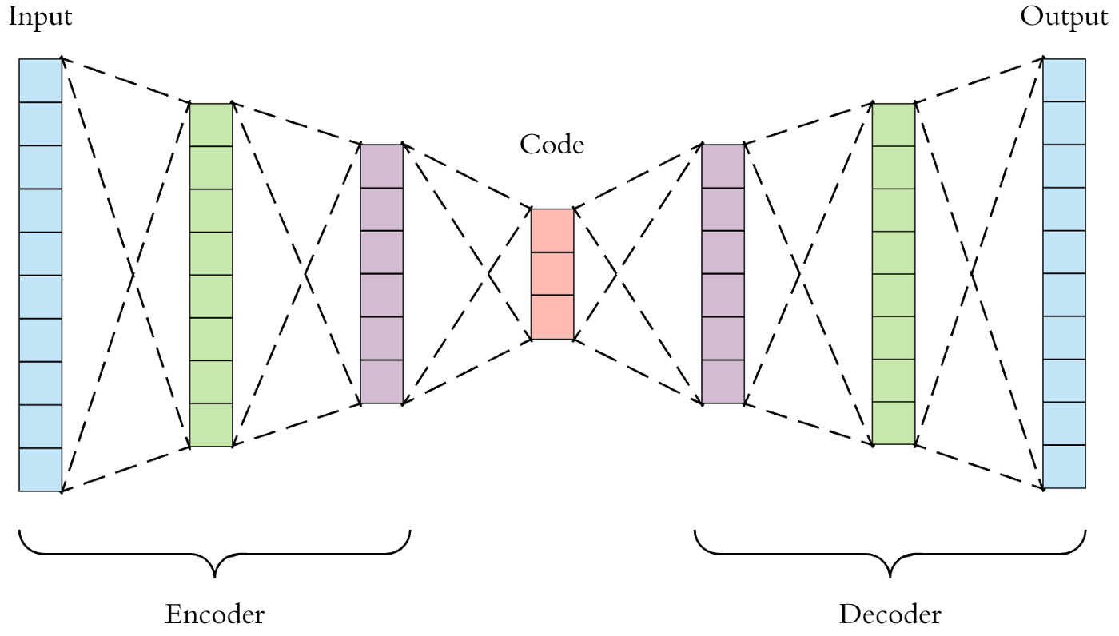
…Machine Learning
Every aspect of science would benefit from machine learning in some way
Changes the way we can analyze data
Lots of new discoveries, provides different perspectives and questions we can ask about data
Where there’s a lot of data (too much for a single person), machine learning helps a lot to automate the data processing.
Autoencoding
Notes:
rebecca

Slide 3
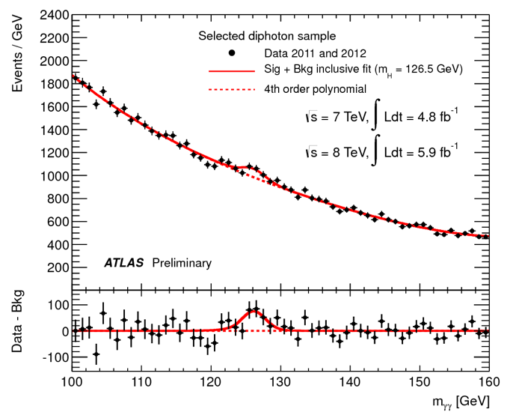
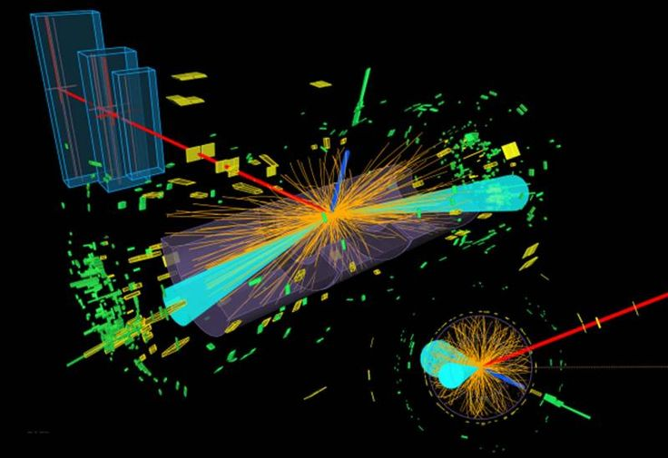
…Particle Physics
Ending up in particle physics was almost an accident — 3 days after attending a particle physics experiment at CERN, the Higgs Boson particle was discovered
Dr. Pettee’s thesis covers a rare interaction of the Higgs Boson decaying into 2 tau particles
Her work confirms that the Higgs Boson behaves exactly how we expect
To Dr. Pettee, particle physics is almost ‘too perfect’ — somehow, it manages to predict everything, and theorists are trying to figure out where this theory falls apart
Notes:
nika

Slide 4
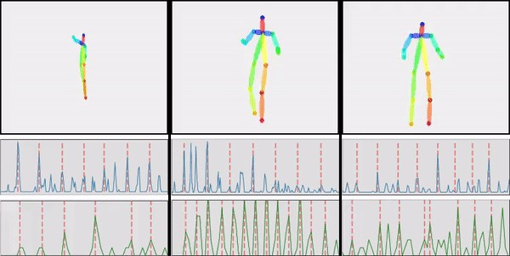
…Dance
Dr. Pettee believes that she is not just a scientist but also an artist — from a young age, she has always enjoyed the arts, especially dance and theater
Art and physics, to her, are both 2 separate lenses from which we can view the world
Even during her PhD, she continued to dance and perform
After noticing that AI in dance was a relatively unexplored field, she trained an algorithm with her own dance routines, using auto-encoding to generate new routines
Notes:
nika

Slide 5
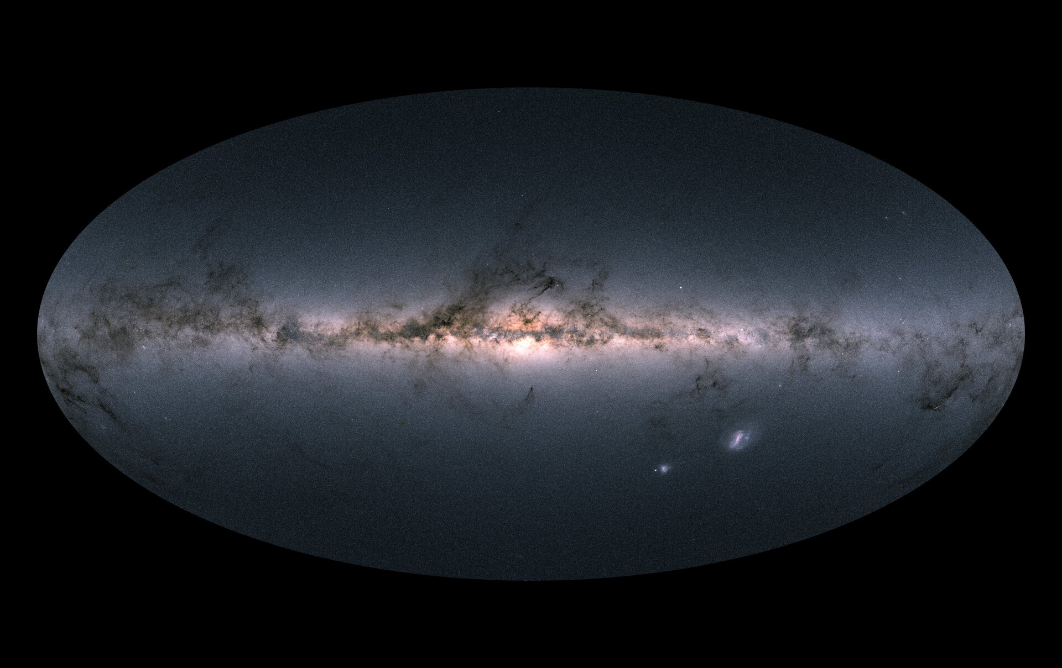
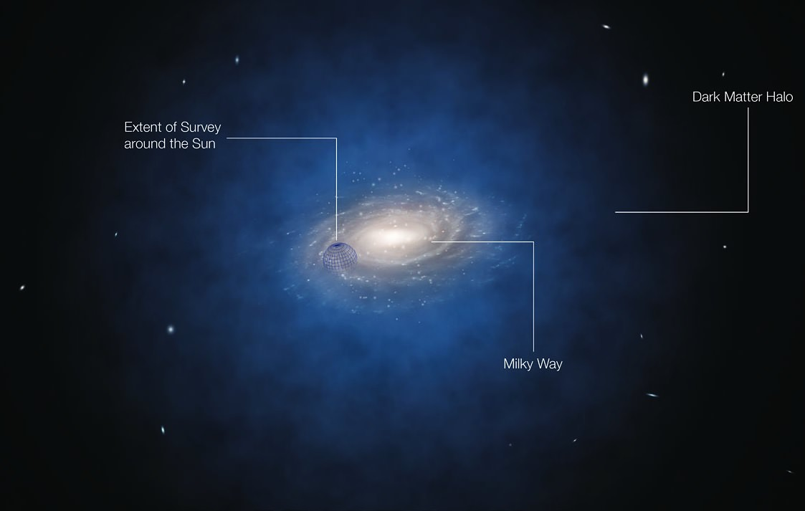
…Dark Matter
According to Dr. Pettee, this is the biggest unanswered question in particle physics
“It keeps me up at night”
Somehow, our standard model has no way of accounting for dark matter, even though it seems to predict almost everything correctly
Gaia satellite — dataset of about 1 billion stars (with positions, velocities, brightness, etc.)
From our talk from Dr. Pettee on Friday, you might remember her explanation of stellar streams
We think the Milky Way evolved by absorbing smaller galaxies — some of these are still being absorbed
Absent dark matter, we’d expect these galaxies to be spun around our galaxy uniformly, creating a smooth stellar stream
However, if we look at what really happens, these stellar streams have a lot of irregularities, which can point to clusters of dark matter in the Milky Way acting as another force
Dr. Pettee uses machine learning to analyze these stellar streams and trains her algorithm to look for irregularities (also known as ‘anomaly detection’)
Notes:
Arnav

Slide 6
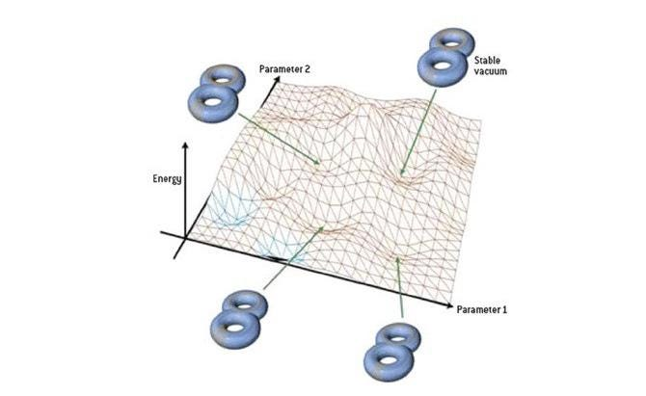
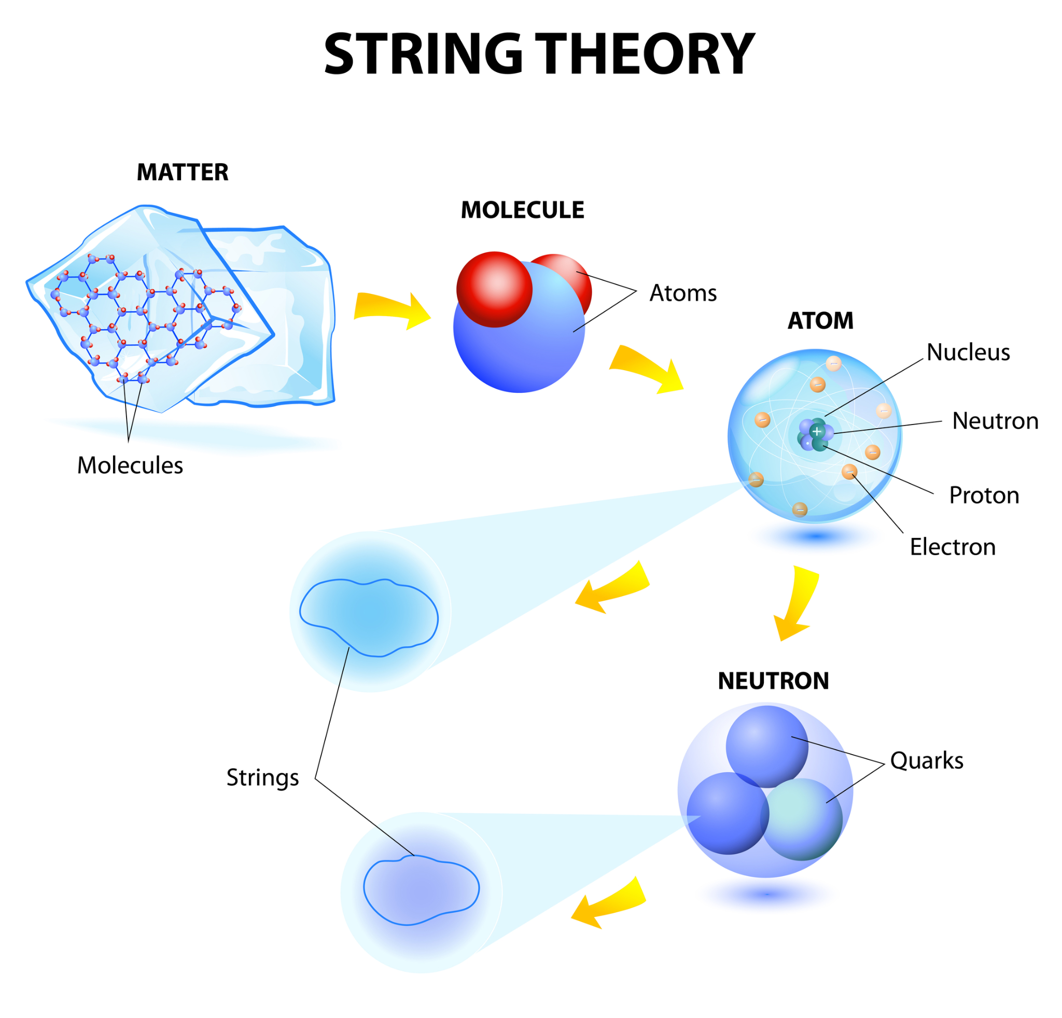
…String Theory
String theory is one of the topics that drew Mariel towards physics
The standard model describes a miniature universe of particles but doesn't accommodate gravity very well. Einstein's theory of general relativity describes gravity at a larger scale, but doesn't do so very well on a smaller scale
While string theory may unify the standard model and gravity, we are as scientists too far from where we need to be to actually test its notions or questions.
While there is nothing that yet disproves this theory, there isn't anything that really proves it to be the best model of particle physics
Notes:
Anton

Slide 7
…Dirty Oat Milk Chai Lattes from East Rock Coffee
"They got me through my thesis"
Such good coffee, asked for a recipe when leaving New Haven, kept her sane.
Notes:
Pablo

Slide 8
Lessons Learned
That Chai Latte was AWESOME!!!
Machine learning has broad applications across several fields
[Particle] Physics remains an exciting area of research with many discoveries likely to come in the near future
Notes:
Pablo

Slide 9
Thank you!

