Slide 1
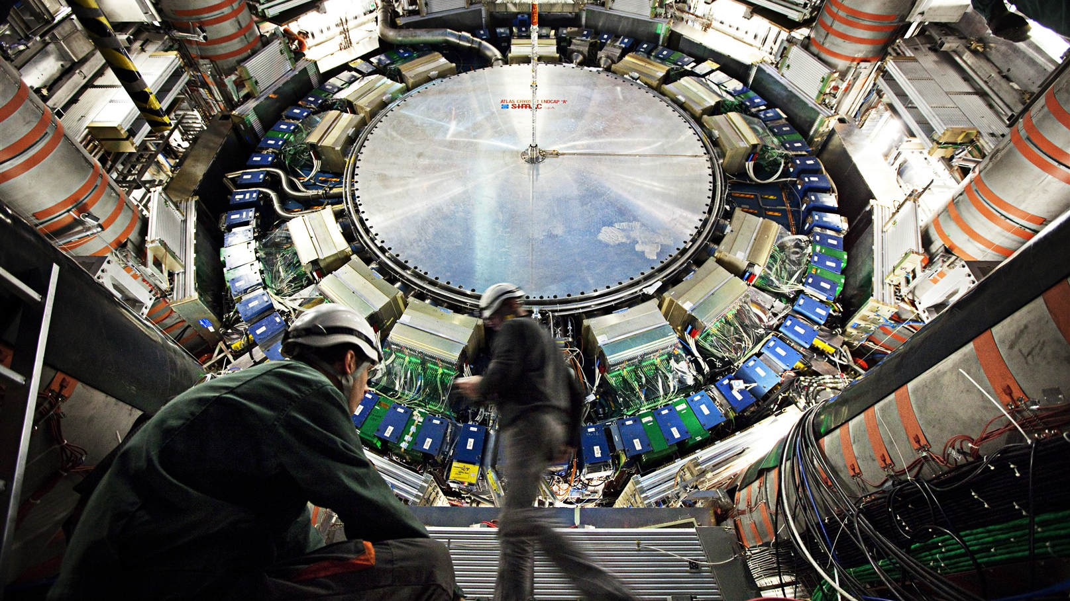
ATLAS
Louis-Guillaume Gagnon
By Andrew, Aatreyo, Issac, Luke, Mari, and Mia
Notes:
Andrew

Slide 2
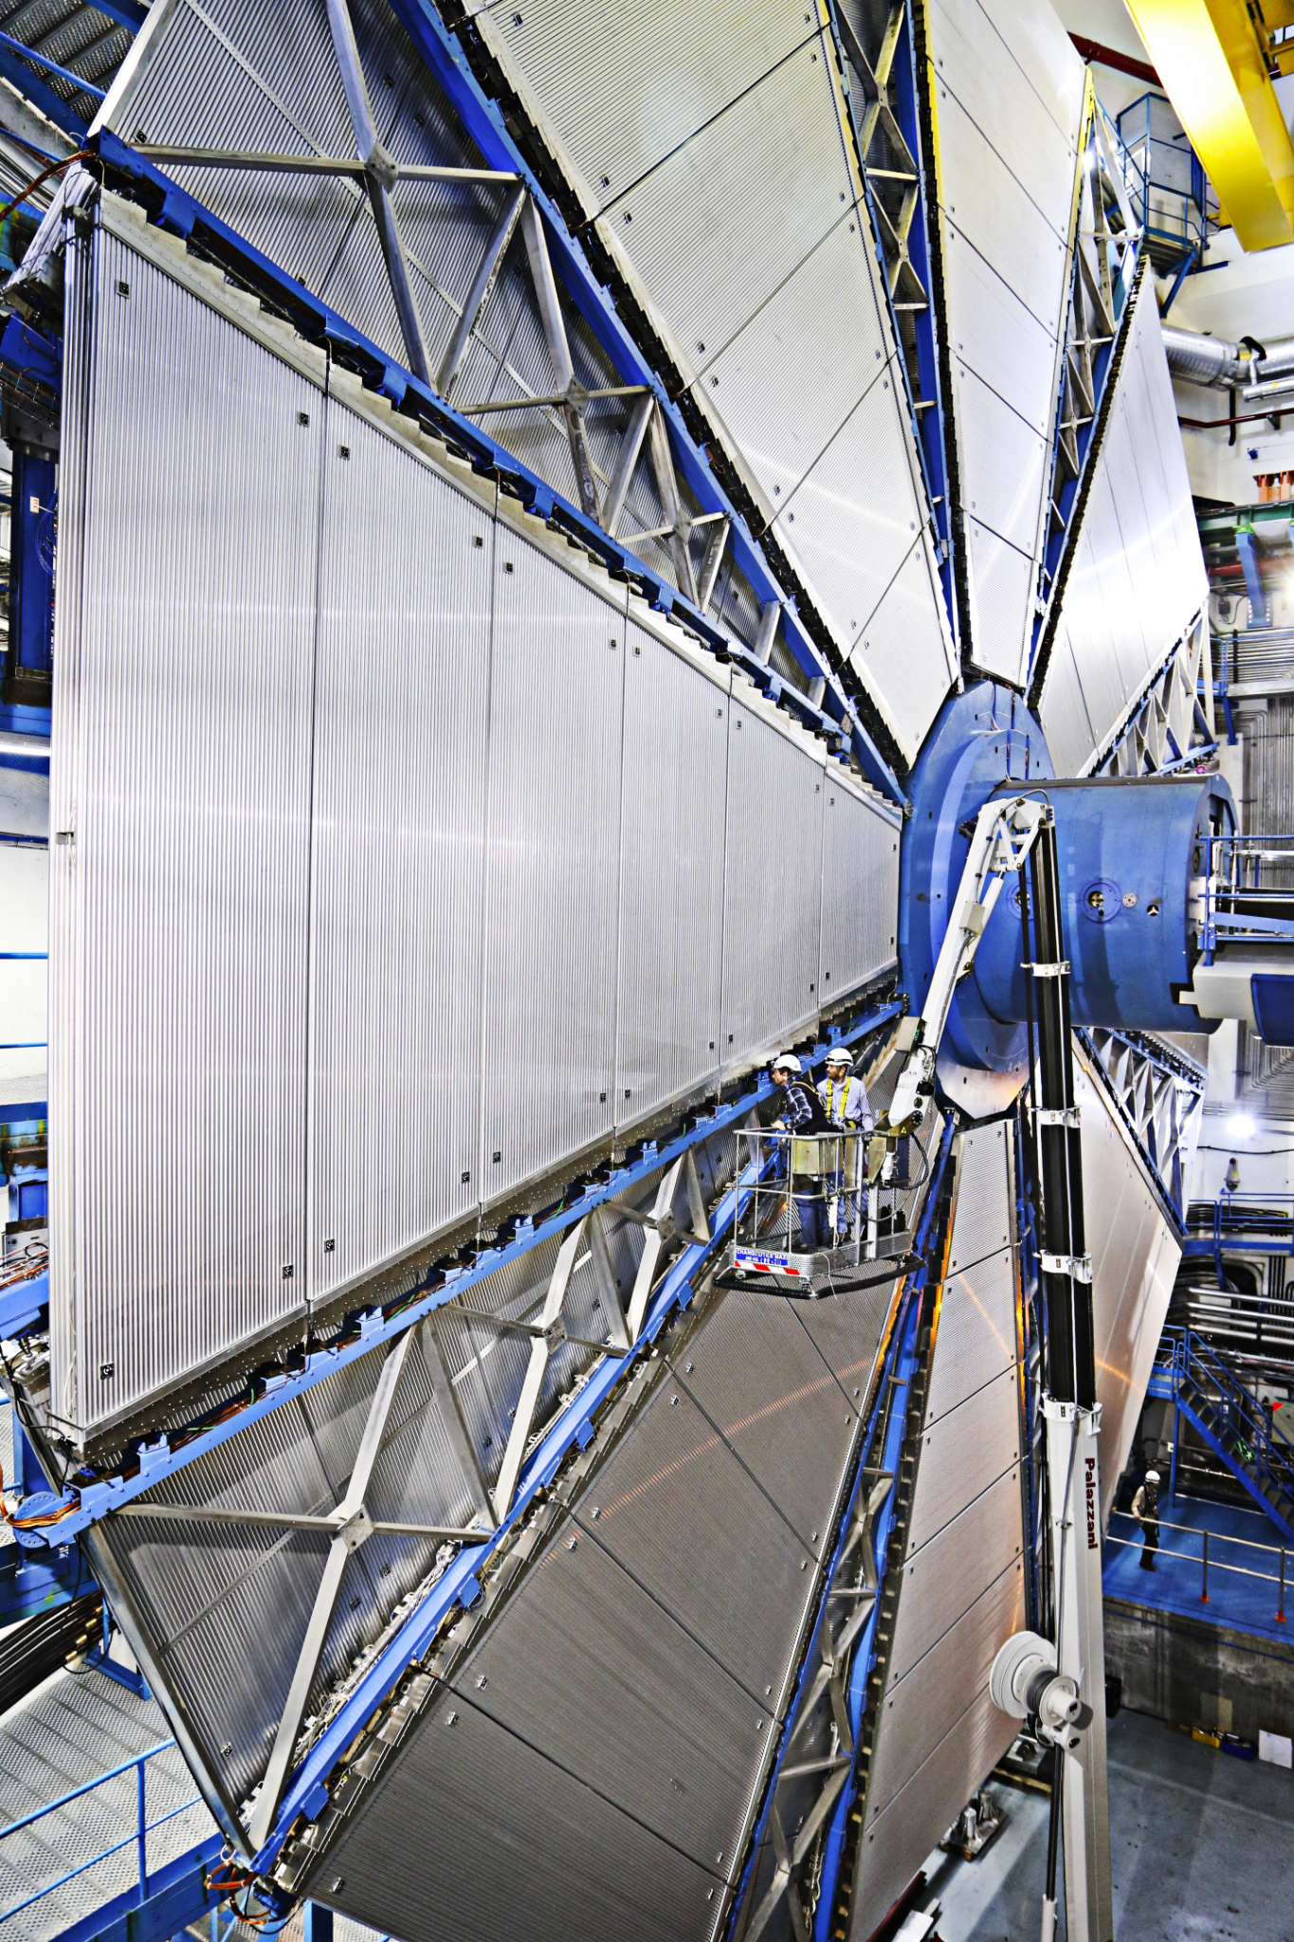
ATLAS
A Toroidal LHC ApparatuS
Started in 1992
The largest particle detector so far
Similar to CMS (also in the LHC)
Detected the Higgs boson in 2012
Detects proton-proton collisions
Notes:
Mia
Altas collaboration began in 1992, idea proposed, construction completed in 2008
Cms is another general purpose detector

Slide 3
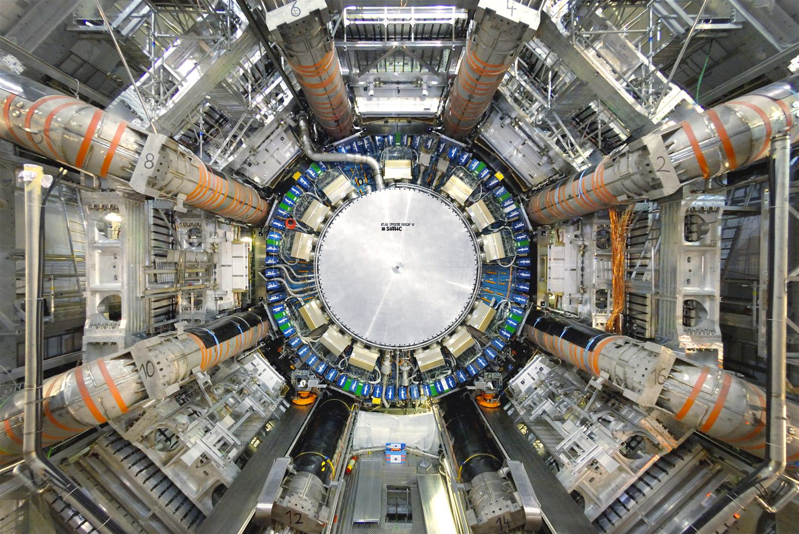
How does ATLAS work?
Uses magnets to bend paths of particles
This is to measure their momentum
Uses “trigger” system via layers to process data from collisions (what events to detect and what to ignore)
Notes:
Andrew

Slide 4
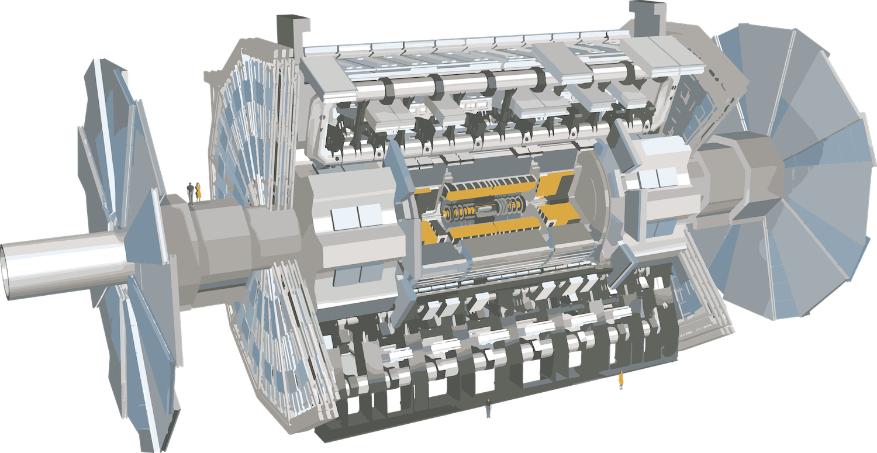
Muon Spectrometer
Calorimeter
Inner Detector
Notes:
Andrew

Slide 5
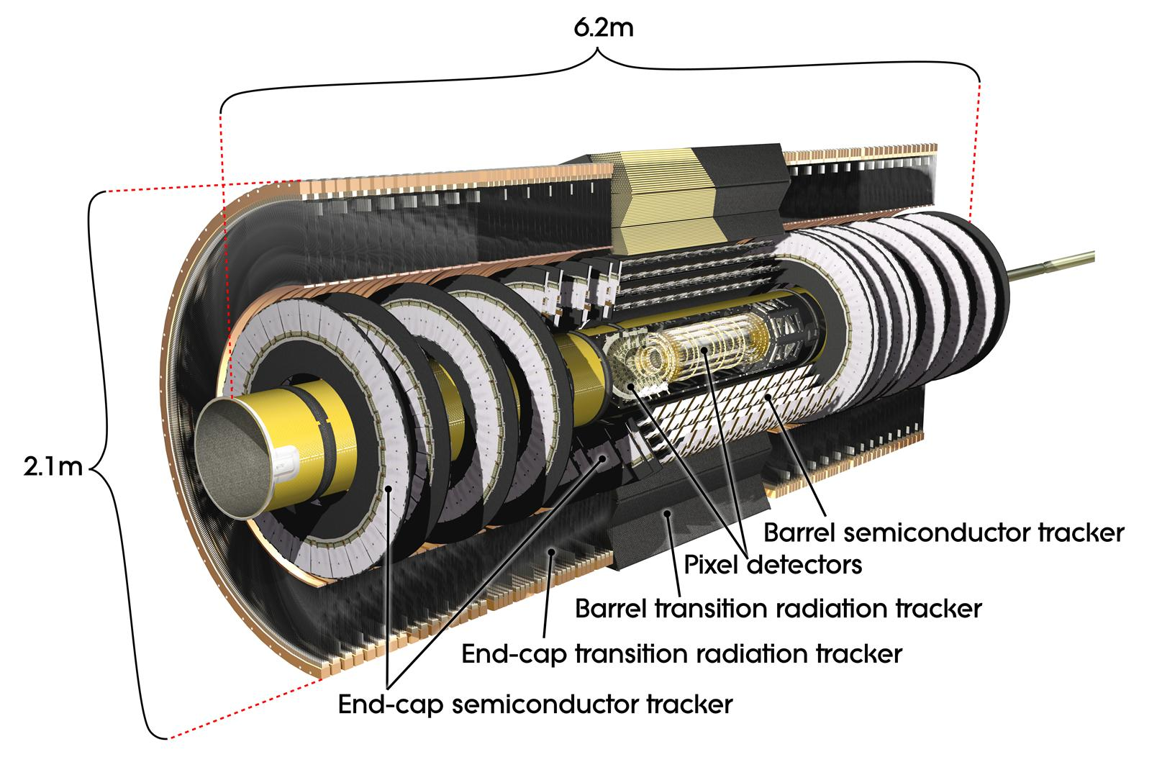
Inner Detector
3 layers
Pixel Detector
Detects charges
90+ million silicon pixels
Semiconductor Tracker
Tracks particles
Transition Radiation Tracker
Identifies particles
Works with proton-proton collisions
Notes:
Isaac

Slide 6
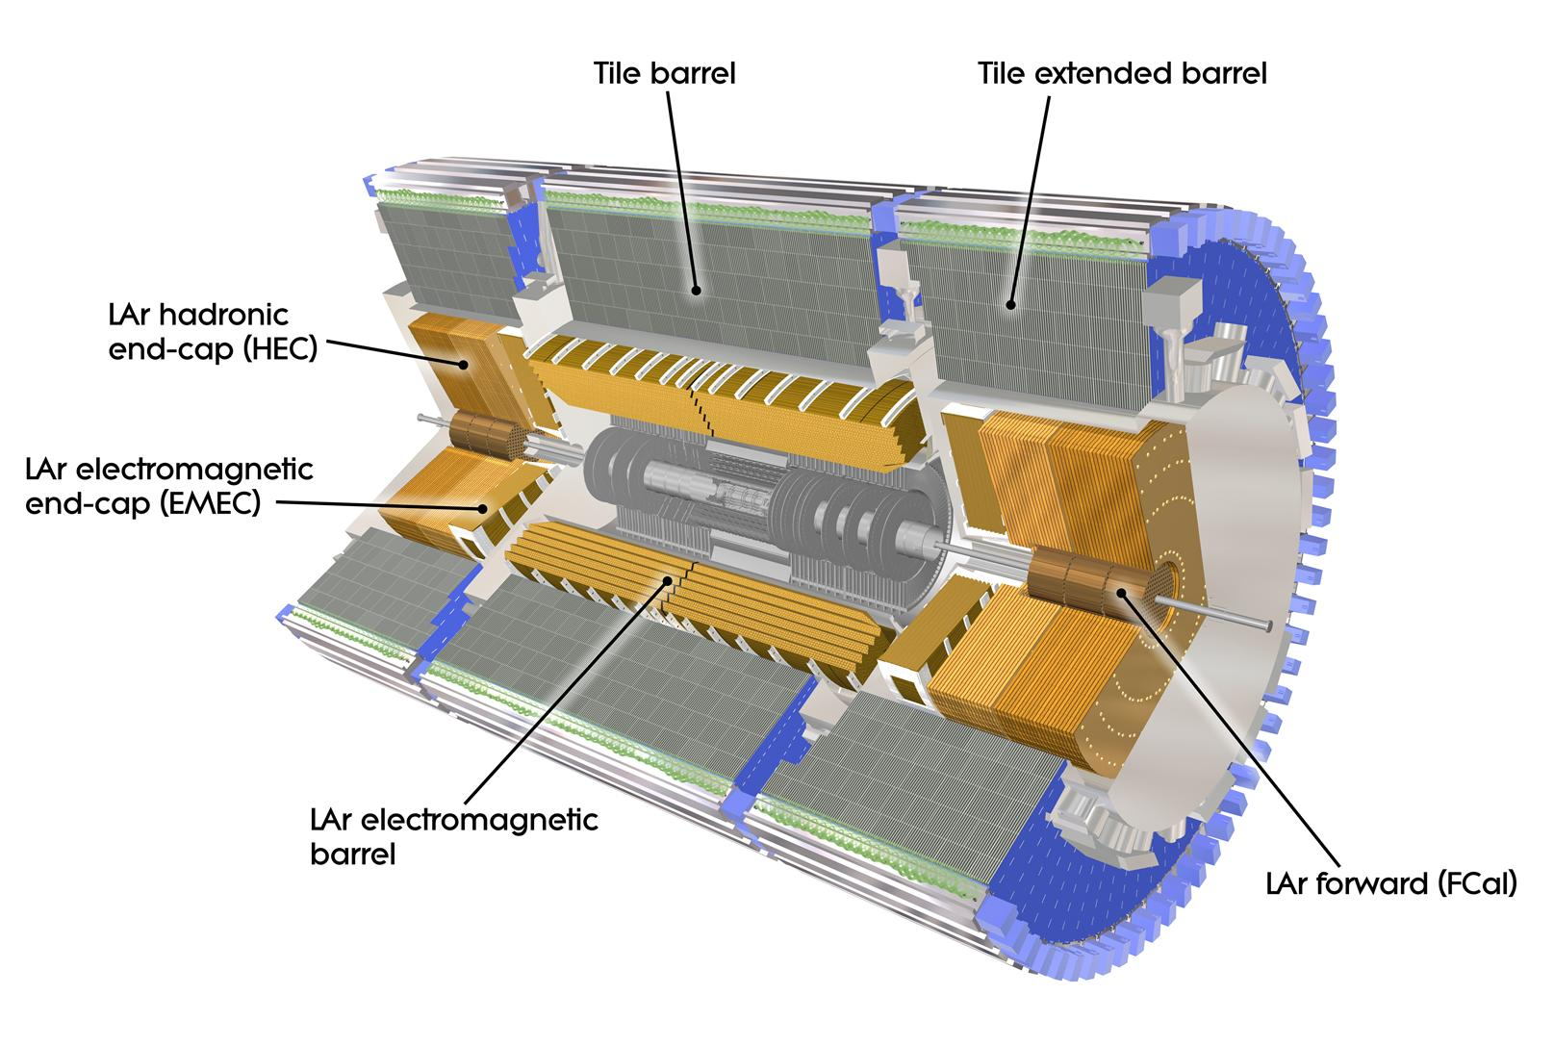
Calorimeter
Absorbs particles from collisions while measuring their energy
2 layers:
Liquid Argon (kept cooled)
Tile Hadronic
Handles hadronic particles
Hadron = 2+ quarks together
Notes:
Andrew

Slide 7
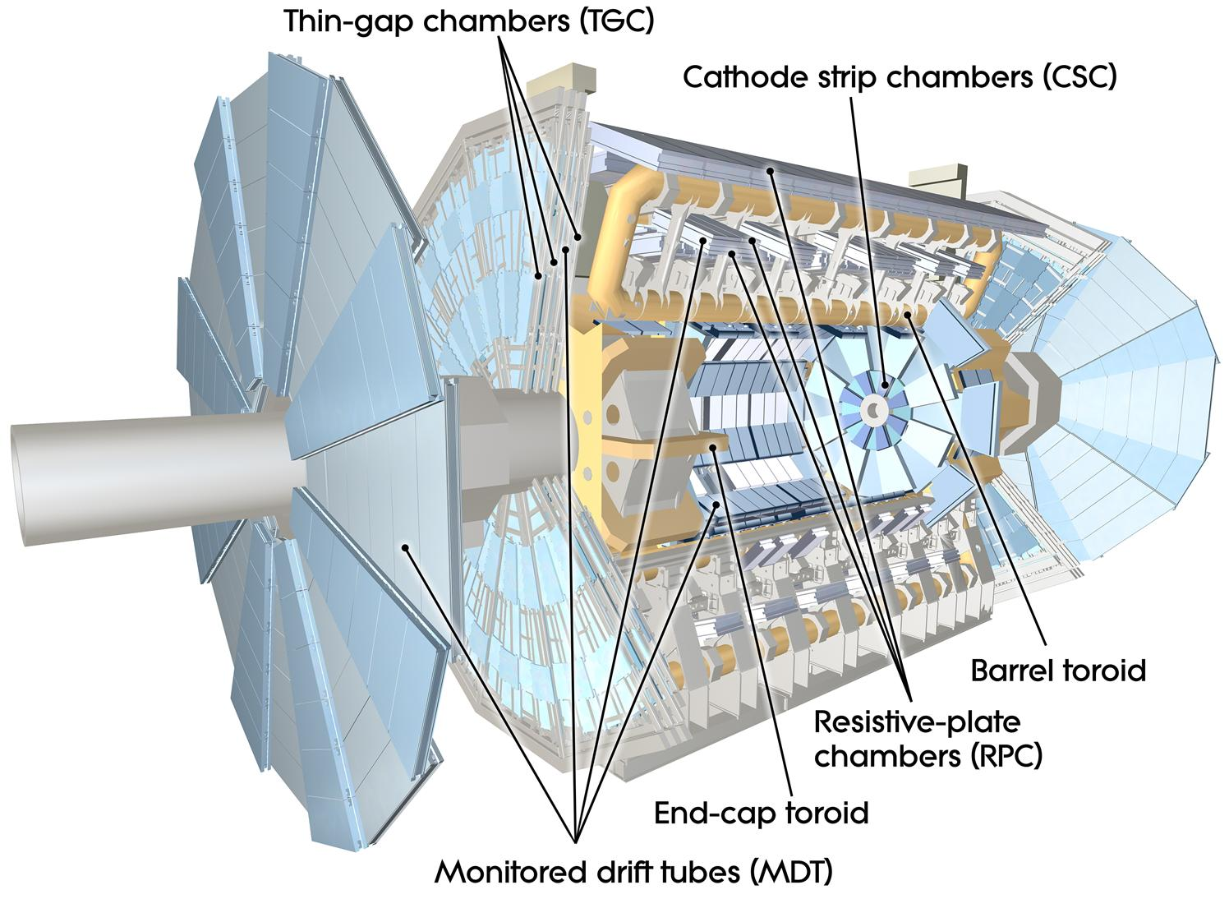
Muon Spectrometer
Measures path, energy and trajectory of muons
Consists of 354,240 tubes
Muon drift tubes include several layers of tubing
Filled with gas mixture of argon and CO2
Notes:
Mia
Outermost part of detector, measures energy and trajectory of muons
Use muon drift tubes, made of several layers of tubing filled with gas mixture of argon and co2 (MDT), through reactions with argon atoms muons leave tracks in the tubes, which are then converted to electronic signals with high voltage between tube wall and central counting wire

Slide 8
What’s ATLAS for?
Lots of purposes.
Built to do as much stuff as possible
Looks into microscopic structures of the universe
Requires very high energies
Look for new particles
Investigates shortcomings of the Standard Model
6k+ members involved
Notes:
Aatreyo

Slide 9
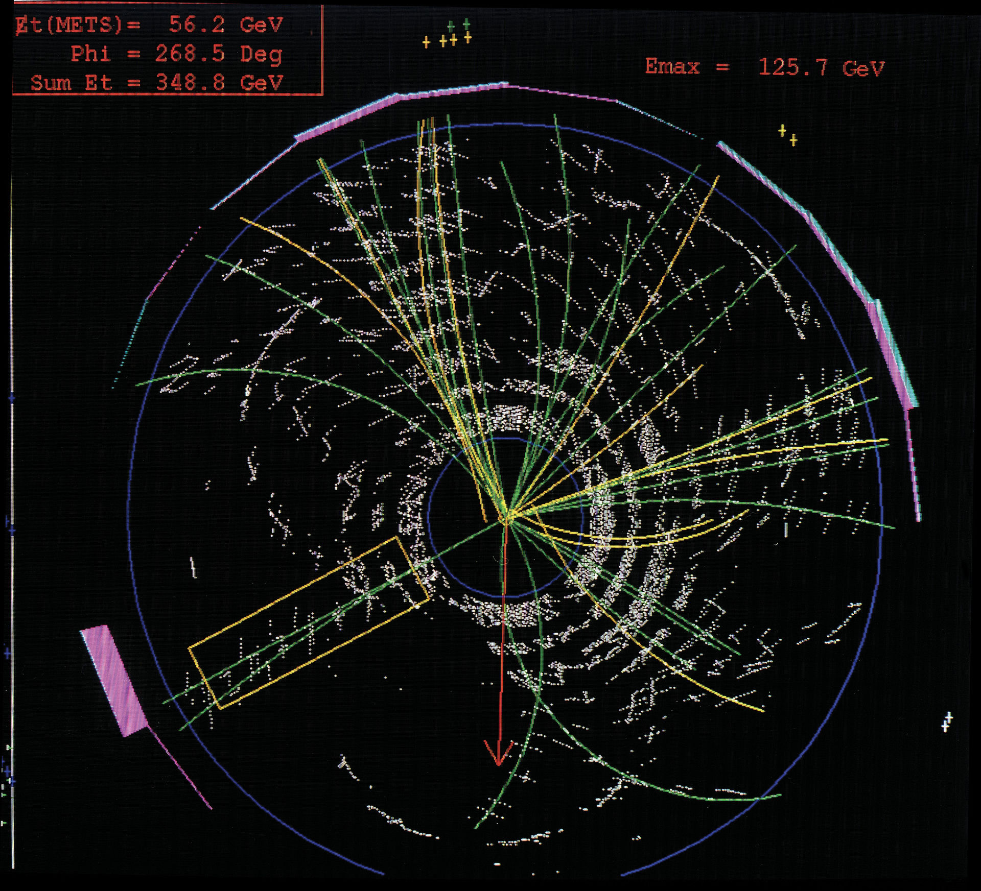
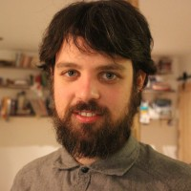
Dr. Gagnon and his work
Attended University of Montreal
Physics and Compsci major
Interned at CERN in 2013
Postdoctoral Scholar @ UC, Berkeley
Works on detection algorithms
Trying to identify jets from charm quarks
Notes:
Luke

Slide 10
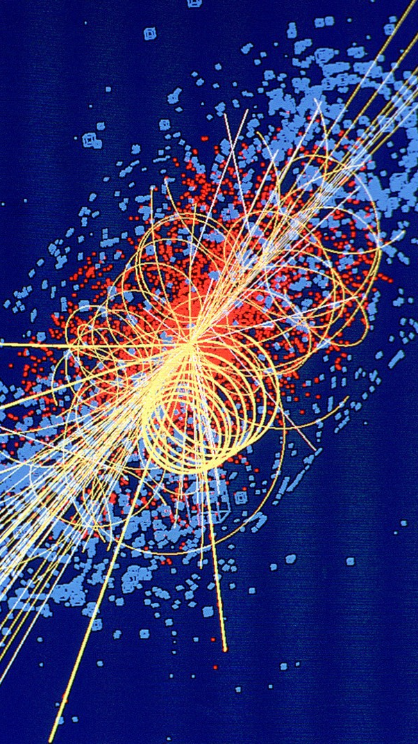
Algorithms
Machine learning is frequently used
Started in the 90s, makes identification easier
Without machine learning:
Look for patterns in proton/electron signatures
Python for most work
C++ when it has to be fast
Notes:
Andrew

Slide 11
Supersymmetry
Unifying framework for fermions and bosons
Supersymmetric particles may have existed at the beginning of the Universe
High energy density
Notes:
Aatreyo

Slide 12
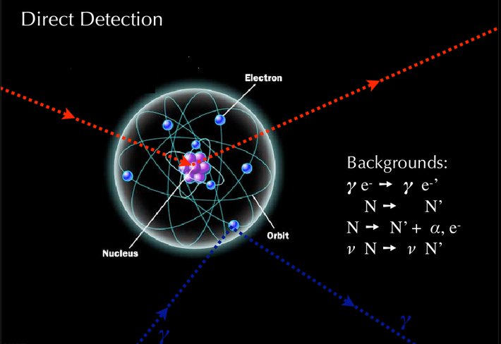
Dark Matter Candidate
Preservation of R-parity in the pair production of gluinos
Indicates that the supersymmetric particle is stable
Interacts weakly
Possible WIMP (Weakly Interacting Massive Particle)
Notes:
Aatreyo

Slide 13
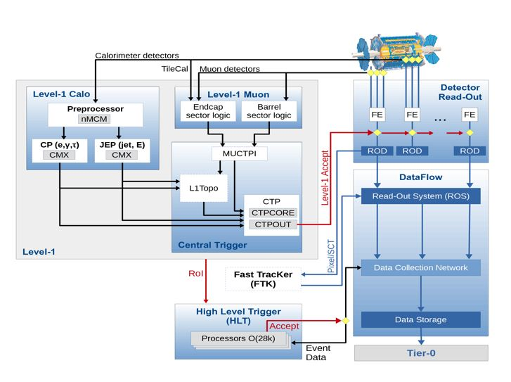
ATLAS trigger system
The trigger system sorts through all of the collisions and selects only the most interesting to keep and study. The rest of the data is thrown out permanently, however in order for important data to not be thrown out a lot of research and work is done on this trigger system to file through all the collisions and data detected.
Notes:
Mari

Slide 14
What is it like working with so many people on ATLAS?
Time zone difference makes it challenging to collaborate with people in Europe (9 hour difference)
Different institutions and different cultures
No strict hierarchy, everyone is working to achieve the same goal
There are less people than you would think, although there are around 5500 people working on this project, everyone is stretched to their limits because of the amount of work that has to be done
Notes:
Mari

Slide 15
What are some of your proudest achievements?
What is some advice you have for students wishing to pursue a career in science?
PhD. It took six years of research daily and was a very difficult topic. His supervisor told him that it was an incredibly difficult topic, but to go for it and see what happens.
Show up everyday, pay attention in math class (it has direct influence on your performance in the sciences), maintain interest, keep up persistence and grit.
Notes:
Mari

Slide 16
What does your day-to-day schedule look like?
Working from bay area while collaboration with people based in europe, communication challenges
Work with other scientists in mornings, afternoons allow more free time to do software work, writing and reading papers
What problems do you encounter at ATLAS?
Software often has problems
Has to manually dig into code to figure out what is going wrong
In process of building new detector, simulations used to work things out
Notes:
Mia

Slide 17
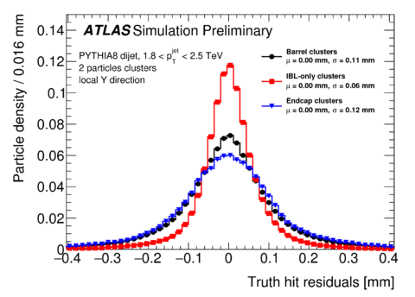
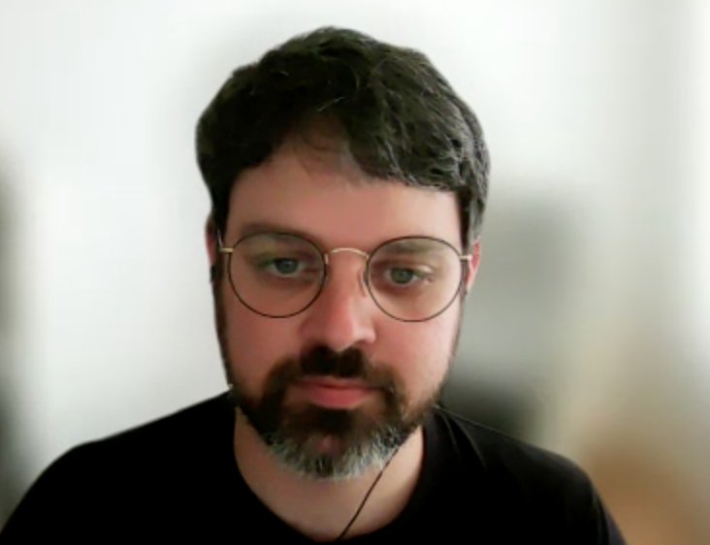
Pixel Clustering Neural Network
Favorite Project
The Pixel Clustering Neural Network detects pixels in particles. As particles pass through the track system, they deposited charge equivalent to 1-3 pixels. The neural network detects how many particles and how much charge is in a cluster, and then splits the clusters.
PhD Work and discovering new particles. While it’s not always successful, Dr. Gagnon describes the excitement of the possibility to change all of physics with a project.
Notes:
Isaac

Slide 18
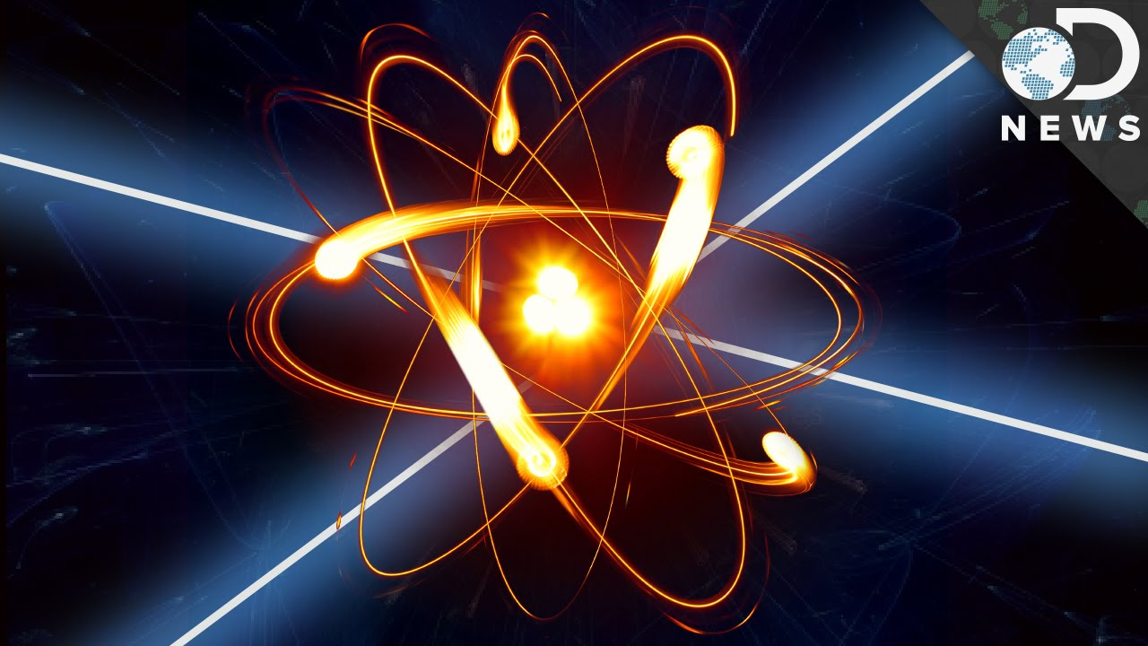
Why Particle Physics?
Dr. Gagnon was always interested, challenging, lots of depth
Experimental side, not theoretical
Good match, CS programming
Internship in 2013, career expanded from there
Notes:
Luke

Slide 19
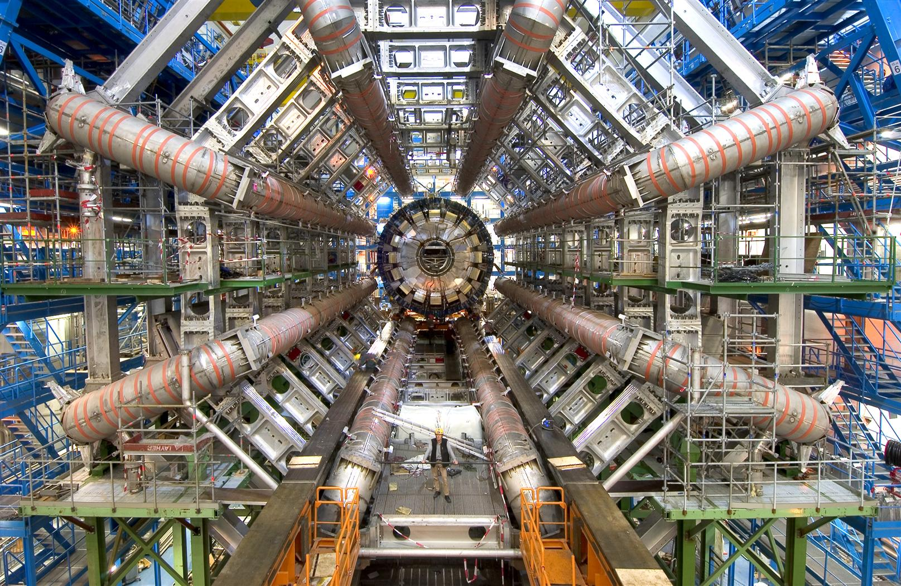
Thanks for listening!

