Slide 1
Our Interview With Julian Borrill
A presentation by Elle Moscinski, Abhiraj Jalagekar, Krishna Ram, Séamus Kenna, and Miya Takeuchi
Notes:
Elle Moscinski

Slide 2
Two Major Questions
How do our two theories fit together?
General Relativity
Quantum Chromodynamics
How did the universe get so lumpy?
Gravitational attraction
Notes:
Elle Moscinski

Slide 3
Question 1
The Two Theories are General Relativity and Quantum Chromodynamics
General Relativity is a theory about gravity. It theorizes that gravity comes from wells that cause the curvature of the fabric of spacetime
Quantum Chromodynamics is a theory that covers the other three forces, the Weak, Strong, and electromagnetism. Simplified, the theory has to do with the interactions of quarks and gluons
They are at odds with each other. They cannot both be right. So how do they fit together and what are we wrong about?
How did we get to have the 4 forces we do today?
Notes:
Elle Moscinski (when reading the last two lines) So, these two theories are at odds with each other. In other words, they cannot both be right. So how do they fit together and what are we wrong about? Since clearly there is something we’re missing, because for complicated reasons, these two theories don’t fit together. Another way to ask these questions would be to ask, how did we get to have the 4 forces we do today? What is the one singular unified theory that allows us to understand why we have the 4 fundamental forces?

Slide 4
Question 2
How did a uniform universe transform into the “lumpy” and chaotic nature we observe today?
The early universe is uniform and isotropic as seen through the CMB.
The late universe is incredibly lumpy. Stars, galaxies, dark matter, etc. are everywhere.
The answer is probably gravity.
Only force that propagates over long distances
Some areas with slightly more matter/energy → over time more mass accumulates due to gravitational attraction
Now, a new question emerges. What caused those initial fluctuations?
Notes:
Abhiraj

Slide 5
The Theoretical Answer
After the Big Bang, the universe is expanding and is initially very hot. However, over time it starts to cool.
The idea is that during this time the universe goes through a series of phase transitions which do two things.
Changes in the nature of matter and energy in the universe
First, they fracture the fundamental force.
1 to 2 to 3 to eventually 4 forces.
Second, they generate fluctuations of higher energy by trapping some of the universe in a high energy phase.
Notes:
Abhiraj

Slide 6
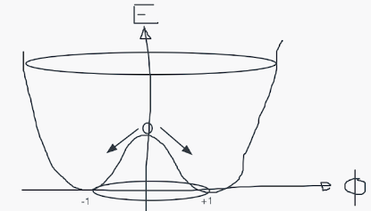
Studying Topological Defects
Topological Defects : Instead of being uniform, the later universe has lumps or regions of varying energy/density (without violating the finite speed of light, as these are on disconnected regions far enough to not know what is happening elsewhere)
Studies on the sources of these defects or theories explaining these defects
Possible Explanation : Quantum fluctuations on waves visualised as a W with different energy levels causing transitions that are random
high energy states on the hill transitioning to left or right valley state, or left valley getting pulled through the hill to the right valley state
Now you are left with different fields falling into different regions, with some still stuck at higher energy levels, causing greater amounts of forces in certain areas then others, causing topological defects
Notes:
Krishna

Slide 7
Possible Source of Topological Defects
Hypothesis : magnetic monopoles were attached to semilocal strings and that more and more of them attached together to create bigger stringed monopoles while some of them formed loops or shrunk into energy, thus causing density perturbations
Experiment: Used the NERSC M Curie supercomputer to simulate different types/formations of these monopole strings
Used the CMB as a way to compare if the simulations were similar or not
Conclusion: Ultimately, the topological defects were not similar, to observed CMB, disproving monopoles attached to strings as a source of primordial perturbations
Notes:
Krishna

Slide 8
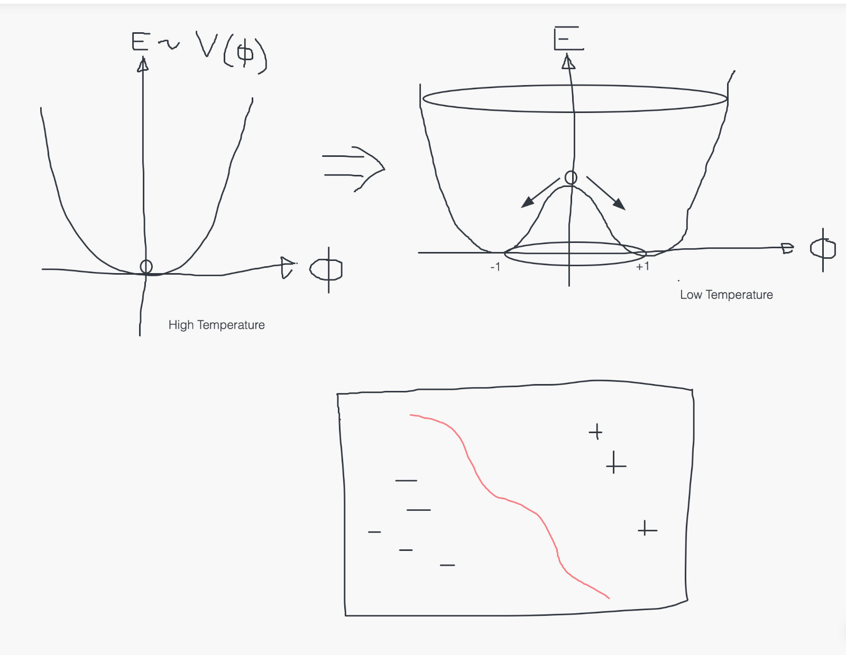
Topological Defects Shown with Quantum Waves
Notes:
seamus

Slide 9
Basic Physics Concepts Utilized
Fields Studied = Relativity, Classical, Philosophical
Forces = electromagnetic with poles and gravity(all fundamental forces)
Thermal fluctuation is basically a temperature change over a certain period of time in an environment.
Phase transitions: change the nature of the matter and energy in the universe.
They also fracture the fundamental forces(gravity)-> topological defects
Notes:
The main forces that are mentioned are electromagnetic and gravity. The Universe expands and cools also known as phase transitions. They also fracture the fundamental forces as they can go from one single force of gravity to a 5th force emerging as they are peeled off from the original force. They can also trap parts of the universe in higher energy phase and as we know this causes an imbalance amongst the strength of the forces therefore creating topological defects.

Slide 10
Thank you
Notes:
Miya

Slide 11
Extra Resources:
The full simulation box: https://berkeleylab.app.box.com/s/0sap5zz0xrdfxp6wbky5xo1ju6od3bj5/file/977304493251
A zoomed in section: https://berkeleylab.app.box.com/s/0sap5zz0xrdfxp6wbky5xo1ju6od3bj5/file/977303935283

