Slide 1
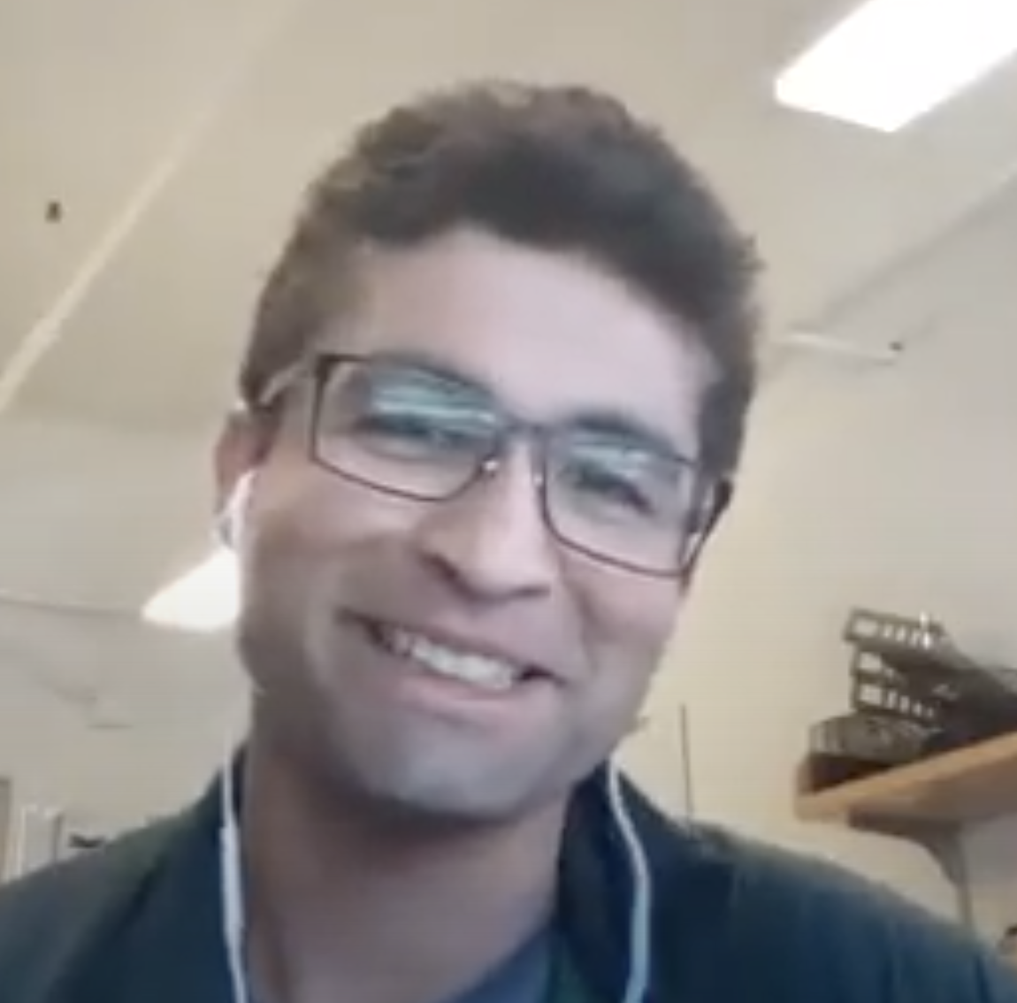
Interview with Fernando Torales Acosta

Slide 2
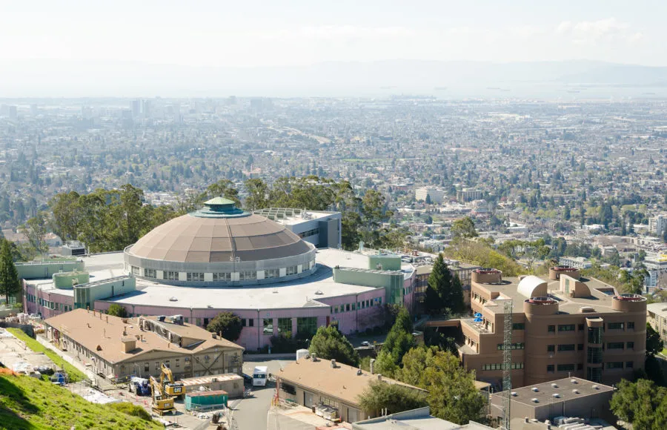
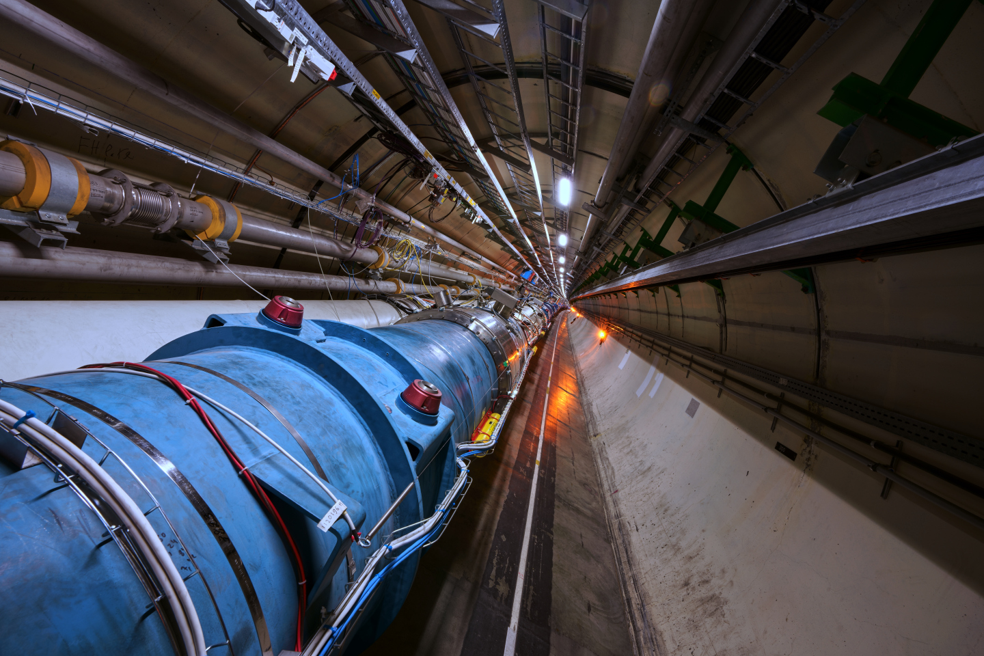
Career path
Undergrad at Stony Brook University - Bachelor of Science in Physics
Grad school at Berkeley (PhD) - Nuclear Physics - Research on Quark-Gluon Plasma
Nuclear Physics with a focus on particle physics
PostDoc at LBL - Machine Learning

Slide 3
Quark-Gluon plasma in lead ion collision

Slide 4
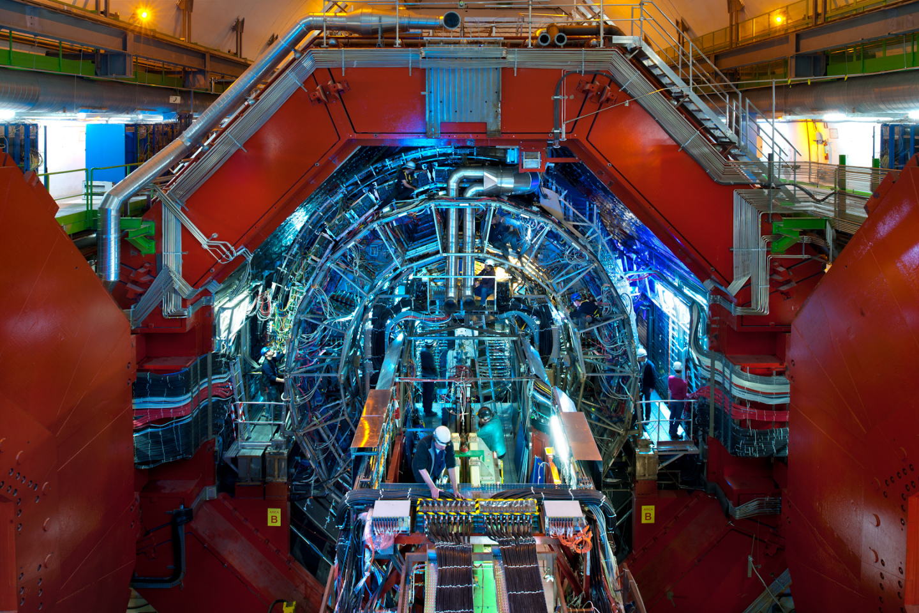
Some Key Points
Dr. Acosta made his findings using the ALICE detector (1 of 8) at the LHC
ALICE focuses on colliding heavy ions as opposed to other detectors which focus on colliding protons
Dr. Acosta wanted to observe a phenomenon called quark-gluon plasma, a hot “soup” of quarks and gluons
Quark-gluon plasma has a signature it leaves behind called Flow, which told Dr. Acosta that it was present; He was looking for this signature in proton-proton collisions and proton-lead collisions
“Are some of the effects we see in lead-lead collisions also present in proton-proton collisions?”

Slide 5
Understanding Quark-Gluon Plasma
Dr. Acosta attempts to understand the universe through understanding of Quark-Gluon Plasma
General information is kept inside matter. During a phase transition (Ex. Water Becoming Ice), the same basic information remains inside the matter despite change in state of matter.
General information is kept inside matter. During a phase transition (Ex. Water Becoming Ice), the same basic information remains inside the matter despite change in state of matter.
The early universe was consistent of Quark-Gluon Plasma that underwent various phase transitions over the course of billions of years.
The early universe was consistent of Quark-Gluon Plasma that underwent various phase transitions over the course of billions of years.
By understanding Quark-Gluon Plasma and the strong nuclear force that influences it, Dr. Acosta attempts to find the initial information that the Quark-Gluon Plasma held before its phase transitions at the beginning of the universe. This information will help us better understand the universe.
By understanding Quark-Gluon Plasma and the strong nuclear force that influences it, Dr. Acosta attempts to find the initial information that the Quark-Gluon Plasma held before its phase transitions at the beginning of the universe. This information will help us better understand the universe.

Slide 6
Machine Learning for Physics in Deep Inelastic Scattering Experiments

Slide 7
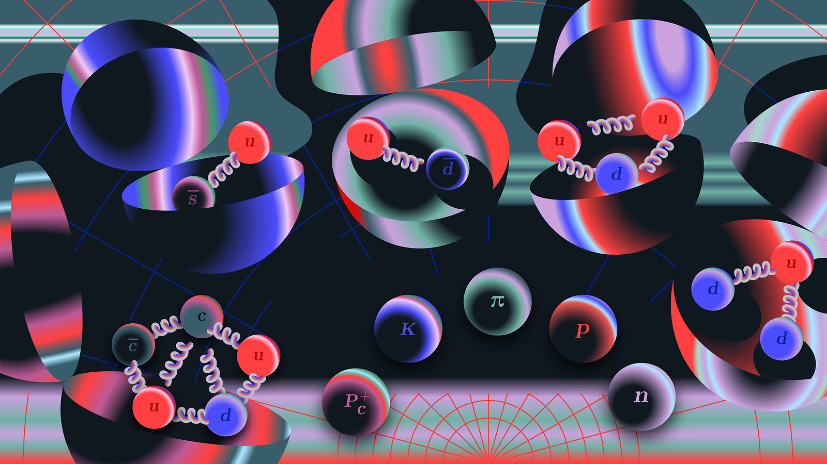
What is deep inelastic scattering?
Leptons eg. electrons scatter off a nucleus or proton and hadrons/quarks break off
Great probe due to its short wavelength
Dr. Fernando measures the energy of the electrons before and after to understand the collisions and strong force

Slide 8
Electron nucleus collider and detector are still being built

Slide 9
Machine learning
Machine learning is being developed to optimize detectors
Computationally expensive simulations are slow and you must change parameters one by one
Neural networks are trained to understand and simulate parameters faster by making a function of larger parameters

Slide 10
Learning as you go
Was machine learning a new skill you had to learn for this research project or did you have experience before?
“I basically didn’t have experience before. That’s kind of the cool thing. There’ll be something interesting you don’t alway have the skillset for it. You don't always go through a rigorous certification program. You kind of just learn as you do. That’s the very cool thing about physics in general.”
“I’m learning a lot of it on the job. The progress initially is slow as I learn, but it’s been lately, very very interesting results.”

Slide 11
Tips for High Schoolers
Even if the courses are hard, don’t give up
Don’t be afraid to ask simple questions
Dr. Acosta had a lot of hobbies in tech before
As a grad student, a lot of hobbies fell to the side
Learned new skills through physics and those things became hobbies
A lot of independence to view interesting things

Slide 12
Hear it from him

Slide 13
Thank you!

