Slide 1
Elliot Reynolds: Particle Physicist
Contributions by Shreya Modak, Catherine Judson, Johan Phan, August Hundal-Simpson, and Tanay Bodducherla
Notes:
Everyone

Slide 2
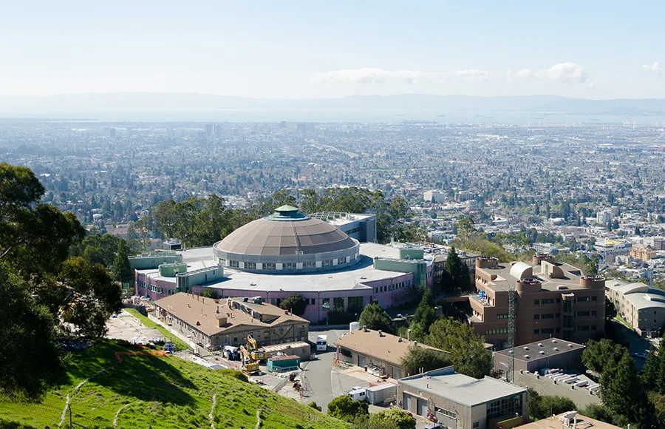
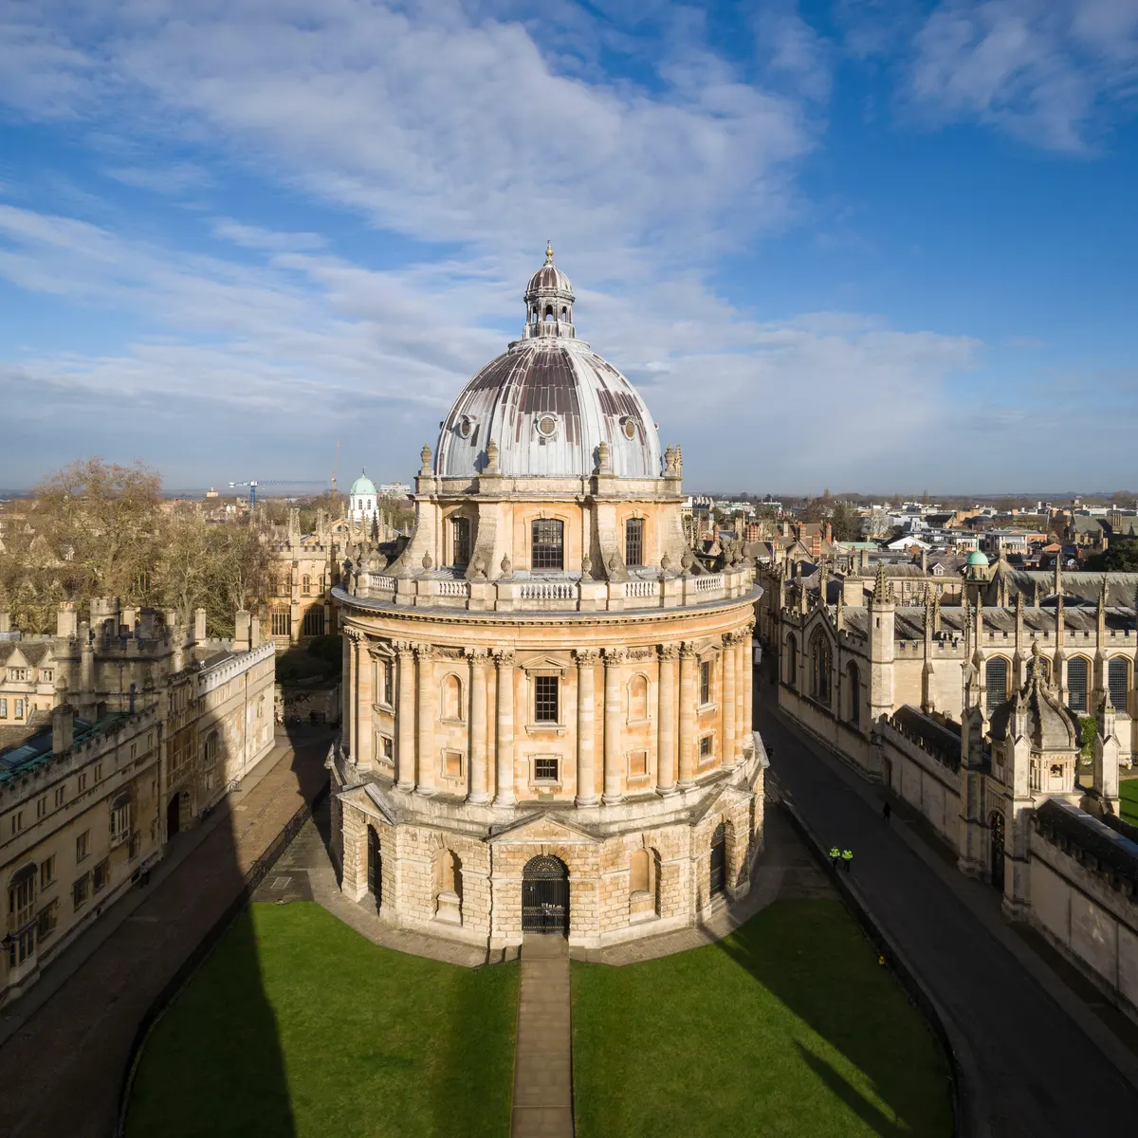
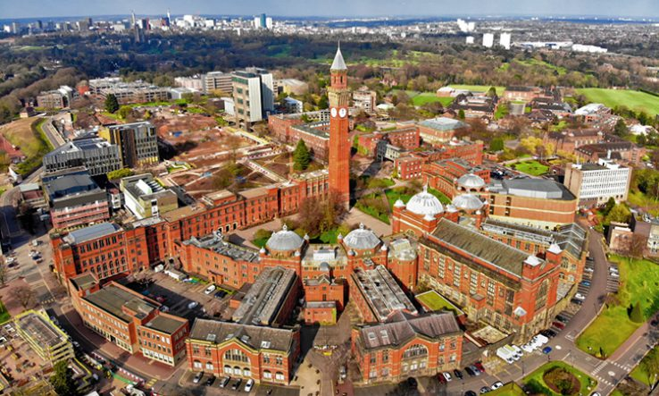
Background
Studied at Oxford for his master’s degree (undergrad)
University of Birmingham for his PhD (dedicated research degree)
Now is a Chamberlain Fellow / postdoc (temporary research job after PhD) at Lawrence Berkeley National Lab as an experimental particle physicist
Has more independence as a fellow- is funded by the lab instead of an advisor
Notes:
Catherine

Slide 3
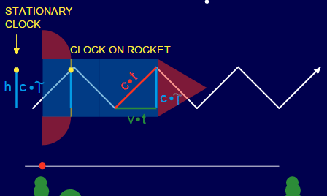
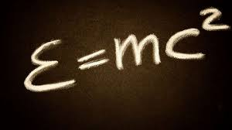
Why he likes physics + inspiration
General feeling of awe
After learning about modern physics, realized everything he previously knew about the universe was completely changed
e=mc² [everything has a bunch of energy]
Young’s double slit experiment [particles can also act as waves]
Special relativity - time dilation + length contraction [unification of space and time]
Notes:
August Hundal-Simpson

Slide 4
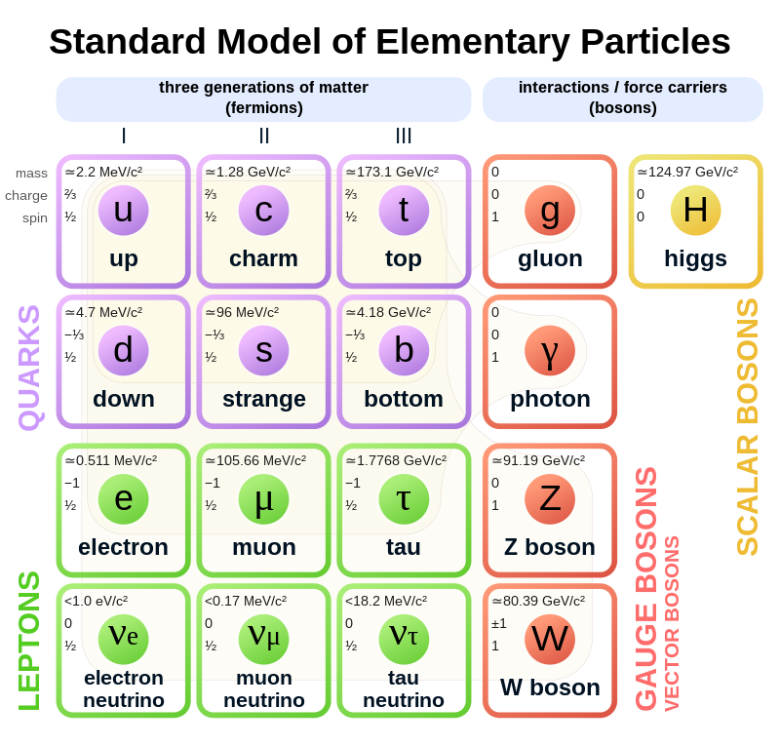
Research
Beyond the standard model physics [BSM physics]
Observing the decay of the Higgs Boson to see if it can produce any new particles that haven’t been observed yet
Measuring the strength of the interactions between the Higgs boson / Higgs field and the charm quark
Methods for production of pairs of Higgs bosons
*uses quantum mechanics as a framework to
study elementary particles - assumes quantum
mechanical model of the universe*
Notes:
Tanay

Slide 5
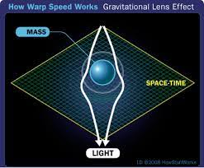
What topics in physics are correlated with his research?
Foundations were laid by the theories of quantum mechanics and special relativity 100 years ago, in relation to general relativity, space and time
Relativistic quantum mechanics, production of pairs of Higgs boson, quantum field theory, in specific the decay of the Higgs Boson into new particles, interaction strength between Higgs boson and charm quark.
Interesting Fact that Elliot mentioned: while you are travelling through space you are essentially aging differently depending on how fast you are travelling. For example if you are going to Venus, you would be aging as you travel there, but on Earth you people would be aging much faster relative to you, due to the principles of special relativity. It could feel like you spent 10 years on the spaceship, but on Earth it would have been significantly longer.
Notes:
Shreya Modak

Slide 6
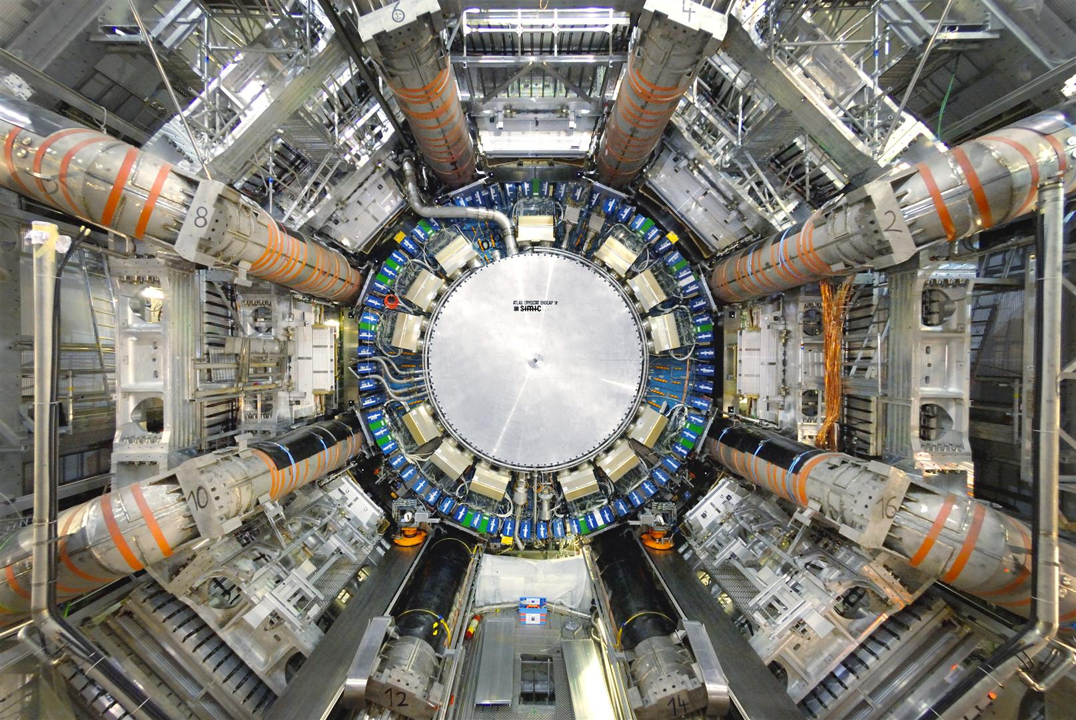
Work with ATLAS
ATLAS is a detector at the Large Hadron Collider (LHC), which is a particle accelerator at CERN.
Studies the Higgs Boson, and how it decays.
Studies how the Higgs boson and charm quark interact
Analyses data coming from the ATLAS detector
Upgrades the detector and accelerator, allowing for data to be taken faster, so more data can be taken.
Probe station: analyzes the quality of silicon to see whether it is suitable to be used in the ATLAS detector
Notes:
Johan Phan

